Slide 1
Chapter 9: Greedy algorithms
Change-making problem
Coin-system in US: 25(quarter), 10 (dime), 5(nickel), 1(penny)
If you need to give a change of 48 cents using coins,
48 cents = 1 quarter + 2 dimes + 3 pennies
This is a greedy algorithm: reduce the amount in the fastest way
The greedy approach constructs a solution through a sequence of steps until a complete solution is reached, On each step, the choice made must be
Feasible: Satisfy the problem’s constraints
locally optimal: the best choice
Irrevocable: Once made, it cannot be changed later

Slide 2
Applications of the Greedy Strategy
Optimal solutions:
change making
Minimum Spanning Tree (MST)
Single-source shortest paths
simple scheduling problems
Huffman codes
Approximations:
Traveling Salesman Problem (TSP)
Knapsack problem
other combinatorial optimization problems

Slide 3
Minimum Spanning Tree (MST)
Motivation: Planning the layout of cables or water pipes with the minimum length to cover all houses in a community
→ a tree structure (a connected acyclic graph)
Spanning tree of a connected graph G
A connected acyclic subgraph of G that includes all of G’s vertices.
At least one spanning tree exists for G.

Slide 4
Minimum Spanning Tree (MST)
Minimum Spanning Tree of a weighted, connected graph G:
a spanning tree of G of minimum total weight.
Example:
4
3
4
3
1
6
1
6
1
1
2
7
7
2
4
4
2
3
2
3

Slide 5
Prim’s MST algorithm
Start with tree consisting of one vertex
“Grow” tree one vertex/edge at a time to produce MST
Construct a series of expanding subtrees T₁, T₂, …
Greedy step: at each stage construct T_{i+1} from T_{i}: add an edge with minimum weight connecting a vertex in tree (T_{i}) to one not yet in tree
For all vertices that are not yet in the tree, we have two groups
Fringe nodes: has a edge to at least one node in current tree T_{i}
unseen nodes: no edge to any node in T_{i}
A priority queue is used
The node with highest priority will be select
The priority queue will be updated every time when a new vertex is added
Algorithm stops when all vertices are included

Slide 6
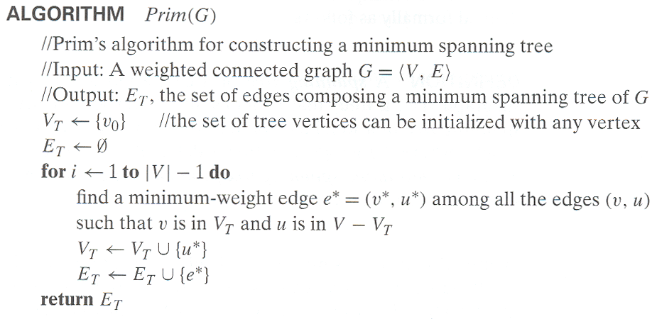
Prim’s MST algorithm

Slide 7
An Example:
Finding the MST of the following graph using Prim’s algorithm
1
b
c
3
4
4
6
5
5
a
f
d
2
6
8
e

Slide 8
Step 1:
Start from empty tree T, pick one vertex, a(-,-) and add it to T
Priority queue: b(a,3), f(a,5), e(a,6), c(-,∞), d(-,∞)
1
b
c
3
4
4
6
5
5
a
f
d
2
6
8
e

Slide 9
Step 2:
Add the minimum-weight fringe edge b(a,3) into T
Priority queue: c(b,1), f(b,4), e(a,6), d(-,∞)
1
b
c
3
4
4
6
5
5
a
f
d
2
6
8
e

Slide 10
Step 3:
Add the minimum-weight fringe edge c(b,1) into T
Priority queue: f(b,4), d(c,6), e(a,6)
1
b
c
3
4
4
6
5
5
a
f
d
2
6
8
e

Slide 11
Step 4:
Add the minimum-weight fringe edge f(b,4) into T
Priority queue: e(f,2), d(f,5)
1
b
c
3
4
4
6
5
5
a
f
d
2
6
8
e

Slide 12
Step 5:
Add the minimum-weight fringe edge e(f,2) into T
Priority queue: d(f,5)
1
b
c
3
4
4
6
5
5
a
f
d
2
6
8
e

Slide 13
Step 6:
Add the minimum-weight fringe edge d(f,5) into T
No remaining vertices and the algorithm is done!
1
b
c
3
4
4
6
5
5
a
f
d
2
6
8
e

Slide 14
An Example
Tree vertices | Priority queue for the fringe vertices
a(-,-) | b(a,3), d(a,4), c(a,5), e(-,∞), f(-,∞), g(-,∞), h(-,∞), i(-,∞), j(-,∞), k(-,∞), l(-,∞)
b(a,3) | e(b,3), d(a,4), c(a,5), f(b,6), g(-,∞), h(-,∞), i(-,∞), j(-,∞), k(-,∞), l(-,∞)
e(b,3) | d(e,1) , f(e,2), i(e,4), c(a,5), g(-,∞), h(-,∞),j(-,∞), k(-,∞), l(-,∞)
d(e,1) | c(d,2), f(e,2), i(e,4), h(d,5), g(-,∞), j(-,∞), k(-,∞), l(-,∞)
c(d,2) | f(e,2), g(c,4), i(e,4), h(d,5), j(-,∞), k(-,∞), l(-,∞)
f(e,2) | g(c,4), i(e,4), h(d,5), j(f,5), k(-,∞), l(-,∞)
g(c,4) | h(g,3), i(e,4), j(f,5) , k(g,6), l(-,∞)
h(g,3) | i(e,4), j(f,5), k(g,6), l(-,∞)
i(e,4) | j(i,3), l(i,5), k(g,6)
j(i,3) | l(i,5), k(g,6)
l(i,5) | k(g,6)
k(g,6)

Slide 15
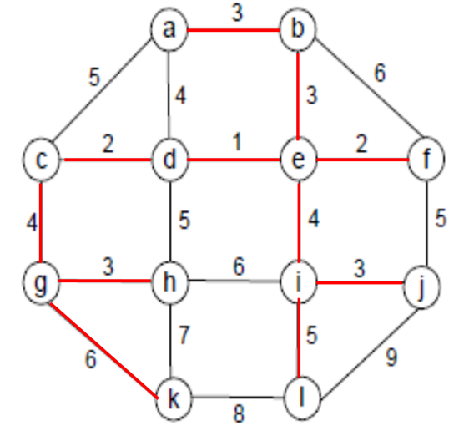
An Example
The MST consists of the edges
ab, be, ed, dc, ef, cg, gh, ei, ij, il, and gk

Slide 16
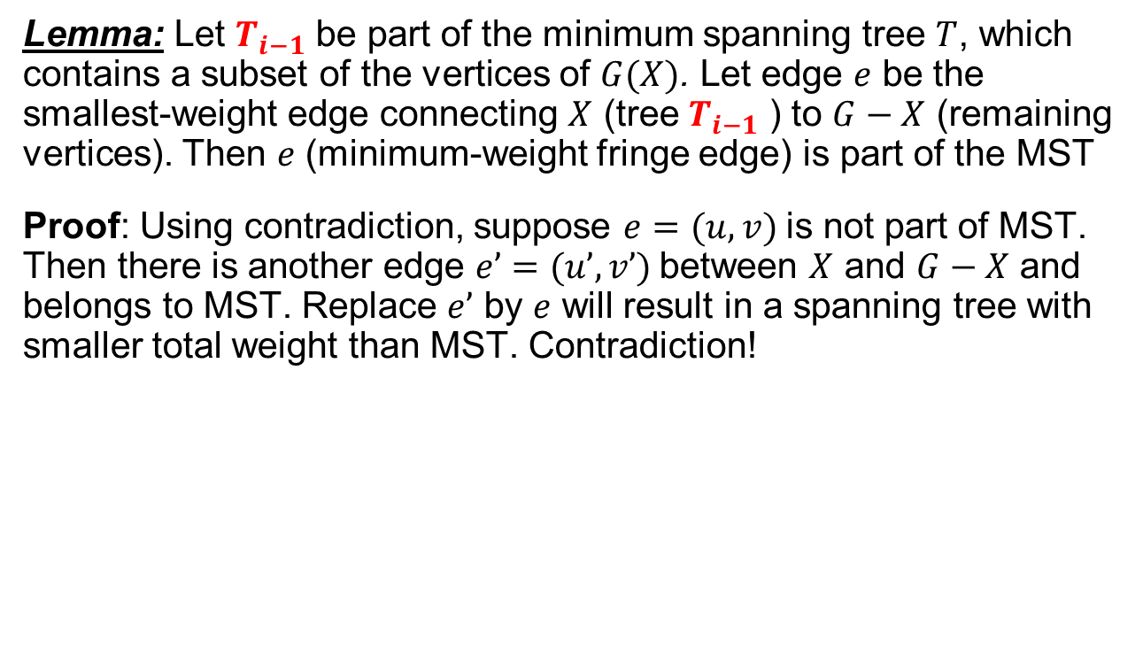

Does Prim’s Algorithm Really Produce MST?

Slide 17
Notes on Prim’s algorithm
To locate the minimum-weight fringe edge, we can use the heap structure. But here we use the min-heap, where the root has a key smaller than both children
Construct the min-heap -- O(|V|)
Delete the min – O(log |V|), it can be performed |V|-1 times
Verify minimum weight from any remaining vertex to the tree – this may be performed |E| times. Each verification may result in a key priority change in the heap, which takes O(log |V|).
Therefore, the total complexity is
O[|V|+(|V|-1+|E|)*log |V|]=O(|E| log |V|)
Notes:
|V|-1<=|E| for a connected graph

Slide 18
MinHeap and Prim’s Algorithm
b(a,3), f(a,5), e(a,6), c(-,∞), d(-,∞)
c(b,1), f(b,4), e(a,6), d(-,∞)
f5
c1
f4
b3
e6
d∞
e6
f4
e6
d∞
e6
f5
c∞
c∞
d ∞
d∞
f(b,4), d(c,6), e(a,6)
f4
e6
d6

Slide 19
Dijkstra’s Algorithm – Single-Source Shortest Paths
Single-source short paths problem – find the shortest path starting from a given vertex to any other vertex
Example: hub airports for airplane planning
Using greedy strategy to find the single-source shortest paths
In Floyd’s algorithm, we find the all-pair shortest paths, which may not be necessary in many applications
Certainly, all-pair shortest paths contain the single-source shortest paths. But Floyd’s algorithm has O(|V|³) complexity!
There are many algorithms that can solve this problem, here we introduce the Dijkstra’s algorithm
Note: Dijkstra’s algorithm only works when all the edge-weight are nonnegative.

Slide 20
Dijkstra’s Algorithm on Undirected Graph
Similar to Prim’s MST algorithm, with the following difference:
Start with tree consisting of one vertex – source
“grow” tree one vertex/edge, which has minimum length of path, at a time to produce spanning tree
Construct a series of expanding subtrees T₁, T₂, …
Keep track of shortest path from source to each of the vertices in T_{i}
at each stage construct T_{i+1} from T_{i}: add minimum weight edge connecting a vertex in tree (T_{i}) to one not yet in tree
choose from “fringe” nodes
(this is the “greedy” step!)
algorithm stops when all vertices are included
edge (v,w) with lowest d(s,v) + d(v,w)
source
destination

Slide 21
Example:
Find the shortest paths starting from vertex a
4
b
c
3
2
5
6
7
4
a
d
e

Slide 22
Step 1:
Tree vertices: a(-,0)
Priority queue: b(a,3), d(a,7), c(-,∞), e (-,∞)
4
b
c
3
2
5
6
7
4
a
d
e

Slide 23
Step 2:
Tree vertices: a(-,0), b(a,3),
Priority queue: d(a,7)→d(b,3+2), c(-,∞)→c(b,3+4), e (-,∞)
4
b
c
3
2
5
6
7
4
a
d
e

Slide 24
Step 3:
Tree vertices: a(-,0), b(a,3), d(b,5)
Priority queue: c(b,3+4), e (-,∞)→e(d,5+4)
4
b
c
3
2
5
6
7
4
a
d
e

Slide 25
Step 4:
Tree vertices: a(-,0), b(a,3), d(b,5), c(b,7)
Priority queue: e(d,9)
4
b
c
3
2
5
6
7
4
a
d
e

Slide 26
Step 5:
Tree vertices: a(-,0), b(a,3), d(b,5), c(b,7), e(d,9)
Remaining vertices: none → the algorithm is done!
4
b
c
3
2
5
6
7
4
a
d
e

Slide 27
Output the Single-Source Shortest Paths
Tree vertices: a(-,0), b(a,3), d(b,5), c(b,7), e(d,9)
4
b
c
3
2
5
6
7
4
a
d
e
from a to b: | a-b | of length 3
from a to d: | a-b-d | of length 5
from a to c: | a-b-c | of length 7
from a to e: | a-b-d-e | of length 9

Slide 28
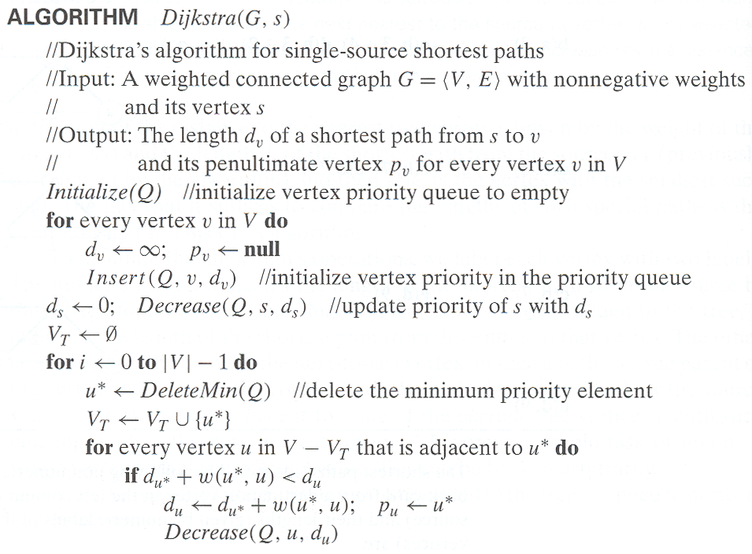
Pseudo Code
source

Slide 29
Example
Dis(b)
b(a,3), d(a,7), c(-,∞), e (-,∞)
4
d(b,3+2), c(-,∞)→c(b,3+4), e (-,∞)
b
c
3
2
5
6
d5
b3
a
7
d
4
e
e∞
c7
d7
c∞
Delete b
e ∞
Dis(d)
4
c(b,7), e (-,∞)→e(d,5+4)
b
c
3
2
5
6
<
a
7
d
4
e
c(d,5+5)
c7
Delete d
e9

Slide 30
An Example
Tree vertices | Priority queue for the fringe vertices and unseen vertices
a(-,0) | b(a,3), d(a,4), c(a,5), e(-,∞), f(-,∞), g(-,∞), h(-,∞), i(-,∞), j(-,∞), k(-,∞), l(-,∞)
b(a,3) | d(a,4), c(a,5), e(b,3+3), f(b,3+6), g(-,∞), h(-,∞), i(-,∞), j(-,∞), k(-,∞), l(-,∞)
d(a,4) | c(a,5), e(d,4+1), f(b,9), h(d,4+5), g(-,∞), i(-,∞), j(-,∞), k(-,∞), l(-,∞)
c(a,5) | e(d,5), f(b,9), h(d,4+5), g(c,5+4), i(-,∞), j(-,∞), k(-,∞), l(-,∞)
e(d,5) | f(e,5+2), h(d,9), g(c,9), i(e,5+4), j(-,∞), k(-,∞), l(-,∞)
f(e,7) | h(d,9), g(c,9), i(e,9), j(f,7+5), k(-,∞), l(-,∞)
h(d,9) | g(c,9), i(e,9), j(f,12), k(h,9+7), l(-,∞)
g(c,9) | i(e,9), j(f,12), k(g,9+6), l(-,∞)
i(e,9) | j(f,12) , l(i,9+5), k(g,9+6)
j(f,12) | l(i,14), k(g,15)
l(i,14) | k(g,15)
k(g,15)

Slide 31
Notes on Dijkstra’s algorithm
Applicable to both undirected and directed graphs
Doesn’t work with negative weights
Efficiency:
O(|E| log |V|) when the graph is represented by adjacency linked list and priority queue is implemented by a min-heap.
Reason: the whole process is almost the same as Prim’s algorithm. Following the same analysis in Prim’s algorithm, we can see that it has the same complexity as Prim’s algorithm.
a
b(a,2), c(a,4)
4
2
c(a,4)
c
b
-10
a->c->b = -6
Shorter than the existing path!
Notes:
The negative weight can be considered as deacceleration, or gain if you walk through the path

Slide 32
Huffman Trees – Coding Problem
Text consists of characters from some n-character alphabet
In communication, we need to code each character by a sequence of bits – codeword
Fixed-length encoding: code for each character has m bits
Standard seven-bit ASCII code does this
Variable-length encoding: using shorter codeword for more frequent characters and longer codeword for less frequent ones
For example, in Morse telegraph code, a(.-), e(.), q(--.-), z(--..)
How many bits represent the characters?
Two important questions:
What is the lower bound of average number of bits?
How to avoid confusion in code decoding?

Slide 33
Basic Concept of Information and Coding
You have m message, 1, 2, …,m to transfer, with probability p₁, p₂, … p_{m}, using digital communication, how many bits is needed for coding?
Example: you have two message, you only need 1 bit to code: 0 represents message “1” and 1 represents message “2”.
Shannon Theorem: let
If B is the average # bits per message for the best code, then

Slide 34
Huffman Tree – From coding to a binary tree
To avoid confusion, here we consider prefix codes, where no codeword is a prefix of a codeword of another character
This way, we can scan the bit string constructed from a text from left to right until get the first group of bits that is a valid codeword for some character. For example, “1” for “A” and “01” for “B”.
Solution:
Associate the characters with leaves of a binary tree in which all the left edges are labeled by 0 and all the right edges are labeled by 1 (or vice versa)
The codeword of a character (leaf) is the list of labels along the path from the root of the binary to the this leaf
Huffman tree can reduce the total bit string by assigning shorter codeword (higher level) to frequent character and longer codeword (lower level) to less frequent ones.

Slide 35
Huffman Coding Algorithm
Step 1: Initialize n one node trees and label them with the characters in a dictionary. Record the frequency of each character in its tree’s root to indicate the tree’s weight
Step 2: Repeat the following operation until a single tree is obtained.
Find two trees with the smallest weights.
Make them the left and right subtrees of a new tree
record the sum of their weights in the root of the new tree as its weight
Example: alphabet {A, B, C, D, _} with frequency
character | A | B | C | D | _
probability | 0.35 | 0.1 | 0.2 | 0.2 | 0.15

Slide 36


Slide 37
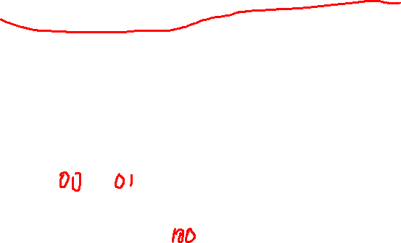

Slide 38
The Huffman Code is
Therefore,
‘DAD’ is encoded as 011101 and
100110110111010 is decoded as BAD_AD
character | A | B | C | D | _
probability | 0.35 | 0.1 | 0.2 | 0.2 | 0.15
codeword | 11 | 100 | 00 | 01 | 101

Slide 39
Notes on Huffman Tree (Coding)
The expected number of bits per character is then
2x0.35 + 3x0.1+2x0.2+2x0.2+3x0.15 = 2.25
Fixed-length encoding needs at 3 bits for each character
This is an important technique for file (data) compression
Huffman tree/coding has more general applications:
Assign n positive numbers w₁, w₂, …, w_{n} to the n leaves of a binary tree
We want to minimize weighted path length with l_{i} be the depth of the leaf I
This has particular applications in making decisions – decision trees

