Slide 1
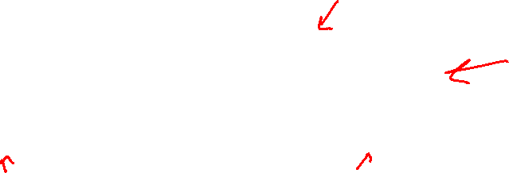
Huffman Coding Algorithm
Step 1: Initialize n one node trees and label them with the characters in a dictionary. Record the frequency of each character in its tree’s root to indicate the tree’s weight
Step 2: Repeat the following operation until a single tree is obtained.
Find two trees with the smallest weights.
Make them the left and right subtrees of a new tree
record the sum of their weights in the root of the new tree as its weight
Example: alphabet {A, B, C, D, _} with frequency
character | A | B | C | D | _
probability | 0.35 | 0.1 | 0.2 | 0.2 | 0.15

Slide 2
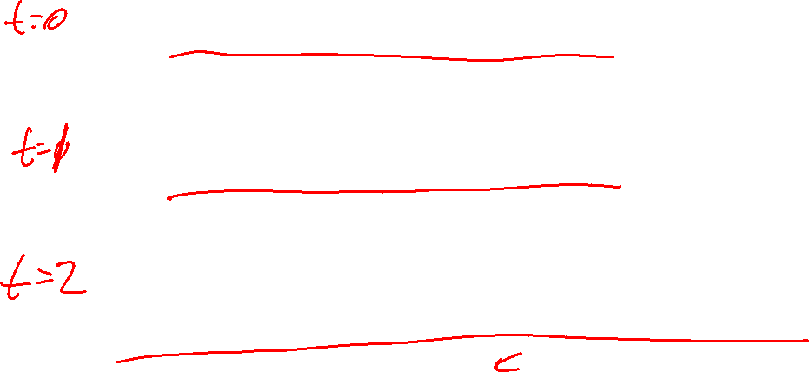

Slide 3
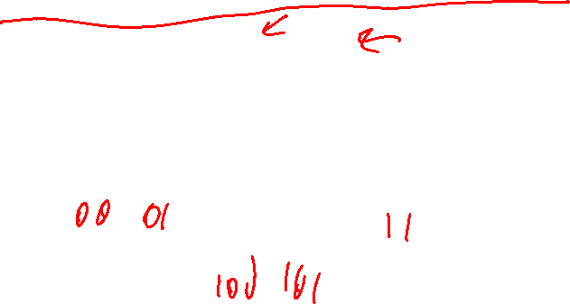

Slide 4
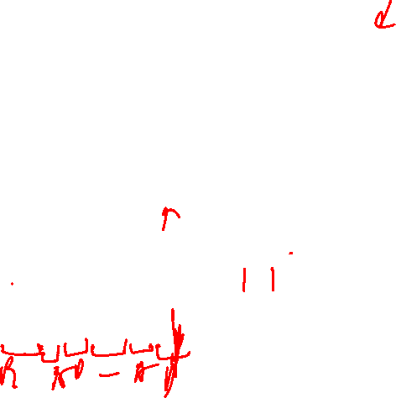
The Huffman Code is
Therefore,
‘DAD’ is encoded as 011101 and
100110110111010 is decoded as BAD_AD
character | A | B | C | D | _
probability | 0.35 | 0.1 | 0.2 | 0.2 | 0.15
codeword | 11 | 100 | 00 | 01 | 101

Slide 5

Notes on Huffman Tree (Coding)
The expected number of bits per character is then
2x0.35 + 3x0.1+2x0.2+2x0.2+3x0.15 = 2.25
Fixed-length encoding needs at 3 bits for each character
This is an important technique for file (data) compression
Huffman tree/coding has more general applications:
Assign n positive numbers w₁, w₂, …, w_{n} to the n leaves of a binary tree
We want to minimize weighted path length with l_{i} be the depth of the leaf I
This has particular applications in making decisions – decision trees

