Slide 1
Juan Rios
Andrew Johnson
Jean Pierre Habimana
Denis Rugira

Slide 2
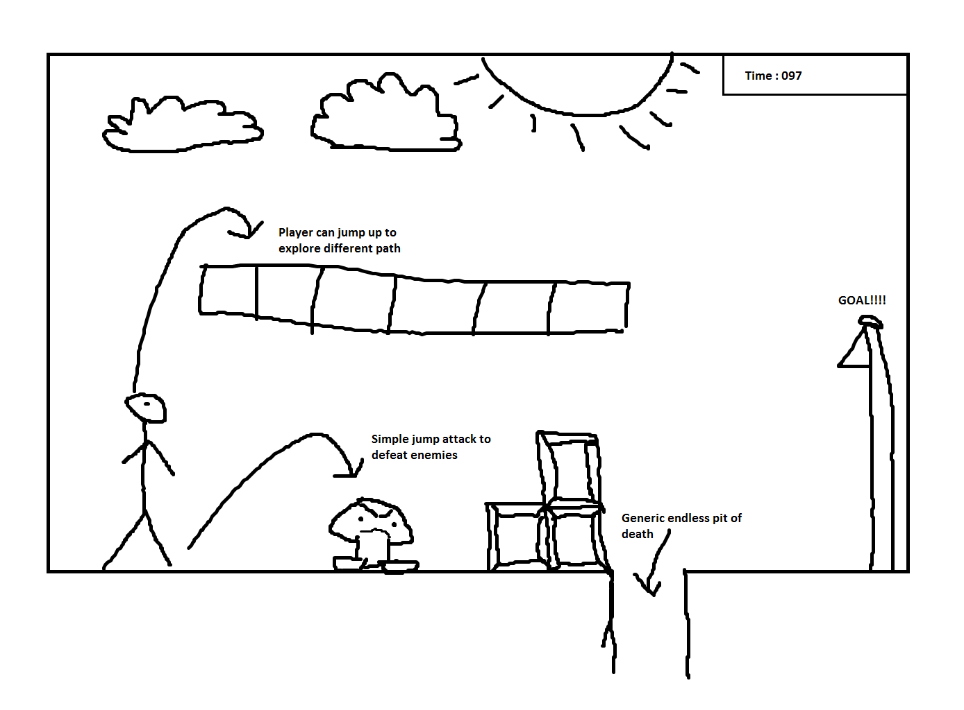
Storyboard

Slide 3
Platform/Language/Toolkits
PC game
Written in Java
JGame: 2D game engine to aid with graphic/sound integration

Slide 4
First Release Use Case
User starts the application by clicking on an icon in a folder made for the game.
Upon startup, the user sees a login screen and is prompted for a username in order to keep score locally. The username can be 9 characters long. If the username does not fit the criteria, the user is prompted to try again.
After entering a valid username, the user can begin playing at Level 1. The AD keys are used to move and the spacebar is used to jump. The user must navigate the level and reach the goal to win.

Slide 5
Tasks/Developers/Est. Time
Task 1: Create a login system that prompts the user for a name.
Estimated time: 8-10 hours
Developers: Denis and J.P.
Task 2: Create the base gameplay where the user controls a shape and must reach a goal.
Estimated time: 12-13 hours
Developers: Juan and Andrew

Slide 6
Meeting Log
Tuesday, January 24
In-class meeting for brainstorming ideas
All members present
Wednesday, January 25
Met in Axiom lab
Meeting to write use case, create tasks, and assign developers
All members present
Other: email correspondence to determine the game engine to use
All members participated in decision-making

