Slide 1
Group 4
Software Engineering

Slide 2
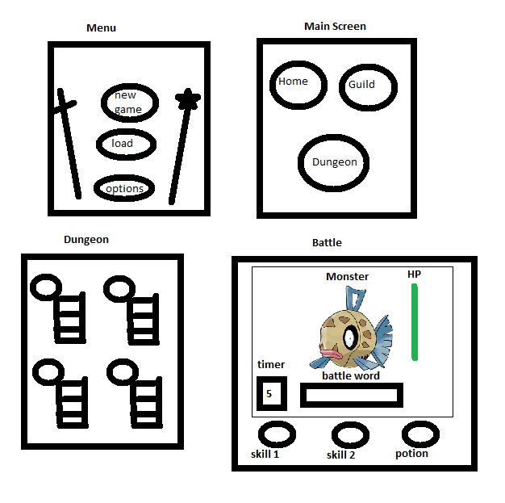
Game layout

Slide 3
Use Case
Menu – Player gets to decide between starting a new game, load old save file, or go to options (If needed)
Main Menu – Player gets to decide between home (undecided), guild( for skills and potions), and Dungeon
Dungeon – Player gets to decide which area he or she wants to fight in.
Battle – Player is presented with a word which they have to type to damage the enemy. Player has skills to help by either modifying the timer or the battle word. Potions are used to restore players health.

Slide 4
Dev/Task
Dev Team: Alleluya, Jack, Richard, Scott
First two tasks: Create game Menu and the Creature class.
Time to complete each task: One week per task.
We will use Agile Development for this project.

Slide 5
Platform / API
PC
LWJGL (Light Weight Java Game Library)
Sphere RPG engine (Javascript)
Others

Slide 6
Meetings
1/24, 1:30-2:30
First team meeting. Discussed game ideas and voted on one.
1/26, 1:30-2:30
Second team meeting, Discussed programming languages, gaming platforms, and decided on the simplied form of our game idea.
1/27 1:30-2:30
Third team meeting, voted on the sphere RPG engine which includes built in animation calls. We're also looking at the light weight javascript engine.
1/30 1:30-2:30
Fourth team meeting, Presentation created.

