Slide 1
Simulating Aphasia through Weight Modifications in Pretrained Large Language Models
Xiang Guan, Ph.D. student, CS
(Steven) Yong Yang , Ph.D. student, CS
Ziyu Bian, Ph.D. student, CS
10/22/24

Slide 2
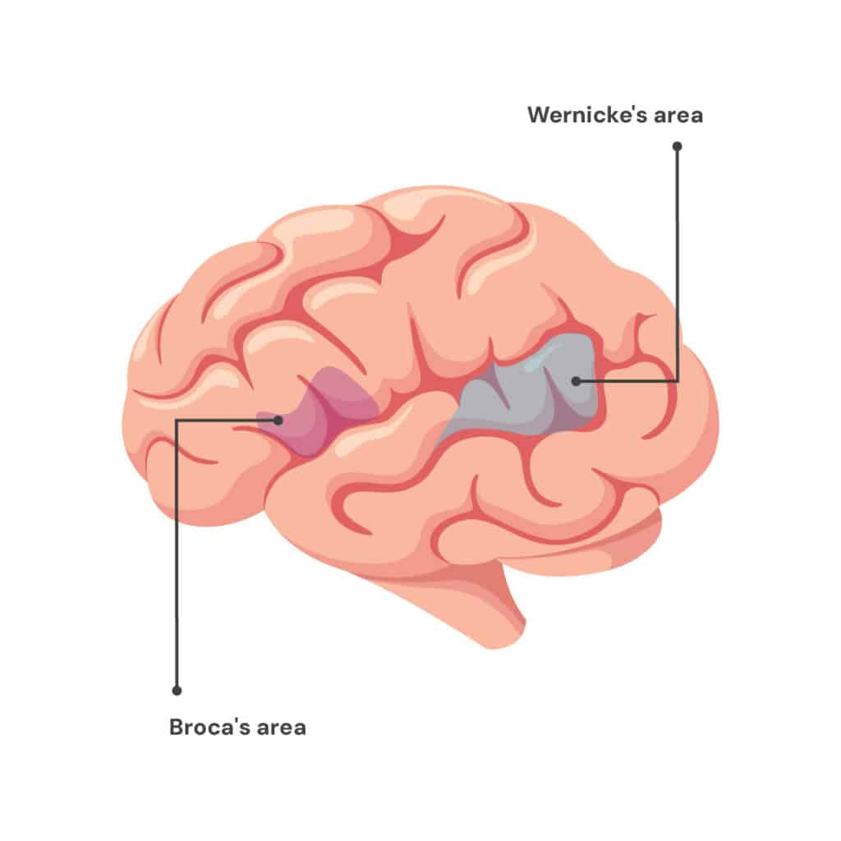
Brain and LLM similarity in Aphasia
Aphasia occurs when there are damage to specific parts of the brain
Both brain and LLMs are hierarchical in language comprehension
Letter, word, sentence, paragraph
Brain pass information through connection between one region and another
In LLM, early layers focus on basic and later layers manage more complex information

Slide 3
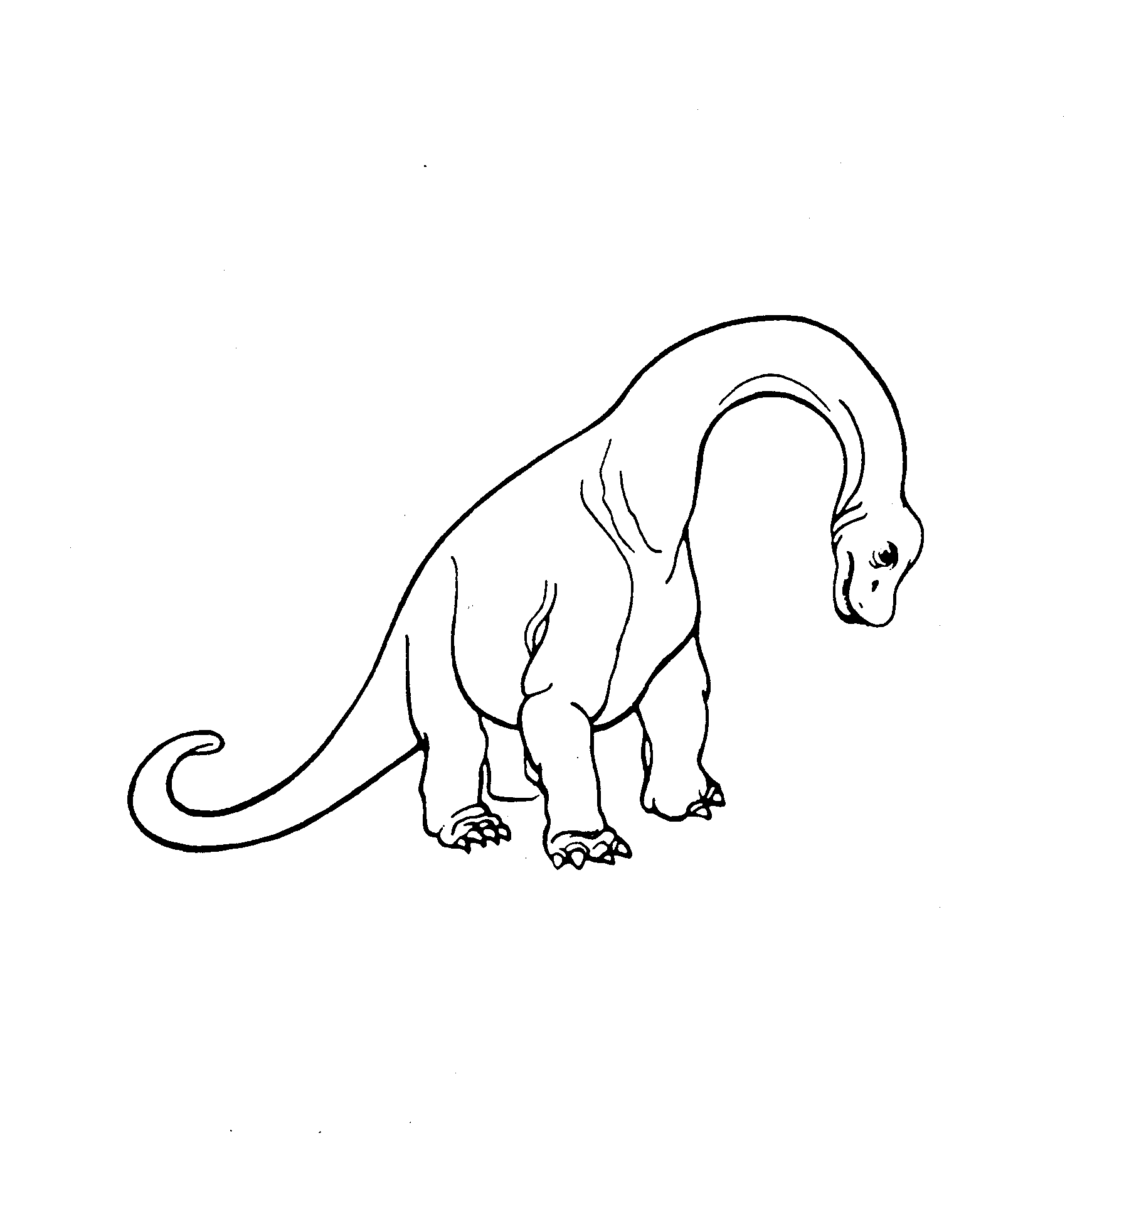
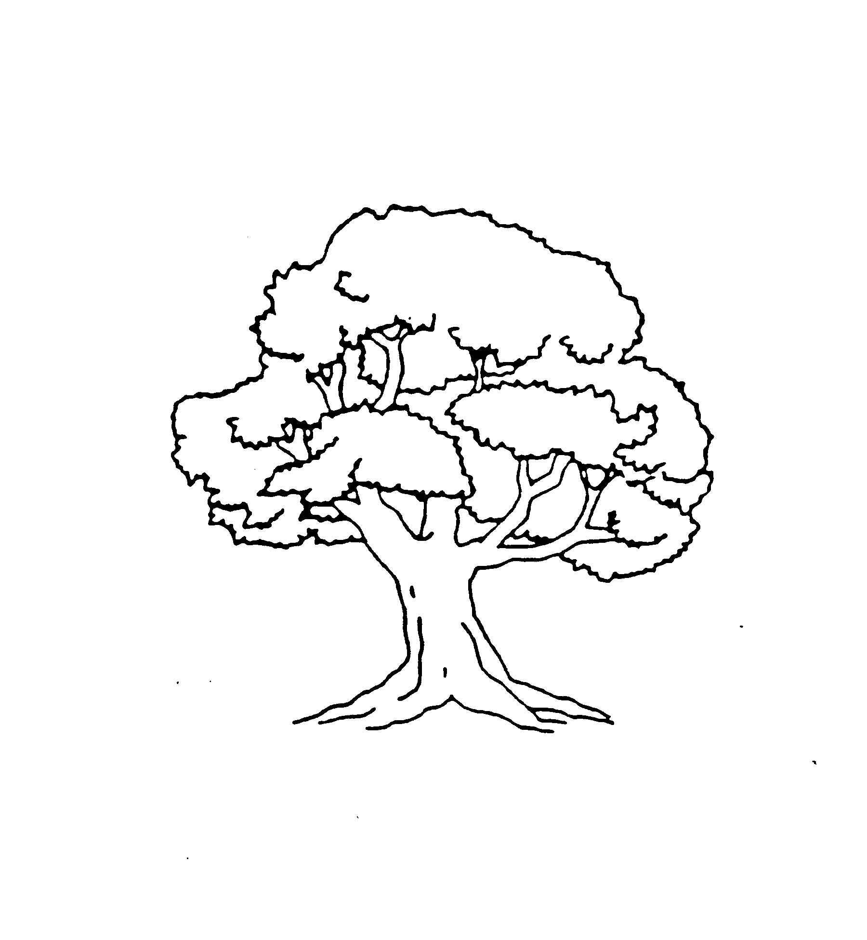
Philadelphia Naming Test
Designed to assess language deficits
185 total pictures
Participants are instructed to produce exactly one word.
Scored based on accuracy and types of error (semantic, phonological, non-response, unrelated, non-word)

Slide 4
Error Classification
Non-response: output is nothing (Have to figure out why)
Phonologoical: Determine if two strings partially match using Levenshtein distance
Semantic error (taxonomical and associative): Get the word embedding from Taxonomic and GloVe table. Check cosine similarity of the vectors
Nonword: Not English word
Correct: Matches
Unrelated: Is a word, but not semantic error

Slide 5
LLM selection
Need to have a vision part
Need to be open-sourced
Mode name | Accuracy | Notes
Flamingo 9B |  | Need multiple prompting
LLaVA 7B | 70% | Not accurate enough
LLaVA 13B | 90% | Selected
LLaVA 43B |  | Too much memory and long running time
Phi 3.5 4B |  | Not accurate enough

Slide 6
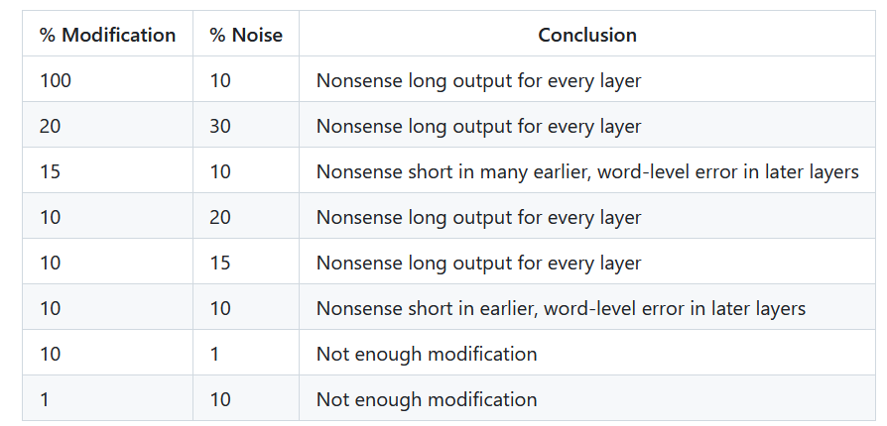
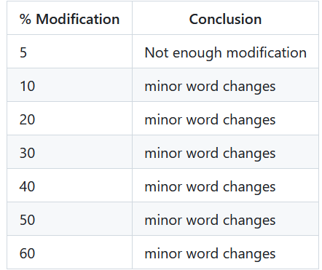
Experiment condition
Adding noise method
Percentage of weights adjusted, percentage of noise added.
Zeroing method
Percentage of weights zeroed.

Slide 7
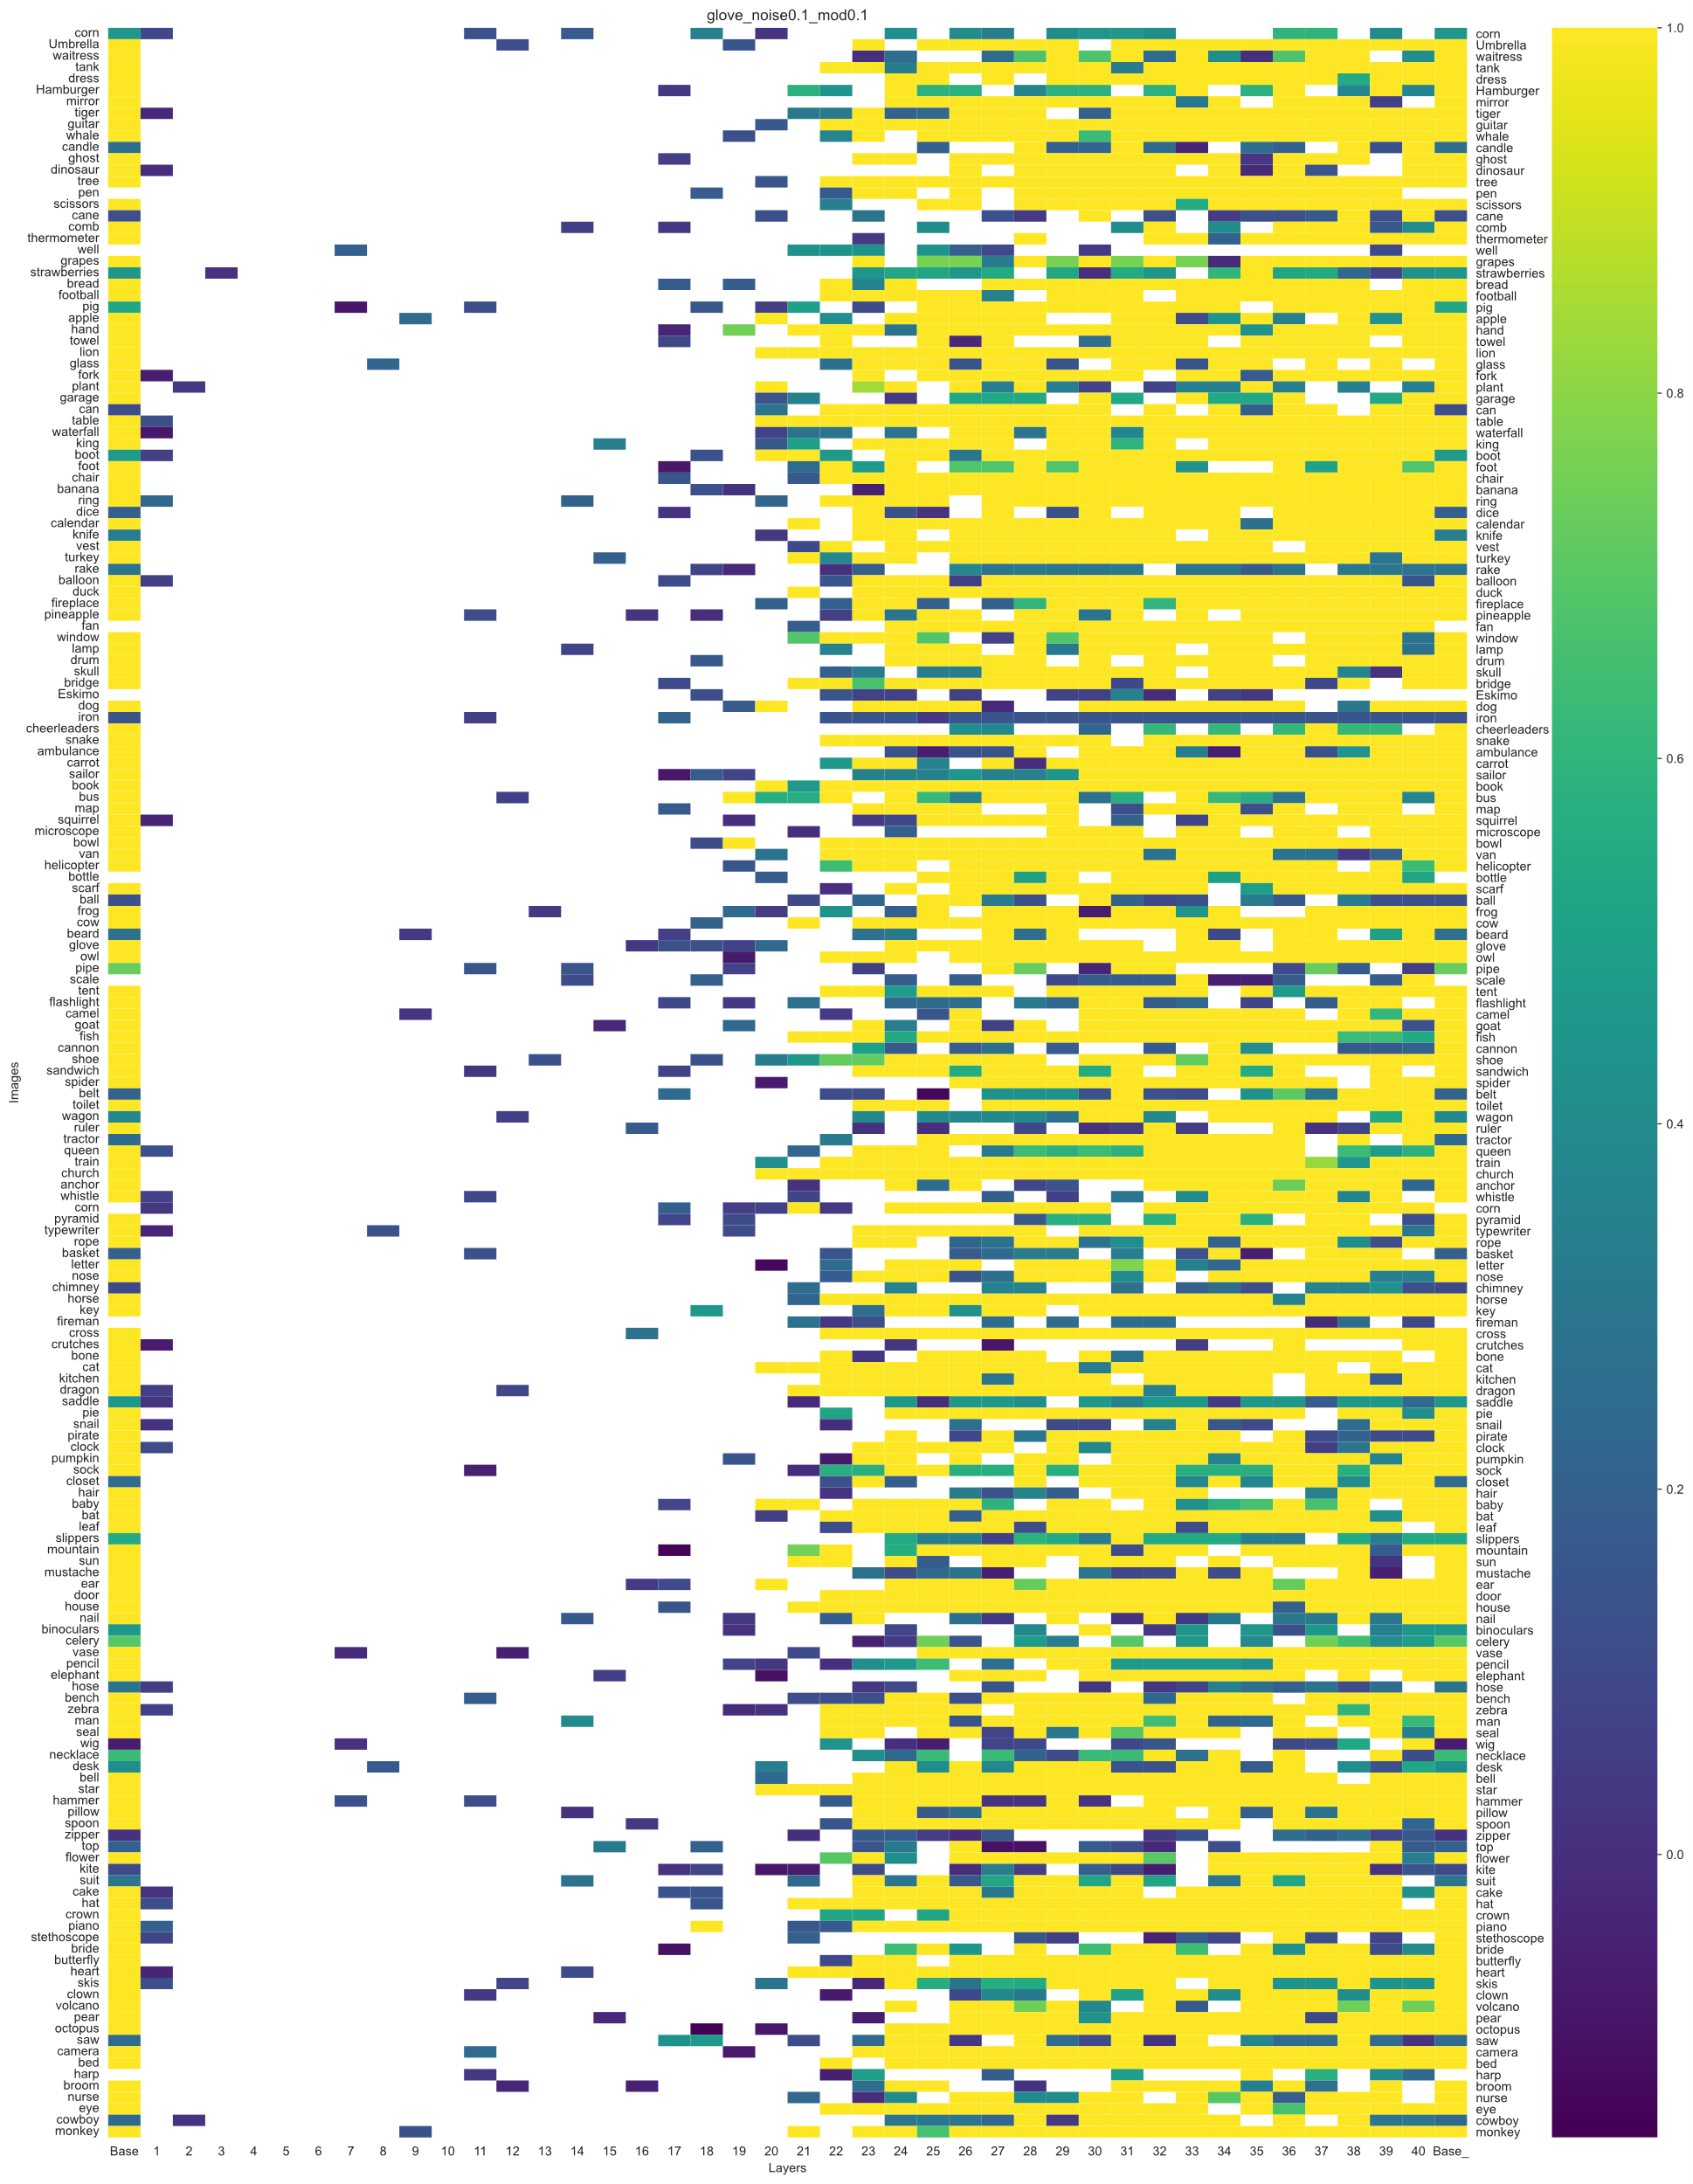

Slide 8
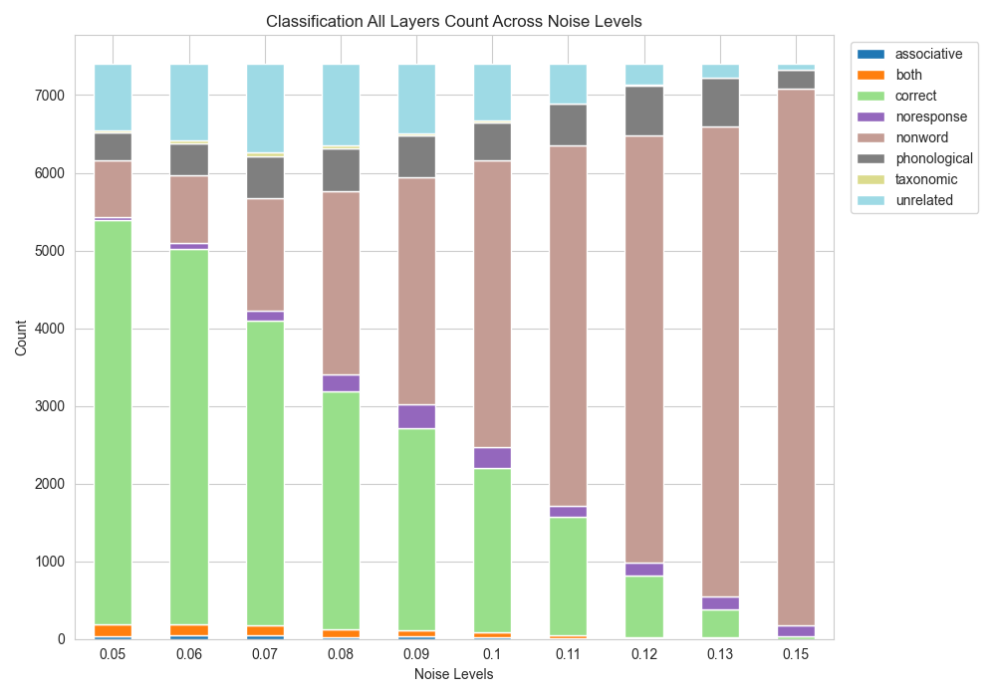

Slide 9
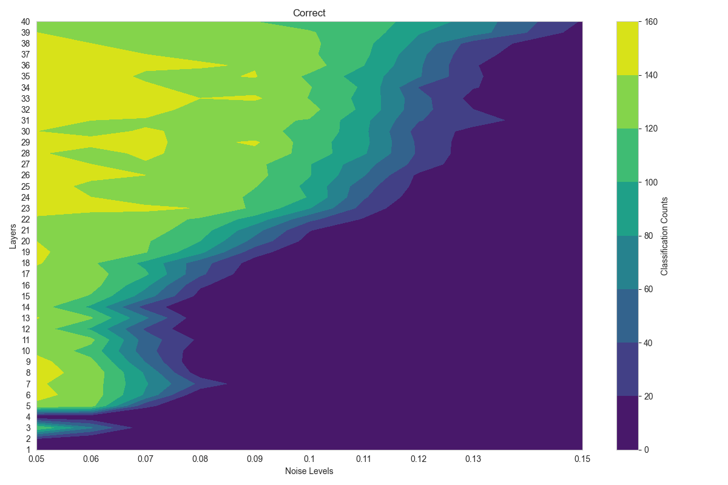

Slide 10
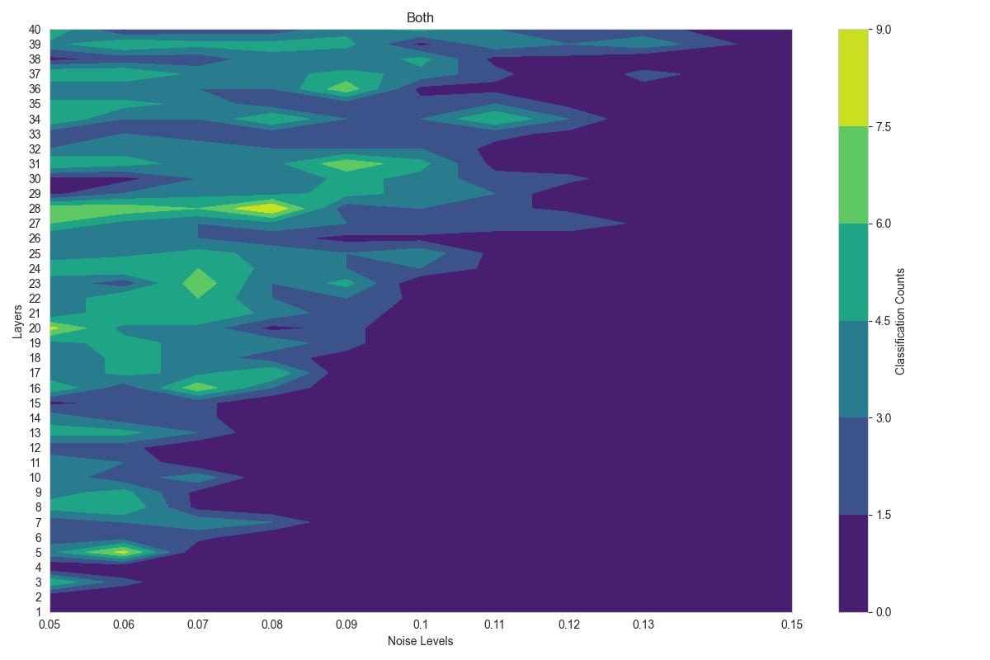

Slide 11
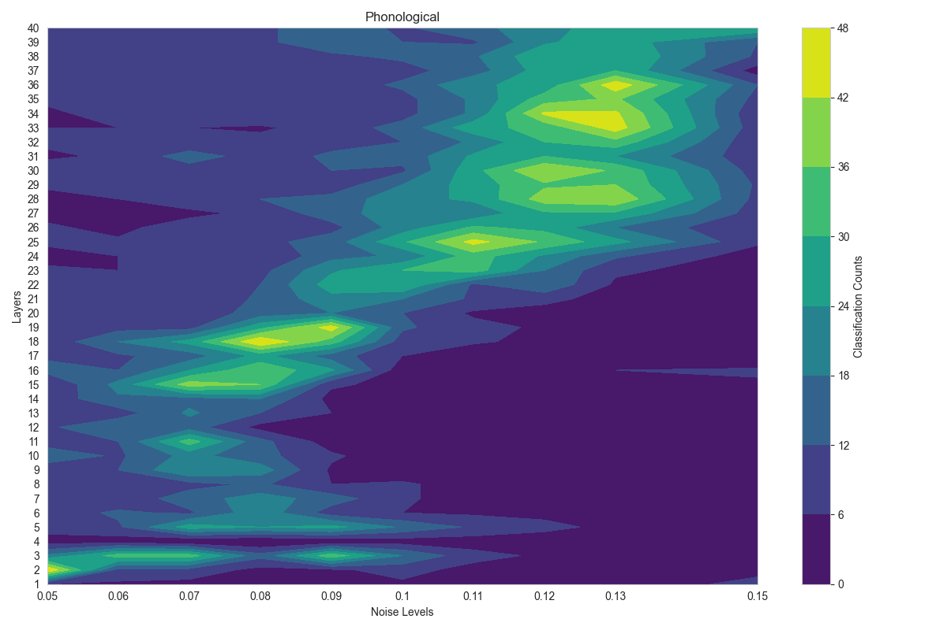

Slide 12
More work to do
Add more types of errors
Experiment with more test parameters
Examine zeroing result
Move to more complex pictures and sentence level testing

