Slide 1

Simulating Aphasia through Weight Modifications in Pretrained Large Language Models
Authors: Yong Yang, Xiang Guan, Ziyu Bian (Ph.D. Student)

Slide 2
Content
Problem Statement
Technical Challenges
Related Work
Approach and Results
Broader Impact

Slide 3
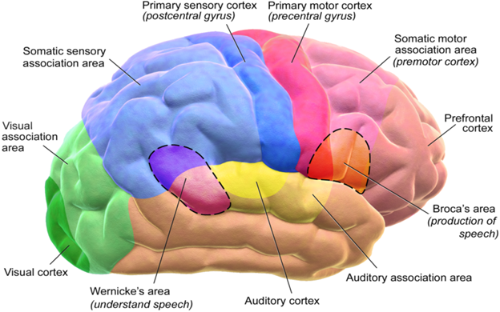
Problem Statement
Problem:
Although Large Language Models (LLMs) have achieved remarkable success in natural language processing tasks, their application in simulating human language disorders has been minimally explored.
Aphasia, a language disorder caused by brain damage, provides a unique perspective on how language is processed in the human brain.
However, due to the lack of suitable computational models, progress in understanding the mechanisms and rehabilitation strategies for aphasia has been slow..
Notes:
Briefly describe the problem your group is tackling. Describe the overall motivation and the input/output of the problem.

Slide 4

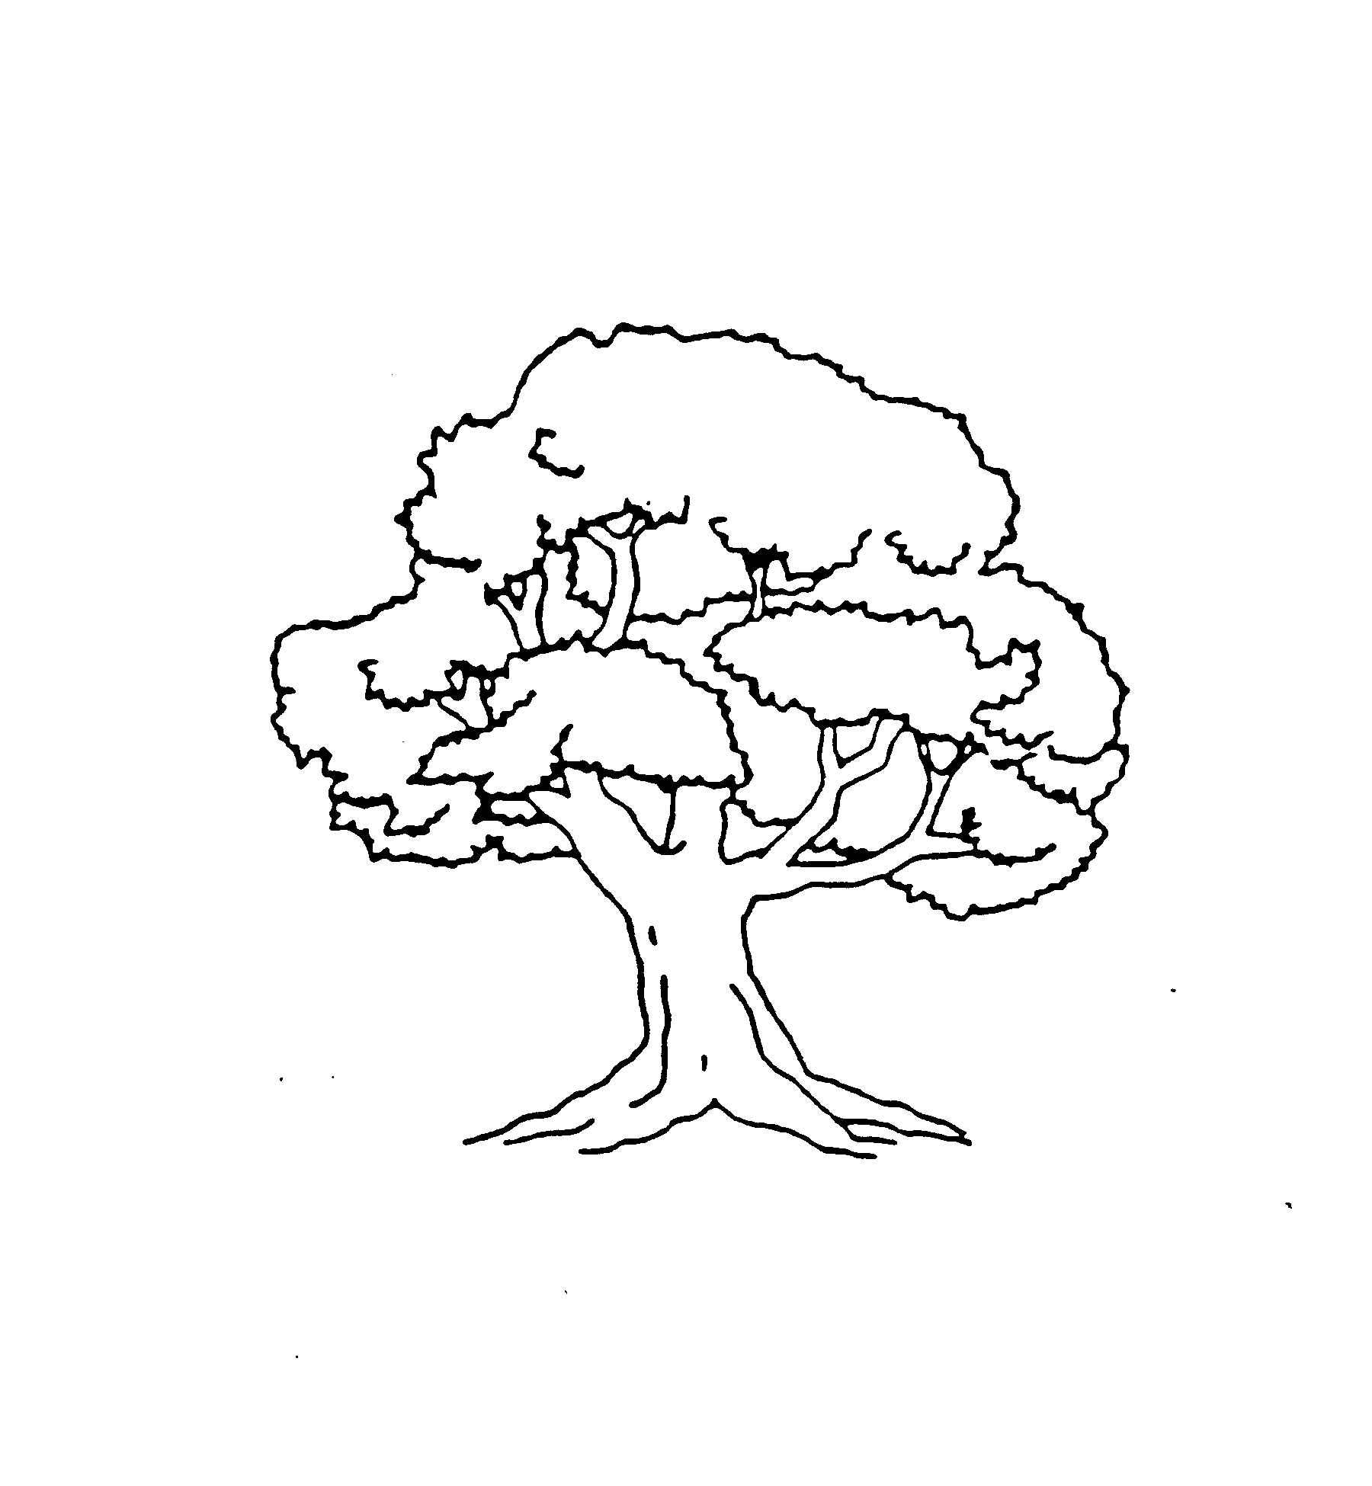
Problem Statement
The goal of this project is to simulate aphasia in LLMs. We modify specific layers in the model to study their impact on language. This approach helps us understand how damage affects language systems. It also allows us to explore similarities between LLMs and the brain. The findings from this study may lead to:
New insights into how language breaks down under damage.
Better understanding of which parts of a language system are most vulnerable.
Ideas for improving rehabilitation methods using computational models.
This study focuses on LLMs as tools to explore human cognition. While LLMs and brains are different, these models provide a controlled way to study language disruptions.
The input to our system consists of:
PNT Test
The input dataset used in this research is the Philadelphia Naming Test (PNT), which is widely used to evaluate language functions in individuals with aphasia. The PNT consists of 185 images, including 10 warmup images and 175 test images. Each image depicts a single object, and the participant is instructed to describe the image using one word.
LLM Model
Llava-1.6 Vicuna-13B version, which achieved 90% accuracy in the benchmark testing

Slide 5
Challenges
Designing an effective and meaningful perturbation strategy for LLM layers.
Interpreting the relationship between perturbed layers and simulated language deficits.
Validating the simulated deficits against clinical data from aphasia patients.
Scaling the simulations to more complex and naturalistic language tasks.
Translating insights from LLM simulations to clinical applications for aphasia diagnosis and treatment.

Slide 6
Related work：
Previous studies have explored the relationship between LLMs and brain-like language processing to simulate or understand linguistic impairments. Schrimpf et al. (2021) demonstrated that transformer-based models exhibit neural predictivity for human brain activity, achieving high "brain scores" by aligning model layers with neural responses during language tasks.
Similarly, Feghhi et al. (2024) questioned over-reliance on brain scores by deconstructing the mappings between LLM representations and neural data, emphasizing the importance of understanding the features captured by different layers.
In terms of characterizing language errors, Fergadiotis et al. (2016) contributed significantly to understanding word-level errors by categorizing paraphasias into phonological, semantic, and unrelated categories, laying the groundwork for modern error classification approaches.
Perez et al. (2024) further demonstrated the utility of generative pretrained transformers for multiclass paraphasia detection, aligning with the use of LLMs for aphasia-like impairment simulations in this study.
While these approaches provide insights into functional alignment and error characterization, they rely on predefined mappings between LLMs and neural or behavioral data. In contrast, the Layer Targeting Strategy (LTS) proposed in this paper bypasses this reliance by focusing on stochastic perturbations and output-driven analysis to identify critical layers for specific language functions.
Notes:
Discuss published work related to your project. How is your approach similar or different from others?
Briefly in what ways previous works have tackled the technical challenges
NGP 代表的是 Neural Graphics Primitives，这是一个用于加速神经辐射场（NeRF）渲染的框架。Instant-NGP 是 NVIDIA 开发的工具，用于快速构建和训练这些神经图形原语，尤其是通过哈希编码（hashing techniques）优化了 NeRF 的性能，使得生成 3D 场景和高质量视图的速度显著提升。

Slide 7
Methodology: idea
The core idea is to systematically perturb specific LLM layers and analyze the resulting errors to identify critical layers for different language functions.
Rather than relying on predefined mappings or assumptions, we employ a data-driven, exploratory approach. By systematically perturbing the LLM layers and rigorously analyzing the resulting errors, we aim to uncover empirical relationships between the model's structure and the language deficits it exhibits under different perturbation conditions.
This search-based methodology allows us to identify critical layers for various language functions in a more objective and unbiased manner. By letting the data guide our understanding of the model's functional organization, we minimize the risks associated with making a priori assumptions about how the model's components map onto brain regions or cognitive processes.
Ultimately, our goal is to leverage the LLM as a controlled experimental platform to generate new insights into the nature of language breakdown, which can then inform hypotheses about the neural basis of aphasia.

Slide 8
Methodology
Step 1: Model Selection and Initialization
Step 2: Randomized Layer Perturbation
Step 3: Task-Specific Output Evaluation
Step 4: Statistical Analysis of Perturbation Effects
Step 5: Iterative Refinement
Notes:
Discuss your approach to solving the problems you set up in the introduction. Why is your approach the right thing to do? Did you consider alternative approaches? You should include figures, diagrams, or tables to describe your method.

Slide 9
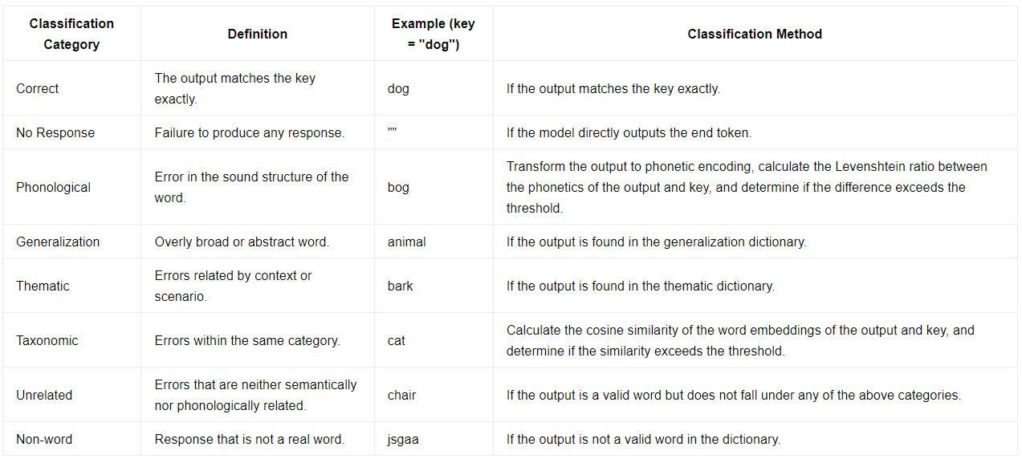
Classification Type

Slide 10
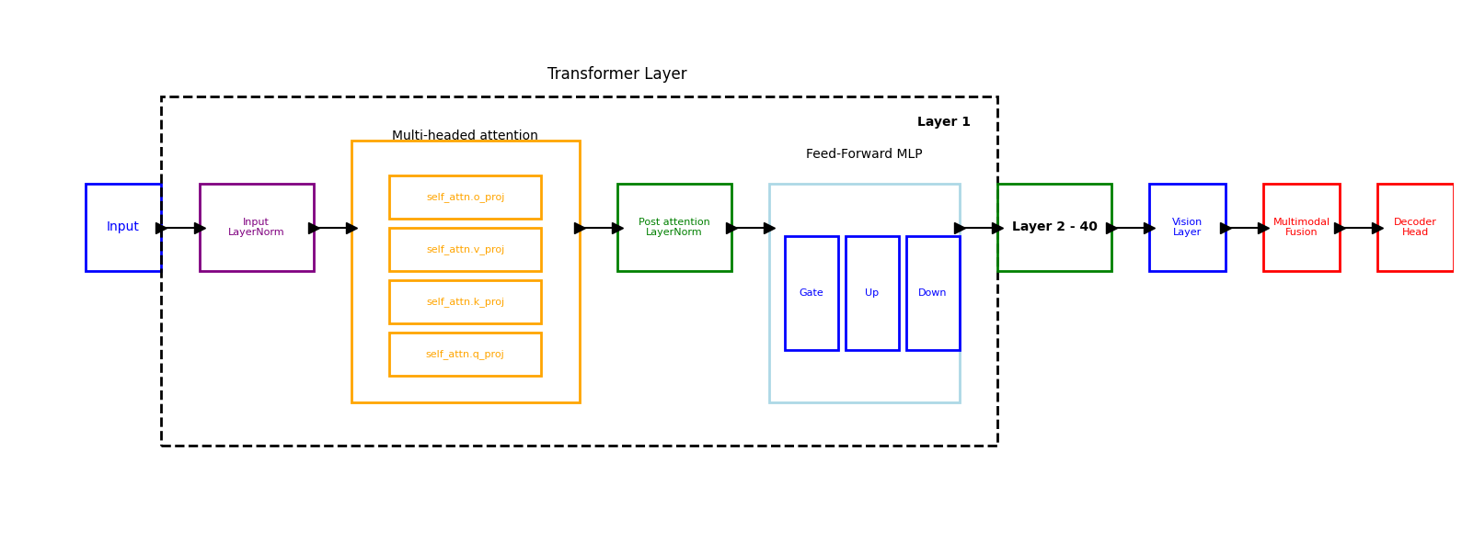
LLM Architecture
Attention Weights: self_attn.q_proj, self_attn.k_proj, self_attn.v_proj, and self_attn.o_proj.
Feedforward MLP: mlp.gate_proj, mlp.up_proj, and mlp.down_proj.
Normalization Layers: input_layernorm and post_attention_layernorm.
Notes:
The exact experiments will vary depending on the project, but you might compare with previously published methods, use visualization techniques to gain insight into how your model works, discuss standard failure modes of your choices. You should include graphs, tables, or other figures to illustrate your experimental results.

Slide 11
Experiments
Adding Noise
Two experimental variables were tested: (1) the percentage of weights modified and (2) the percentage of noise added.
Zeroing
(1) the percentage of weights modified
The baseline inference accuracy for unmodified weights was 166 out of 185 images correctly named. Misclassified images were excluded from further analysis. Across the 40 layers, the total classification count was 6640 (40×166). However, overlapping error classifications (e.g., an output falling into multiple error types) could lead to higher counts.
Notes:
The exact experiments will vary depending on the project, but you might compare with previously published methods, use visualization techniques to gain insight into how your model works, discuss standard failure modes of your choices. You should include graphs, tables, or other figures to illustrate your experimental results.

Slide 12
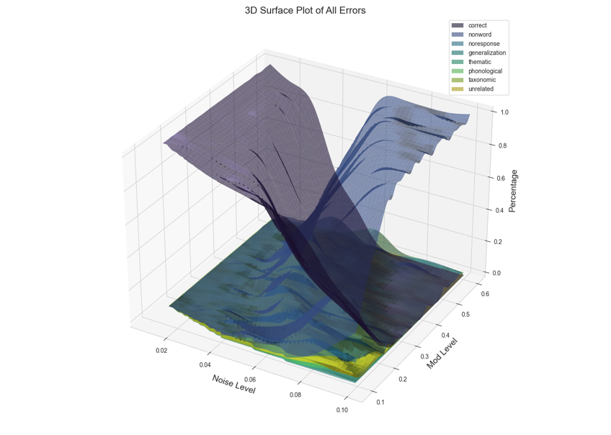
Results - Error Trends - Variable Weight Modification (10% to 60%)

Slide 13
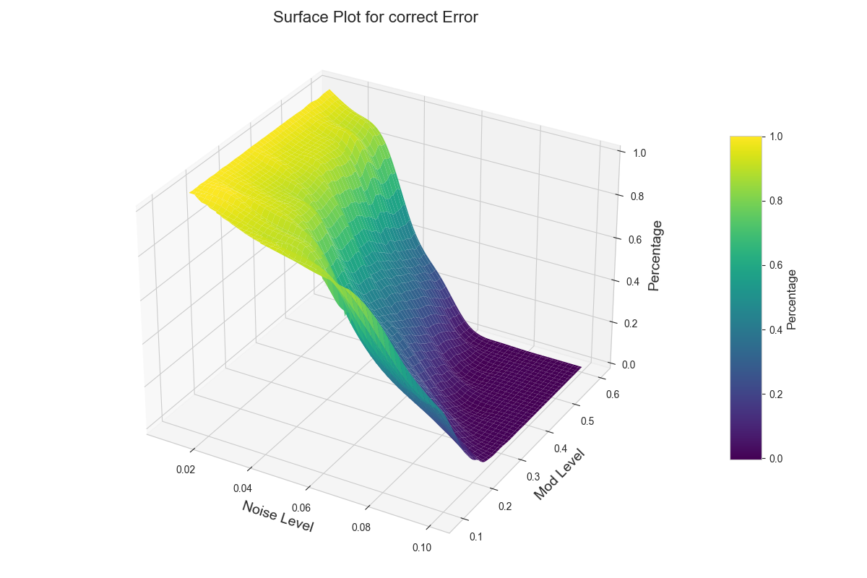
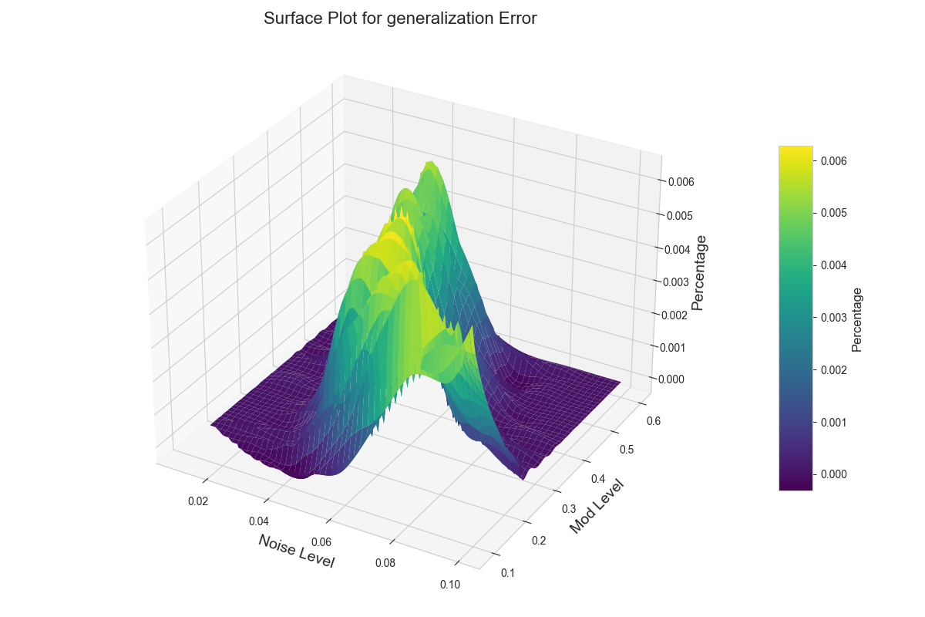
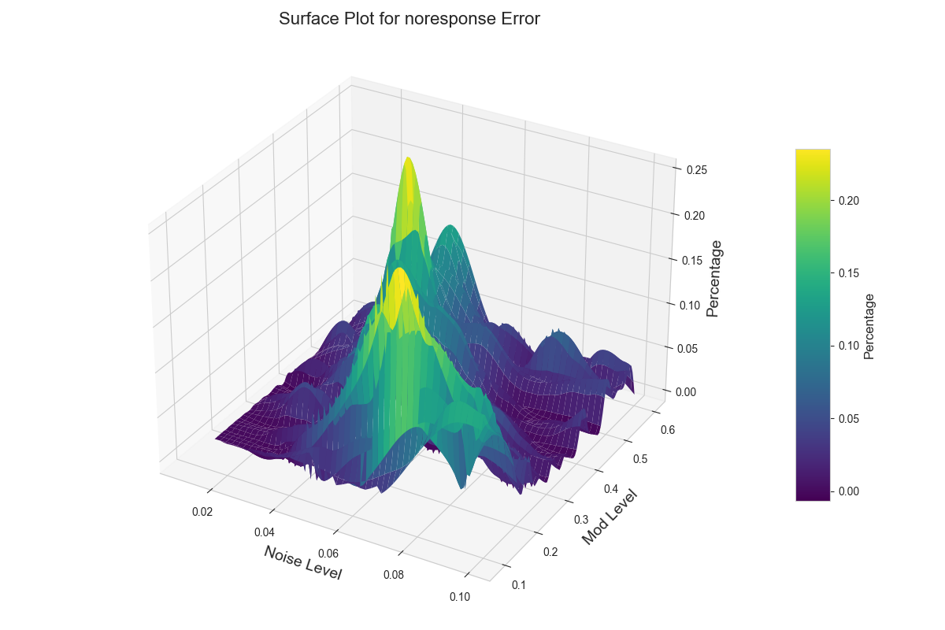
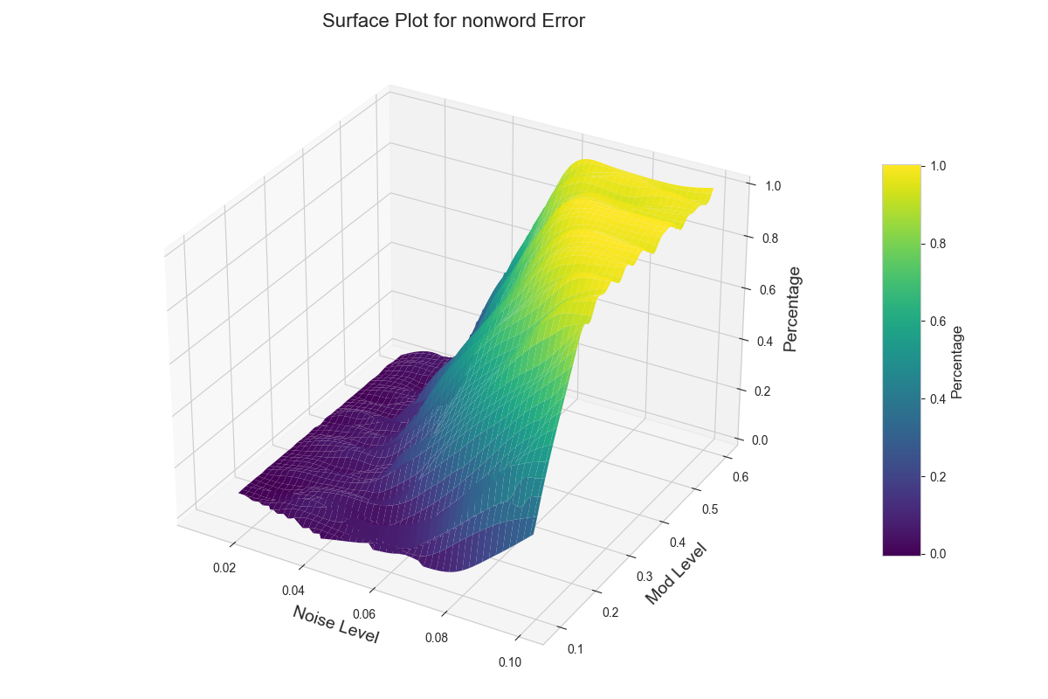
Results
Figure 2b: Distribution of Error Under Different Perturbation Conditions (by Error Type)
A: Correct Predictions Distribution
G: Generalization Errors Distribution ​
C: No-Response Errors Distribution
B: Nonword Errors Distribution

Slide 14
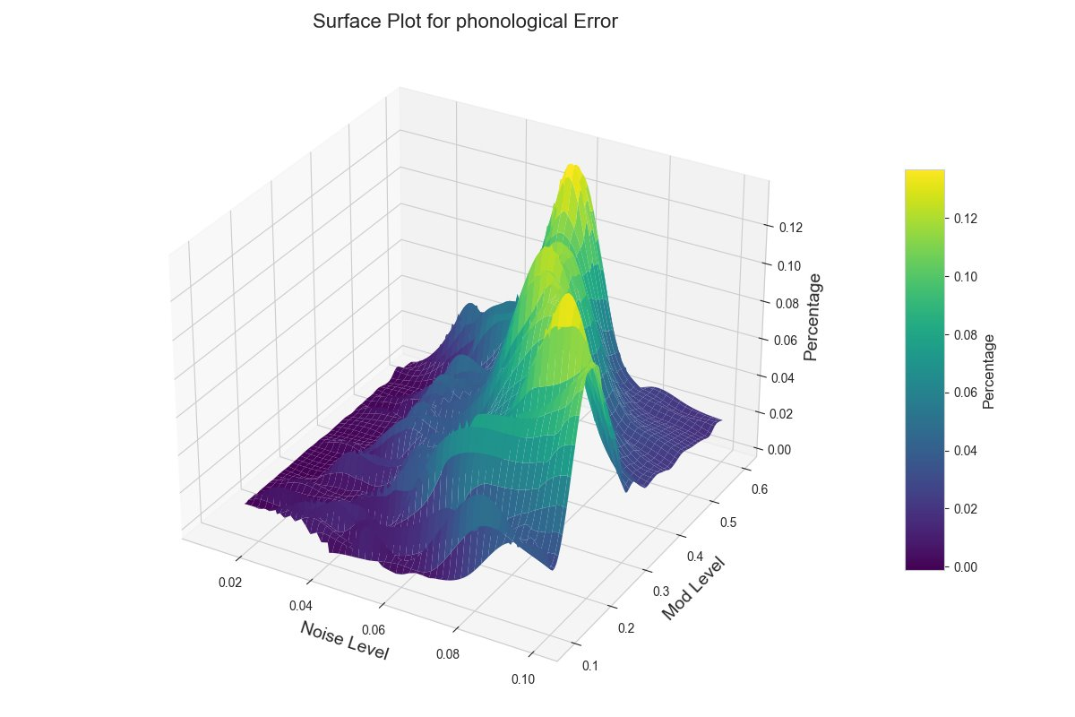
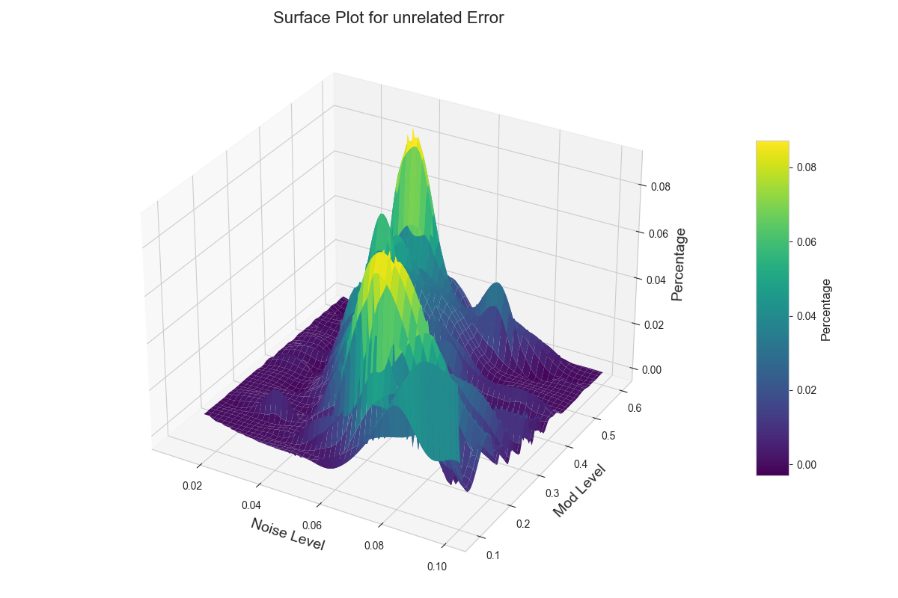
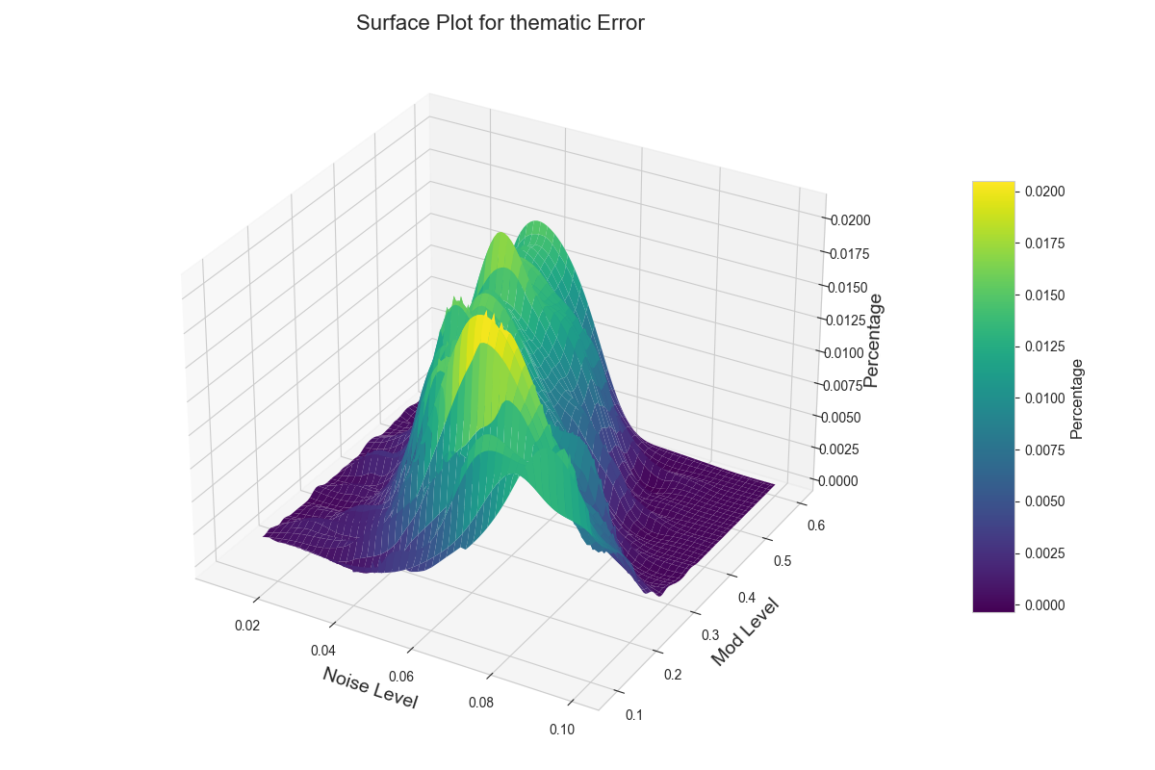
Results
Figure 2b provides a comprehensive 3D surface plot of all error types.
As noise levels and modification percentages increase, a sharp decline in correct predictions is observed.
Beyond a noise threshold of 0.11, "nonword" errors dominate, indicating significant disruption in linguistic coherence.
F: Phonological Errors Distribution
D: Taxonomic Errors Distribution
E: Thematic Errors Distribution
H: Unrelated Errors Distribution

Slide 15
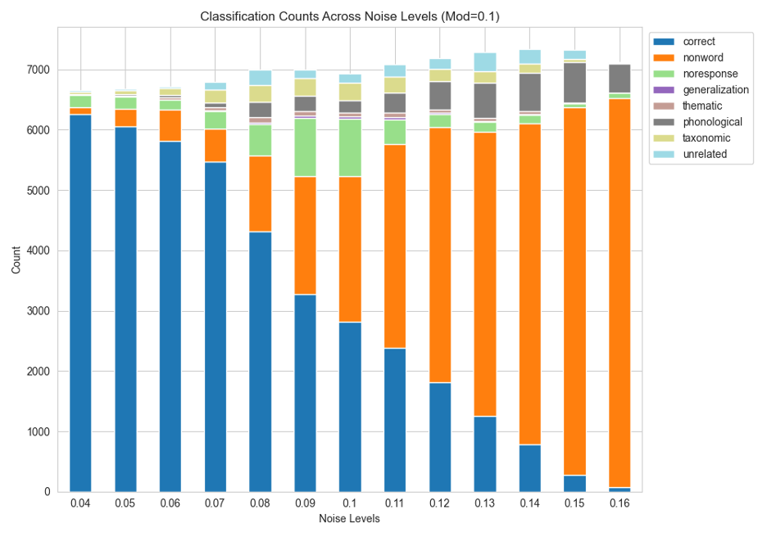
Results - Error Trends - Fixed weight modification (10%)
40 layers x
166 images
≈ 6500 Inferences

Slide 16
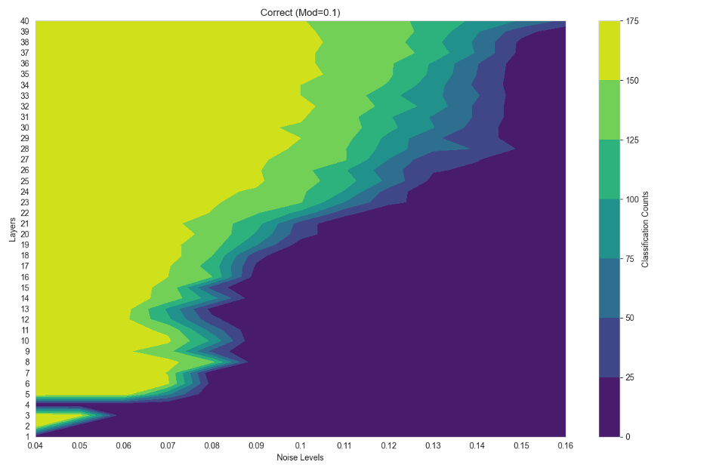
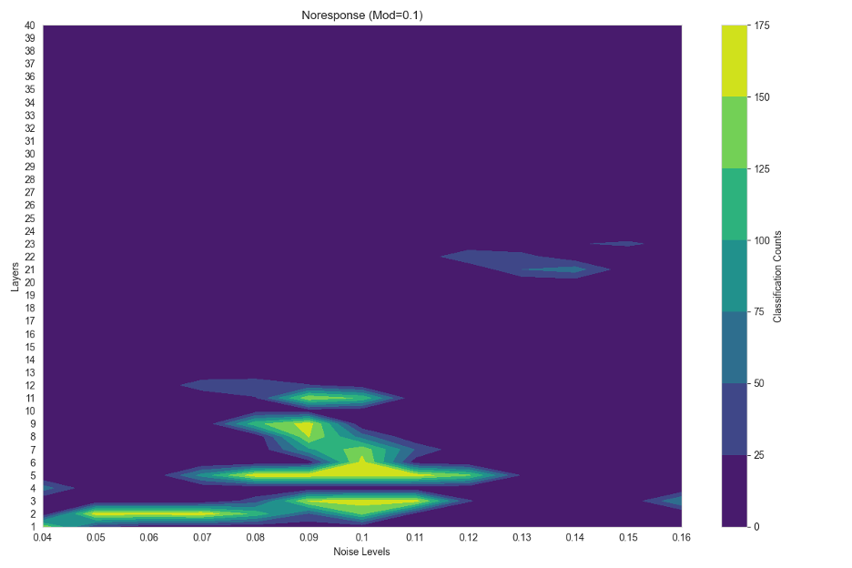
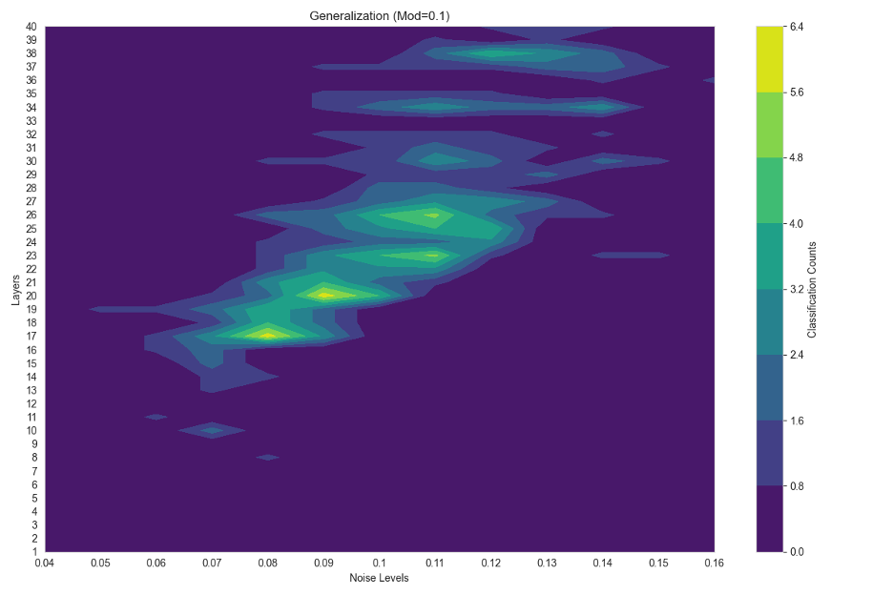
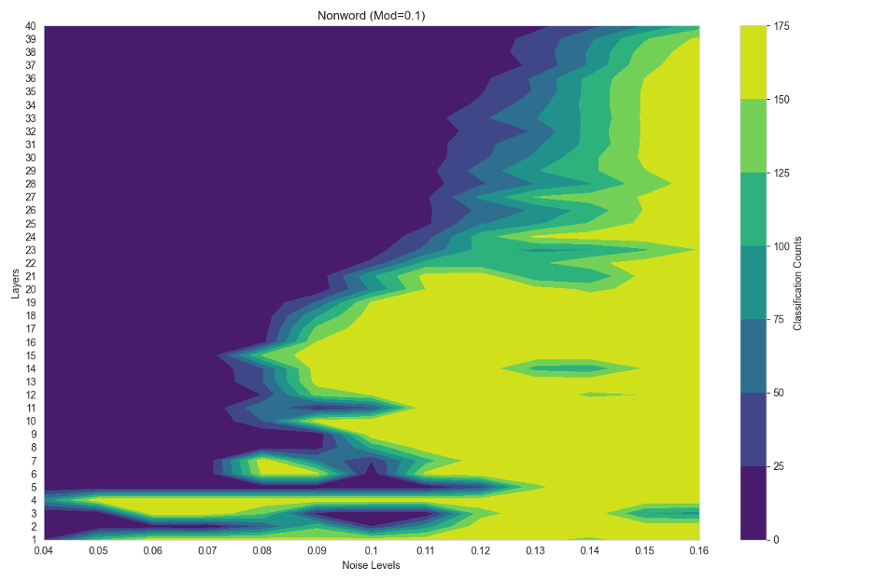
Results – Adding Noise

Slide 17
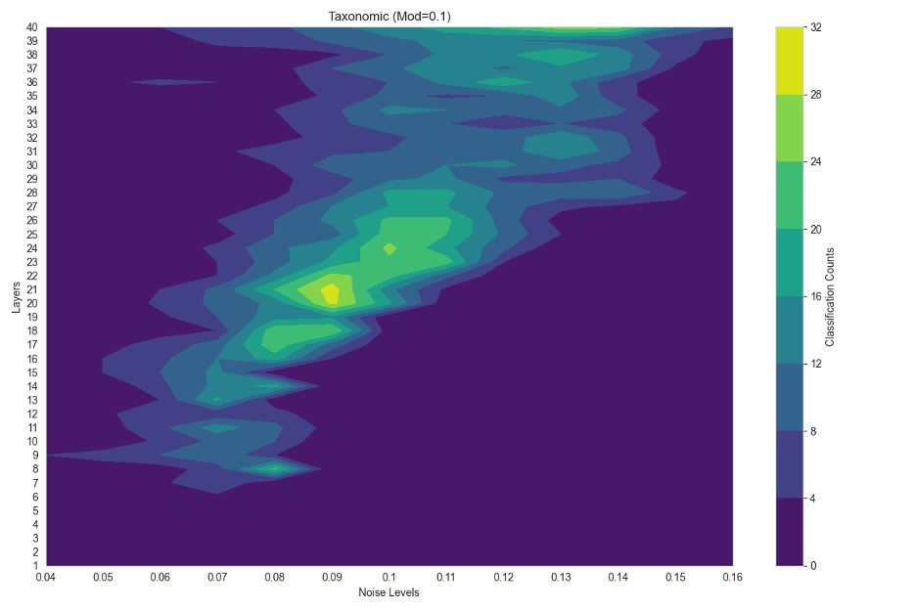
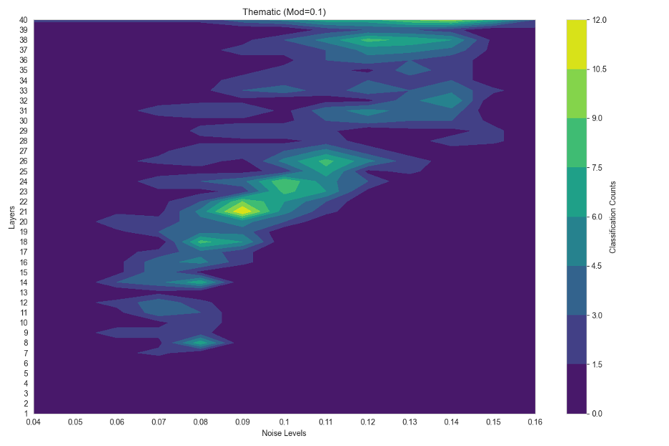
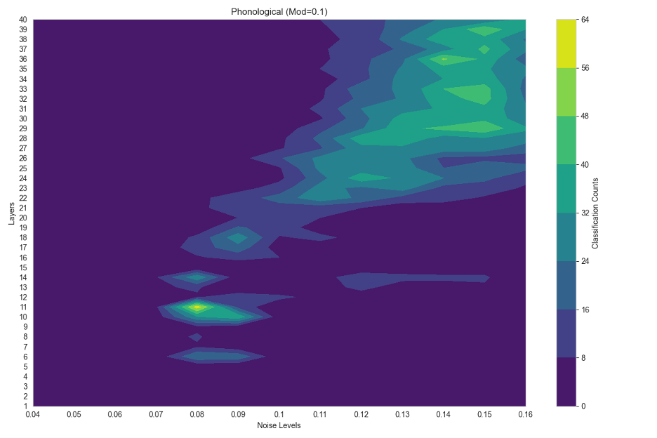
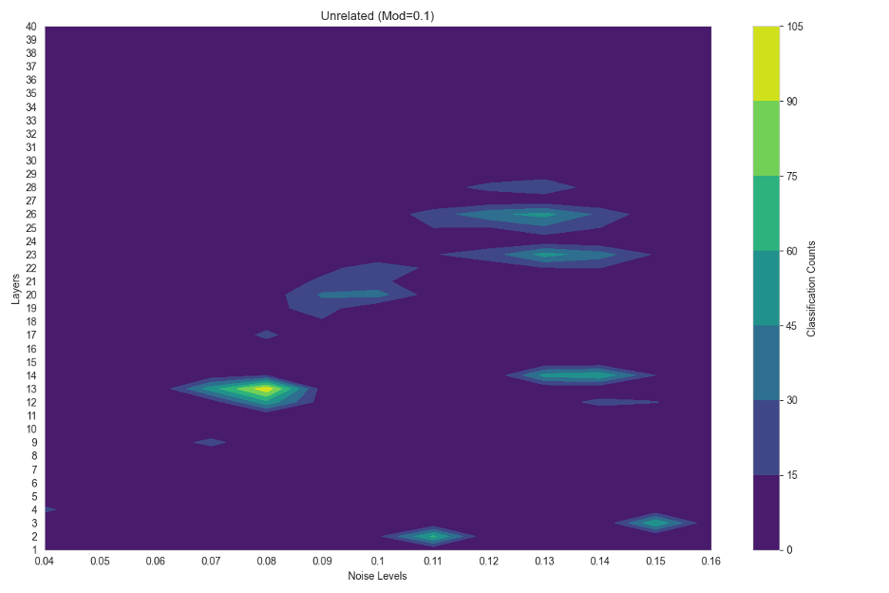
Results – Adding Noise

Slide 18
Experiments-Zeroing
With the weights set as zero, we also systematically modify one transformer layer at a time.
Two experimental variables were tested: (1) Incremental zeroing, increasing the percentage of weights zeroed from 10% to 100% (2) skip-layer zeroing, randomly selecting layers 1, 2, 4, and 6 for zeroing
We discovered that the first few layers have the most critical influence on the network's output, and the network's performance only significantly deteriorates when a large number of consecutive layers have their parameters zeroed out. This provided valuable insights into the internal mechanisms of neural networks.
Notes:
The exact experiments will vary depending on the project, but you might compare with previously published methods, use visualization techniques to gain insight into how your model works, discuss standard failure modes of your choices. You should include graphs, tables, or other figures to illustrate your experimental results.

Slide 19
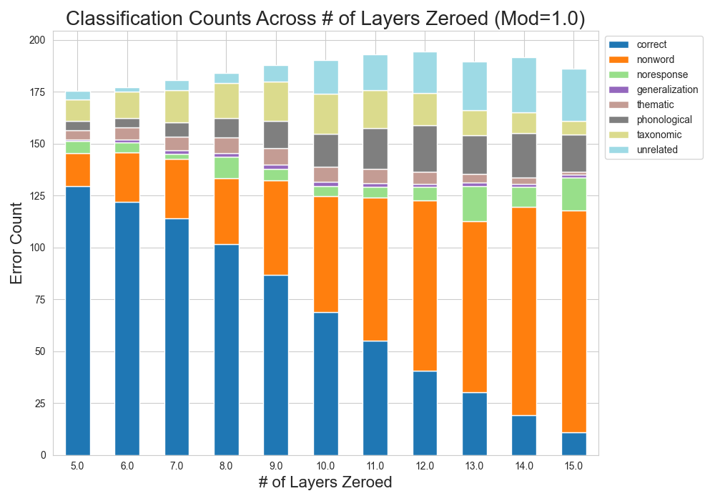
Results - Error Trends – ZEROing Different NUMber of LAyers
Overall number of output classifications at different number of layers zeroed. It shows we are getting a higher proportion of errors other than nonword and correct. This could be because we have a shallower LLM by zeroing multiple layers at a time.
Figure 5: Distribution of Error under Modifying 10% of the Weights at Varying Noise Levels (x axis)
Note: Each column in the figure has been normalized by dividing by the number of zeroings.

Slide 20
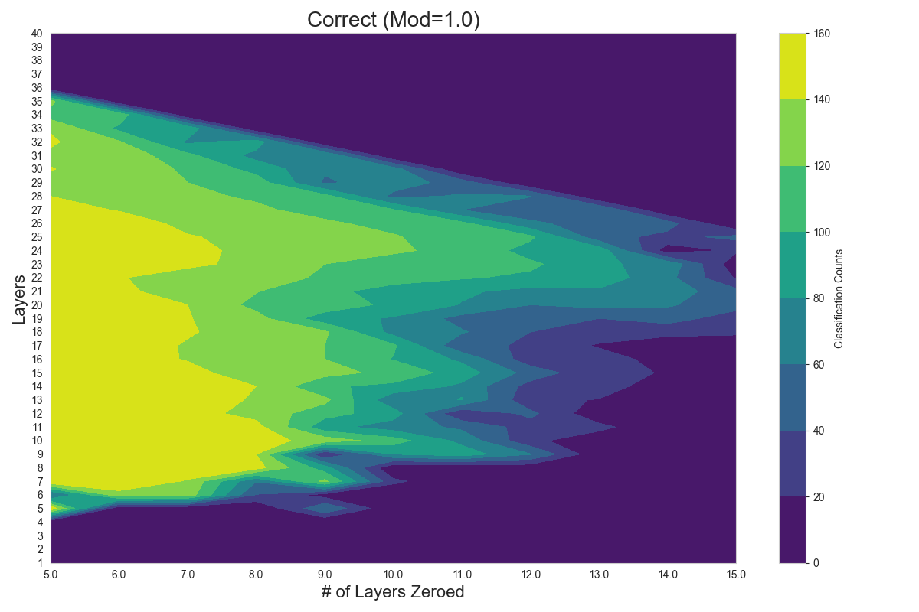
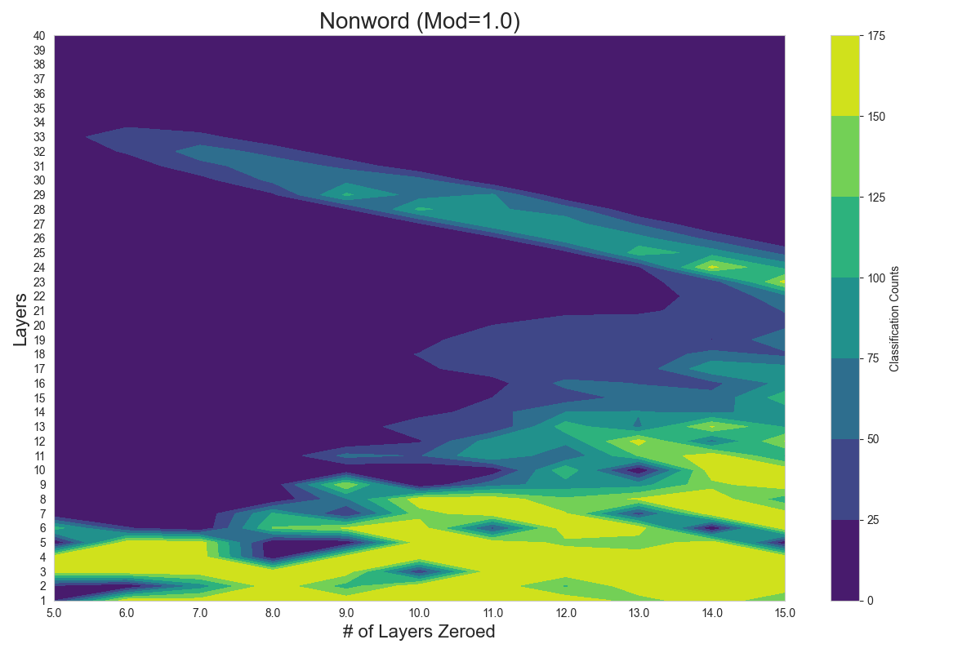
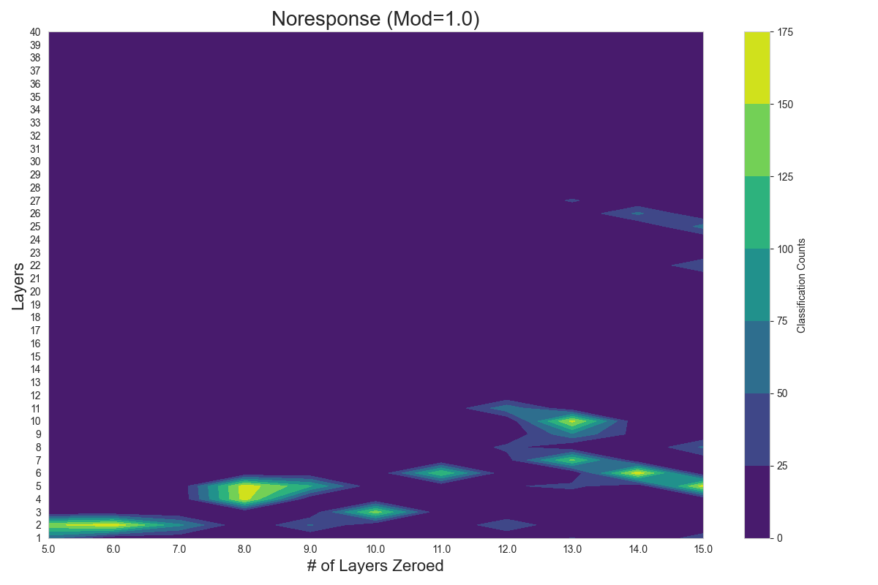
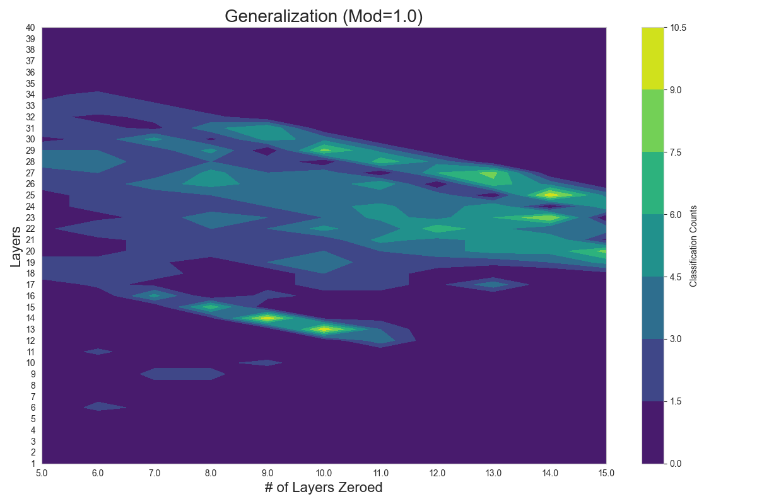
Results - Zeroing
A: Correct Predictions
B: Nonword Errors
B: Nonword Errors
C: No-Response Errors
D: Taxonomic Errors

Slide 21
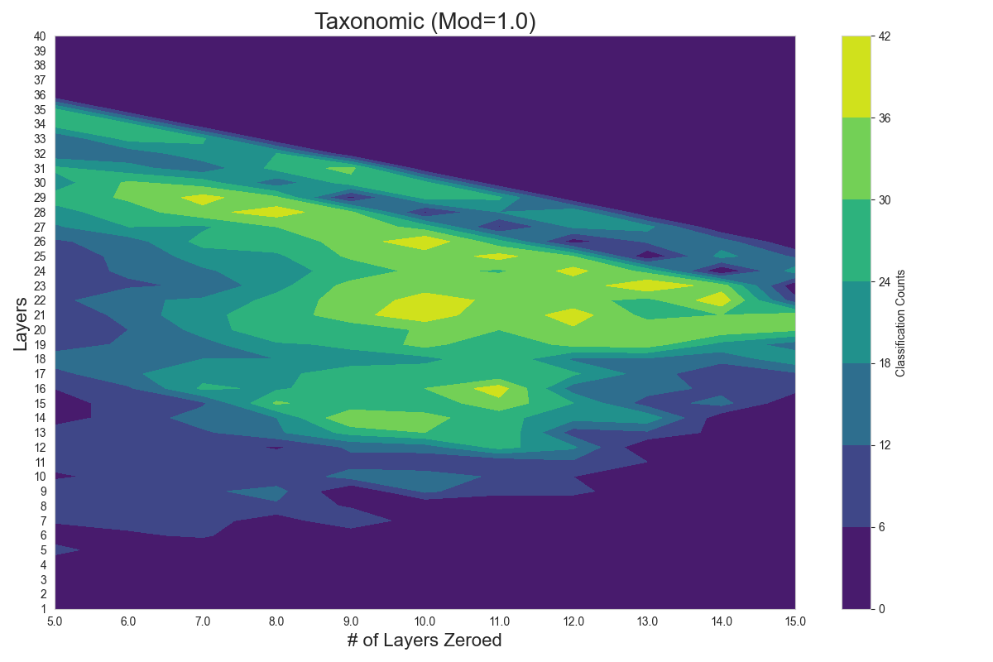
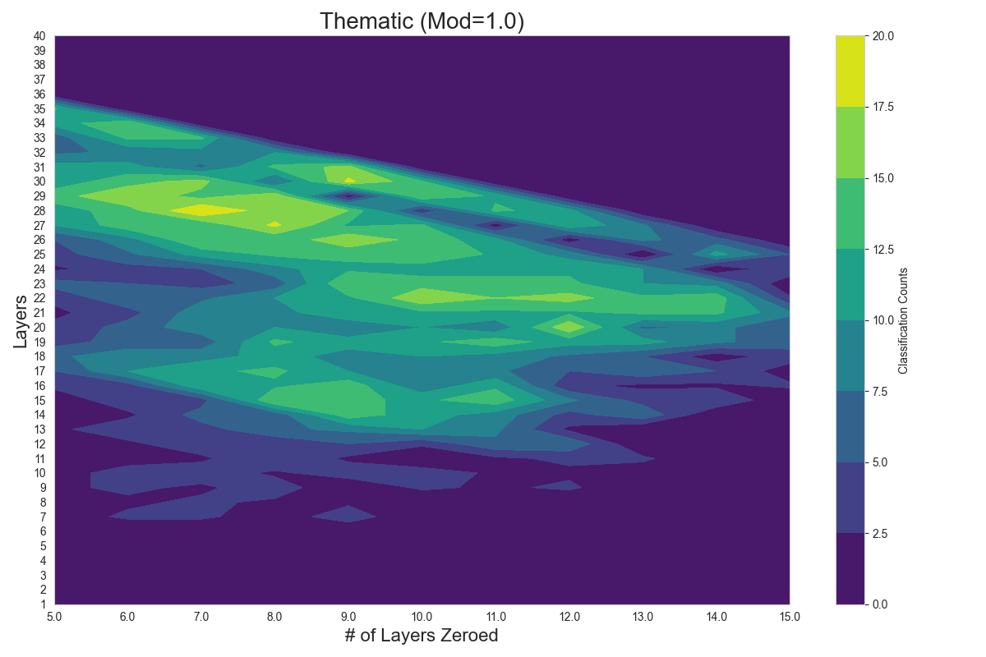
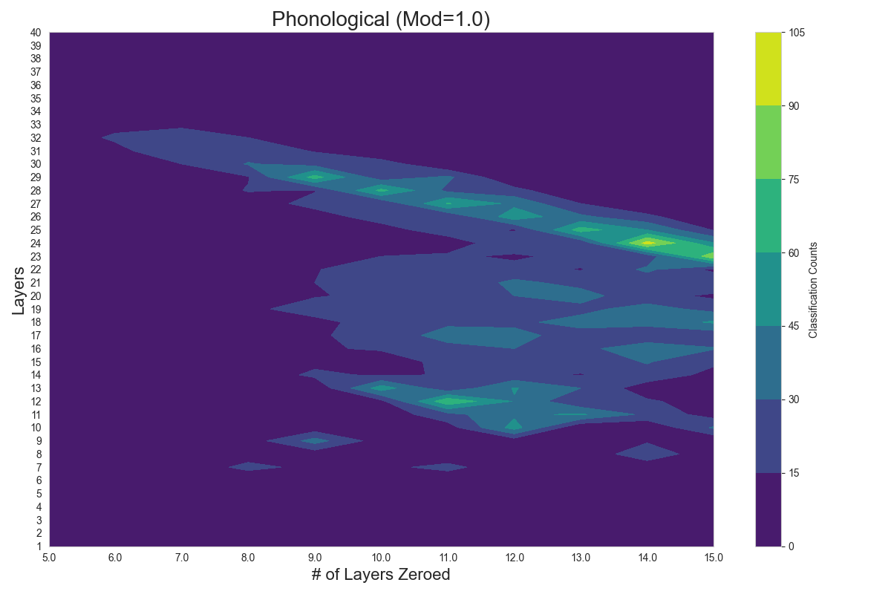
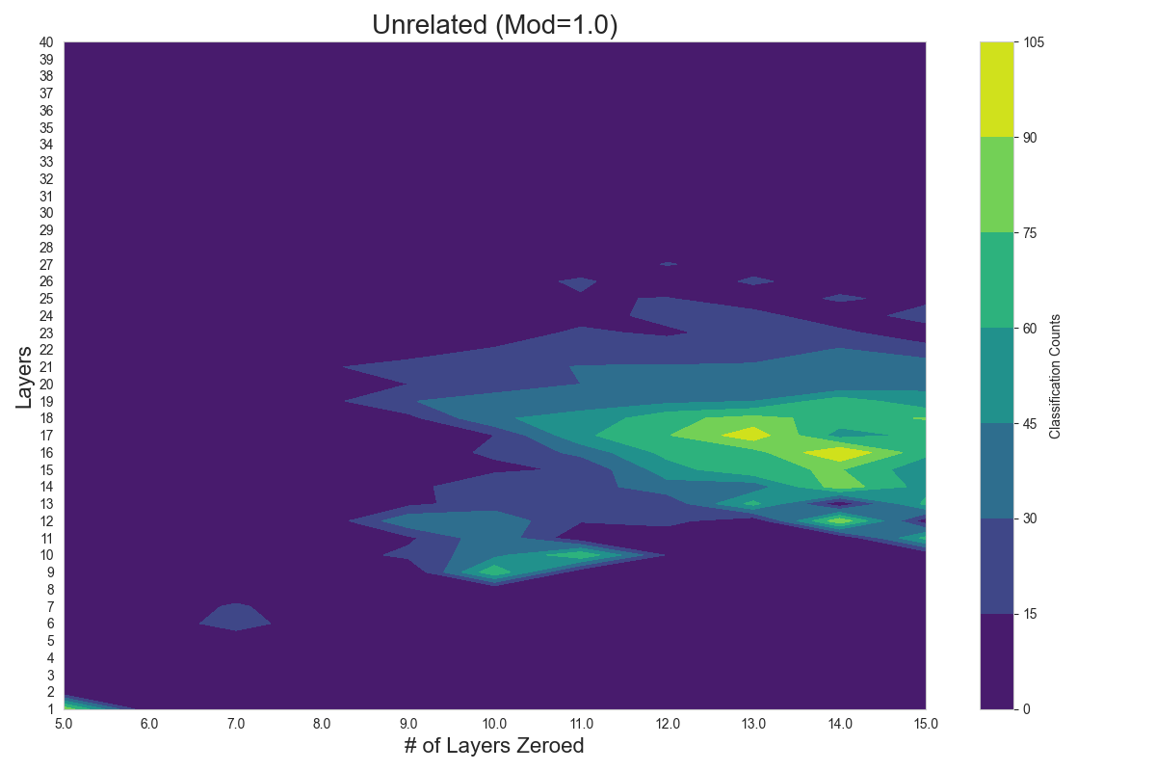
Results - Zeroing
E: Thematic Errors
F: Phonological Errors
G: Generalization Errors
H: Unrelated Errors

Slide 22
Broader Impact - Limitations
Limitations:
Single-image naming tasks may underutilize the full capacity of the LLM, potentially masking deeper dependencies between layers.
Results from Llava-1.6 may not generalize to other architectures without further validation.
Future Possible Improvement:
Complex Linguistic Tasks
Model Comparisons
Layer Sensitivity Thresholds
Neural Data Integration

Slide 23
Reference
Fergadiotis, G., Gorman, K., & Bedrick, S. (2016). Algorithmic classification of five characteristic types of paraphasias. American Journal of Speech-Language Pathology. https://doi.org/10.1044/2016_AJSLP-15-0147
Goodglass, H., & Kaplan, E. (1983). The Assessment of Aphasia and Related Disorders. Lea & Febiger.
Katz, R. B. (1986). The Philadelphia Naming Test. In Clinical Aphasiology.
MacWhinney, B., Fromm, D., Forbes, M., & Holland, A. (2011). AphasiaBank: Methods for studying discourse. Aphasiology, 25(11), 1286-1307.
Perez, M., Sampath, A., Niu, M., & Mower Provost, E. (2024). Beyond Binary: Multiclass Paraphasia Detection with Generative Pretrained Transformers and End-to-End Models. Proceedings of Interspeech 2024. https://doi.org/10.21437/interspeech.2024-1281
Notes:
APA Style

Slide 24
Supplementary
Github: https://github.com/csce585-mlsystems/Aphasia_LLM
Data: https://github.com/csce585-mlsystems/Aphasia_LLM/tree/main/1_Baseline/PNT_images
Code: https://github.com/csce585-mlsystems/Aphasia_LLM/tree/main/Code
Results: https://github.com/csce585-mlsystems/Aphasia_LLM/tree/main/Result/Classifications_plots/12_3_24_Noise_with_probabilities

Slide 25
Thanks!
Name
Title
Email
Social

