Slide 1
Simulating Aphasia through Weight Modifications in Pretrained Large Language Models
Xiang Guan, Ph.D. student, CS
(Steven) Yong Yang , Ph.D. student, CS
Ziyu Bian, Ph.D. student, CS
Notes:
We are both in the same lab with the same advisor. We meet each other frequently. We worked on projects in the past for other courses.

Slide 2
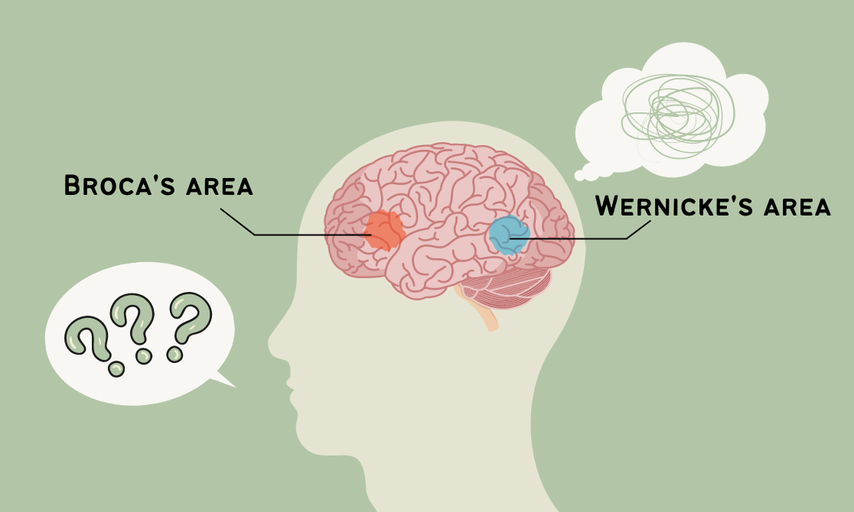
Motivation
Two million people in the USA affected with aphasia.
Aphasia is most often caused by a left hemisphere stroke.
Conceptualize LLMs as a model of healty brain function
Use LLMs simulate the neural disruptions observed in aphasia.
Can LLMs help us understand the mechanisms of aphasia?
Method can be applicable to studying other language disorders.
https://silverliningsclinic.com/blog/what-to-know-about-aphasia
Notes:
Aphasia is a language disorder following neurological damage, typically following a stroke. Broca’s is a non-fluent aphasia consisting of slow, laborious, halting speech.

Slide 3
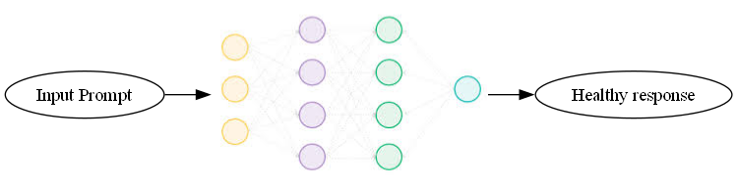
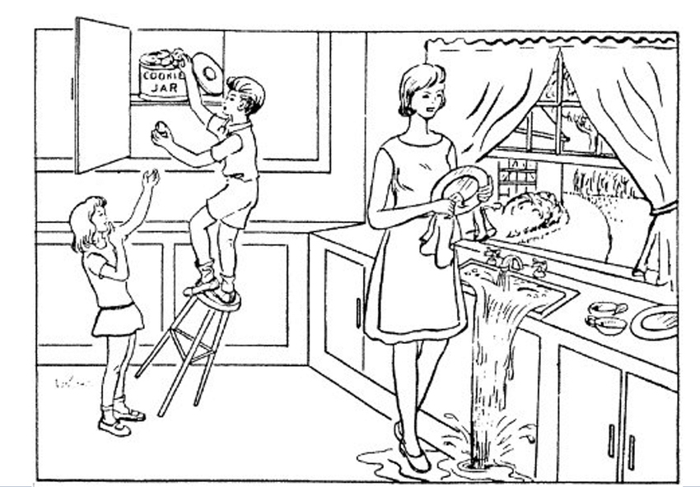
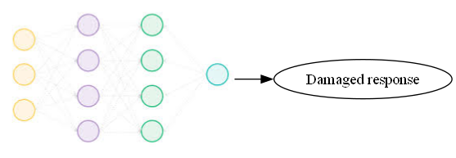
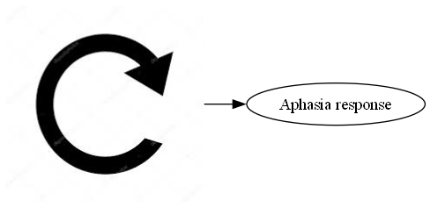
Method
Describe as much as you can
about this picture

Slide 4
Evaluation
Create a classifier to label the output from the LLM.
Use classification metrics such as F1 score
Intended healthy: “I went to the store to buy some groceries.”
Over-tuned model: “dkjlkjkl;xd tyrcz dajonmiwqepu”
Non-fluent aphasia: “Go... store... buy... Food”
Fluent aphasia: "I went to the crayon and found the mitty for tobbles.“
Notes:
Not many existing paper with this approach.

