Slide 1
CSCE 585 Machine Learning Project Optimizing Chess Engine Training
Vito Spatafora

Slide 2
Background in Chess Engines
What Is a Chess Engine?
A chess engine is a computer program that evaluates chess positions and chooses optimal moves.
Modern engines (like Stockfish, Leela Chess Zero, AlphaZero) often exceed top human skill levels.
Chess is not a “Solved Game” meaning the perfect strategy isn’t known for every position
How It Works (Conceptual Overview)
Search Algorithm
Explores possible future move sequences (game tree) using algorithms like minimax with alpha-beta pruning to cut off bad branches.
Evaluation Function
Scores board positions using heuristics (material count, king safety, pawn structure, etc.) or learned neural network predictions.
Modern engines combine deep neural networks for evaluation + classical search for move planning.
Example: Leela Chess Zero uses a convolutional neural network (CNN) trained through self-play reinforcement learning.

Slide 3
Why This Matters
Chess as an AI Benchmark – Chess engines are a classic way to measure the capabilities of AI systems.
Catalyst for ML Advances – Progress in chess engines has historically driven broader breakthroughs in AI and machine learning.
Efficiency Enables Scale – Training complex neural models requires massive compute; improving efficiency allows faster iteration and larger experiments.
Sustainability Concerns – Reducing energy usage lowers costs, limits environmental impact, and supports sustainable AI development.
Self-Play Is Powerful but Costly – Millions of self-play games produce strong models, but require huge computational and energy resources.
Optimizing Training Improves AI – Streamlined, energy-efficient training pipelines make it easier to develop stronger AI systems overall.

Slide 4


Why Training Uses So Much Energy
Massive Self-Play
Millions of games are simulated to generate training data.
Large Neural Networks
Deep networks require heavy GPU/TPU computation for both forward and backward passes.
Iterative Training
Training occurs in multiple rounds (generations), requiring thousands of GPU hours.
Energy-Hungry Hardware
GPUs and TPUs consume hundreds of watts each, multiplied across clusters of machines.

Slide 5

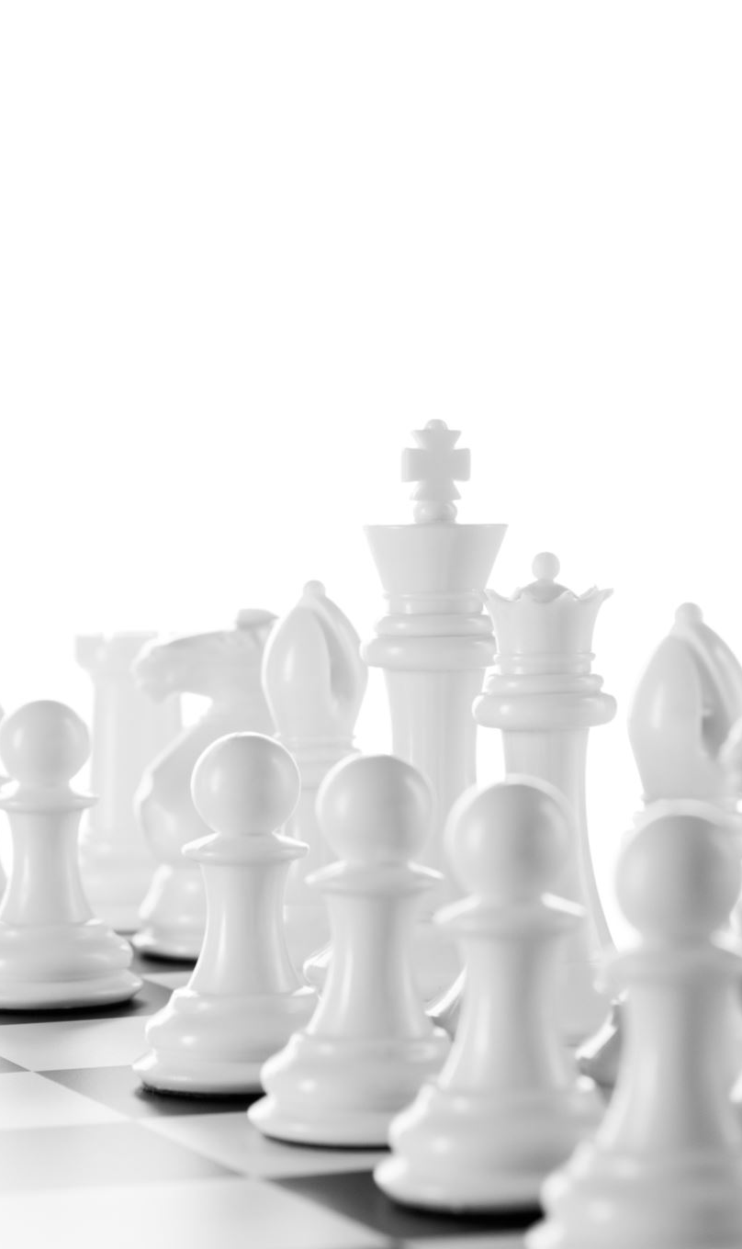
Goals
• Develop and compare two neural network evaluation functions for a chess engine
• Improve training efficiency (energy & convergence time) through training strategy

Slide 6

Experimental Setup
Baseline: Full-Game Self-Play
Train on full games from the start
Learns patterns slowly while initially playing poorly
Win → reward
Loss → negative reward
Guided Curriculum Self-Play
• Start with short games (10–20 moves per side)
Gradually increase game length as strength improves
more material count than opponent after set n moves → reward
Checkmate → big reward

Slide 7
Final COmparison
Both evaluation functions will be used in the same engine to determine relative elo (playing Strength) against other chess engines
Energy used for the training of both systems will be monitored and documented
The elo of each engine will be compared to the energy spent during its training to get the relative elo/unit of electricity to determine which method is more efficient

Slide 8
Hypothesis
Curriculum-based training will:
– Achieve strong play in fewer training steps
– Reduce total energy consumption
– Maintain or improve final performance

Slide 9
Thank you!

