Slide 2
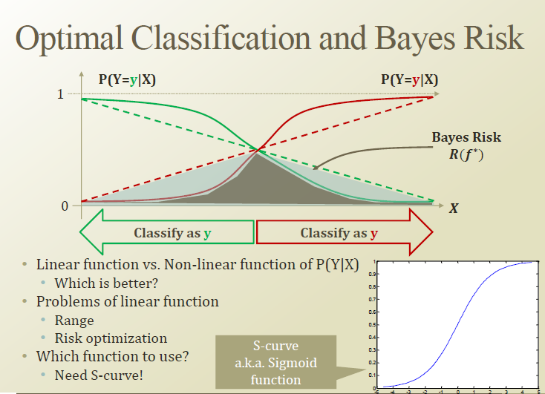

Slide 3
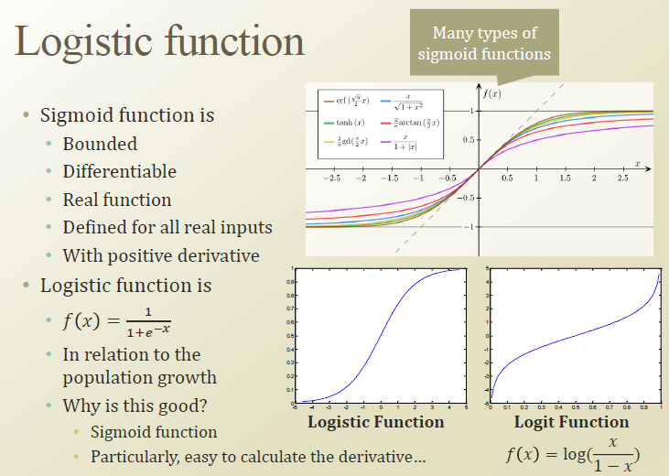

Slide 4
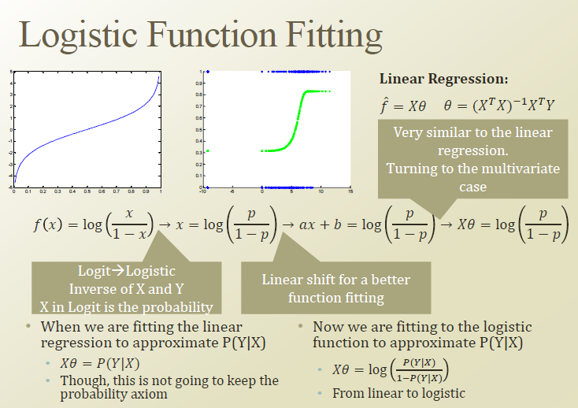



Slide 5
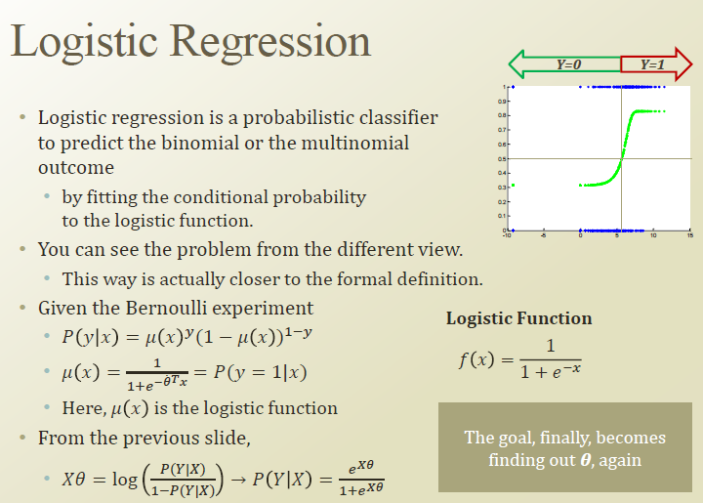

Slide 6
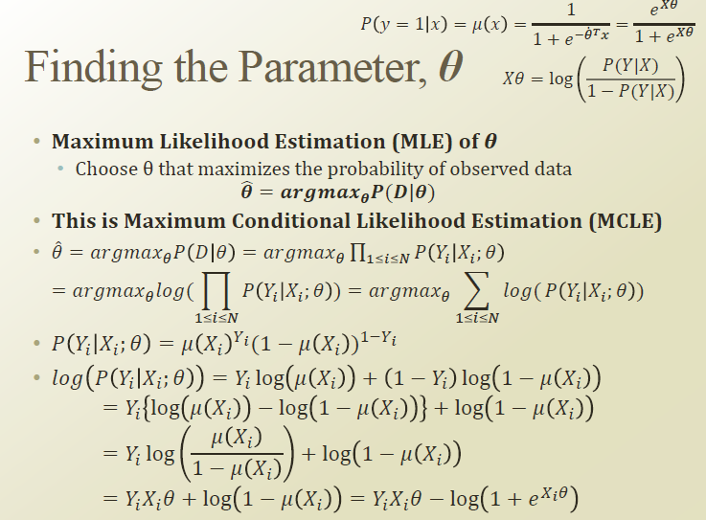

Slide 7
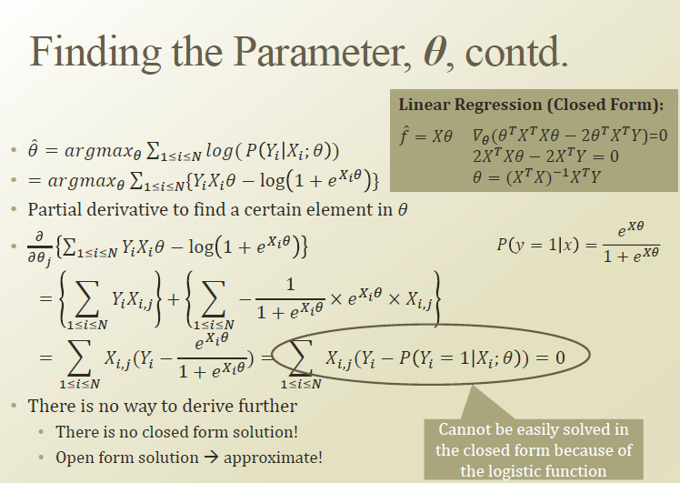

Slide 8
Tackling overfitting via regularization
Overfitting is a common problem in machine learning, where a model performs well on training data but does not generalize well to unseen data (test data).
If a model suffers from overfitting, we also say that the model has a high variance, which can be caused by having too many parameters that lead to a model that is too complex given the underlying data.
our model can also suffer from underfitting (high bias), which means that our model is not complex enough to capture the pattern in the training data well and therefore also suffers from low performance on unseen data.

Slide 9
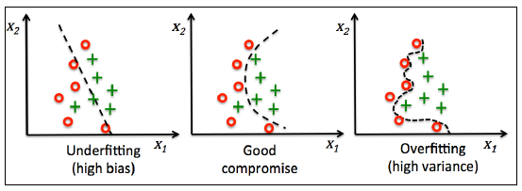

Slide 10



One way of finding a good bias-variance tradeoff is to tune the complexity of the model via regularization
Regularization is a very useful method to handle collinearity (high correlation among features), filter out noise from data, and eventually prevent overfitting

Slide 11
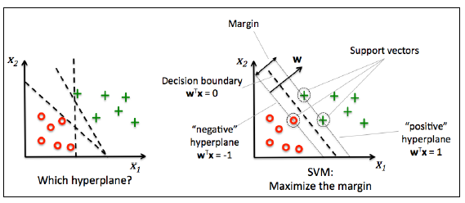
Maximum margin classification with support vector machines
In SVMs, our optimization objective is to maximize the margin. The margin is defined as the distance between the separating hyperplane (decision boundary) and the training samples that are closest to this hyperplane, which are the so-called support vectors

Slide 12
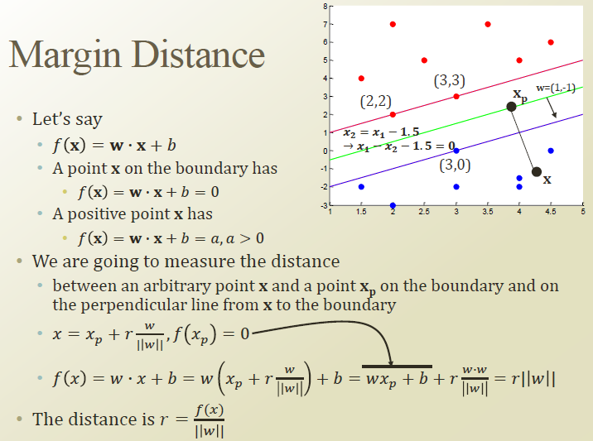

Slide 13
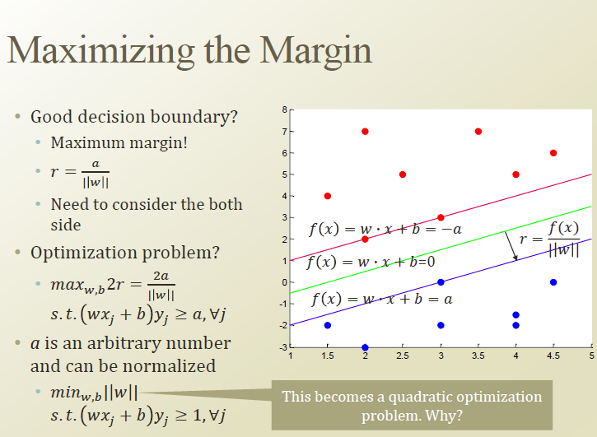

Slide 14

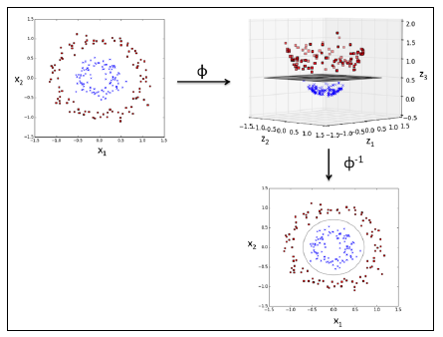
The basic idea behind kernel methods to deal with such linearly inseparable data is to create nonlinear combinations of the original features to project them onto a higher dimensional space via a mapping function () where it becomes linearly separable.

