Slide 1
SCC'24 Practicalities

Slide 2
SCC'24 Schedule
Deadline for second part in application due on 5th of August
Needed for this:
Picture of the team
Short description of the team
Team logo
Remember to fill in your individual information!
Poster due (most likely) a few weeks before the competition
Assigning people responsible for planning and designing this
You should fill up an ESTA application ASAP when we learn about the hotel accommodation

Slide 3
Other practicalities
Social media?
CSC will write a blog post on our site about the team later
Expenses
Hotel accommodation and conference tickets provided by the conference
The vendor sponsor and CSC will provide costs for the plane tickets
Some "daily allowance" for food will be provided, but the exact details are being planned out

Slide 4
The competition cluster

Slide 5

Our cluster provider and contacts
The cluster will be provided by HPE
Nathalie Viollet (Manager at HPE)
Jeremy Foulon (HPC & AI program manager at HPE)
Working with the bid for SCC since 2022
Provider for LUMI
Offices at Grenoble, France
5

Slide 6
Cluster timetable
BOM delivered
Let's look at it together
Regular meetings over Zoom will start in August
HPE will order the system ASAP
Virtual access to the cluster before the competition
HPE will provide us some training
HPE will ship the cluster on-site to Atlanta
6

Slide 7
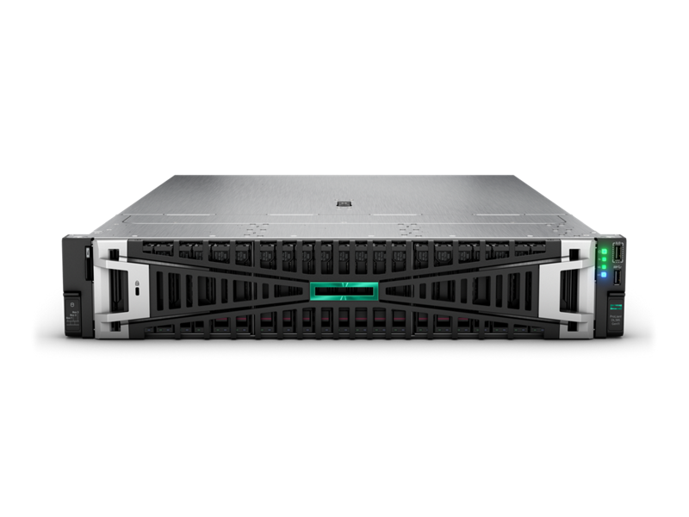
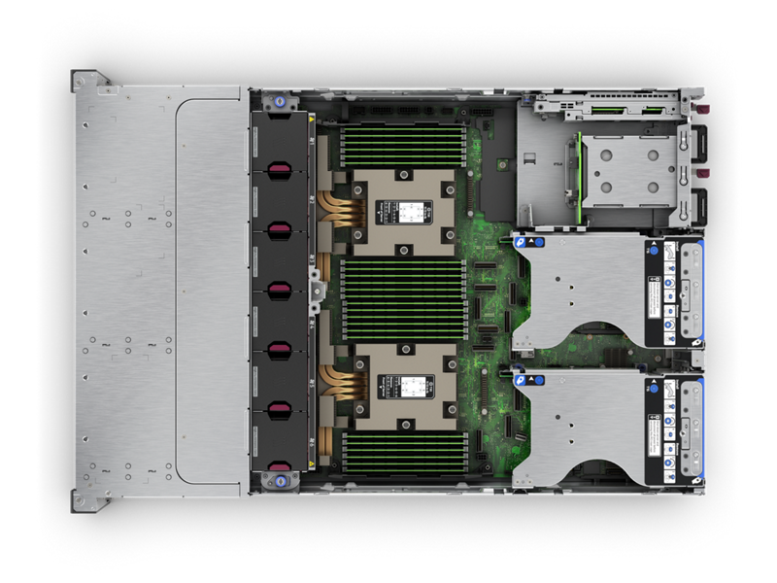
The hardware (currently)
HPE ProLiant DL385 Gen11 server
Three nodes in total
Connected via 200Gb/s Infiniband interconnect
AMD EPYC 9354-processors (2 per node)
32 cores @ 3.25 GHz
TDP: 280W
AMD MI210 GPUs (2 per node)
22,6 TFLOP/s peak performance
TDP: 300W
768GB of RAM per server
6,4 TB NVMe Gen4 disk space per server
7

Slide 8
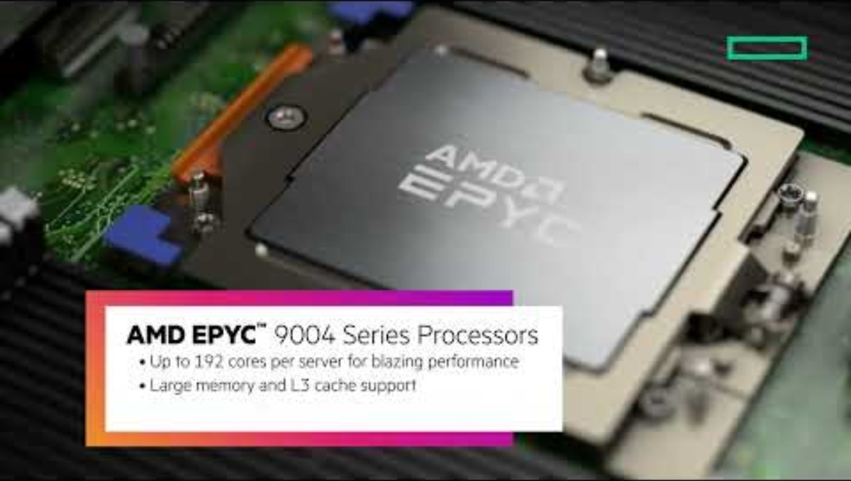
https://www.youtube.com/watch?v=3pwISbpSawA

Slide 9
Our training plan with the hardware
You will get free access to the system when it's assembled
The people interested in the sysadmin tasks in the competition should start working with the system first
We will set up the system to be as ready as possible before the competition
Slurm , software stack, users for everybody,...
Building readymade recipes of HPL, HPCG, etc. for the hardware before the competition
9

