Slide 1
Reporting
BASE - Basic Analysis and Security Engine
Based on the code from the Analysis Console for Intrusion Databases (ACID) project
Provides a web front-end to query and analyze the alerts coming from a SNORT IDS system

Slide 2
BASE
SNORT
Alerts
MySQL
BROWSER
BASE

Slide 3
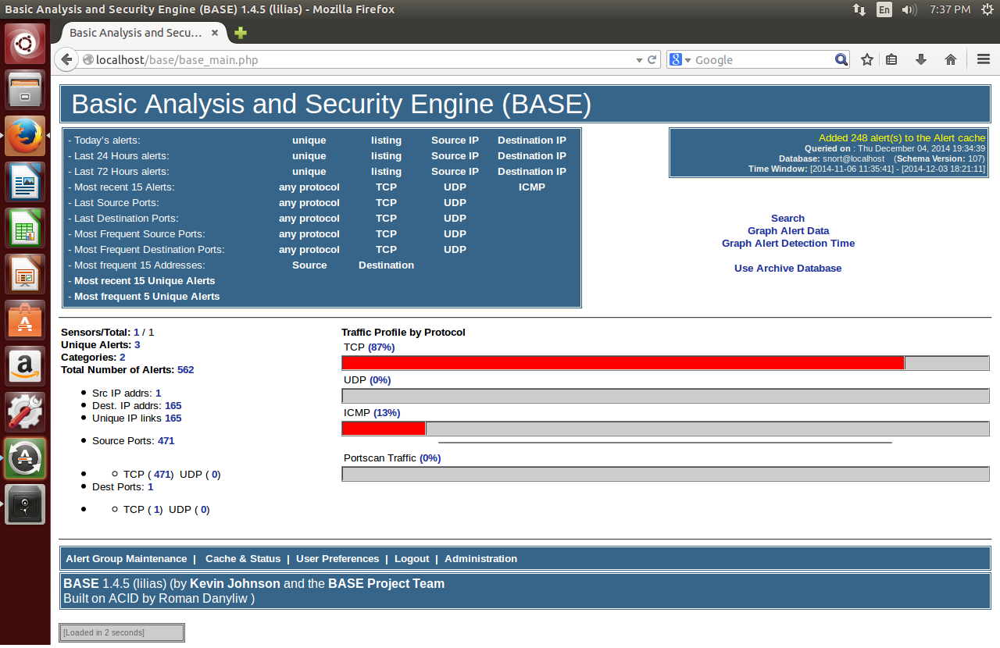

Slide 4
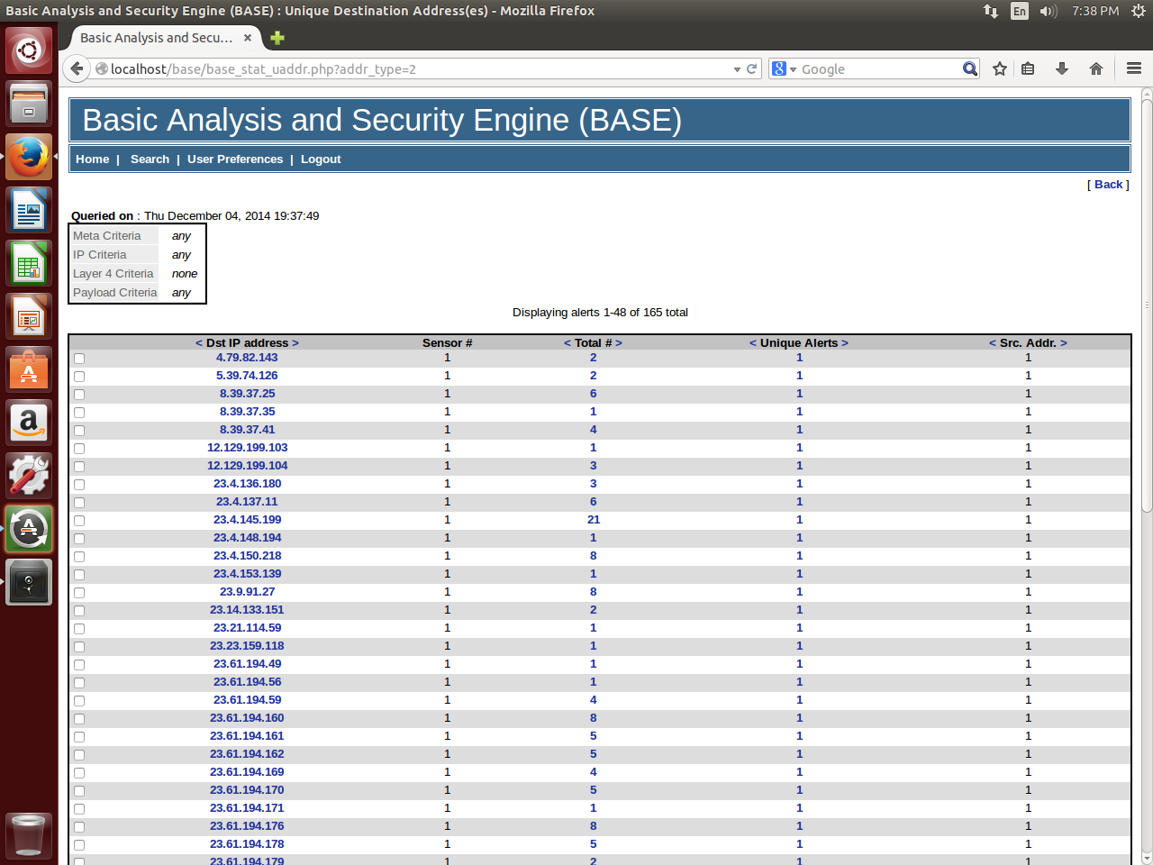

Slide 5
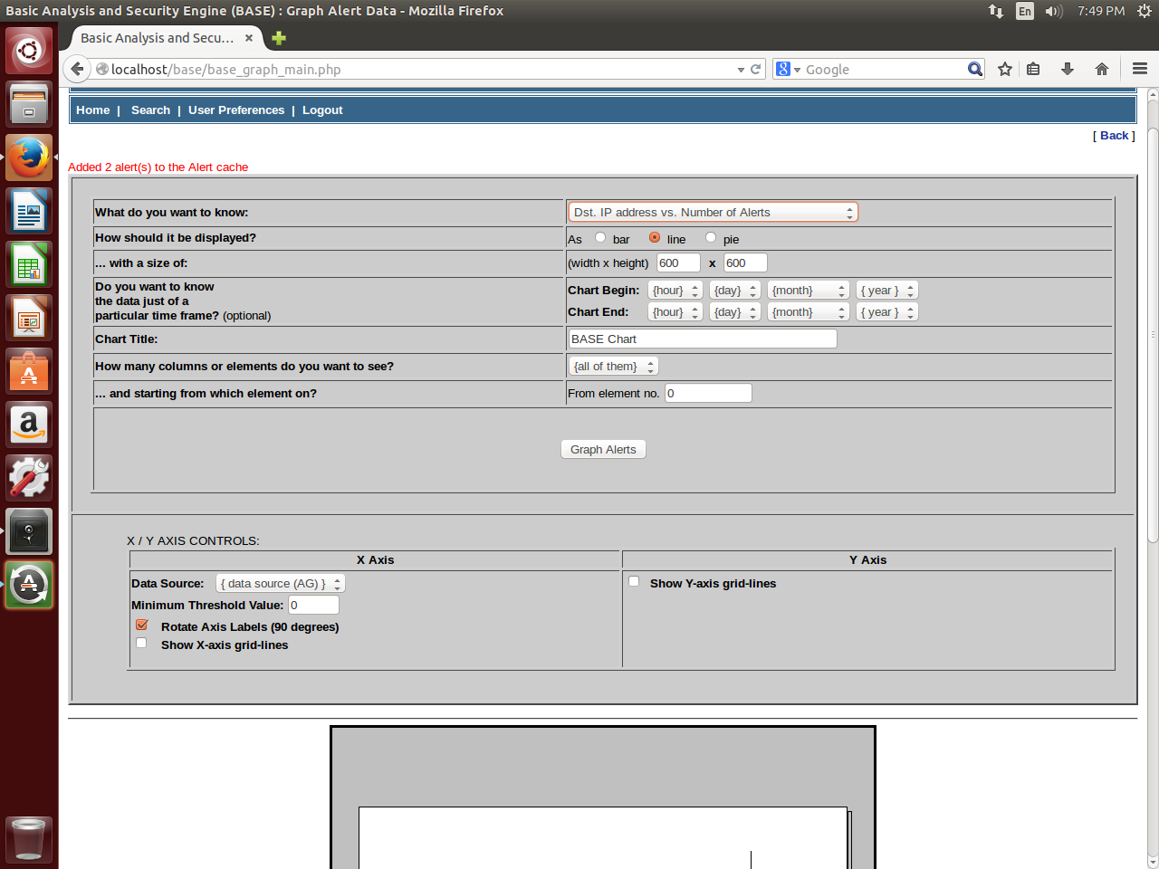

Slide 6
BASE
Simple Web interface
Provides summary information and built-in reports

Slide 7
Improvements/Future Work
Make network traffic reporting more user friendly
Domain Names in addition to/instead of IP
Automate process to maintain whitelist addresses

