Slide 1
Kindsicher
Children's Safe Internet Browsing
Chaitu Achan
Philip Lundrigan
Christian Schreiner

Slide 2
Motivation

Slide 3
Internet use: required
In the past, children's internet use was optional, e.g. games and entertainment

Slide 4
Internet use: required
In the past, children's internet use was optional, e.g. games and entertainment
Children's internet use is increasingly required, e.g. homework, communicating with family members

Slide 5
Internet use: required
In the past, children's internet use was optional, e.g. games and entertainment
Children's internet use is increasingly required, e.g. homework, communicating with family members
Children must use internet unsupervised

Slide 6
Unsupervised Use is Risky
Children encounter content that
They cannot handle
Exploits them

Slide 7
Unsupervised Use is Risky
Children encounter content that
They cannot handle
Exploits them
Parents cannot always be present to warn, intervene or instruct.

Slide 8
Previous work
Focus: identify “bad” content and deny it

Slide 9
Previous work
Focus: identify “bad” content and deny it
Means:
List bad sites
Automatically classify content
Humans classify content

Slide 10
Previous work
Focus: identify “bad” content and deny it
Means:
List bad sites
Automatically classify content
Humans classify content
This is beyond the abilities of most families.

Slide 11
Commercial Services
Classify content (often with some human aid)
e.g. OpenDNS
e.g. Dan's Guardian

Slide 12
Commercial Services
Classify content (often with some human aid)
e.g. OpenDNS
e.g. Dan's Guardian
Overwhelmed with today's large volumes of content

Slide 13
Commercial Services
Classify content (often with some human aid)
e.g. OpenDNS
e.g. Dan's Guardian
Overwhelmed with today's large volumes of content
Black Hats continually invent new means to circumvent

Slide 14
Commercial Services
Classify content (often with some human aid)
e.g. OpenDNS
e.g. Dan's Guardian
Overwhelmed with today's large volumes of content
Black Hats continually invent new means to circumvent
“Outsourcing” classification prevents family-specific policies
e.g. Phobias
e.g. Parental instruction needed

Slide 15
Commercial Services
Common justifications for misclassification

Slide 16
Commercial Services
Common justifications for misclassification
False denial: acceptable because children's internet use is optional.

Slide 17
Commercial Services
Common justifications for misclassification
False denial: acceptable because children's internet use is optional.
False allow: acceptable because children should always be supervised

Slide 18
Commercial Services
Common justifications for misclassification
False denial: acceptable because children's internet use is optional.
False allow: acceptable because children should always be supervised
Both assumptions are wrong.

Slide 19
Helplessness feeds denial... or paranoia
“Filtering content would be unethical”

Slide 20
Helplessness feeds denial... or paranoia
“Filtering content would be unethical”
“I've raised my children to be able to handle everything”

Slide 21
Helplessness feeds denial... or paranoia
“Filtering content would be unethical”
“I've raised my children to be able to handle everything”
“It is a risk we have to run these days.”

Slide 22
Helplessness feeds denial... or paranoia
“Filtering content would be unethical”
“I've raised my children to be able to handle everything”
“It is a risk we have to run these days.”
“It won't happen to us.”

Slide 23
Helplessness feeds denial... or paranoia
“Filtering content would be unethical”
“I've raised my children to be able to handle everything”
“It is a risk we have to run these days.”
“It won't happen to us.”
Or
“I just don't let my children use a computer at all unless I'm standing over their shoulder.”

Slide 24
Helplessness feeds denial... or paranoia
“Filtering content would be unethical”
“I've raised my children to be able to handle everything”
“It is a risk we have to run these days.”
“It won't happen to us.”
Or
“I just don't let my children use a computer at all unless I'm standing over their shoulder.”
“The Internet is just full of evil things. We don't even have a computer.”

Slide 25
An opposite approach
Parents define the sites children may visit without supervision.

Slide 26
An opposite approach
Parents define the sites children may visit without supervision.
Other internet activity must wait for parental intervention.

Slide 27
Example
Parents of young children might decide their children may do these things on their own:

Slide 28
Example
Parents of young children might decide their children may do these things on their own:
Visit the school website (for homework)

Slide 29
Example
Parents of young children might decide their children may do these things on their own:
Visit the school website (for homework)
Visit Grandpa's blog in India

Slide 30
Example
Parents of young children might decide their children may do these things on their own:
Visit the school website (for homework)
Visit Grandpa's blog in India
Visit a few trusted game sites

Slide 31
Example
Parents of young children might decide their children may do these things on their own:
Visit the school website (for homework)
Visit Grandpa's blog in India
Visit a few trusted game sites
Visit Weather Underground

Slide 32
Example
Parents of young children might decide their children may do these things on their own:
Visit the school website (for homework)
Visit Grandpa's blog in India
Visit a few trusted game sites
Visit Weather Underground
Visit sites related to our faith

Slide 33
Example
Parents of young children might decide their children may do these things on their own:
Visit the school website (for homework)
Visit Grandpa's blog in India
Visit a few trusted game sites
Visit Weather Underground
Visit sites related to our faith
Visit city Park and Recreation's website

Slide 34
Example
Parents of young children might decide their children may do these things on their own:
Visit the school website (for homework)
Visit Grandpa's blog in India
Visit a few trusted game sites
Visit Weather Underground
Visit sites related to our faith
Visit city Park and Recreation's website
Visit National Geographic's website

Slide 35
Example
Parents of young children might decide their children may do these things on their own:
Visit the school website (for homework)
Visit Grandpa's blog in India
Visit a few trusted game sites
Visit Weather Underground
Visit sites related to our faith
Visit city Park and Recreation's website
Visit National Geographic's website
Go get a parent to do other things.

Slide 36
Design
Overview

Slide 37
Network Topology
Internet
modem

Slide 38
Network Topology
Internet
modem
Ethernet hub

Slide 39
Network Topology
Internet
modem
Ethernet hub
Kindsicher
server

Slide 40
Network Topology
Internet
modem
Ethernet hub
Ethernet switch
Kindsicher
server
PC
#1
PC
#2
Tablet
#1
Etc...

Slide 41
Threat Model
External:
“Black Hat” site tries to mix its content with legitimate content
  No advantage unless they mix it with an explicitly permitted site

Slide 42
Threat Model
External:
“Black Hat” site tries to mix its content with legitimate content
  No advantage unless they mix it with an explicitly permitted site
Weblink uses internet address, not domain name (e.g. http://155.98.65.24)
  No advantage unless parents approved the address

Slide 43
Threat Model
Internal:
Child enters an internet address into web browser (e.g. http://155.97.137.55)
  No advantage unless parents approved the address

Slide 44
Threat Model
Internal:
Child enters an internet address into web browser (e.g. http://155.97.137.55)
  No advantage unless parents approved the address
Problem teenager rearranges network wiring
  May require parents putting Kindsicher server, ethernet hub and modem in a locked cabinet

Slide 45
Threat Model
Internal:
Child enters an internet address into web browser (e.g. http://155.97.137.55)
  No advantage unless parents approved the address
Problem teenager rearranges network wiring
  May require parents putting Kindsicher server, ethernet hub and modem in a locked cabinet
Friend brings laptop or tablet to home
  No advantage, Kindsicher is implemented as part of network infrastructure, no “client” component needed

Slide 46
Threat Model
Internal:
Child goes to friend's house or library
  Physical absence creates other telltales
  No tool can substitute for parenting.
  Parents' Overall Goal:
  Create an environment where children can develop good Internet security and privacy skills with limited risk.

Slide 47
Technical
Implementation

Slide 48
Blocking

Slide 49

Snort
Intrusion detection system (IDS)
Rule based
Rules can alert, log, pass, drop, or reject

Slide 50
TCP Reset
Man in the middle
Send TCP RST packet to each end of connection
Connection is stopped

Slide 51
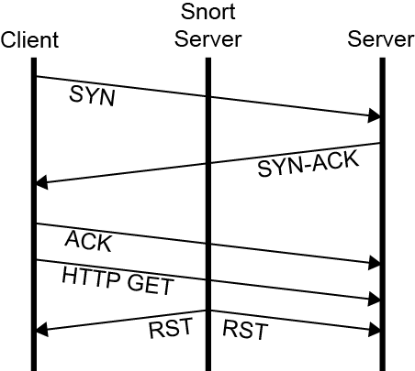
TCP Reset

Slide 52
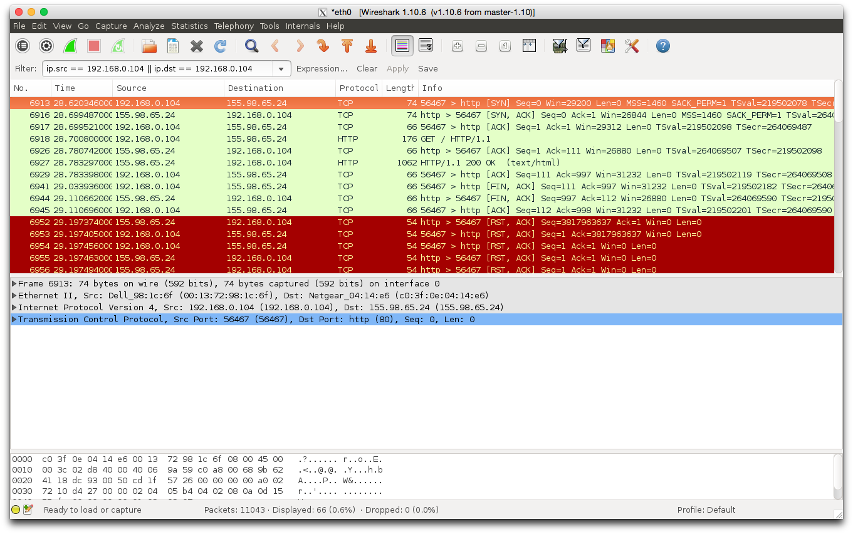
Problems with Snort: Slow
Snort is sometimes too slow!

Slide 53
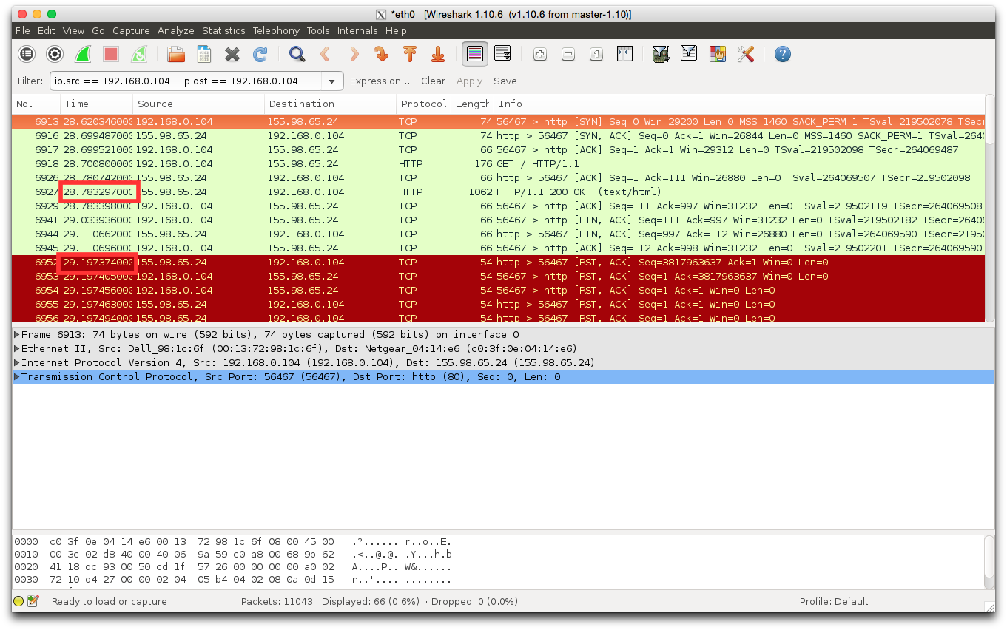

Slide 54
Problems with Snort: Slow
Snort is sometimes too slow!
This is a fundamental issue with not using Snort inline.
Remove extra functionality of Snort
Website size and latency might be factors
More testing needed...

Slide 55
Snort
Tested in three environments:
Laptop
Home network
Emulab network

Slide 56
Demo

Slide 57
Whitelist
Whitelist creation
Created a script that reads host from HTTP GET request
Host name → IP address

Slide 58
Problems with Snort: Only IP Addresses
Snort wants IP addresses, but IP addresses are not human friendly
Create a mapping of host name to IP address

Slide 59
Reporting
BASE - Basic Analysis and Security Engine
Based on the code from the Analysis Console for Intrusion Databases (ACID) project
Provides a web front-end to query and analyze the alerts coming from a SNORT IDS system

Slide 60
BASE
SNORT
Alerts
MySQL
BROWSER
BASE

Slide 61
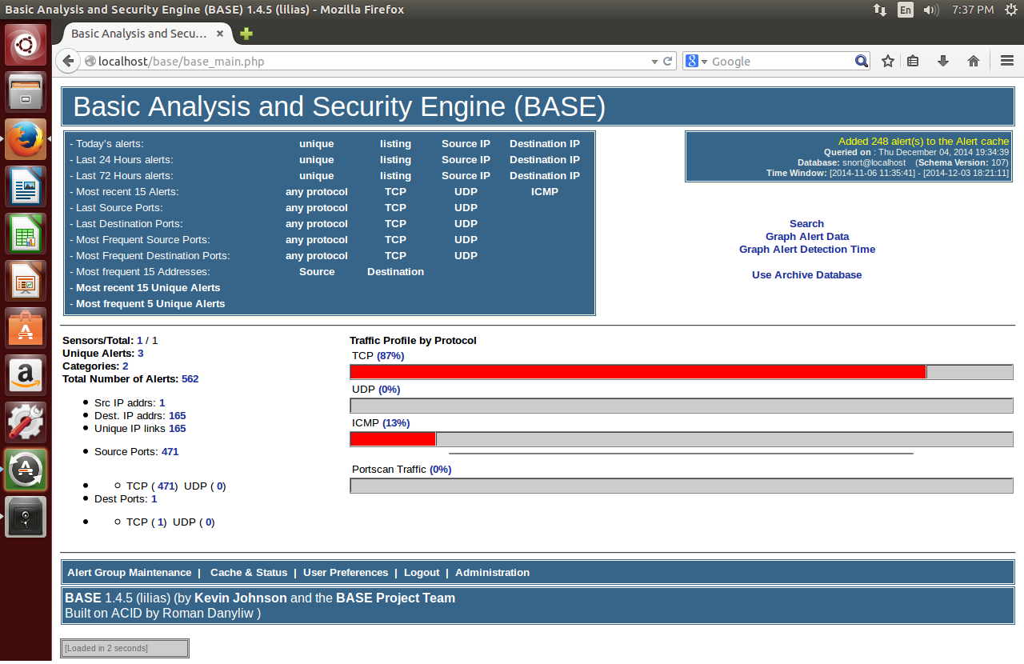

Slide 62
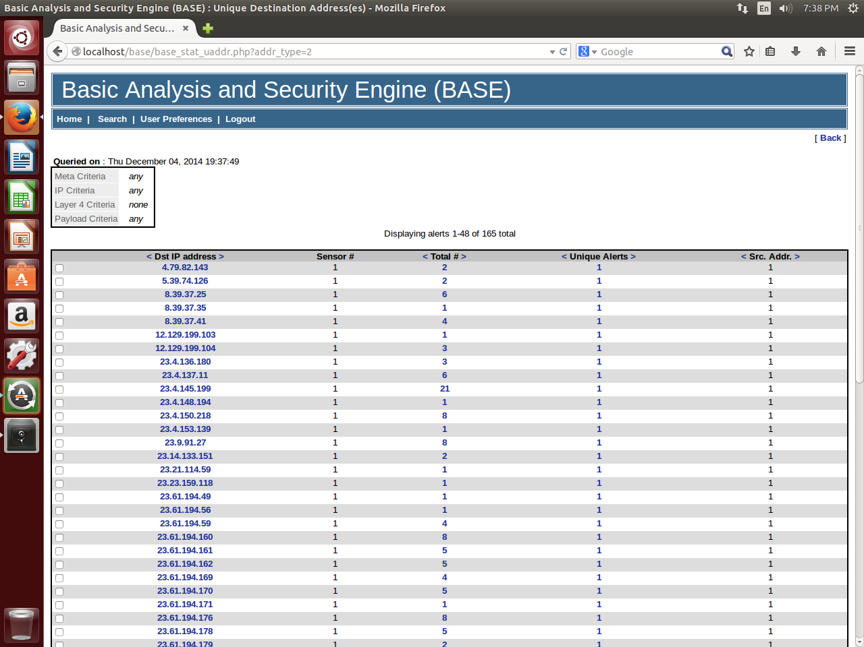

Slide 63
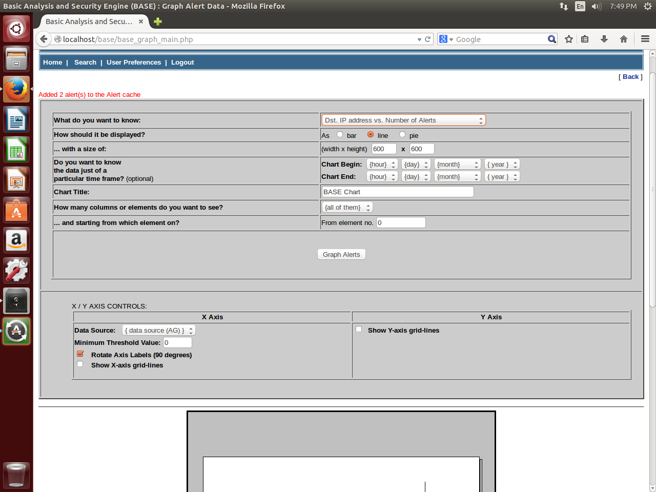

Slide 64
BASE
Simple Web interface
Provides summary information and built-in reports

Slide 65
Improvements/Future Work
Make network traffic reporting more user friendly
Domain Names in addition to/instead of IP
Automate process to maintain whitelist addresses

Slide 66
Thank You

Slide 67
title

