Slide 1

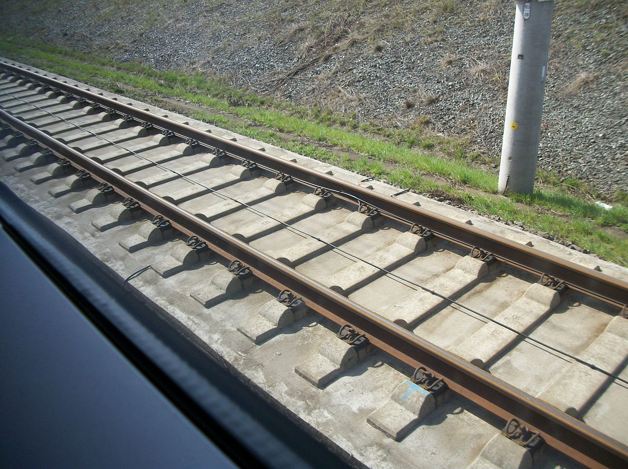
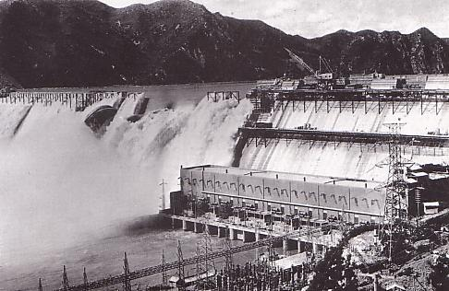

Poisoned by the Compiler: Optimizations Gone Wrong
Some optimizations don't hold for all data values. How to insure correctness without sacrificing execution speed?
Classic Example:
int compute_tax( int income )
{
tax= income* FEDERAL_RATE/ 100 +
income* STATE_RATE/ 100;
return tax;
}
Research Track: create a tool that detects undefined
overflows, traces their effects, and halts when
affected data is output. This has shown that some
optimizations thought correct are subtly flawed.
Compiles into:
int compute_tax( int income )
{
// One division fewer! One multiplication fewer!
tax= income* (FEDERAL_RATE+ STATE_RATE)/ 100;
return tax;
}
Research Track: create a formal, mathematical
definition of overflow that can be used to verify
compiler optimizations.
Thought: What happens when the business grows
enough that the variable “income” exceeds 500 million?
(Assume a 32-bit integer length. The sum of the two tax rates is at least 10.)
Hint: (i.e. catastrophic overflow)
Research Track: Compare proposed poison
definitions with the intuitive expectations of the
LLVM compiler community, and justify discrepancies.
Research Track: make sure that as many existing
optimizations as possible are still possible. Verify
speed and accuracy differences on end-user
applications.
!
The LLVM compiler family designates this sort of undefined behavior as “poison”. It is an error to output a poisoned value, or a value derived from a poisoned value.
Acknowledgments
The LLVM Developer Mailing List, including entries by David Majnemer, Sanjoy Das, Nuno Lopes, Chandler Carruth, John Regehr, and many others.
Poison symbol is the EU standard toxic symbol, defined in Directive 67/548/EEC.
"Sui-ho Dam under construction" by Unknown - Japanese book "Showa History: History of Japanese colony" published by Mainichi Newspapers Company.. Licensed under Public Domain via Wikimedia Commons - http://commons.wikimedia.org/wiki/File:Sui-ho_Dam_under_construction.JPG#mediaviewer/File:Sui-ho_Dam_under_construction.JPG
"ICE TrainTrack" by Photnart - Own work. Licensed under CC0 via Wikimedia Commons http://commons.wikimedia.org/wiki/File:ICE_TrainTrack.JPG#mediaviewer/File:ICE_TrainTrack.JPG
Copyright © 2015 University of Utah.
`int foo= 27 << 512` creates a poison value.

