Slide 1
Homework 0
String processing

Slide 2
Overview
Warm-up mini program (10%)
Due date 10/7 23:59
if you can’t submit it on time, your score will *0.75 for one day.
In this mini program, you will write a program (C or C++) with three commands:
Reverse the string that you type.
Split the string with specific character.
Terminate itself by the command.
There should be only one source file named main.c.
You have to submit your code to new e3 system, compress your code with zip file, and renamed as your student ID (e.g. 0256521.zip). https://e3new.nctu.edu.tw/
If you have any questions, please email TAs.

Slide 3
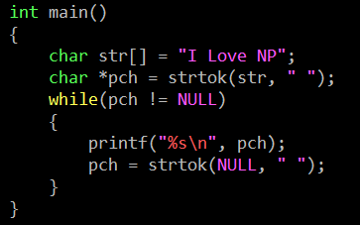
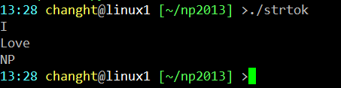
String - strtok
char * strtok ( char * str, const char * delimiters );
CODE
OUTPUT

Slide 4
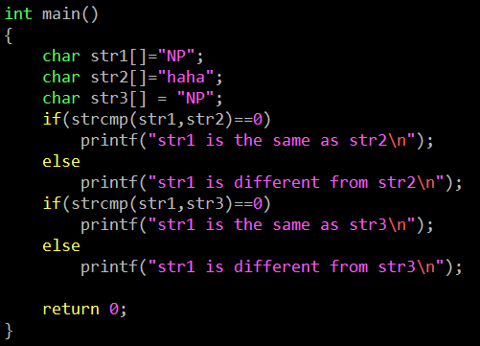

String - strcmp
int strcmp ( const char * str1, const char * str2 );
CODE
OUTPUT

Slide 5
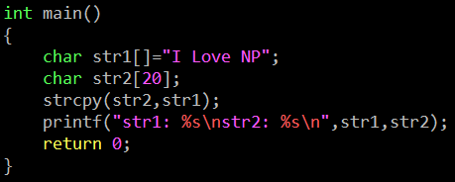

String - strcpy
char * strcpy ( char * destination, const char * source );
CODE
OUTPUT

Slide 6
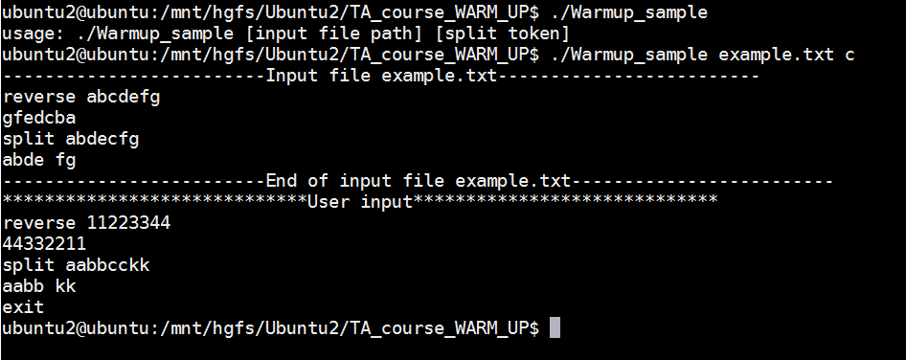
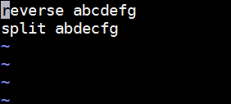
DEMO
c text file

Slide 7
Q & A

