Slide 1
Causality with entropy

Slide 2

Contents
Granger Causality shortcomings
Entropy
Shannon entropy
Conditional entropy
Mutual information
Transfer entropy
Nonlinear information flows
Contents
Contents
Contents
‹#›

Slide 3
Granger Causality
VAR (Vector Auto Regression)
X GC Y if any coefficients to lags of X is non-zero (typically with F-test)
However,
GC has low detection power
When Model complexity given finite sample size
For causal links if too many variables are used
If strong autocorrelation among variables
See Runge et. al. (2019)
Runge, J., Nowack, P., Kretschmer, M., Flaxman, S. & Sejdinovic, D. Detecting and quantifying causal associations in large nonlinear time series datasets. Sci. Adv. 5, eaau4996 (2019).

Slide 4

Entropy
See web

Slide 5
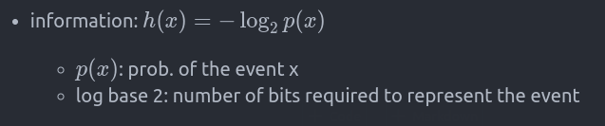
Entropy
See web

Slide 6
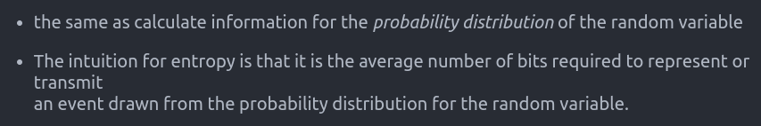
Entropy
See web

Slide 7
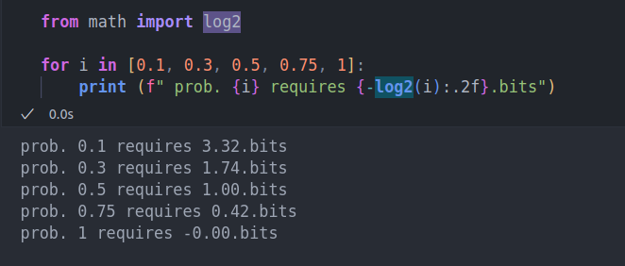
Entropy
See web

Slide 8
Entropy
Used in numerous fields including information theory
If rare events happen, it is more informative to learn than more likely events
Low Prob = surprising = more uncertain = High information
See web

Slide 9
Entropy
Used in numerous fields including information theory
Average amount of information produced by a stationary source of data
amount of disorder in a system in physics Or
the quantity of energy incapable of physical movements
The entropy of a random variable measures uncertainty in probability theory
In sociology, entropy is the natural decay of structures
See web

Slide 10
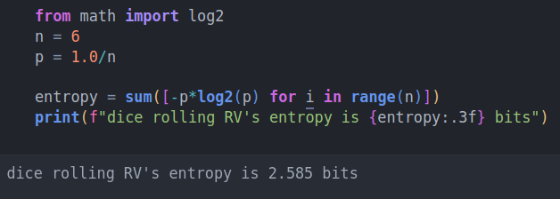
Entropy
See web

Slide 11
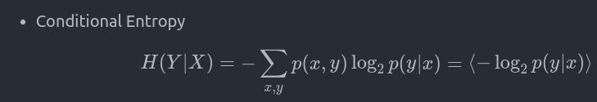
Entropy: Conditional Entropy

Slide 12
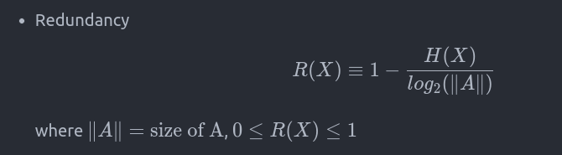
Entropy: Redundancy

Slide 13
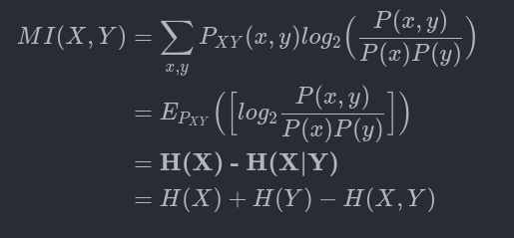
Entropy: Mutual information

Slide 14
Entropy: Mutual information
MI is a measure of two random variables' relation regardless of linearity
Covariance is a weighted sum of the product of two random variables

Slide 15
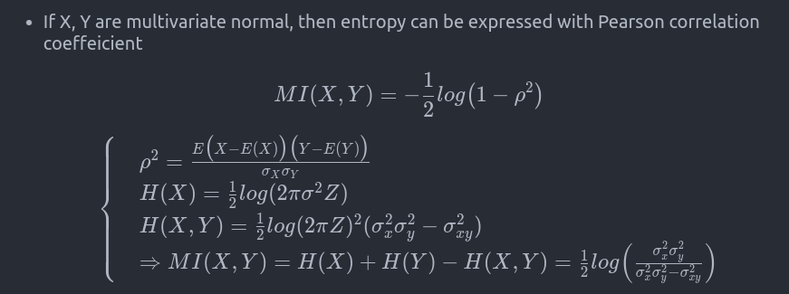
Entropy: Mutual information: Normal case

Slide 16
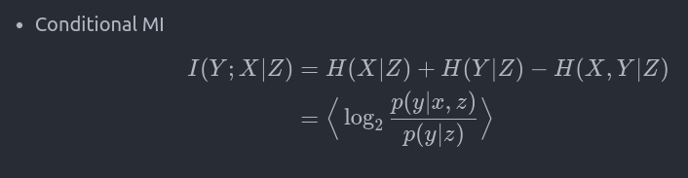
Entropy: Conditional MI

Slide 17
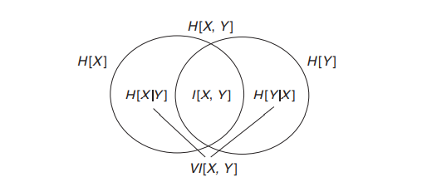
Entropy with diagram

Slide 18
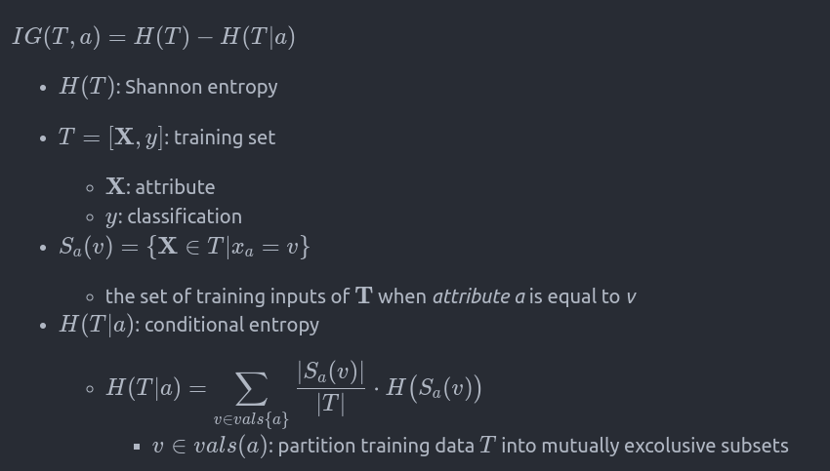
Entropy: Information gain

Slide 19
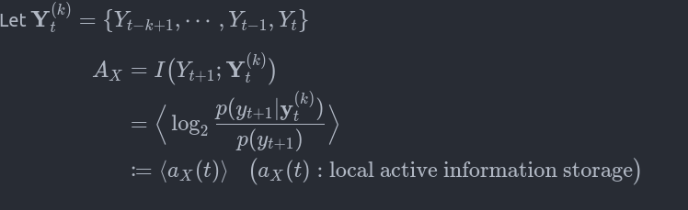
Entropy: Active information gain
Average information from past state used in predicting the next value

Slide 20
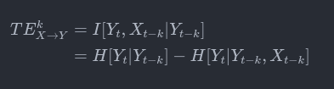
Entropy: Transfer Entropy

Slide 21
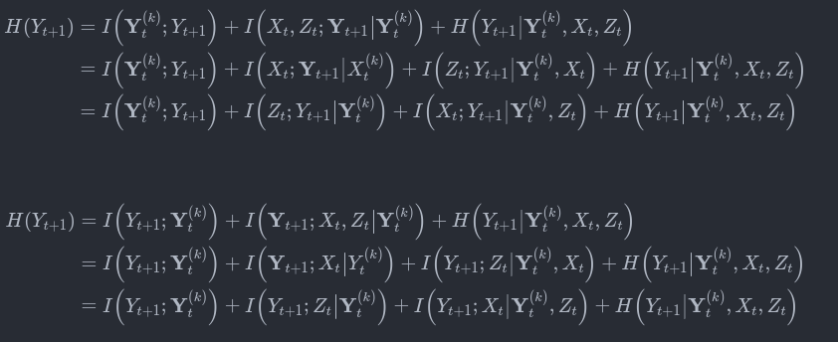
Entropy: information regression model
Modeling the information process in a random variable
Assume two sources: (X ->Y, Z->Y)

Slide 22
Entropy: information regression model
Kim et. al., (2020, IEEE)
Wismuller et. al.,(2021, Nature)

Slide 23
Empirics: Transfer Entropy
Using IDTxL
Information Dynamics Toolkit xl (IDTxl)

Slide 24
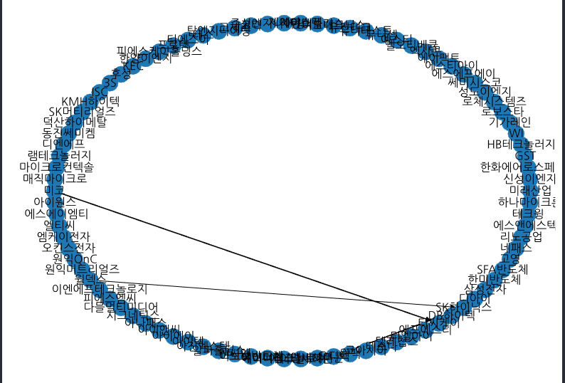
Empirics: Transfer Entropy (반도체)

Slide 25
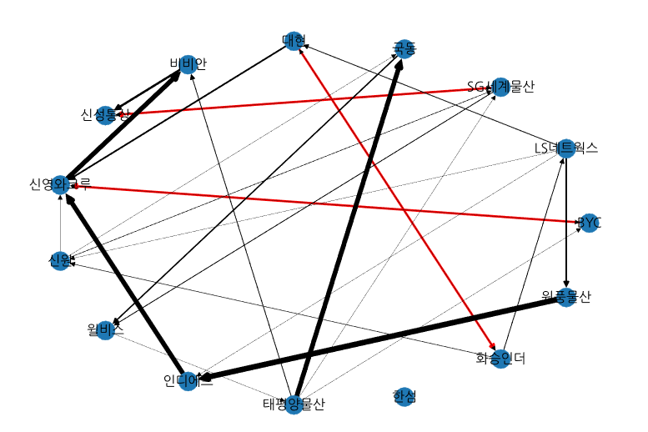
Empirics: Transfer Entropy (의류산업)

Slide 26
Graph applications
Financial Services
Detecting fraud (suspicious transaction)
Connected components
Context based importance person
Interactive communities
Similar transaction habits
E-commerce
Recommendations
Customer segmentation / marketing
Node feature transferring

Slide 27
Graph applications
Drug discovery
interference/interaction/potentiation
SNS
Cybersecurity
Traffic prediction

