Slide 1
Graph Math review

Slide 2

Contents
Granger Causality shortcomings
Entropy
Shannon entropy
Conditional entropy
Mutual information
Transfer entropy
Nonlinear information flows
Contents
Contents
Contents
graph/network
‹#›
‹#›

Slide 3
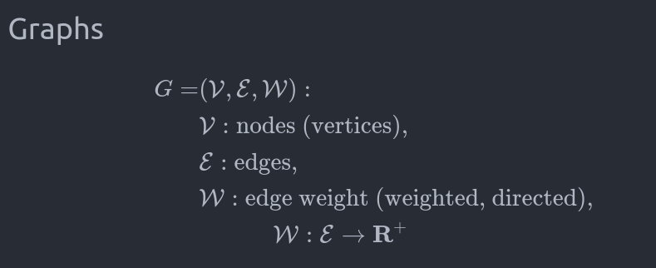
Graph
Neo4j
‹#›

Slide 4
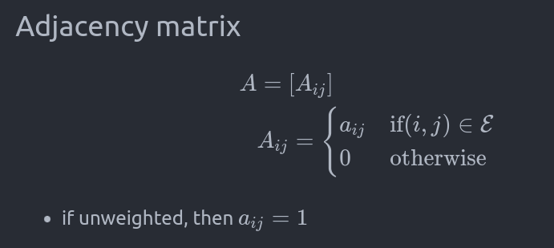
Adjacency matrix
Neo4j
See web
‹#›

Slide 5
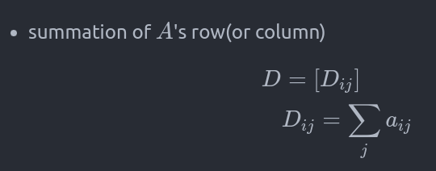
Degree
Neo4j
See web
‹#›

Slide 6
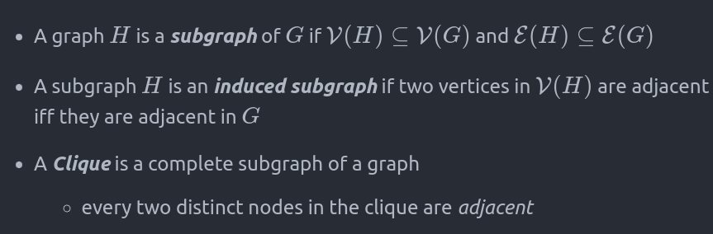
Terminology
Neo4j
See web
‹#›

Slide 7
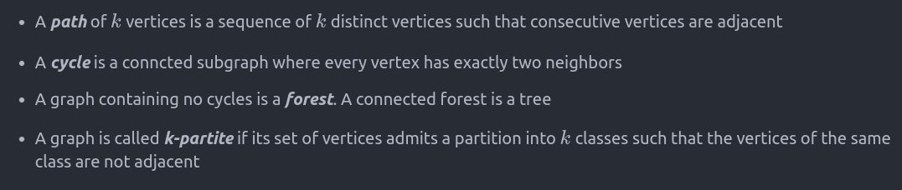
Terminology
Neo4j
See web
‹#›

Slide 8
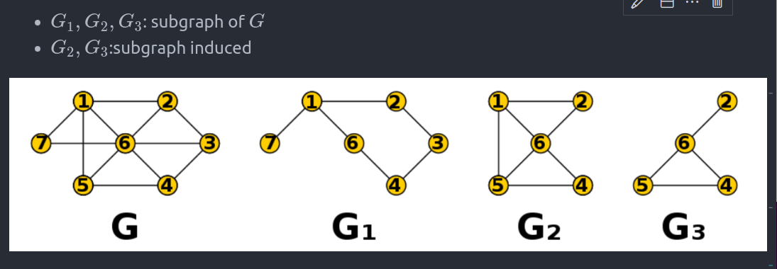
Subgraph
graph/network
From wiki
‹#›

Slide 9
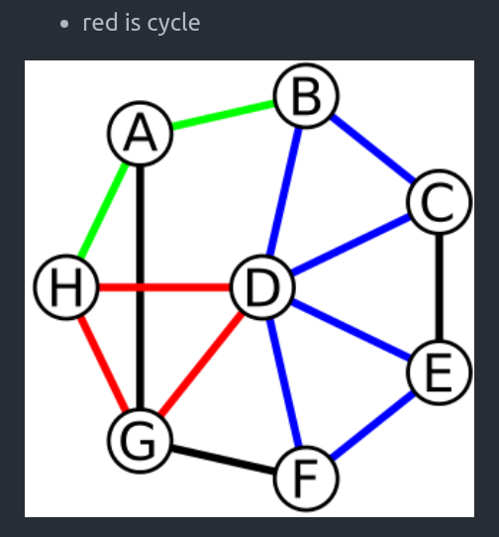
cycle
Neo4j
See web
‹#›

Slide 10
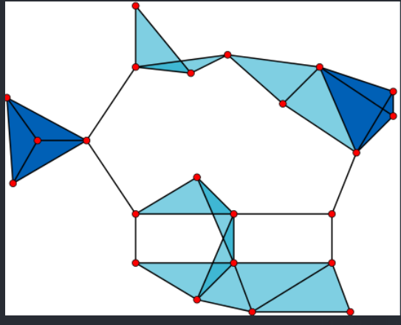
clique
Neo4j
‹#›

Slide 11
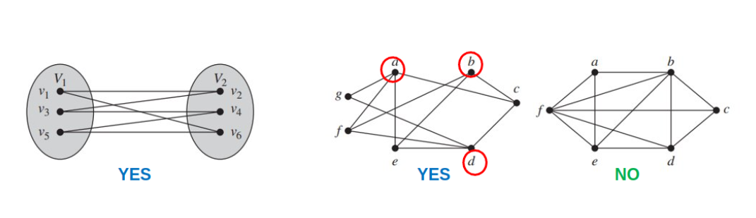
bipartite
Neo4j
From Rosen
‹#›

Slide 12
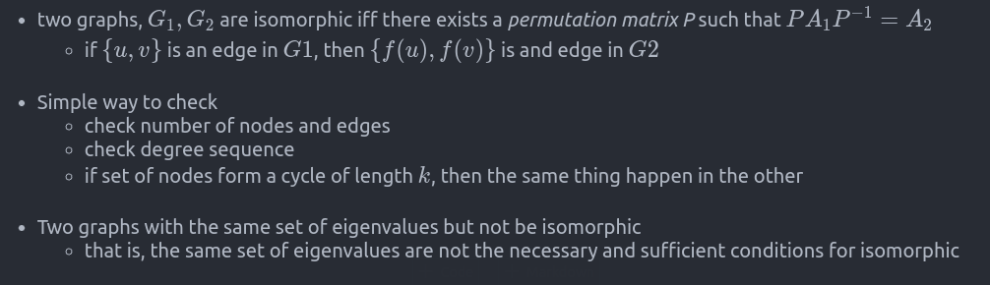
Isomorphic invariants
Neo4j
‹#›

Slide 13
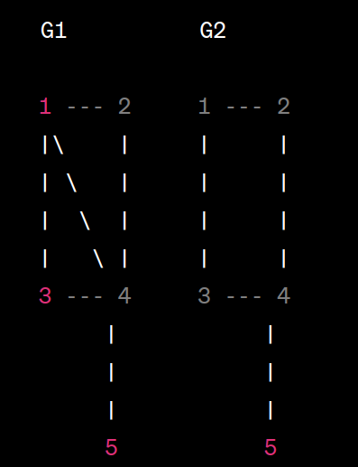
Eigenvalues are (2,2,1, -1, -1)

Slide 14
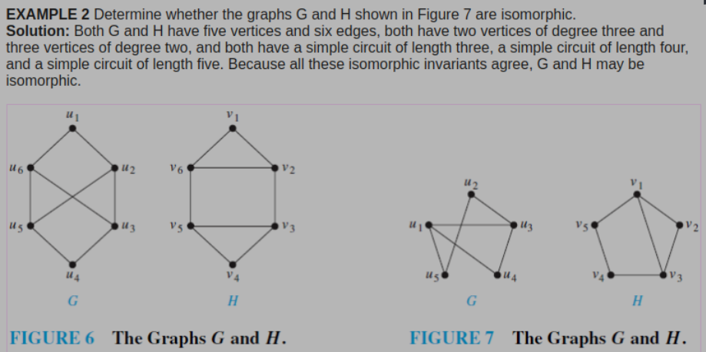
Isomorphic invariants
Neo4j
See web
‹#›

Slide 15
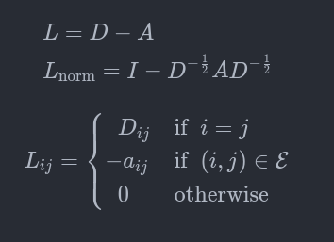
Laplacian
Neo4j
‹#›

Slide 16
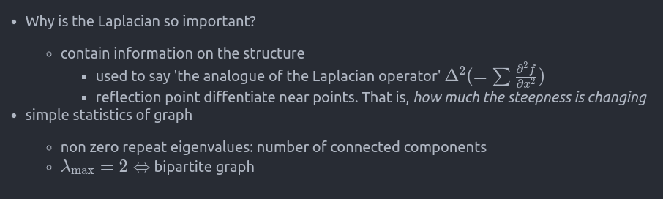
Laplacian
Neo4j
‹#›

Slide 17
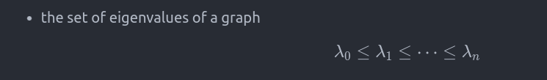
Spectrum
Neo4j
‹#›

Slide 18
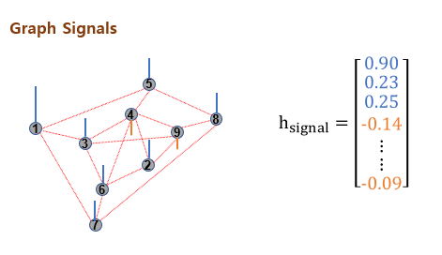
Graph signals
graph/network
‹#›

Slide 19
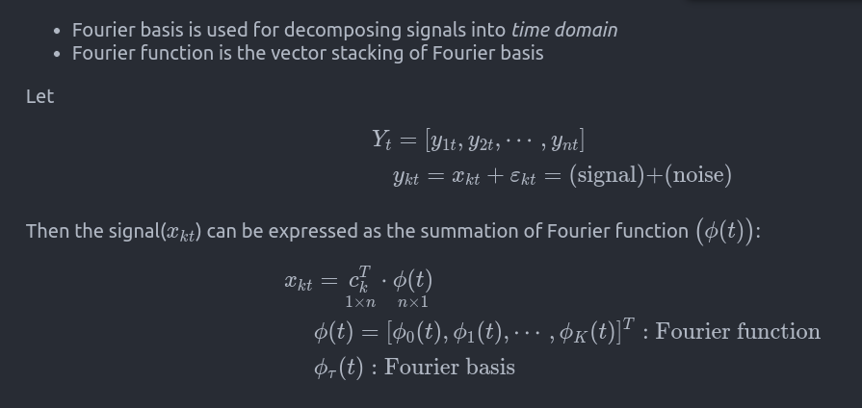
Fourier basis
graph/network
‹#›

Slide 20
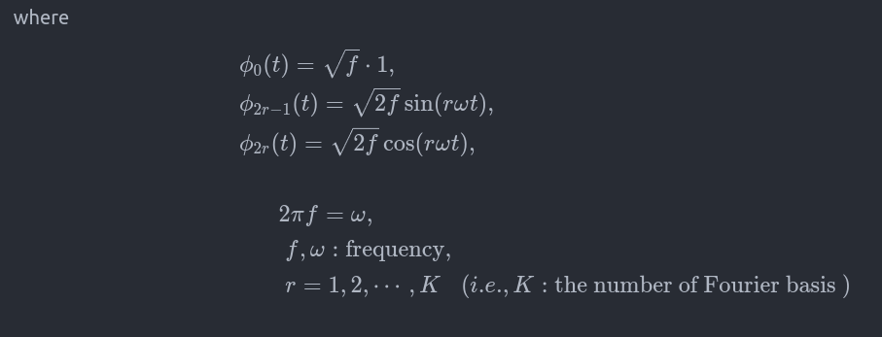
Fourier basis
graph/network
‹#›

Slide 21
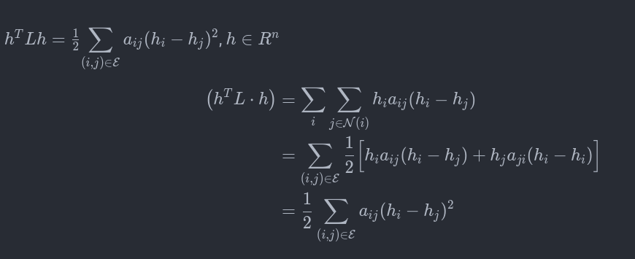
Local variations: Laplacian quadratic form
graph/network
‹#›

Slide 22
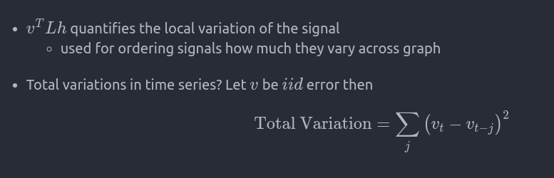
Local variations: Laplacian quadratic form
graph/network
‹#›

Slide 23
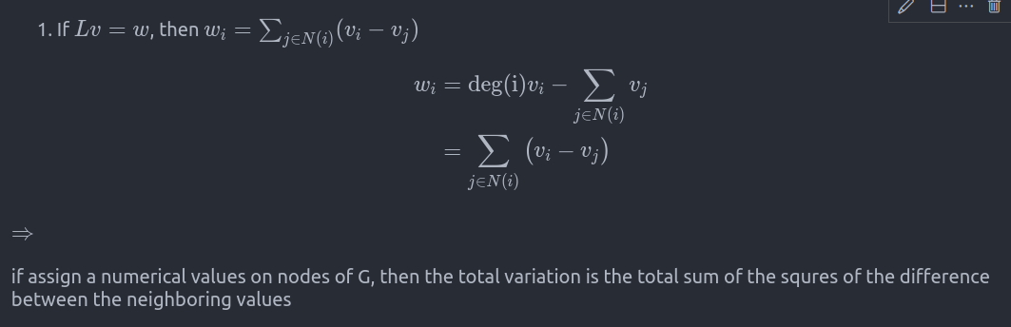
Local variations: Laplacian quadratic form
graph/network
‹#›

Slide 24
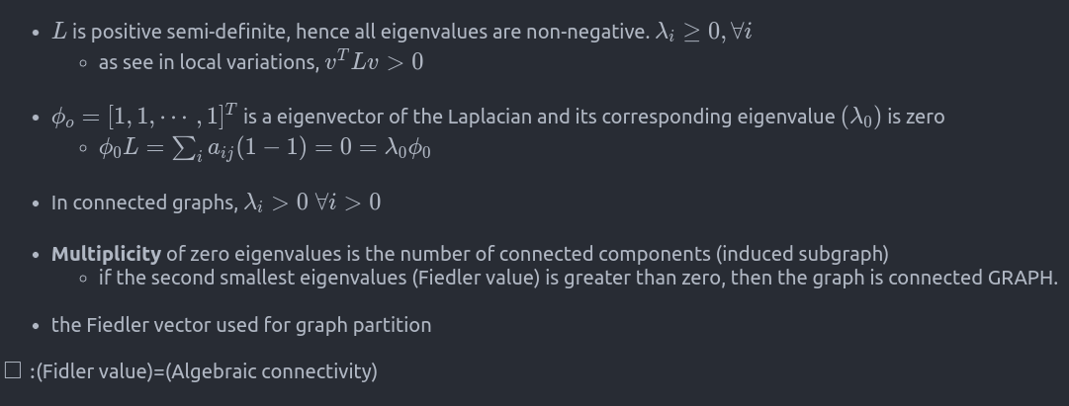
Laplacian: Evalues, EVectors
graph/network
‹#›

Slide 25
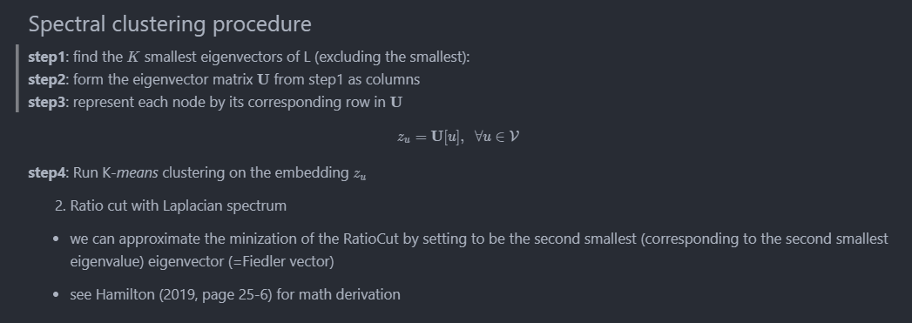
graph/network
‹#›

Slide 26
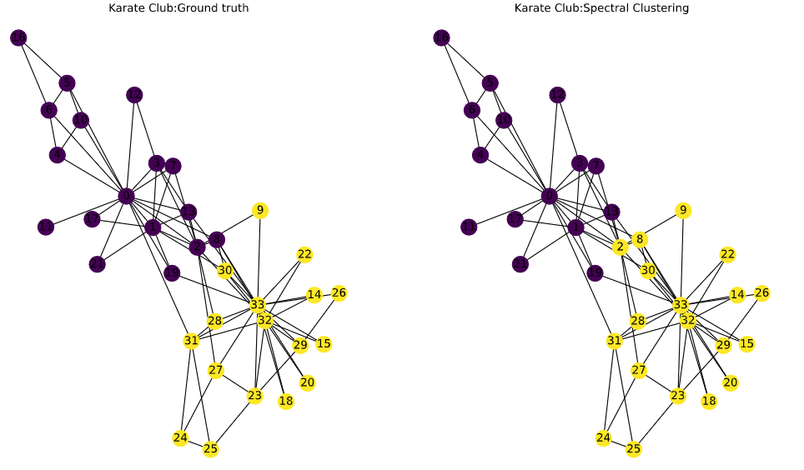
Spectral clustering
graph/network
‹#›

Slide 27
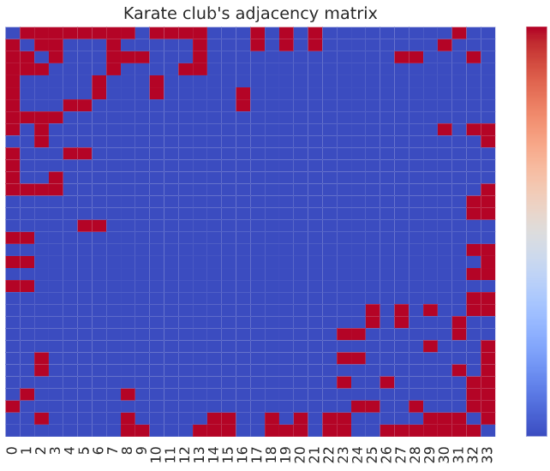
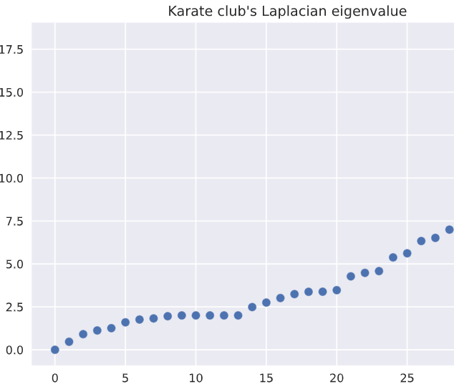
Spectral clustering
graph/network
‹#›

Slide 28
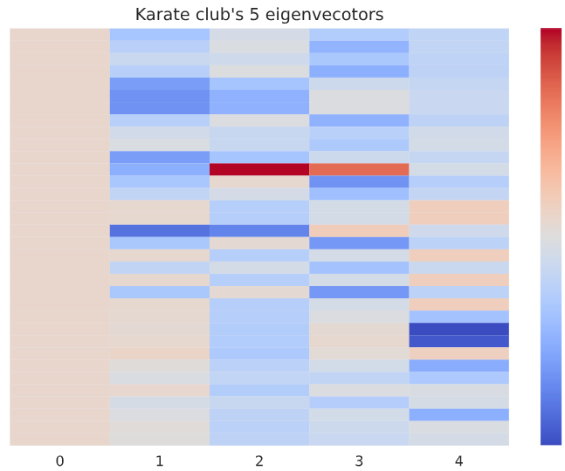
Spectral clustering
constant
graph/network
‹#›

Slide 29
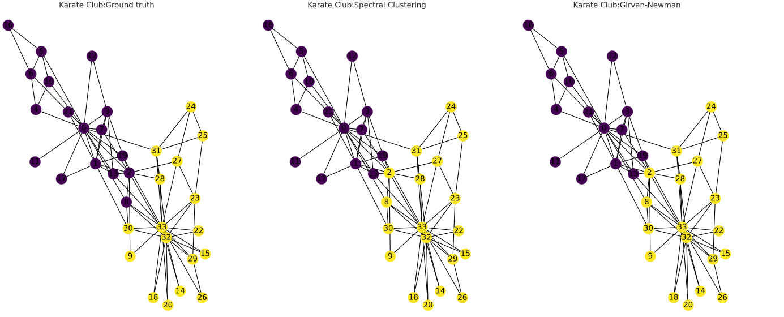
Comparison: community detection
graph/network
‹#›

Slide 30
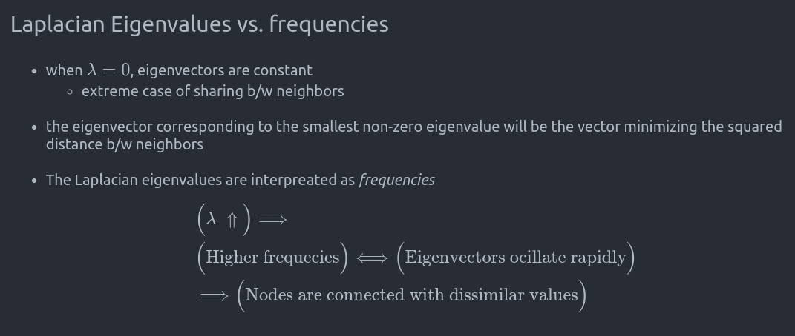
graph/network
‹#›

Slide 31
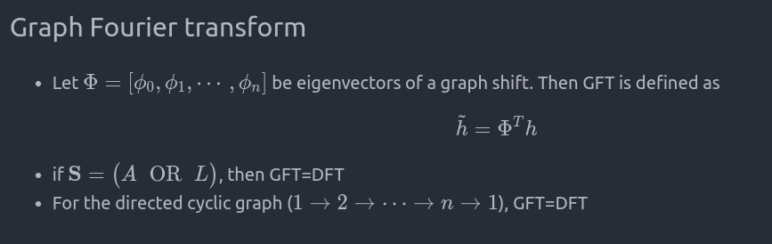
graph/network
‹#›

Slide 32
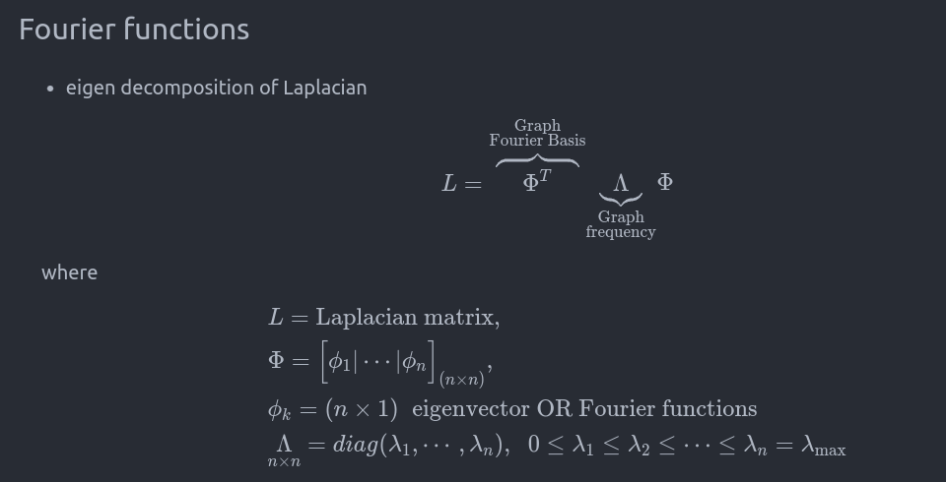
graph/network
‹#›

Slide 33
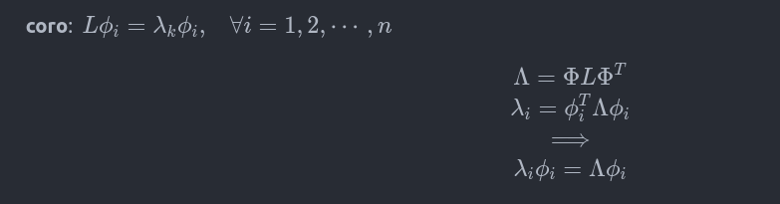
graph/network
‹#›

Slide 34
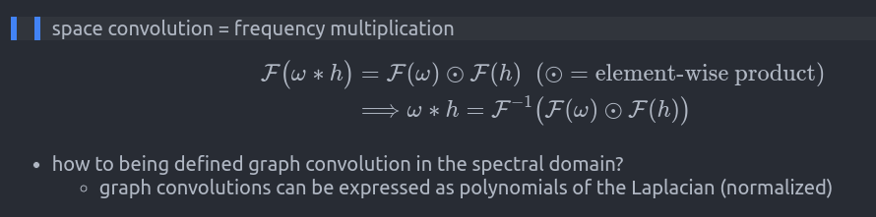
Convolution theorem
graph/network
‹#›

Slide 35
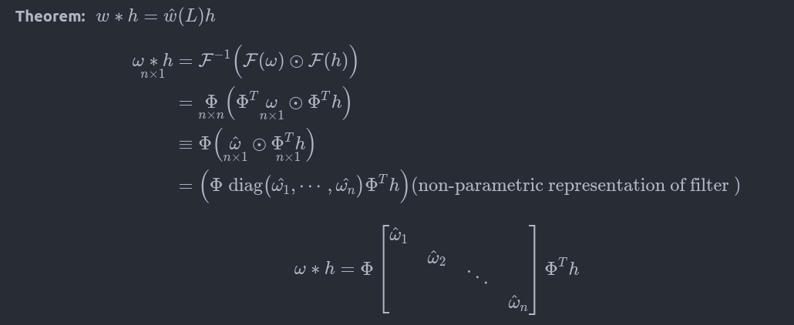
graph/network
‹#›

Slide 36
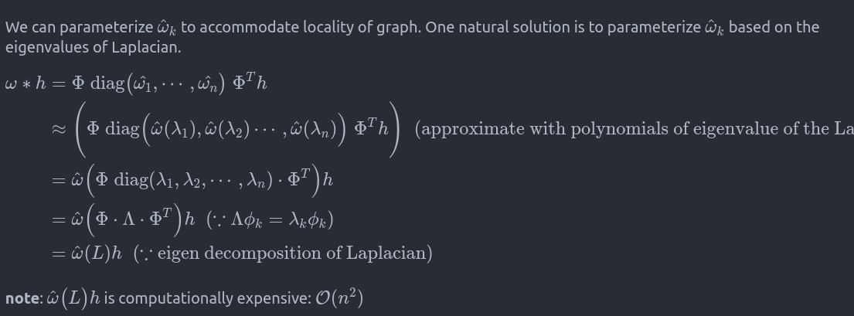
graph/network
‹#›

Slide 37
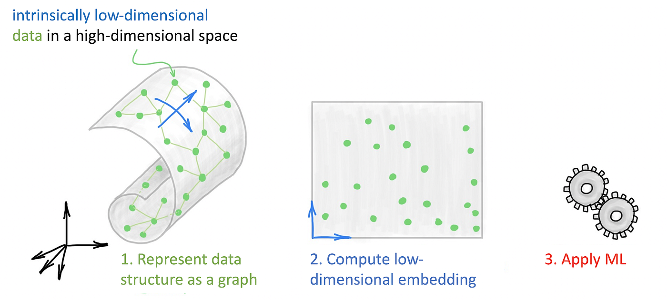

Slide 38
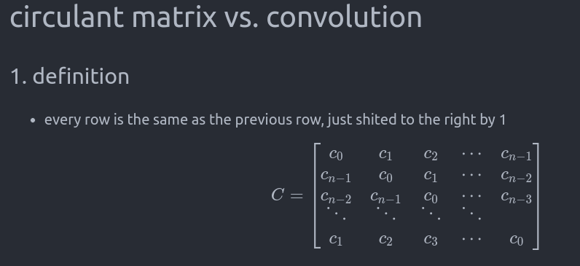
graph/network
‹#›

Slide 39
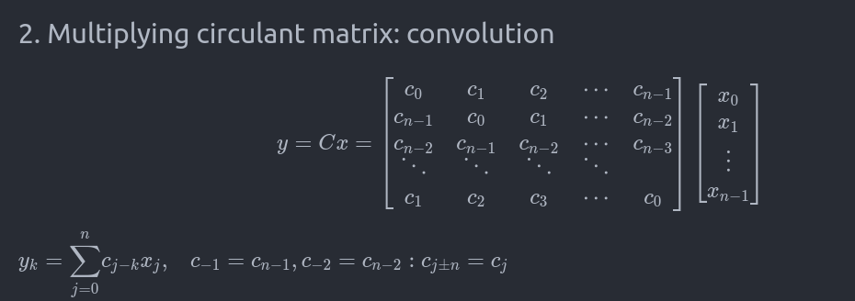
graph/network
‹#›

Slide 40
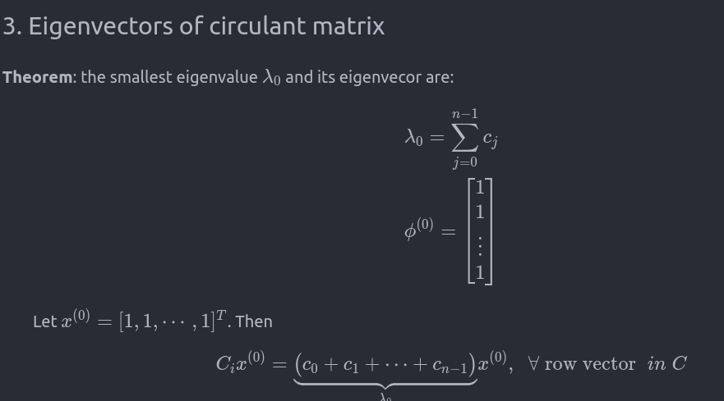
graph/network
‹#›

Slide 41
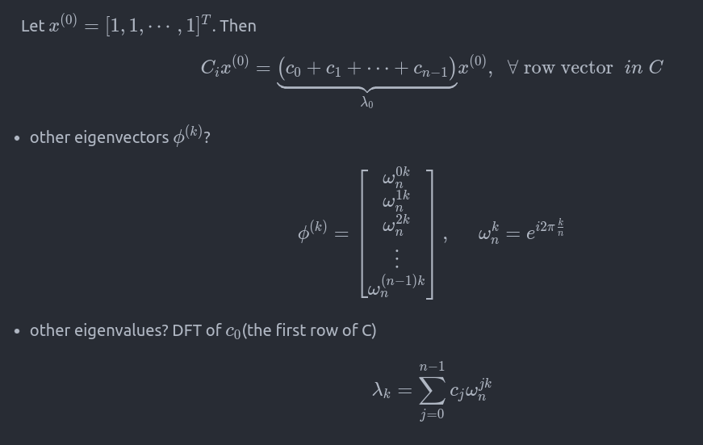
graph/network
‹#›

Slide 42
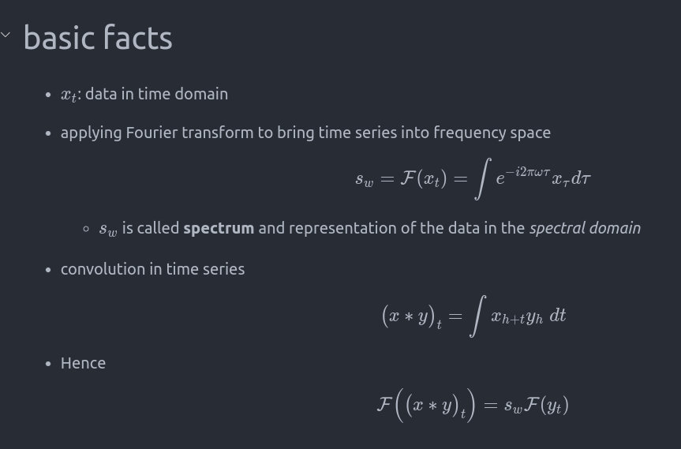
graph/network
‹#›

