Slide 1
Graph:
networkx and graph stats.

Slide 2

Contents
Contents
Contents
Networkx
Basics
graph generator
add/remove/naming nodes
add/remove/naming edges
nodes labeling
graph/network
‹#›
‹#›

Slide 3
NetworkX basics

Slide 4
Installation
conda install –c anaconda networkx
pip install networkx
import networkx as nx
graph/network
‹#›

Slide 5
networkx can do?
1. how to do instantiate graph?
2. how to add node(s)?
3. how to add edge(s)?
4. how to generate path graph?
5. how to apply different colors and width for each node add edge?
6. how to add features to node?
7. analysis
graph/network
‹#›

Slide 6
Instantiation
G = nx.Graph()
print(G.nodes())
print(G.edges())
print(type(G.nodes())
graph/network
‹#›

Slide 7
Add a node or nodes
G.add_node(‘a’)
G.add_nodes_from([‘b’, ‘c’, ‘d’])
graph/network
‹#›

Slide 8
Add a edge or edges
G.add_edge(‘a’, ‘b’)
G.add_edges_from([(‘b’, ‘c’), (‘a’, ‘c’)])
graph/network
‹#›

Slide 9

removing node
graph/network
‹#›

Slide 10
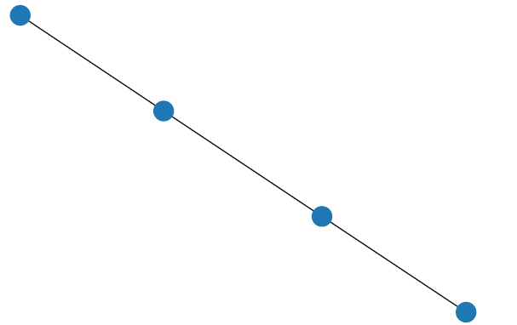
plotting
plt.figure(figsize=(5,5))
pos = nx.spring_layout(G)
nx.draw(G, pos=pos)
graph/network
‹#›

Slide 11
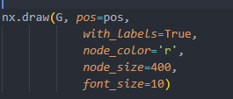
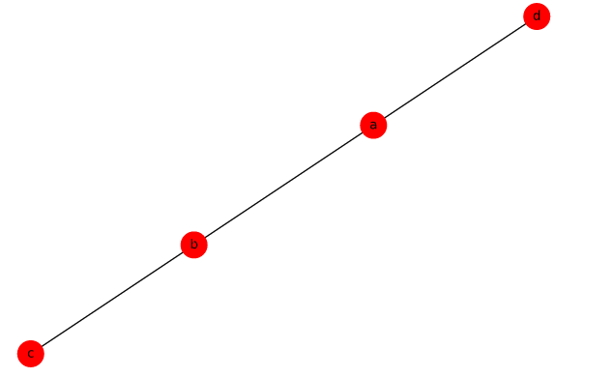
plotting (labeling, color, font size)
graph/network
‹#›

Slide 12

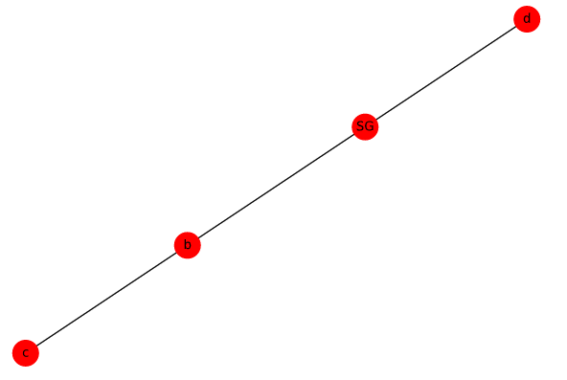
relabeling
graph/network
‹#›

Slide 13
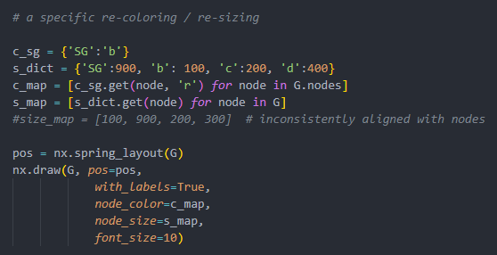
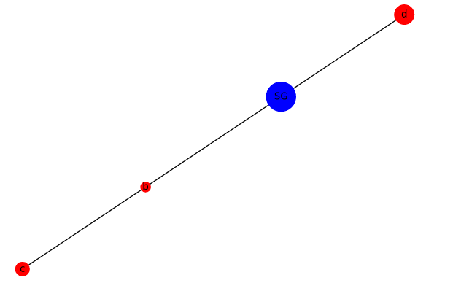
re-coloring/ re-sizing
graph/network
‹#›

Slide 14
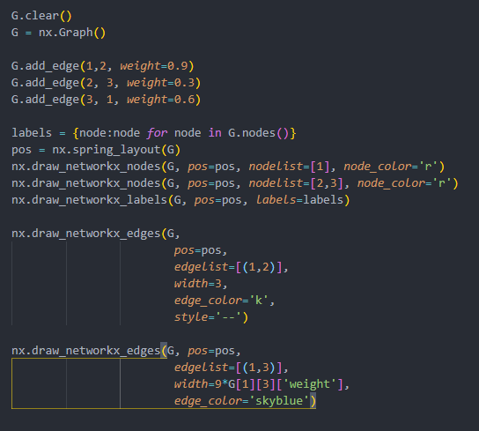
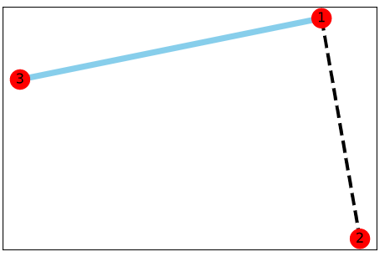
color:size:type: nx.draw_networkx_(nodes, labels, edges)
graph/network
‹#›

Slide 15
Contents
Complete graph
bipartitie graph
Erdos-Renyi graph
GNR (growing network with redirection)
Barabashi-Albert graph
Petersen graph
Karate club (Zachary)
Useful graph
Contents
Contents
graph/network
‹#›
‹#›

Slide 16

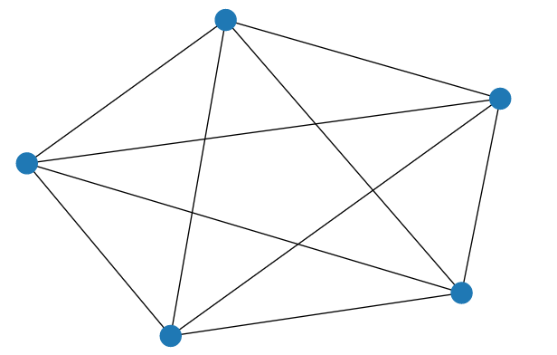
Complet graph
graph/network
‹#›

Slide 17
Complet Bipartitie graph
graph/network
‹#›

Slide 18
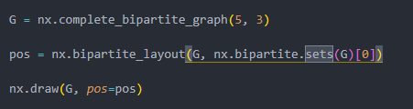
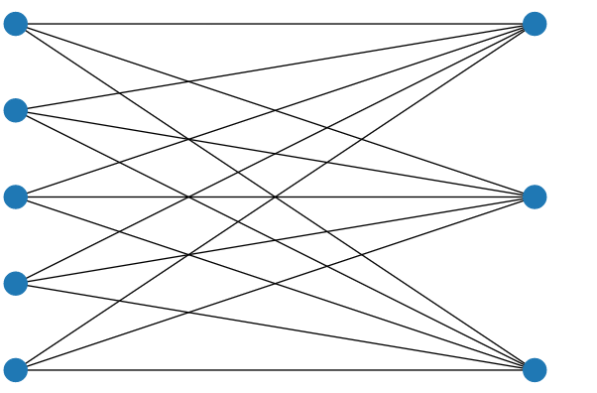
Complet Bipartitie graph(2)
graph/network
‹#›

Slide 19
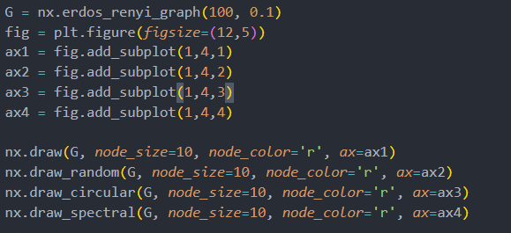
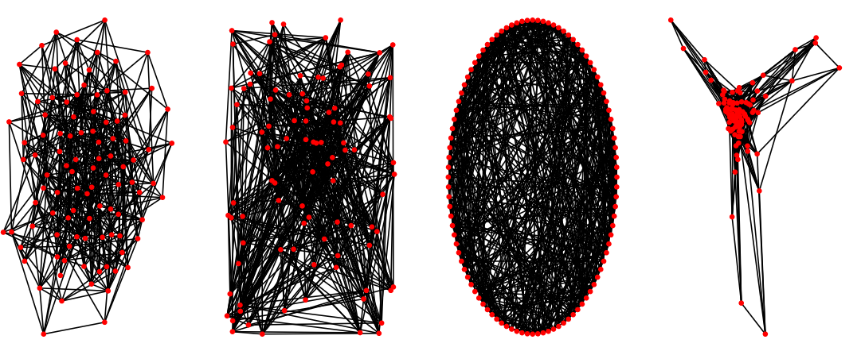
Erdos-Renyi Graph (a random graph)
graph/network
‹#›

Slide 20
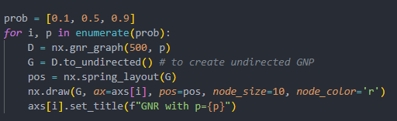
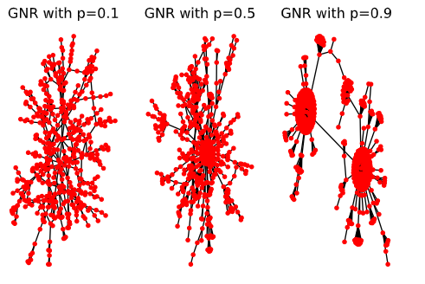
Growning network with redirection
graph/network
‹#›

Slide 21
GNR:
simulated a preferential attachment process; distribute among
a number of individuals o objects according to they already have.
it generates a long-tail distribution
example: the number of citations,
the wealth of extremely wealthy individuals,
graph/network
‹#›

Slide 22
Barabasi-Albert model
BA or scale-free model says that network develops following
two steps
1. growth: add a new node with m links
2. preferential attachement: new node to node i depends on it’s
degree
graph/network
‹#›

Slide 23

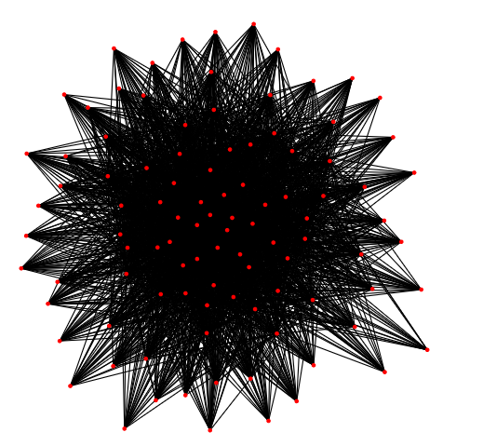
Barabasi-Albert model
graph/network
‹#›

Slide 24

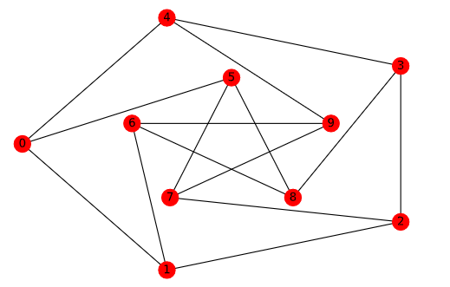
Petersen Graph (math)
graph/network
‹#›

Slide 25

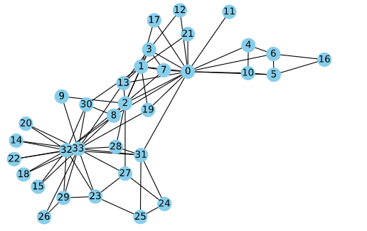
Karate Club graph: an example of community structure
graph/network
‹#›

Slide 26
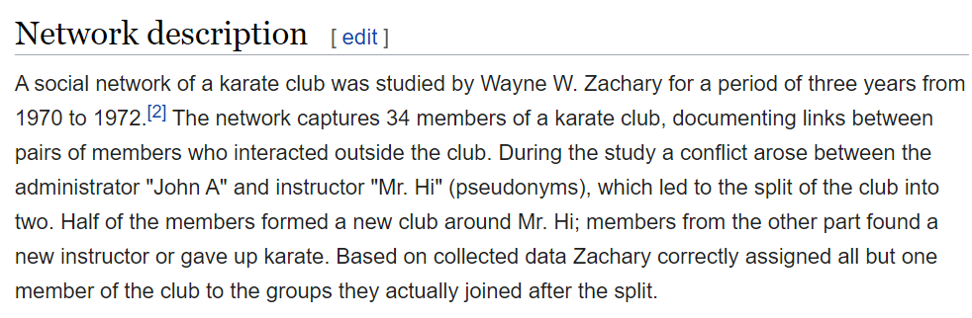
Karate club (from wiki)
graph/network
‹#›

Slide 27
Contents
Contents
Node related
statistics-like
Contents
1. shortest-path 2. clustering coefficient 3. degree distribution 4. subgraph
graph/network
‹#›
‹#›

Slide 28
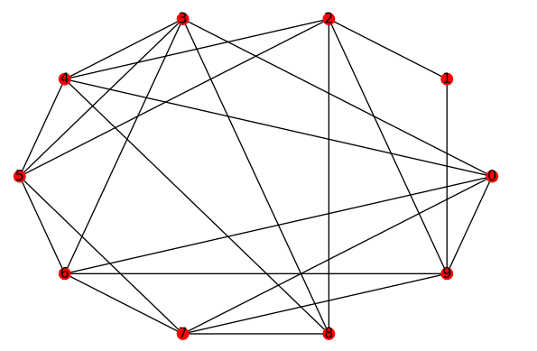
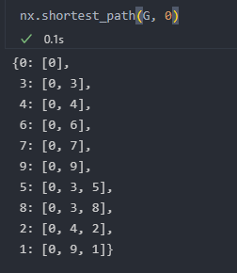
shortest-path: nx.shortest_path(Graph, source, target)
graph/network
‹#›

Slide 29
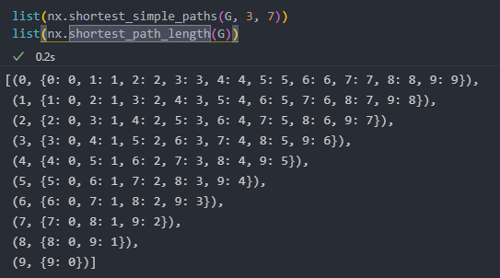
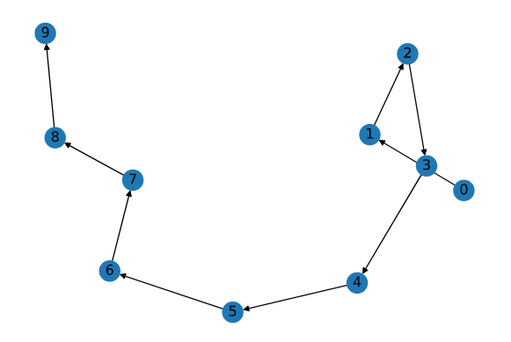
shortest-path: nx.shortest_path_length(Graph)
graph/network
‹#›

Slide 30
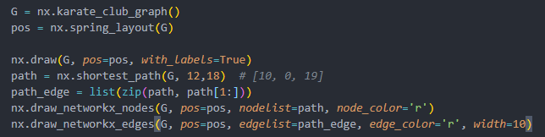
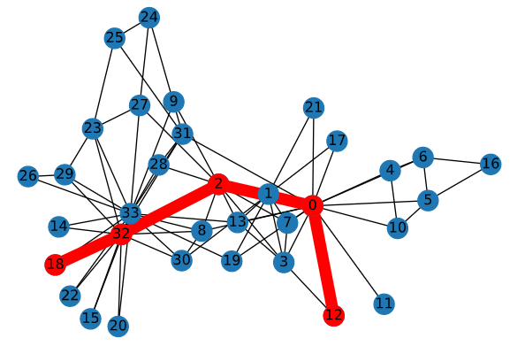
shortest path drawing
graph/network
‹#›

Slide 31
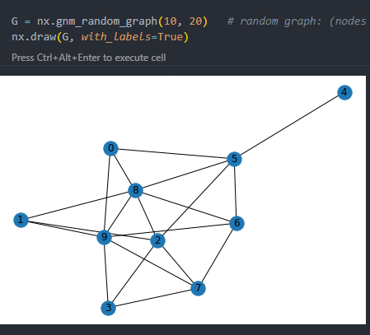
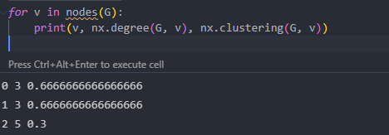
clustering coefficient, degree
graph/network
‹#›

Slide 32
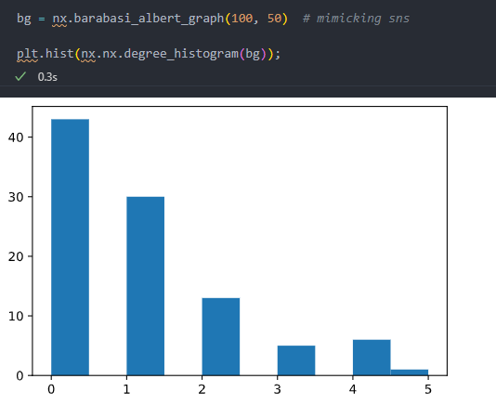
degree distribution
graph/network
‹#›

Slide 33
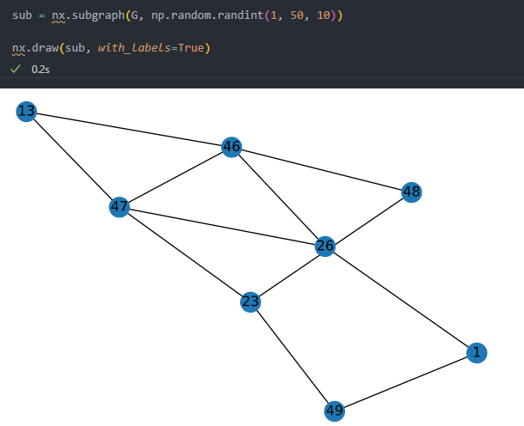
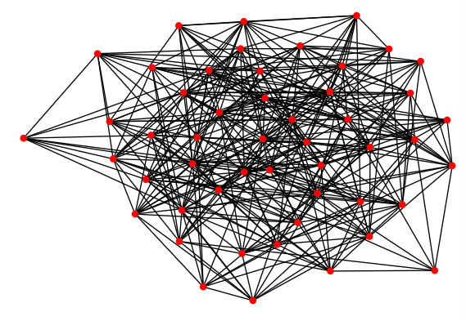
subgraph
graph/network
‹#›

Slide 34
Contents
Degree
Betweenness
Closeness
PageRank
Centrality
Contents
Contents
graph/network
‹#›
‹#›

Slide 35
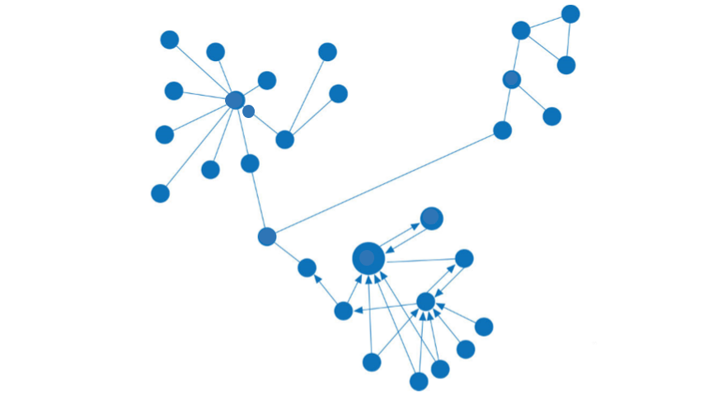
Various centrality
Degree
closeness
Betweenness
PageRank
graph/network
‹#›

Slide 36
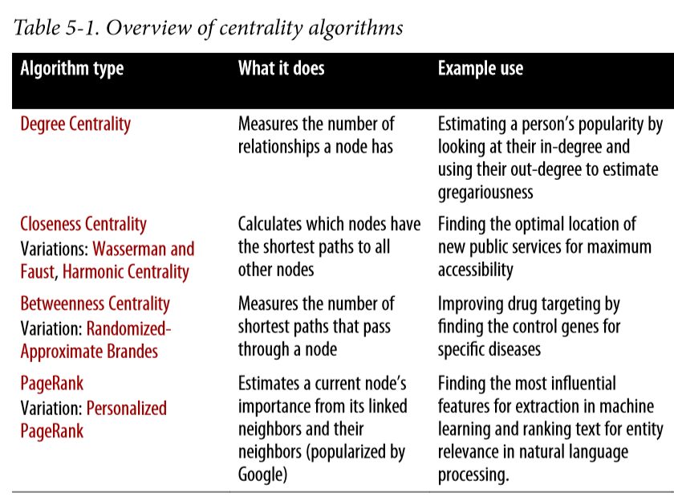
Various centrality
graph/network
‹#›

Slide 37
Various centrality: degree
graph/network
‹#›

Slide 38
Various centrality: betweenness (bridge)
graph/network
‹#›

Slide 39
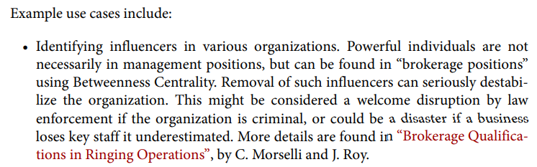
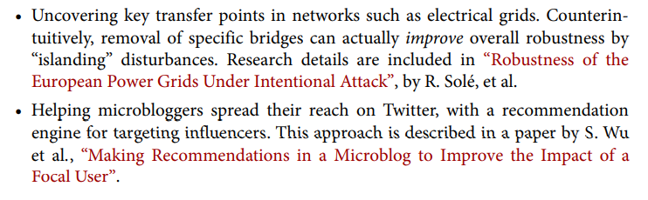
betweenness centrality
graph/network
‹#›

Slide 40
Various centrality: closeness
graph/network
‹#›

Slide 41
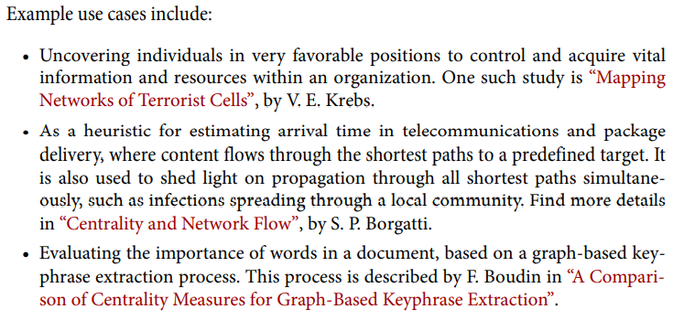
closeness centrality
graph/network
‹#›

Slide 42
Various centrality: PageRank
based on number and weighting in-links
graph/network
‹#›

Slide 43
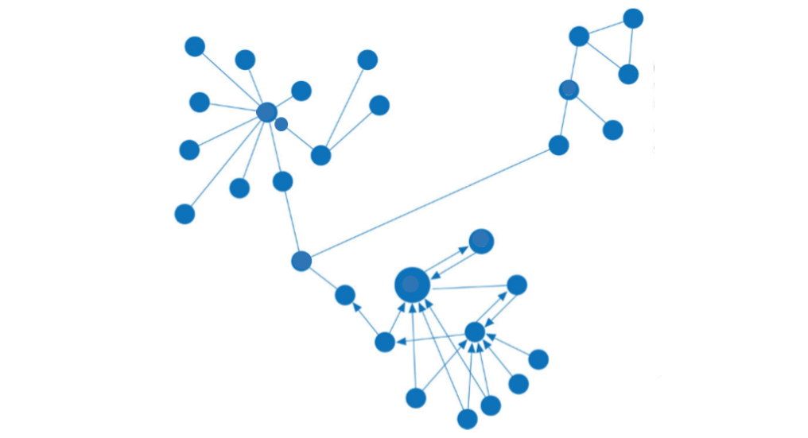
Various centrality: PageRank: 2nd important?
based on number and weighting in-links
influence on the 1st PageRank node
graph/network
‹#›

Slide 44
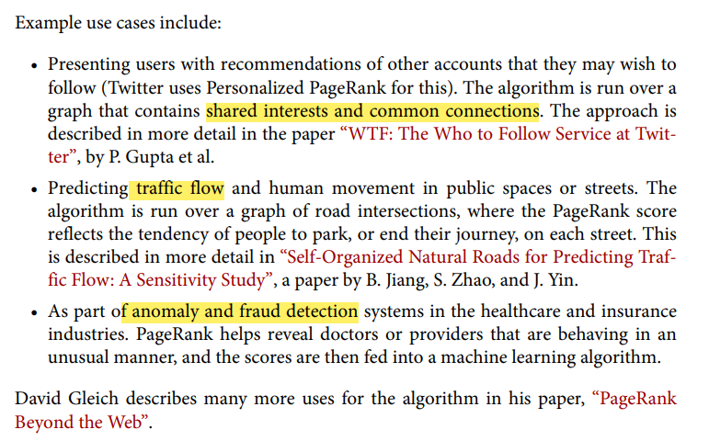
PageRank example
graph/network

Slide 45
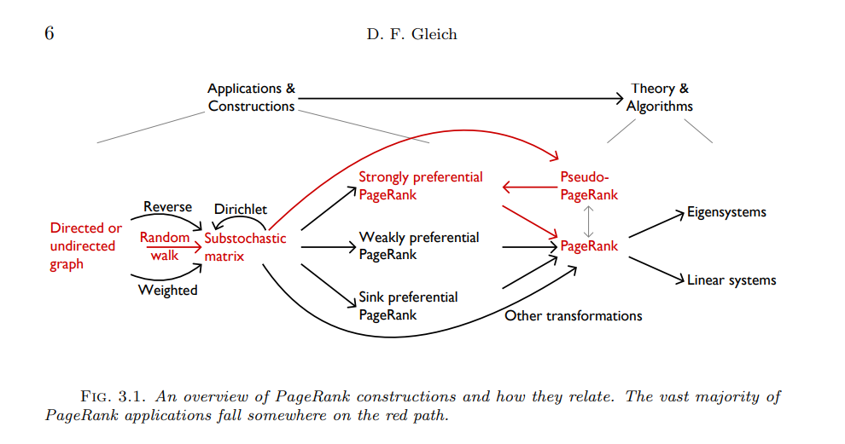
PageRank Beyond the Web

Slide 46
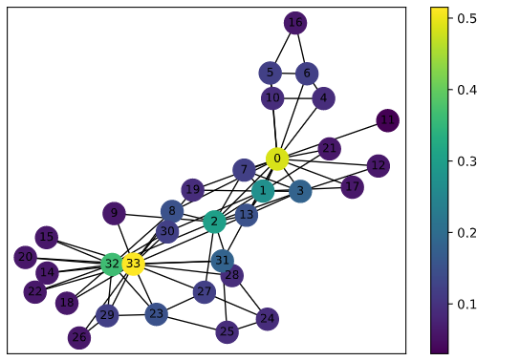
degree centrality
graph/network
‹#›

Slide 47
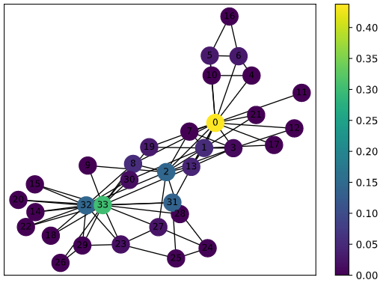
betweenness centrality
graph/network
‹#›

Slide 48
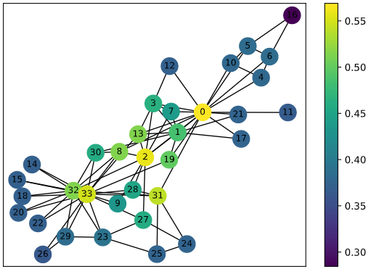
closeness centrality
graph/network
‹#›

Slide 49
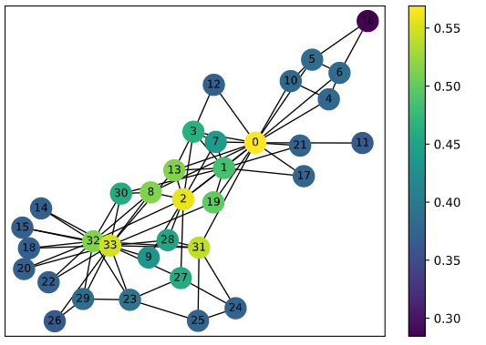
Wasserman and Faust closeness centrality
graph/network
‹#›

Slide 50
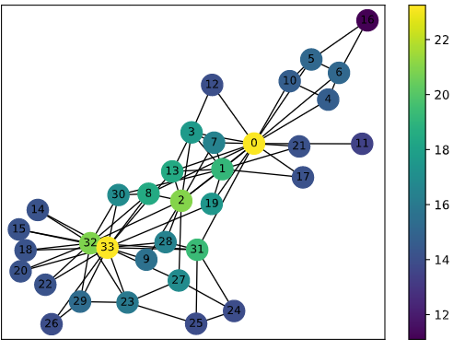
Harmonic closeness centrality
graph/network
‹#›

Slide 51
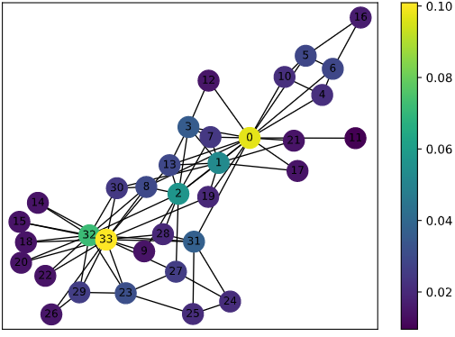
PageRank
graph/network
‹#›

Slide 52
Contents
Bag of Nodes
Weisfeiler-Lehman Subtree
Bag of colors
Graph Kernel
Contents
Contents
graph/network
‹#›
‹#›

Slide 53
Graph kernel: bag of nodes
Deg1: Deg2: Deg3:
( )
=
count( )
= [1 , 3 , 0]
( )
=
count( )
= [1 , 3 , 0]
graph/network
‹#›

Slide 54
graph kernel: graphlet features
For k = 3, there are 4 graphlets
For k = 4, there are 11 graphlets
graph/network
‹#›

Slide 55
Graphlet features: examples (nodes=3)
= ( 1, 3, 6, 0)
graph/network
‹#›

Slide 56
WL subtree kernel: BAG of Colors
Graph G with nodes V
assign an inital color to each node
iteratively refine node colors by
)=HASH
where HASH maps different inputs into different colors
graph/network
‹#›

Slide 57
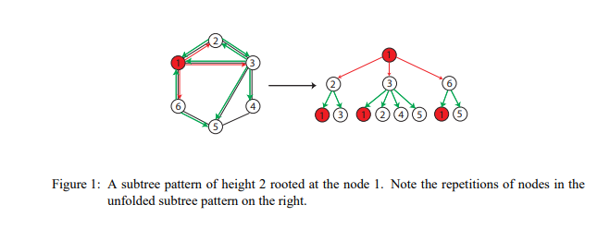
WL subtree kernel
Weisfeiler-Lehman Graph Kernels(2011)
graph/network
‹#›

Slide 58
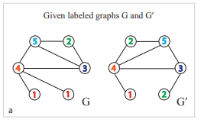
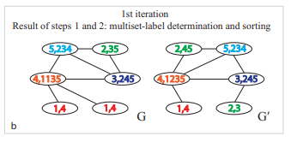
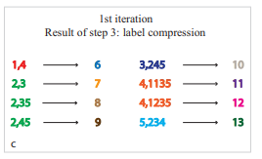
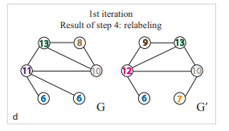
WL subtree kernel
agg. neighbor nodes(colors)
HASH table
Weisfeiler-Lehman Graph Kernels(2011)
graph/network
‹#›

Slide 59
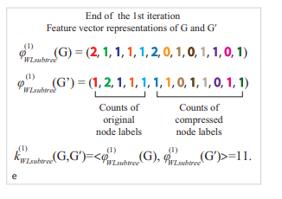
Weisfeiler-Lehman Graph Kernels(2011)

Slide 60






WL subtree kernel
(
)=
=
= 11
Weisfeiler-Lehman Graph Kernels(2011)
graph/network
‹#›

Slide 61

WL in DGCNN
graph/network
‹#›

Slide 62
Contents
Triangle count /clustering coefficient
Strongly connected components
directed
Label propagation
Louvain Modularity
Community
detection
Contents
Contents
graph/network
‹#›
‹#›

Slide 63

graph/network
‹#›

Slide 64

community detection: triangle count / cc
graph/network
‹#›

Slide 65

community detection: connected components
graph/network
‹#›

Slide 66

SCC example
graph/network
‹#›

Slide 67

community detection: Label propagation
graph/network
‹#›

Slide 68

community detection: Louvain Modularity
graph/network
‹#›

Slide 69

Community detection algorithm
graph/network
‹#›

Slide 70
triangle and clustering coefficient

Slide 71
Triangle count
Tri-angle count is the number of triangles passing thru each node in the graph
A triangle is a set of three nodes, where each node has a relationship to all other nodes
triangle count can also be run globally for evaluating overall dataset
graph/network
‹#›

Slide 72

Triangle count
Triangle count is the number of triangle pass thru each node in the graph
graph/network
‹#›

Slide 73
Clustering count (cc)
CC of a Node is the likelihood of its neighbors are connected
involve calculation of triangles
: degree
: number of triangle
is measuring the degree of clustering compared to it could being achieved
graph/network
‹#›

Slide 74
Clustering count (cc)
is measuring the degree of clustering compared to it could being achieved
If node , then there is 20% chance of ’s two neighbor nodes are connected
graph/network
‹#›

Slide 75

TC and CC?
graph/network
‹#›

Slide 76

TC and CC?
graph/network
‹#›

Slide 77

Triangles with karate club
graph/network
‹#›

Slide 78
clique
induced complete subgraph of a graph
a subset of edges of an undirected graph such that two distinct
edges in the clique are adjacent
clique with 3 nodes = triangle
graph/network
‹#›

Slide 79

clique(3) in karate club
graph/network
‹#›

Slide 80


clique(5) in karate club
graph/network
‹#›

Slide 81

TC and CC’s application
See The Anatomy of the Facebook Social Graph
graph/network
‹#›

Slide 82
TC and CC’s application
Applied SNS to detect communities
graph/network
‹#›

Slide 83

Efficient Semi-Streaming Algorithms for Local Triangle Counting in Massive Graphs
apply triangle count and clustering coefficient on SNS
to detect WEB spam
content quality in SNS
https://dl.acm.org/doi/pdf/10.1145/1401890.1401898
graph/network
‹#›

Slide 84
Efficient Semi-Streaming Algorithms for Local Triangle Counting in Massive Graphs
apply triangle count and clustering coefficient on SNS
to detect WEB spam: correlation structure in finance
content quality in SNS: Naver discussion among some key companies
https://dl.acm.org/doi/pdf/10.1145/1401890.1401898
graph/network
‹#›

Slide 85
Curvature of co-links uncovers hidden thematic layers in the World Wide Web
“This curvature (derived from cc and tc_mine) defines a World Wide Web landscape whose connected regions of high curvature characterize a common topic.”
graph/network
https://www.pnas.org/content/99/9/5825
‹#›

Slide 86

local clustering coefficient: curvature
Curvature of co-links uncovers hidden thematic layers in the World Wide Web
graph/network
‹#›

Slide 87
Label propagation algorithm
Newly developed fast algorithm for finding communities in a graph
proposed by Raghavan, Albert, and Kumara (2007)
Well suited to networks where groupings are less clear and weights used to help a node determine which community to place itself within
suitable for semi-supervised learning and parallelization
SL: small labeled but larger unlabeled data
graph/network
‹#›

Slide 88
Label propagation algorithm
LPA-Push
push labels to neighbors to find clusters
LPA-Pull
pull labels from neighbors based on relationship weights to find clusters
graph/network
‹#›

Slide 89

Label propagation algorithm: push
cv
graph/network
‹#›

Slide 90

Label propagation algorithm: pull
graph/network
‹#›

Slide 91

Label propagation algorithm: pull
graph/network
‹#›

Slide 92
Label propagation algorithm: pull
graph/network
‹#›

Slide 93
Label propagation algorithm: pull
graph/network
‹#›

Slide 94
Label propagation algorithm: pull
graph/network
‹#›

Slide 95

Label propagation algorithm: pull
graph/network
‹#›

Slide 96

Label propagation algorithm: pull
graph/network
‹#›

Slide 97
Label propagation algorithm Procedure
Every node is initialized with a unique label (an identifier), and, optionally preliminary “seed” labels can be used.
These labels propagate through the network.
At every propagation iteration, each node updates its label to match the one with the maximum weight, which is calculated based on the weights of neighbor nodes and their relationships.
Ties are broken uniformly and randomly.
LPA reaches convergence when each node has the majority label of its neighbors
graph/network
‹#›

Slide 98
Label propagation algorithm Procedure
Every node is initialized with a unique label (an identifier), and, optionally preliminary “seed” labels can be used.
These labels propagate through the network.
At every propagation iteration, each node updates its label to match the one with the maximum weight, which is calculated based on the weights of neighbor nodes and their relationships.
Ties are broken uniformly and randomly.
LPA reaches convergence when each node has the majority label of its neighbors
graph/network
‹#›

Slide 99
Label propagation algorithm Procedure
Every node is initialized with a unique label (an identifier), and, optionally preliminary “seed” labels can be used.
These labels propagate through the network.
At every propagation iteration, each node updates its label to match the one with the maximum weight, which is calculated based on the weights of neighbor nodes and their relationships.
Ties are broken uniformly and randomly.
LPA reaches convergence when each node has the majority label of its neighbors
graph/network
‹#›

Slide 100
Label propagation algorithm Procedure
Every node is initialized with a unique label (an identifier), and, optionally preliminary “seed” labels can be used.
These labels propagate through the network.
At every propagation iteration, each node updates its label to match the one with the maximum weight, which is calculated based on the weights of neighbor nodes and their relationships.
Ties are broken uniformly and randomly.
LPA reaches convergence when each node has the majority label of its neighbors
graph/network
‹#›

Slide 101
Label propagation algorithm Procedure
Every node is initialized with a unique label (an identifier), and, optionally preliminary “seed” labels can be used.
These labels propagate through the network.
At every propagation iteration, each node updates its label to match the one with the maximum weight, which is calculated based on the weights of neighbor nodes and their relationships.
Ties are broken uniformly and randomly.
LPA reaches convergence when each node has the majority label of its neighbors
graph/network
‹#›

Slide 102


Label propagation algorithm Example
graph/network
‹#›

Slide 103
Louvain algorithm
modularity based community detection algorithm
modularity: measure of grouping quality
L: number of relationships in entire group
: number of relationships in a partition
: degree of nodes in a partition
Fastest modularity-based algo
Can be used for revealing hierarchy of communities at different scales
help to understand the structure of a network at different levels of granularity
graph/network
‹#›

Slide 104

modularity example:
graph/network
‹#›

Slide 105


modularity example:
graph/network
‹#›

Slide 106

Louvain algorithm: two steps
sum of degrees within the group
based on modularity
graph/network
‹#›

Slide 107

Louvain algorithm: two steps
=14+4ⅹ2+4
=14+2ⅹ2+2
Links are based on previous links
graph/network
‹#›

Slide 108

Louvain algo: example
graph/network
‹#›

Slide 109

graph/network
‹#›

Slide 110

graph/network
‹#›

Slide 111
graph/network
‹#›

Slide 112

graph/network
‹#›

