Slide 1
NetworkX with Granger Causality

Slide 2

Contents
VAR
Statsmodels
Lag selection
Variance decomposition
Impulse response function
Granger causality
Contents
Contents
Contents
‹#›

Slide 3
Restricted analysis in KRX: 반도체 관련
반도체 장비
시스템 반도체
반도체 재료부품
반도체 대표주 (생산)

Slide 4
Restricted analysis in KRX: 반도체 관련
반도체 장비 (88)
시스템 반도체 (42)
반도체 재료부품 (52)
반도체 대표주 (생산) (3)
삼성전자, SK하이닉스, DB하이텍

Slide 5
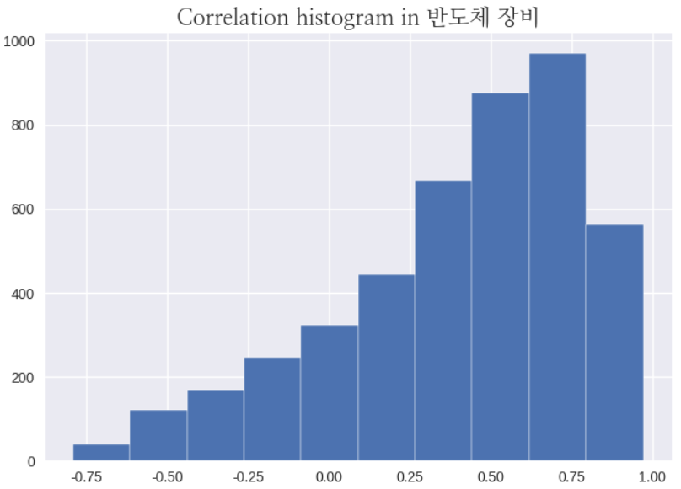
KRX: 반도체 장비(88-10=78)

Slide 6
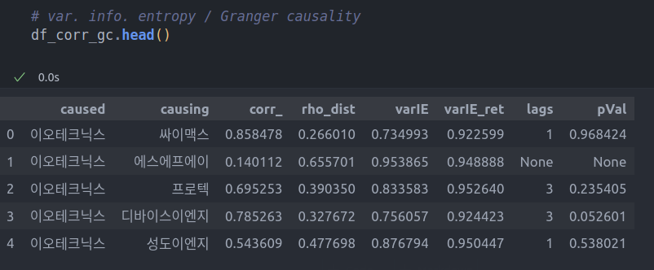
반도체장비: 상관관계 관련

Slide 7
반도체장비: network graph

Slide 8
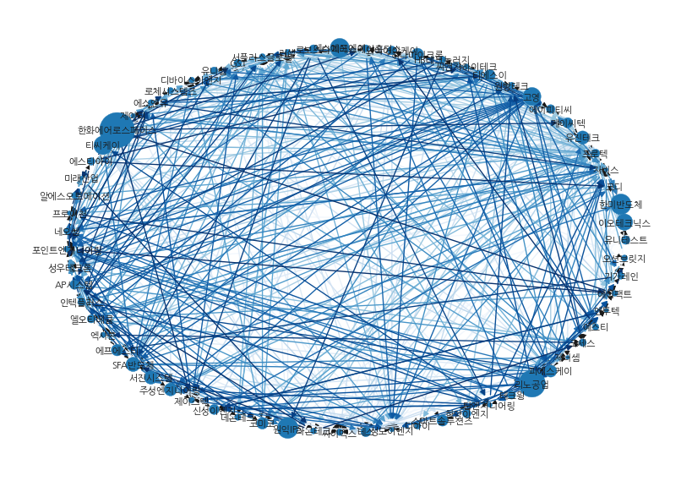
반도체장비: network graph

Slide 9
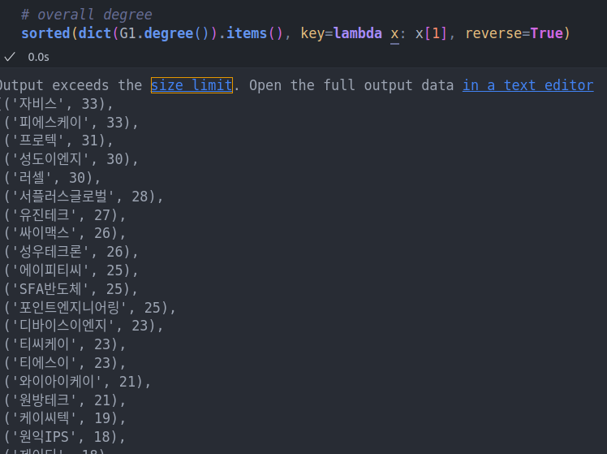
반도체장비: network graph: degree

Slide 10
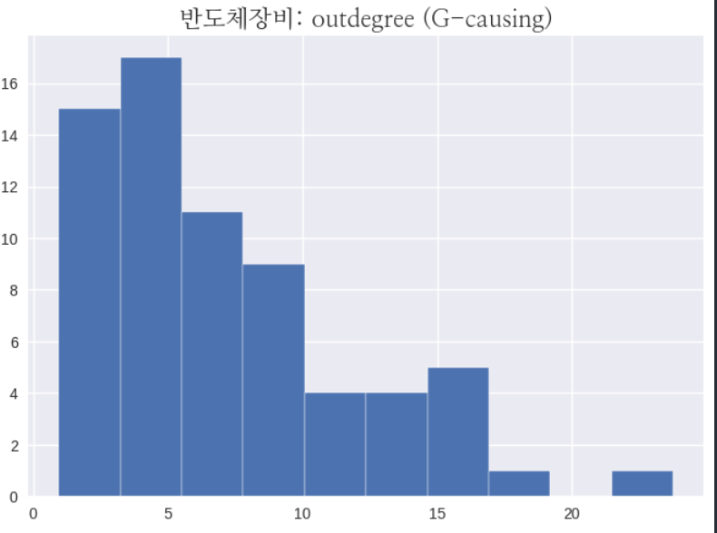
반도체장비: network graph: out-degree

Slide 11
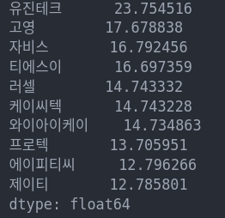
반도체장비: network graph: out-degree

Slide 12
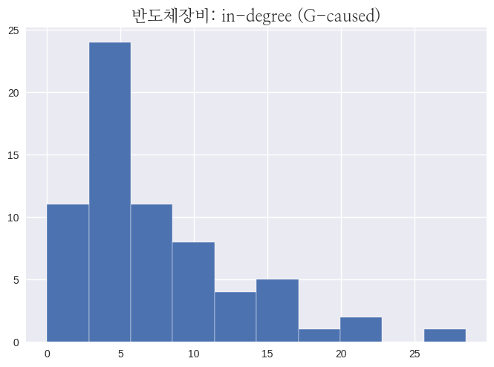
반도체장비: network graph: in-degree

Slide 13
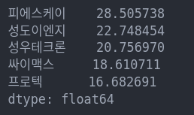
반도체장비: network graph: in-degree

Slide 14
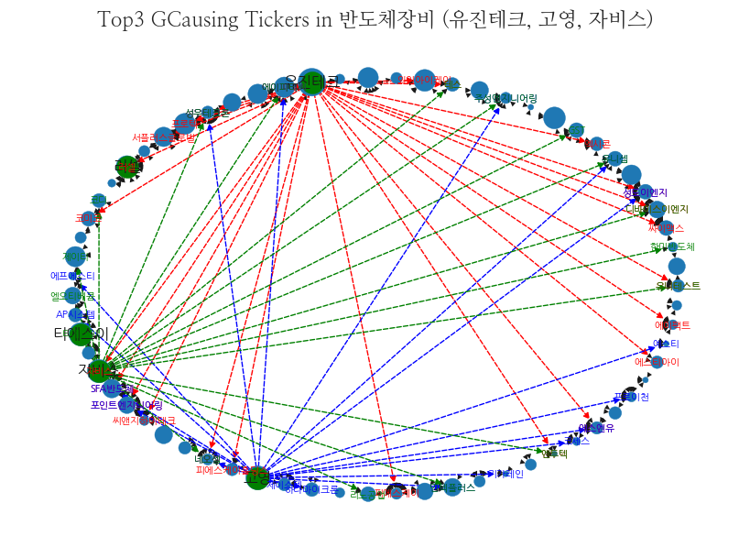
반도체장비: network graph
유진테크
자비스
고영

Slide 15
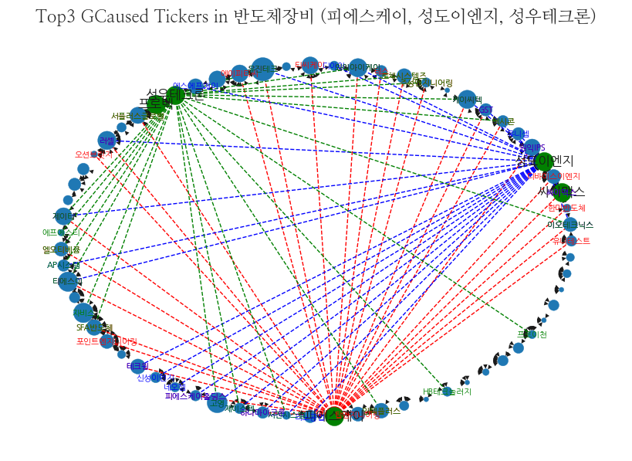
반도체장비: network graph
성우테크론
성도이엔지
피에스케이

Slide 16

반도체장비: betweeness centrality: bridge?

Slide 17
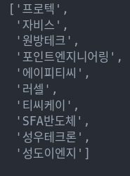
반도체장비: betweeness centrality: bridge?

Slide 18
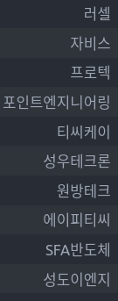
반도체장비: betweeness centrality: bridge?

Slide 19
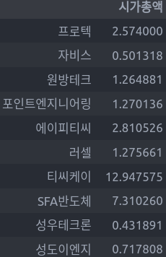
반도체장비: betweeness centrality: bridge?

Slide 20
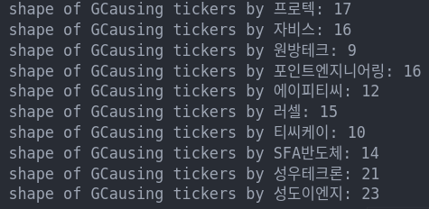
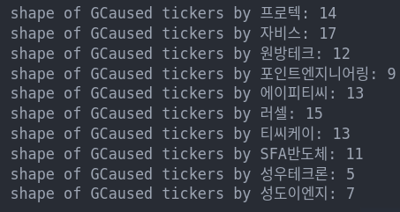
반도체장비: betweeness centrality: bridge?

Slide 21
반도체장비: betweeness centrality: bridge?

Slide 22
반도체장비: betweeness centrality: bridge?

Slide 23
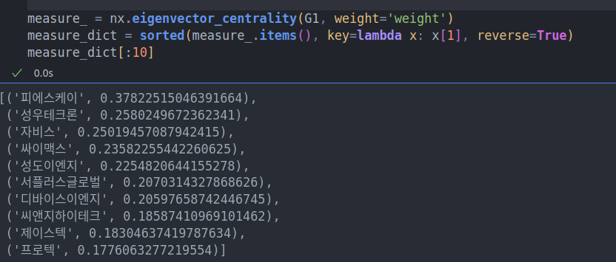
반도체장비: eigen. vector: pointed to by many

Slide 24
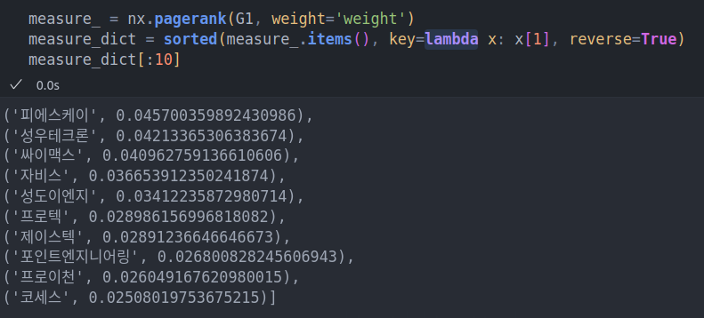
반도체장비: page rank: influential nodes

Slide 25
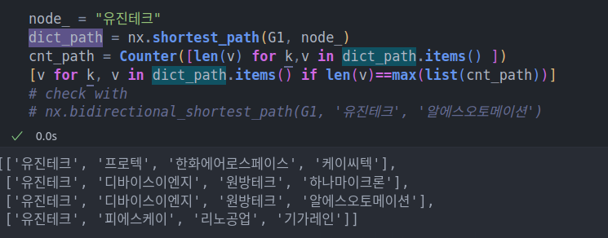
반도체장비: shortest path

Slide 26
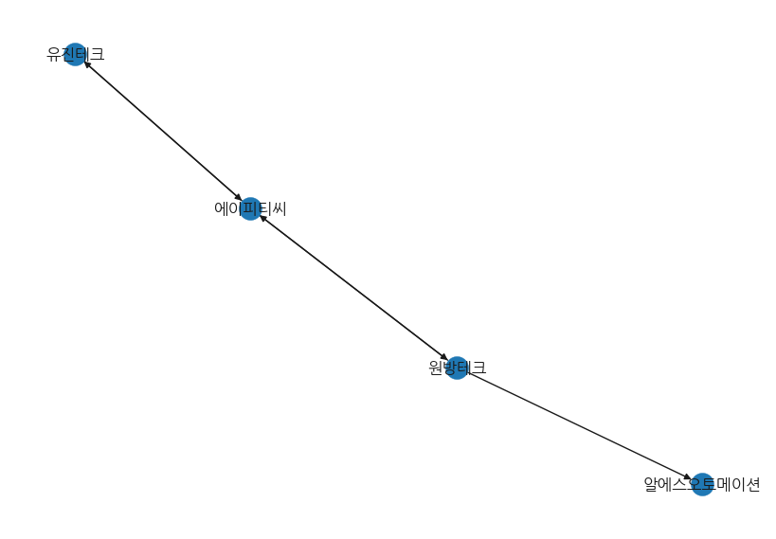
반도체장비: shortest path

Slide 27
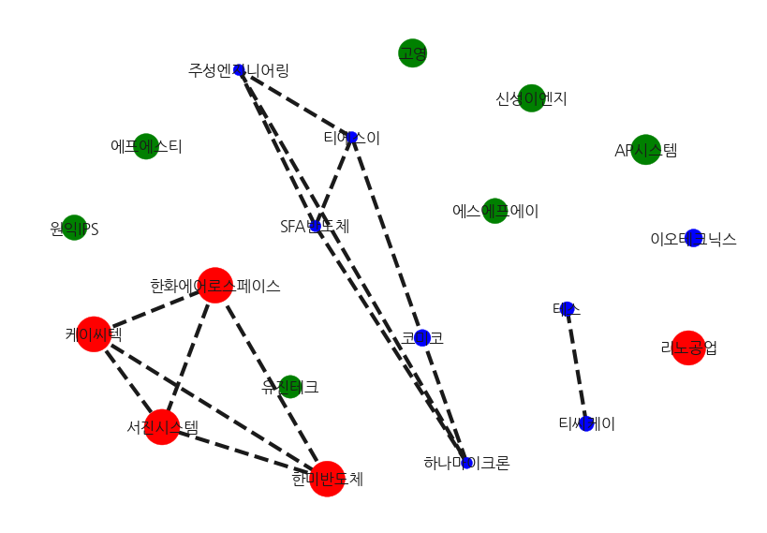
반도체장비: to where?
Greens are to be the next?

