Slide 1
VAR

Slide 2

Contents
VAR
Statsmodels
Lag selection
Variance decomposition
Impulse response function
Granger causality
Contents
Contents
Contents
‹#›

Slide 3
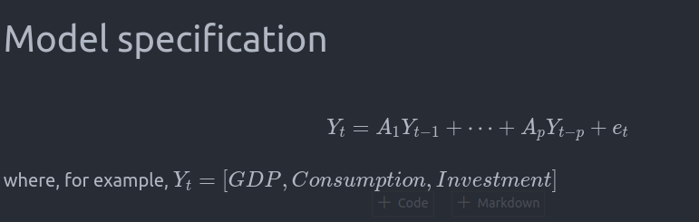
Model specification

Slide 4
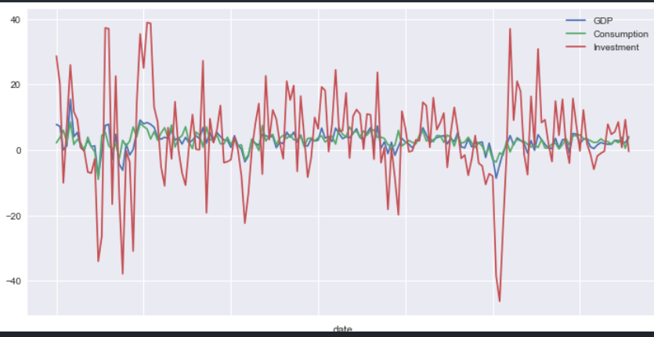
VAR: example

Slide 5

VAR: Lag Selection

Slide 6
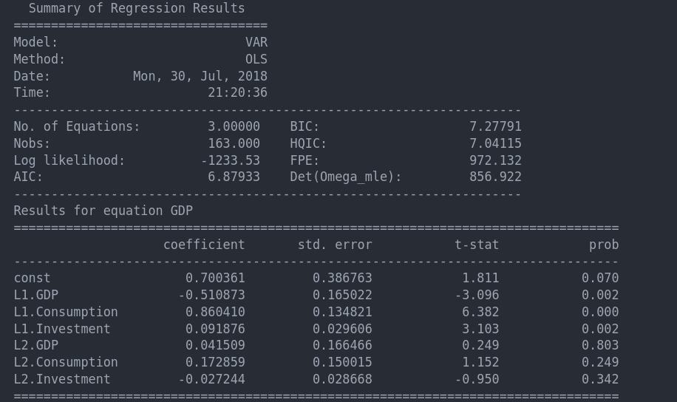
VAR: Lag Selection

Slide 7
VAR: Lag Selection

Slide 8
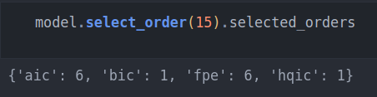
VAR: Lag Selection

Slide 9
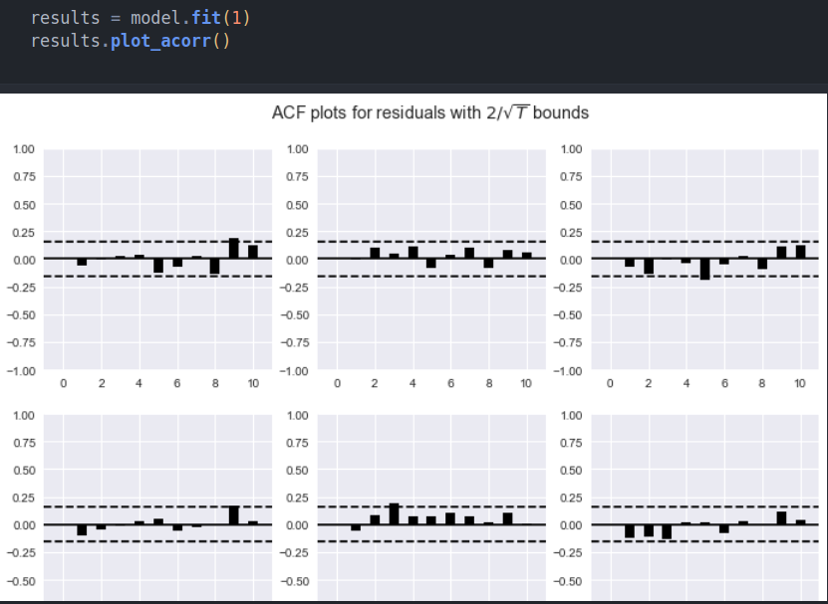
VAR: Robustness: with residuals

Slide 10
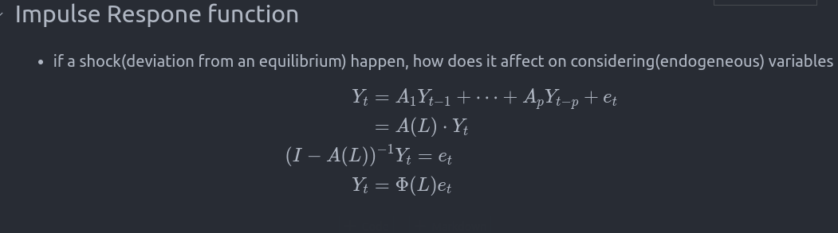
Dynamics: Granger Causality, Impulse Response, Variance decomposition

Slide 11
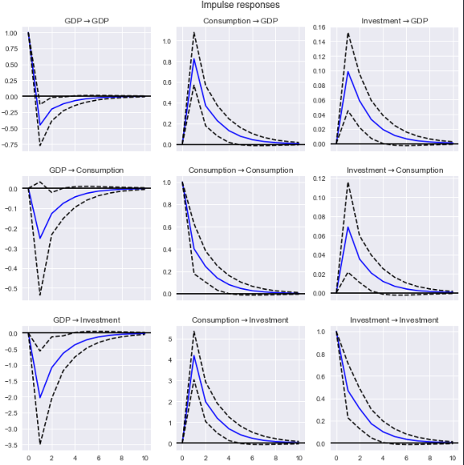
Dynamics: Granger Causality, Impulse Response, Variance decomposition

Slide 12

Dynamics: Granger Causality, Impulse Response, Variance decomposition

Slide 13
Forecast error variance
Forecast errors of component x on z in an j-step ahead forecast can be decomposed using the orthogonalized impulse response

Slide 14
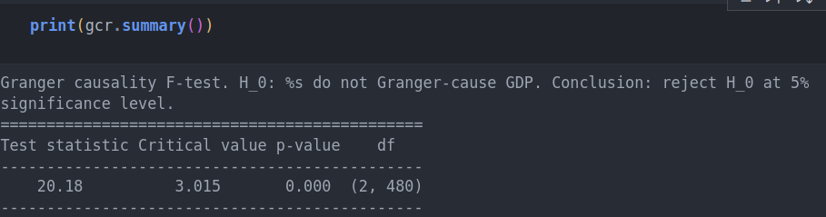
Granger causality

