Slide 1
NetworkX: centrality

Slide 2

Contents
Graph Theory
introduction
basic terminology
why GT in economics/finance?
research trend
Contents
Contents
Contents
2

Slide 3
Nx: centrality
Information on how important nodes
How many connections
The location of nodes(s) in the network

Slide 4
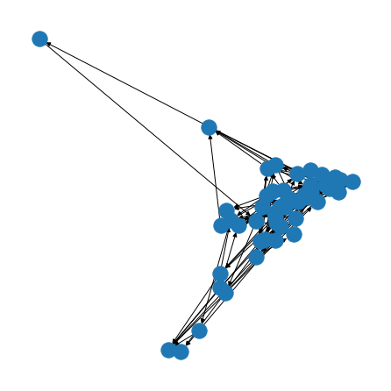
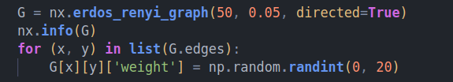
Degree

Slide 5
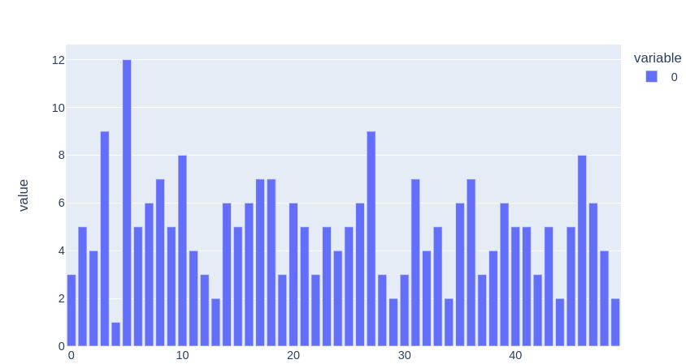
Degree

Slide 6
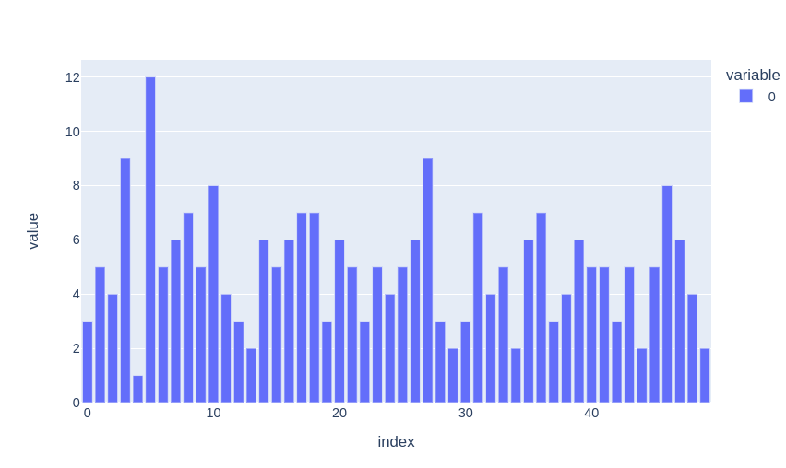
G.degree(k, weight='weight')

Slide 7
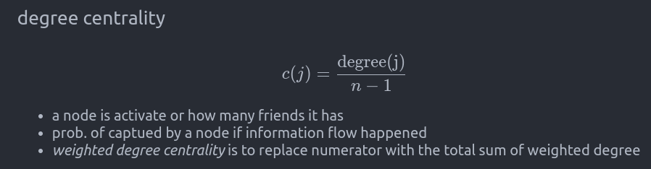
Degree centrality

Slide 8
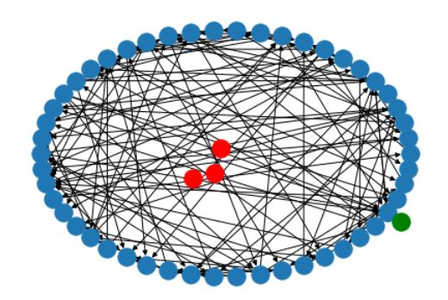
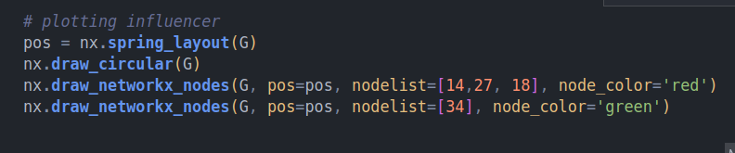
Degree centrality

Slide 9
Degree centrality

Slide 10
Degree centrality

Slide 11
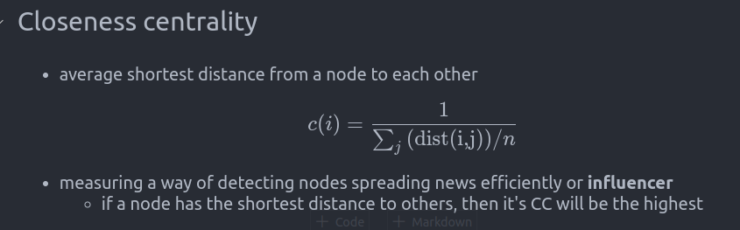
Closeness

Slide 12
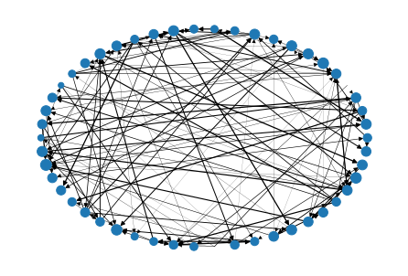
Closeness (node_size, width)

Slide 13
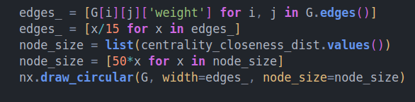
Closeness (node_size, width)

Slide 14
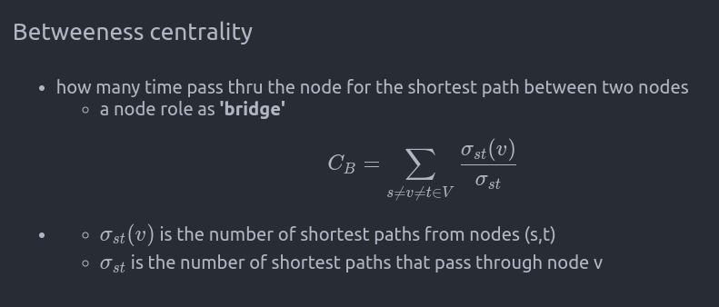

Slide 15


Slide 16
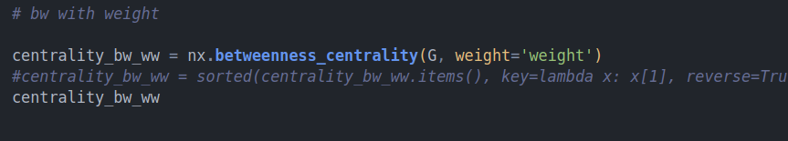

Slide 17
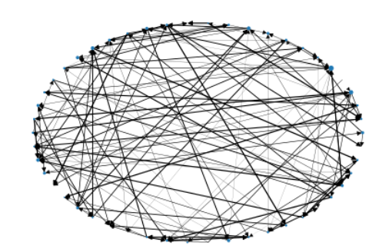
Betweeness

Slide 18
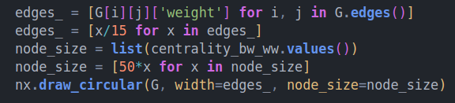
Betweeness

Slide 19
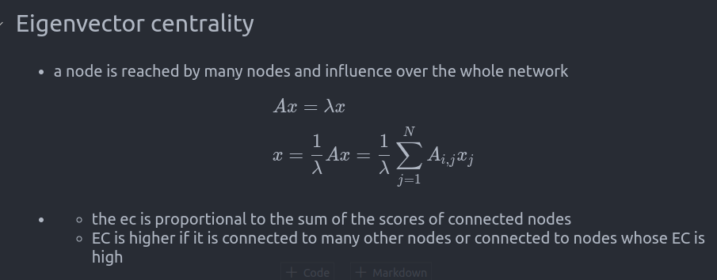

Slide 20


Slide 21


Slide 22
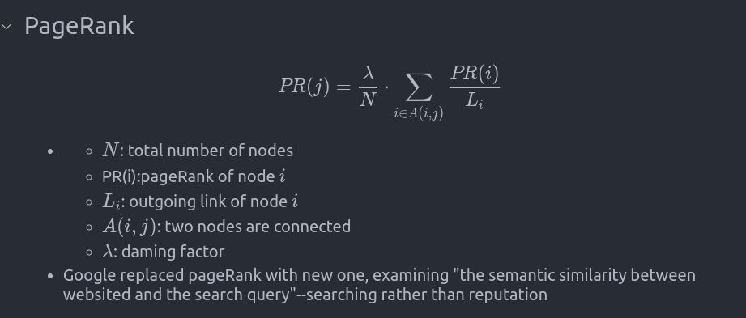

Slide 23


