Slide 1
Graph: networkx

Slide 2
networkx basics: 1. graph generator 2. add/remove/naming nodes 3. add/remove/naming edges 4. nodes labeling

Slide 3
Installation
conda install –c anaconda networkx
pip install networkx
import networkx as nx

Slide 4
Add a edge or edges
G.add_edge(‘a’, ‘b’)
G.add_edges_from([(‘b’, ‘c’), (‘a’, ‘c’)])

Slide 5
networkx can do?
1. how to do instantiate graph?
2. how to add node(s)?
3. how to add edge(s)?
4. how to generate path graph?
5. how to apply different colors and width for each node add edge?
6. how to add features to node?
7. analysis

Slide 6
Instantiation
G = nx.Graph()
print(G.nodes())
print(G.edges())
print(type(G.nodes())

Slide 7
Add a node or nodes
G.add_node(‘a’)
G.add_nodes_from([‘b’, ‘c’, ‘d’])

Slide 8

removing node

Slide 9
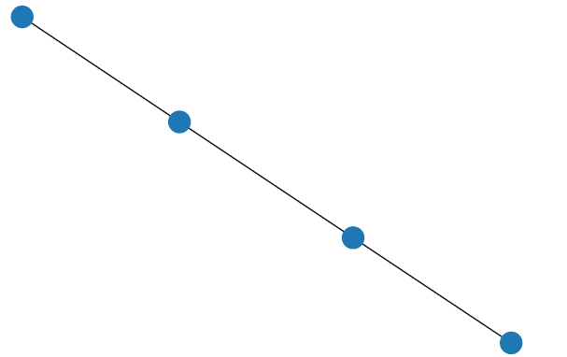
plotting
plt.figure(figsize=(5,5))
pos = nx.spring_layout(G)
nx.draw(G, pos=pos)

Slide 10
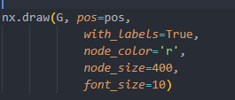
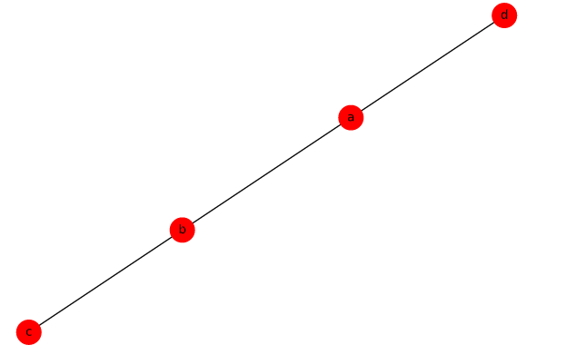
plotting (labeling, color, font size)

Slide 11

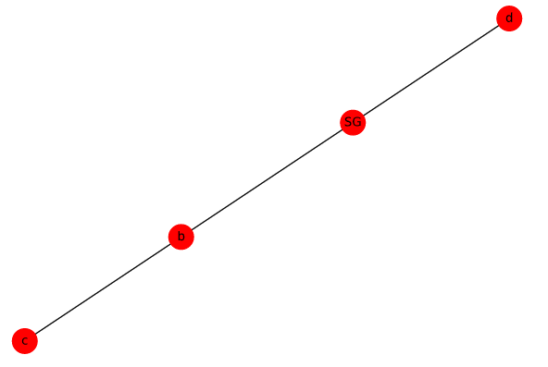
relabeling

Slide 12
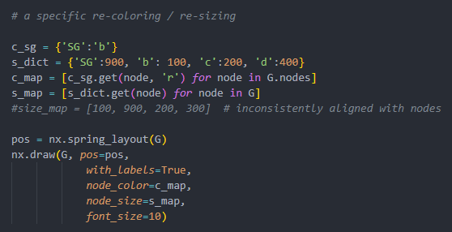
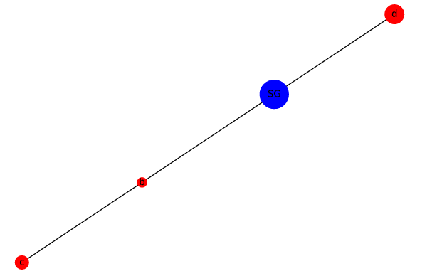
re-coloring/ re-sizing

Slide 13
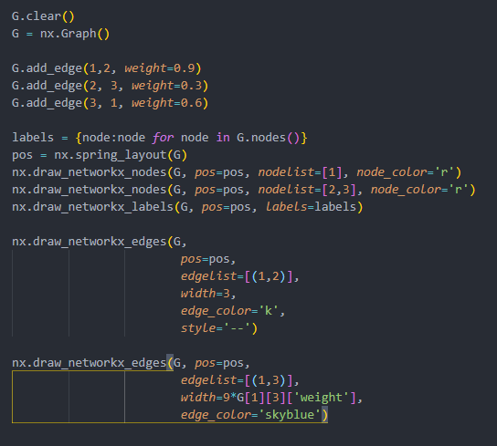
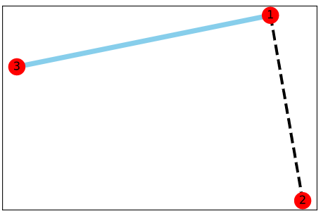
color:size:type: nx.draw_networkx_(nodes, labels, edges)

Slide 14
networkx graph generator 1. useful graph 2. famous graph 3. classical graph

Slide 15

Contents
Complete graph
bi-partitie graph
GNR (growing network with redirection)
Barabashi-Albert graph
Petersen graph
Karate club (Zachary)
Useful graph
Contents
Contents
‹#›

Slide 16

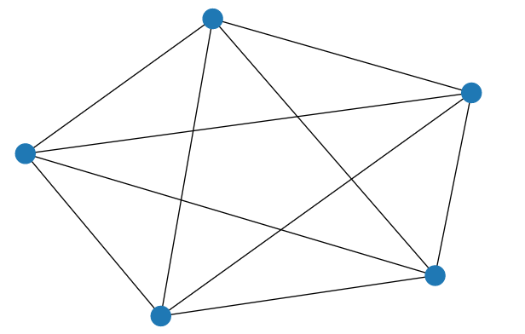
Complete graph

Slide 17
Complete Bi-partitie graph

Slide 18
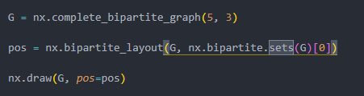
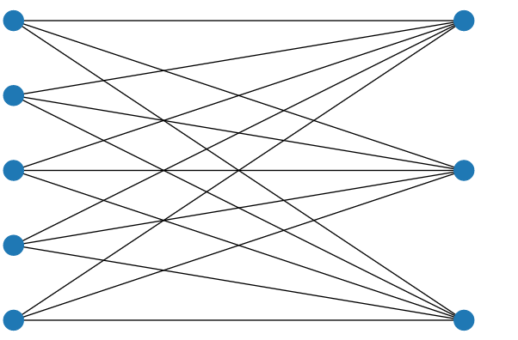
Complete Bi-partitie graph(2)

Slide 19
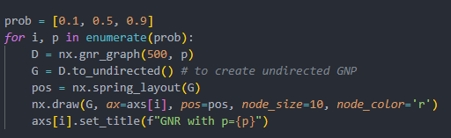
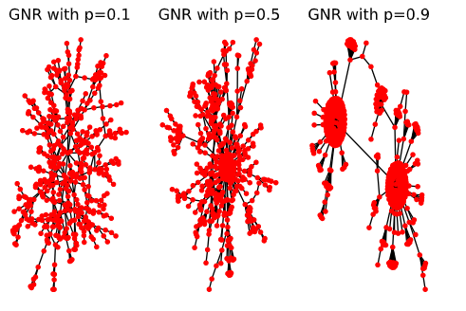
Growing network with redirection

Slide 20
GNR:
simulated a preferential attachment process; distribute among
a number of individuals objects according to they already have.
it generates a long-tail distribution
example: the number of citations,
the wealth of extremely wealthy individuals,

Slide 21
Barabasi-Albert model
BA or scale-free model says that network develops following
two steps
1. growth: add a new node with m links
2. preferential attachment: new node to node i depends on it’s
degree

Slide 22

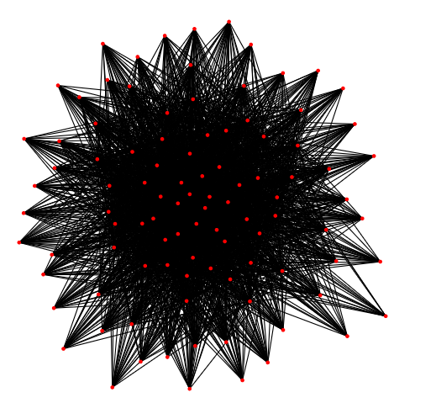
Barabasi-Albert model

Slide 23

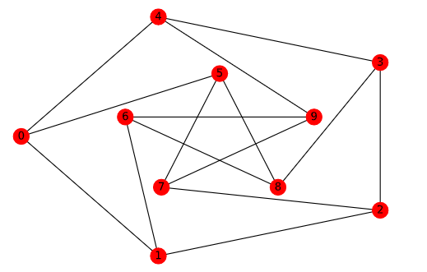
Petersen Graph (math)

Slide 24

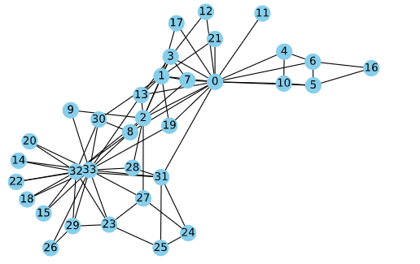
Karate Club graph: an example of community structure

Slide 25
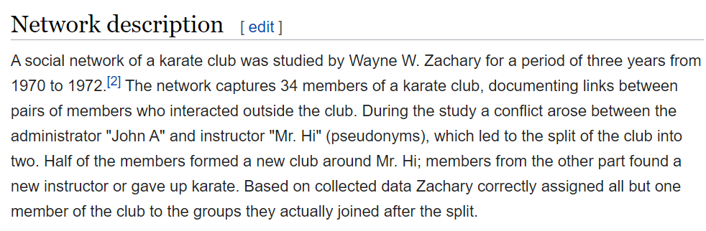
Karate club (from wiki)

