Slide 1
preliminary: no circulation please
GCN embedding
(pyG)
정재식
서강대학교 경제학부

Slide 2
GCN embedding Karate club data
How to import the data?
Export pyG data to networkX
How to train and embed?
See pyG_tutorial_gcn_embedding_karateclub.ipynb

Slide 3
Import karate club data
from torch_geometric.datasets import KarateClub
dataset = KarateClub
data= dataset[0]
G = nx.karate_club_graph()

Slide 4
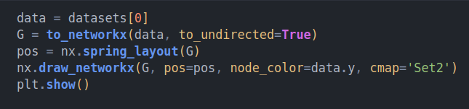
PyG data to nx plotting

Slide 5
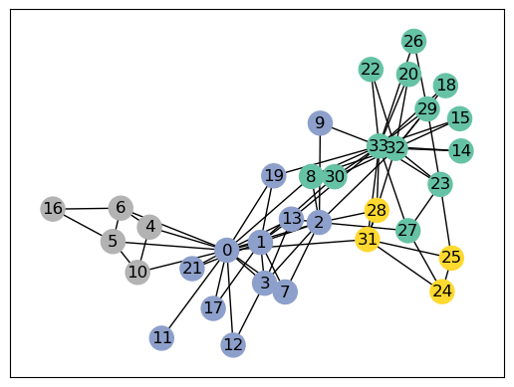
PyG data to nx plotting

Slide 6
Embedding the data
Import library
Create GCN library
Instantiation of GCN
Train

Slide 7
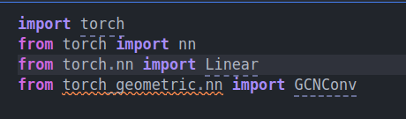
Embedding the data: Library
Import library
Create GCN Module
Instantiation of GCN
Train

Slide 8
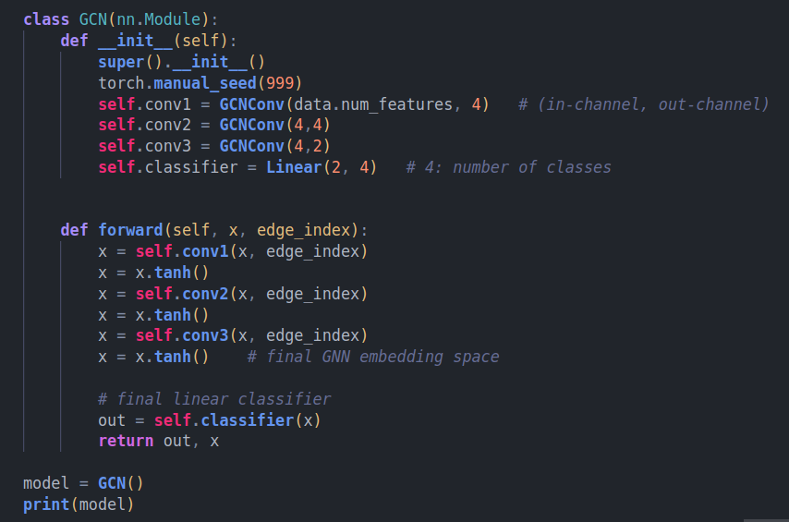
Embedding the data: GCN
Import library
Create GCN Module
Instantiation of GCN
Train

Slide 9
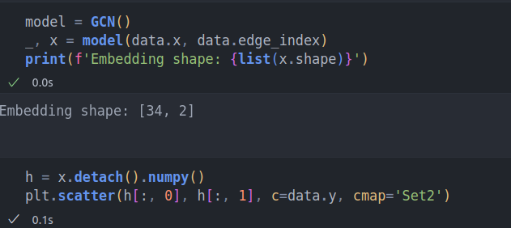
Embedding the data: GCN
Import library
Create GCN Module
Instantiation of GCN
Train

Slide 10
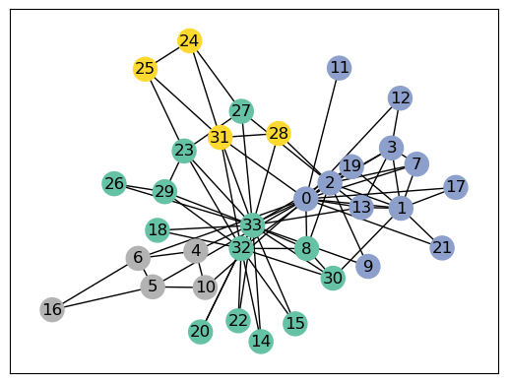
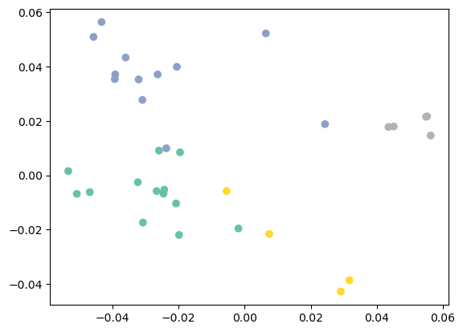
Embedding the data: GCN
Original graph
Graph embedding

Slide 11
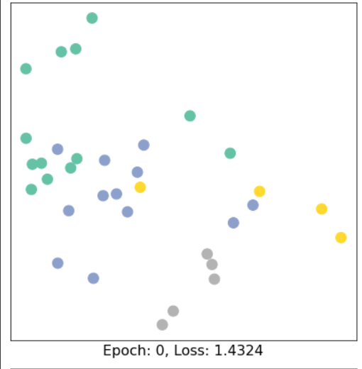
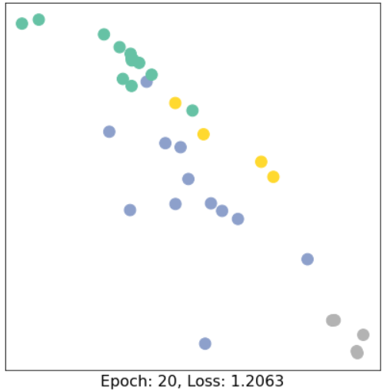
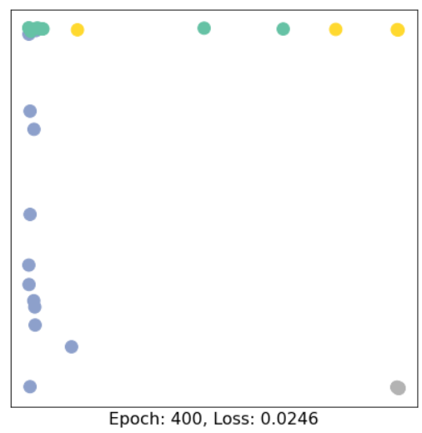
Embedding the data: GCN
As epoch gets bigger, the graph gives linearly separable embedding

