Slide 1

myHomeSearch

Slide 2
myHomeSearch a Customized Home Search App
A home search app that uses a preferred school district or even a specific school address as a starting point for the search.
Search result will be homes for sale within the boundary of that school district or that specific school.
Starting point is not limited to a school, it could be a work place and the search boundary will be some radius from that point.

Slide 3
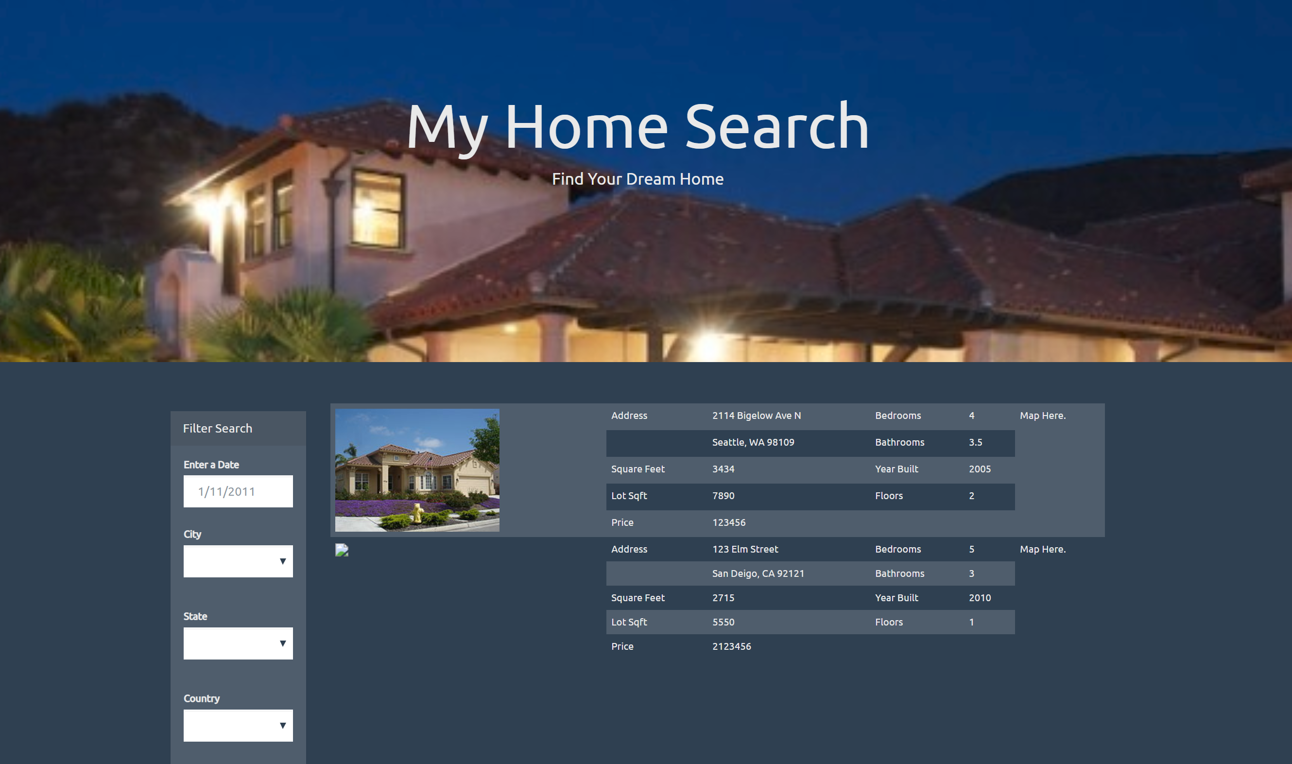

Slide 4
Resources
Zillow API
Cartographic Boundary Shapefiles - School Districts https://www.census.gov/did/www/schooldistricts/data/boundaries.html
American Fact Finder - San Diego County School Districts (Elementary) Poverty and Income - General Economic Characteristics https://factfinder.census.gov/faces/tableservices/jsf/pages/productview.xhtml?pid=ACS_17_5YR_DP03&src=pt

