Slide 1
DAT-NYC-1.17 Final Presentation: Predicting “BABIP”
by Corey Schwartz

Slide 2
What is BABIP?
Batting Average on Balls In Play
In baseball, it is one of the main components of “Batting Average”, along with Home Runs and Strike Outs
The other 2 components are more predictable, and it’s easier to identify trends within them
BABIP fluctuates, and higher or lower BABIPs are often attributed to “luck”
When predicting BABIP, analysts often assign players the league average, or perhaps an arbitrary number similar to the players’ BABIPs from the previous season(s)
I attempted to identify other statistics (features) that correlate with and could predict BABIP

Slide 3
Hypothesis
My Hypothesis: BABIP correlates positively with the type of hits a player hits (i.e., line drives instead of fly balls, which are in the air longer), the speed of the player (fielders have less time to throw him out), and the power of the player (harder to make outs on harder hits); it also correlates with the age of the player (better in the player’s “prime” years)
My Goal: Develop a formula that, given other statistics (or predicted statistics) of a player, would accurately predict his BABIP

Slide 4
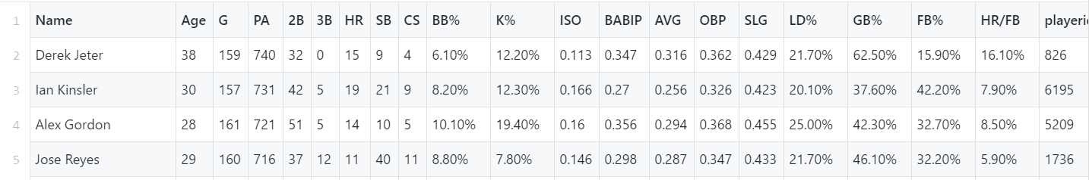
The dataset
Fangraphs.com – export custom statistics from any given season for every Major League Baseball player
Pulled in 5 CSVs like this (1 for each year 2012-2016), combined them into one DataFrame
Only kept instances where PA > 200
In addition to the target variable (BABIP), only kept potentially relevant other statistics:
SB/PA (the SB column divided by the PA column) – a proxy for a player’s “speed”
HR/FB – a proxy for a player’s “power”
LD%
GB%
Age (integer)

Slide 5
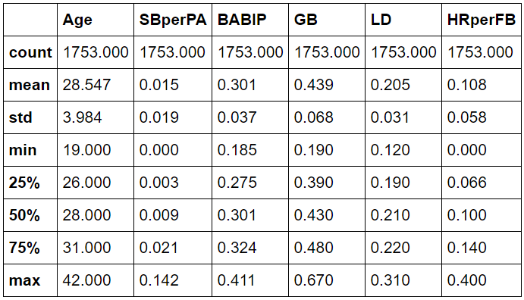
The dataset
The data I ended up using:
I also turned “Age” into dummy variables (Age_20 through Age_42, dropped Age_19)

Slide 6
Data pre-processing and Model selection
Train-Test Split: 80% Train, 20% Test
StandardScaler: Standardized X_train and X_test
Models:
Linear Regression – this would be ideal, as it would be transparent and easiest to explain to my co-workers and any other audience
Random Forest Regression – see if this would be more accurate than a Linear regression. Would also be nice to see “feature importance”

Slide 7
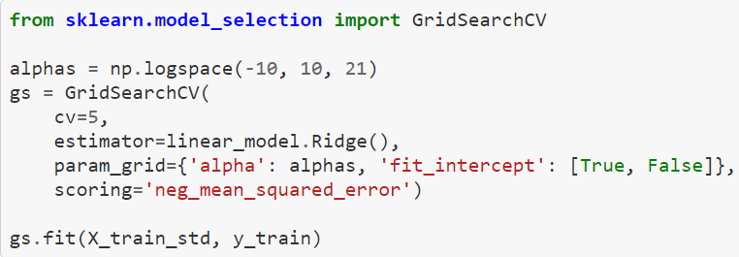
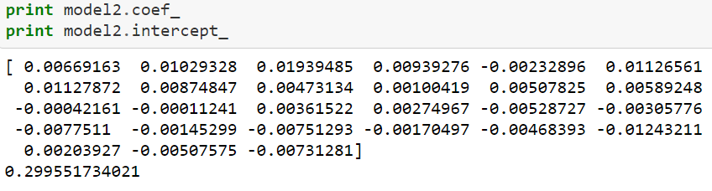
Linear model
Regularization: Ridge, used GridSearchCV to find optimal alpha (10.0, fit_intercept = True)
Coefficients and Intercept:

Slide 8
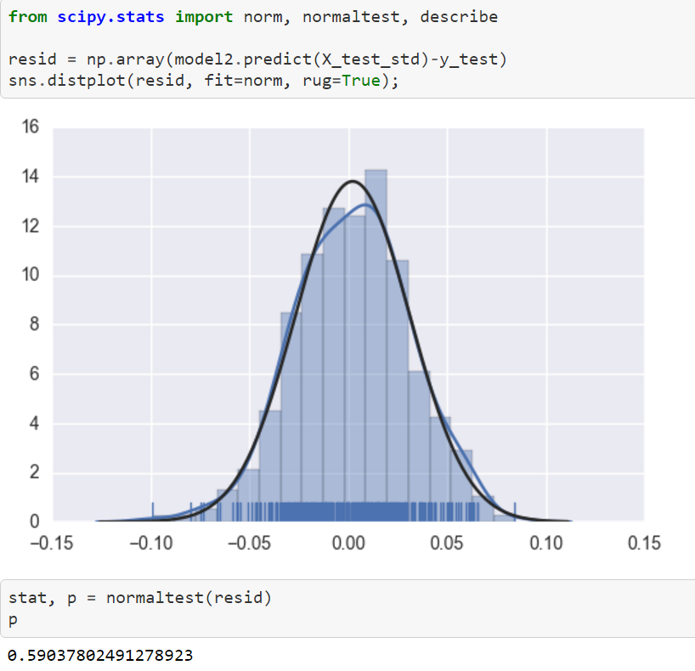
Linear model, cont’d
Evaluation: MSE = 0.000841
Test Normality of Residuals
Conclusion: This model has an OKAY MSE. 0.0008 looks low, but the square root, 0.028, is a rather large portion of the average BABIP (0.300). The residuals are approximately normal, so the model works.

Slide 9
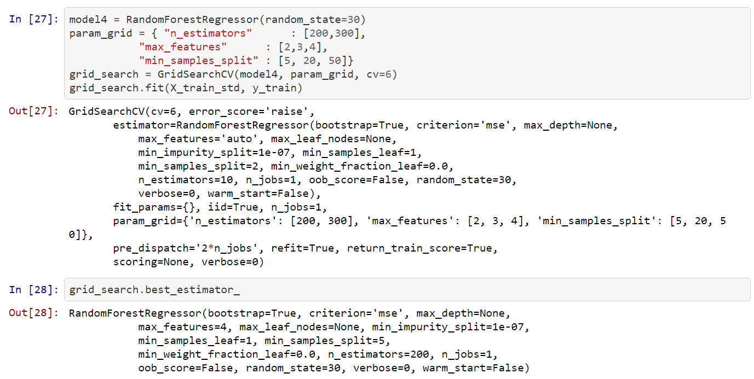
Random forest model
Tuning: Used GridSearch to optimize “n_estimators”, “max_features”, and “min_samples_split”
Without doing this, I was severely overfitting – thanks to Nico for showing me how to do this!
Best_estimator_: n_estimators = 200, max_features = 4, min_samples_split = 5

Slide 10
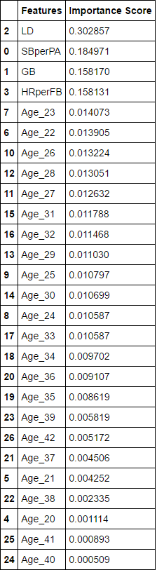
Random forest model, cont’d
Feature Importance:
Evaluation: MSE = 0.000905
Ridge Model MSE = 0.000841
Conclusion: This model is more complicated to explain, less transparent, and less accurate than the regularized linear model, so would want to use the linear model for predictive purposes
Observations from Feature Importance: LD% is easily the best indicator of high BABIP, with speed (SBperPA) a distant 2nd

Slide 11
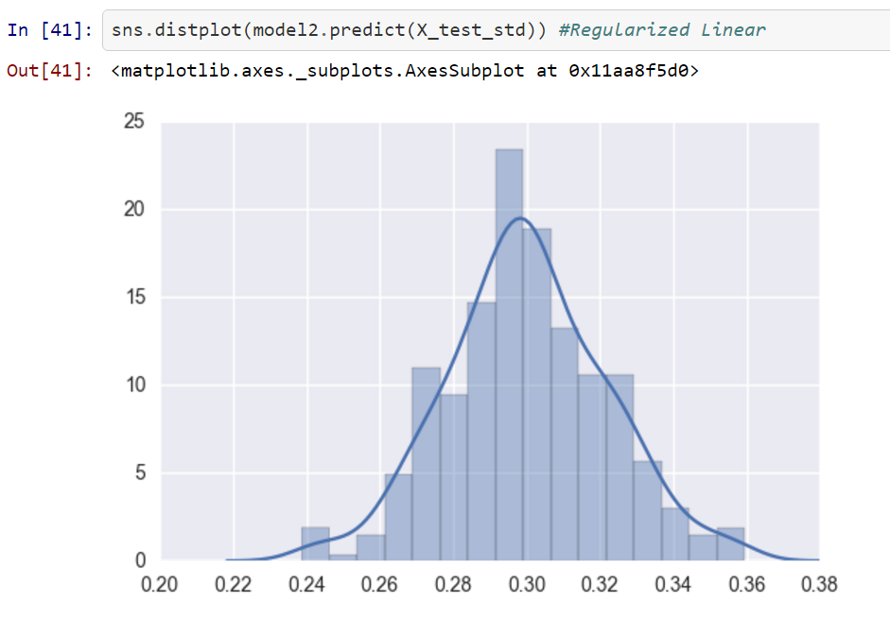
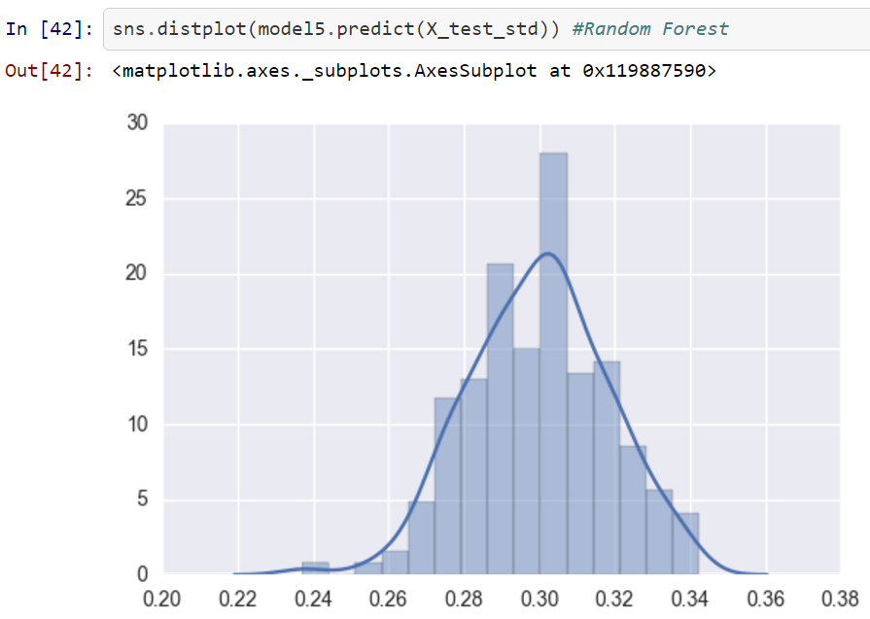
Visuals: normality of predicted babip

Slide 12
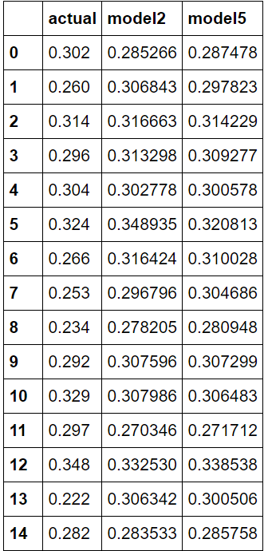
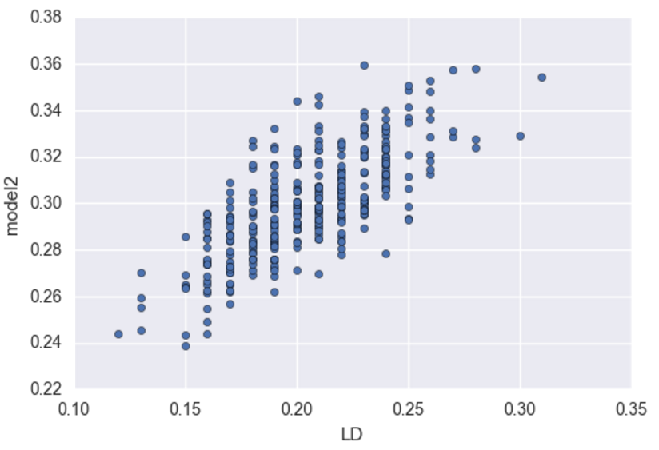
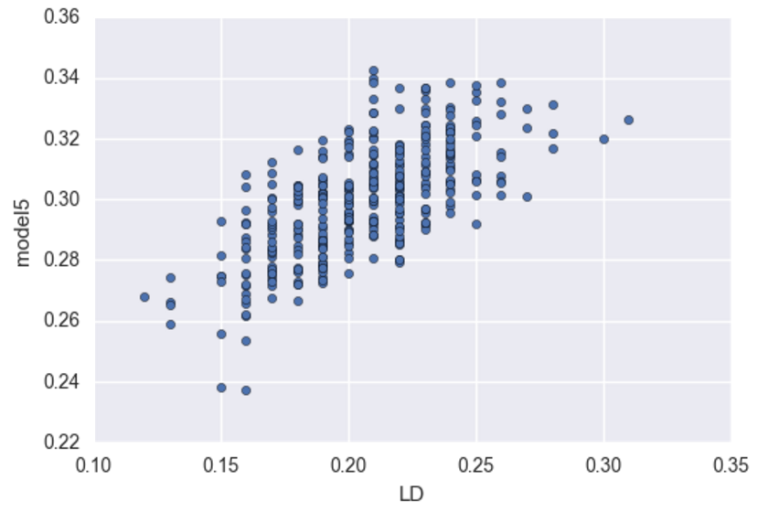
Visuals: comparison of predictions
Predicted BABIP vs. LD% (most important feature)
Note: model2 = regularized Linear;
model5 = Random Forest

Slide 13
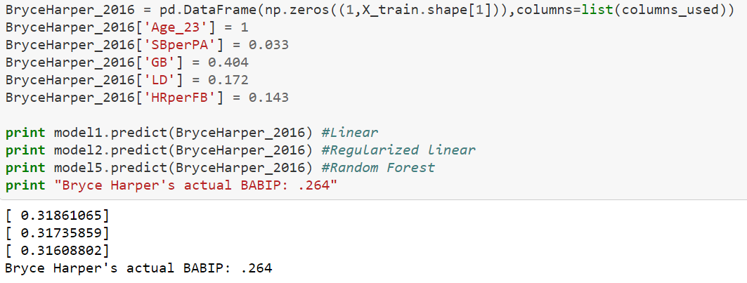
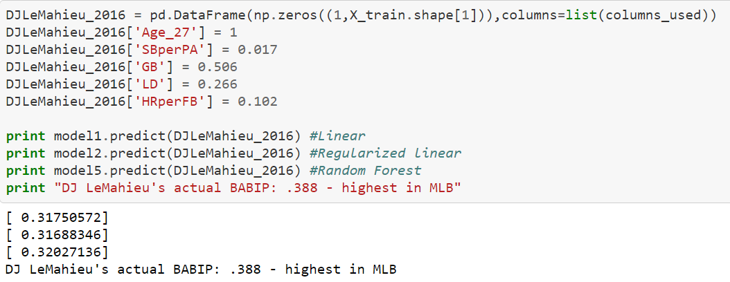
Application of the models
Bryce Harper, 2015 NL MVP, was unlucky in 2016 when he posted a .243 batting average (with .264 BABIP)
He’s young and close to his prime years, he is faster than average, and he is more powerful than average, and his BABIP should be average to above-average, rather than well below average
DJ LeMahieu, 2016 NL Batting Champion, was lucky in 2016 when he posted a .348 batting average and .388 BABIP (both highest in MLB)
However, it would be foolish to assume regression to a league-average BABIP. His prime age, above average speed, and, most importantly, very high Line-Drive rate, make him a tough hitter to get out. He should post above-average BABIP.

Slide 14
Issues with the models
Additional Statistics could/would improve the model
Ballpark
Spray chart / hit directions
Exit velocity (direct measure of how hard a hitter hits the ball)
In some cases, common sense should prevail
Some players are not “normal” – they get paid $30million for a reason
The model projects these players closer to league-average than they should be
Perhaps inclusion of more, and more innovative, statistics (like the above) would explain the sustainability of these players’ abnormal results
For now, I hesitate to use machine-learning only to project these types of players

