Slide 1

STATISTICAL MODELING OF NEST SURVIVAL USING
COX PROPORTIONAL HAZARDS MODEL AND
PARAMETRIC SURVIVAL TIME REGRESSION
Nadav Nur, Mark Herzog, Aaron Holmes, and Geoffrey Geupel PRBO Conservation Science, 15 June 2005

Slide 2
Outline of Talk
Introduction to Survival-time Analysis
  History,
  Concepts and Taxonomy
“How to Guide” for conducting ST Analyses
Example of ST Analysis: Loggerhead Shrikes in OR
Example of ST Analysis: Song Sparrows in SF Bay
Comparison of ST Analysis with Other Methods,
  Example of Logistic Exposure
Strengths and weaknesses of ST Analysis
Challenges for conducting age-specific survival analyses,
  implications for field studies
Next steps for analyses, validation, simulations

Slide 3
Introduction I
What is Survival Time Analysis?
ST Analysis is easy to use, readily and widely available, statistically powerful, very quick, in particular easy to analyze data “on the fly”, with well-developed statistical theory, statistical applications, and diagnostics.
Maximum-likelihood method; hence can use Information-theoretic methods
Today’s objectives:
Introduce ST Analyses to avian ecologist, ornithologists
Provide examples
Show how to implement and interpret ST Analysis
Compare ST Analysis with Other Methods
Discuss implications for field data collection and analysis
For the future:
Conduct computer simulations to determine accuracy, sensitivity to errors in aging, for ST Analysis and other methods

Slide 4
Introduction II: What is Survival Time Analysis?
Goes by different names:
  Survival Analysis
  Time to Failure Analysis (“Failure Time Analysis”)
  Time to Event Analysis (also Time to Occurrence)
ST Analysis includes 3 different types of analyses
Descriptive (Kaplan-Meier survival function, Log-rank test)
Semi-parametric regression
  Cox regression: Cox Proportional Hazards Model and variants, e.g., Accelerated Failure Time, non-proportional hazards
Parametric regression (Parametric survival regression)
  Weibull, Exponential, Gompertz, Log-logistic, Generalized Gamma

Slide 5
Survival Time Analysis: Past and Present
ST Analysis has long history:
Cox model goes back to 1972. Weibull to 1973 (earlier?). Kaplan-Meier to 1958.
Very widely used: Dozens of current texts available; thousands of papers have been written using these methods
New methods and new statistical treatments developed all the time.
Most widely used in biomedical fields, but others as well (engineering).
Much software available:
SAS, S-Plus, R, STATA; many free programs available.
Many books have been written specific to each software program,
e.g., Allison (1995) for SAS;
Cleves et al. (2002) for STATA, also Hosmer & Lemeshow (1999).

Slide 6
Introduction III:
Key to Survival Time Analysis is “time”
An individual (or nest) is at risk of failure, starting at time t = 0.
For example, call the day the first egg is laid, t = 0.
  For example for Song Sparrow: t = 0, 1, 2, 3, …23
One follows the fate of that nest until it fails (dies, etc.).
one records the number of days the nest survives.
If the nesting period is always 23 days, then a successful nest will have survived all 23 days and has an unknown time of failure.
  But this nest will be very informative. It is included, not excluded.
ST Analysis analyzes the fraction of nests surviving to time t, S(t),
e.g., focus of Kaplan-Meier function
STA also analyzes the hazard rate,
  h, = daily probability a nest dies,= 1 – Daily Survival Rate.
  h(t) = is probability a nest “alive” on day t fails between t and t+1
Cox model, and parametric regression focus on analysis of h(t)

Slide 7
Introduction IV:
In other words, the key variable is h, a function of t, time.
Note: could be h(t) = c, a constant (i.e., the Mayfield assumption).
One then models h as a function of other factors and covariates.
Two approaches:
Fit parameters to estimate h as an explicit function of t (e.g., Weibull)
Use a non-parametric approach for h(t), i.e., a smoothing approach but develop parametric model for the other factors that influence h(t).
  This is the Cox model.
Censoring
ST Analysis incorporates “left-censoring”, i.e., nests are found at various ages, i.e., enter the study at t=1, 2, …
  Assumption: the age of the nest, when it enters the study, can be determined.
  Note: can study nest survival from hatching, i.e., t=0 is hatching day.
ST Analysis can incorporate “right-censoring”, i.e., ultimate fate of nest may be unknown. For example, nest was known to be active at day 18, but fate after that is not known (e.g., study stopped; nest plot not revisited). Available data are used.

Slide 8
How to code data and analyze with STA: example using STATA
For each nest, need to code age of nest when first discovered (or “entered”). e.g. “findage” This allows us to track t, the time variable.
For unsuccessful nest need to code age at which it failed.
Call this age variable, ‘florfa_age”
These nests have indicator variable failed=1
For successful nests need to code age at which nest “fledged” (succeeded).
For nests with unknown outcome, need to code age at which fate was last known.
These nests have indicator variable failed=0
Here, too, we use the same variable “florfaage”. i.e., age at which nest exits the study
In STATA, you need to define or “set” the ST data:
stset florfa_age, failure(failed) enter(findage).
That’s it. Can now run survival time analyses,
e.g., stcox nestheight
Streg nestheight, distribution(weibull)

Slide 9


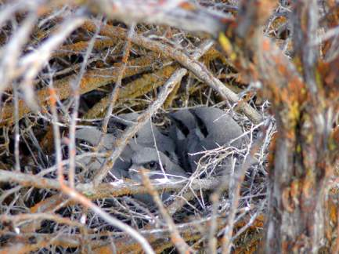
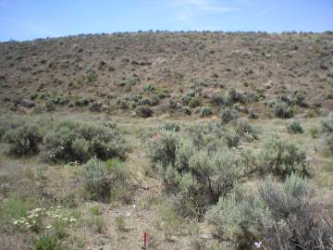
Loggerhead Shrike Example
2500 ha census area (1995-1997)
Local population ranged from 35 to 38 pairs
  146 nests found and monitored over 3 years
  137 nests could be aged reasonably
Mean clutch size 6.16 (4-8)
Total period = 39 days
  laying = 5.5 d
  incubation = 16.5 d
  nestling = 17 d

Slide 10
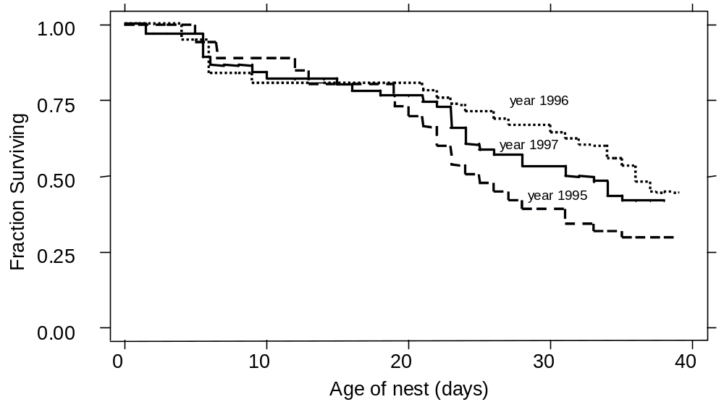
Kaplan Meier Survival: By Year
Both a Year Effect and a Date effect in the AIC preferred model (Cox regression and Weibull regression results)
Hatching = day 22

Slide 11
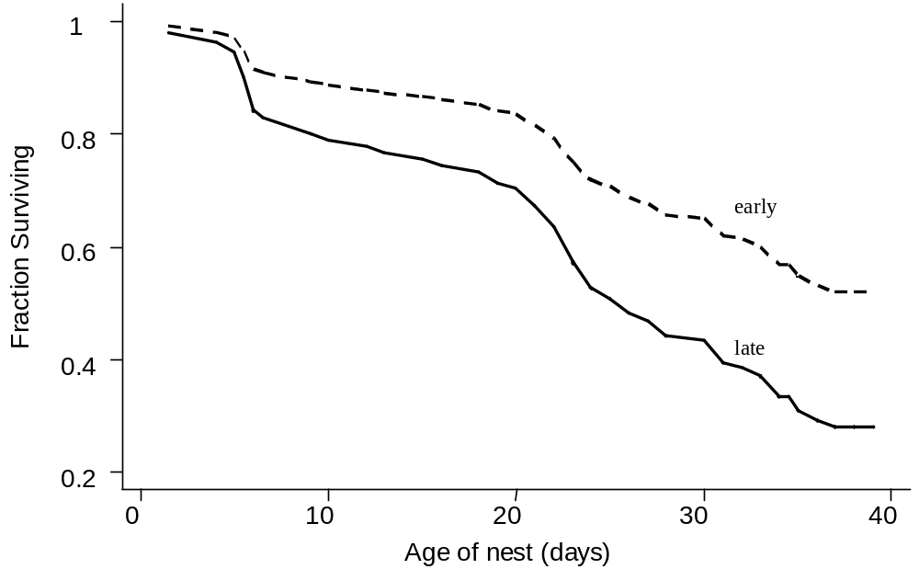
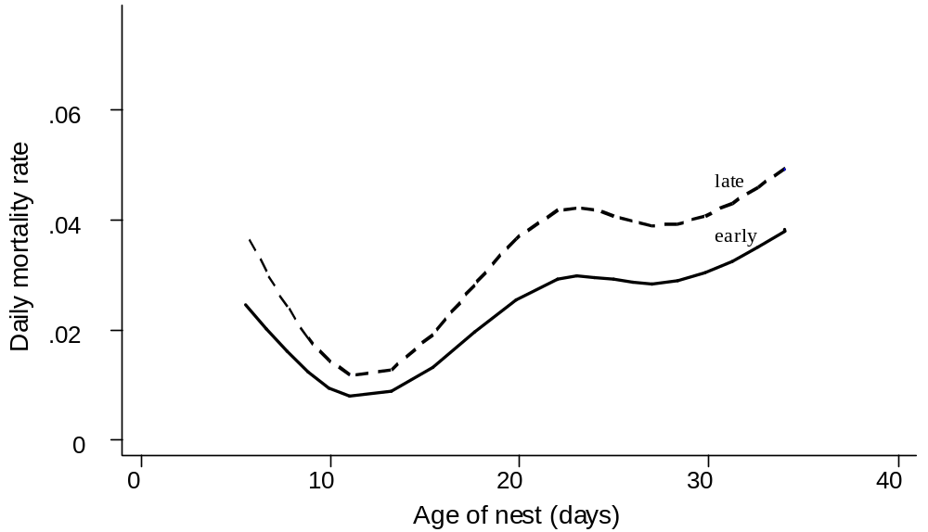
Cox Model: Comparison of Early and Late Nests
Survival function
Hazard ratio estimate = increased daily nest mortality rate by relative 1.2% per day,
or increased by 13% per 10 day period.
Increased by 94% comparing early and late nests
Early
Late
h, Hazard Rate
Late
h(t) = h₀(t)exp(β₁x₁ + β₂x₂)
ln h is a linear function of predictor variables

Slide 12
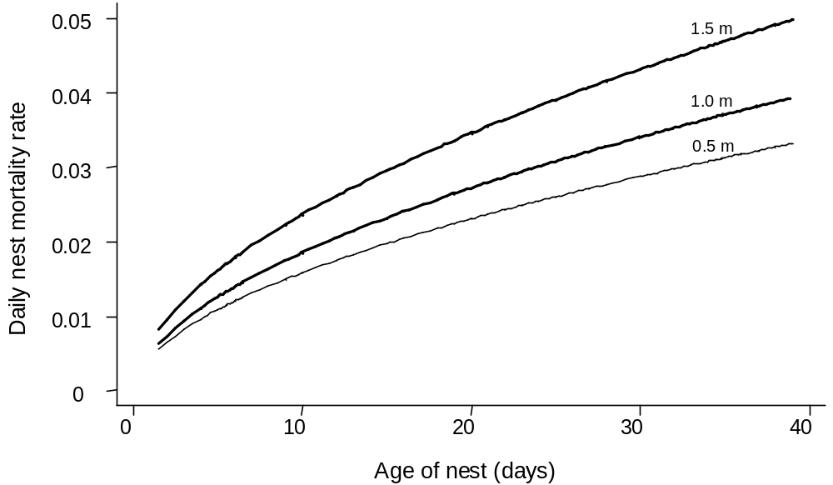
Weibull Regression example: Nest height

Slide 13


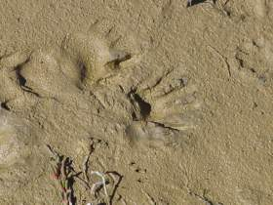
Song Sparrow Example
Suisun Song Sparrow Nest
PRBO’s studies of reproductive ecology of Song Sparrows in San Francisco Estuary:
Data set analyzed, 1997 – 2004
7 sites: 5 in San Pablo Bay, 2 in Suisun Bay
N = 969 nests with good information on nest age (nests found during building or egg-laying).
Nests visited every 2 to 3 days

Slide 14
Number of Tidal Marsh Song Sparrow Nests
 | 1997 | 1998 | 1999 | 2000 | 2001 | 2002 | 2003 | 2004 | Total
Black John Slough |  |  | 17 | 10 | 16 | 32 |  |  | 75
China Camp State Park | 40 | 48 | 65 | 71 | 60 | 39 | 52 | 29 | 404
Petaluma Restor Marsh |  |  |  |  |  |  |  | 22 | 22
Pond 2A |  |  |  |  |  |  |  | 9 | 9
Petaluma River Mouth | 8 | 10 | 12 | 33 | 10 |  |  |  | 73
Rush Ranch | 9 | 8 | 7 | 8 | 8 | 12 |  | 14 | 66
Benicia State Park | 80 | 34 | 24 | 31 | 35 | 40 | 49 | 27 | 320
Total | 137 | 100 | 125 | 153 | 129 | 123 | 101 | 101 | 969

Slide 15
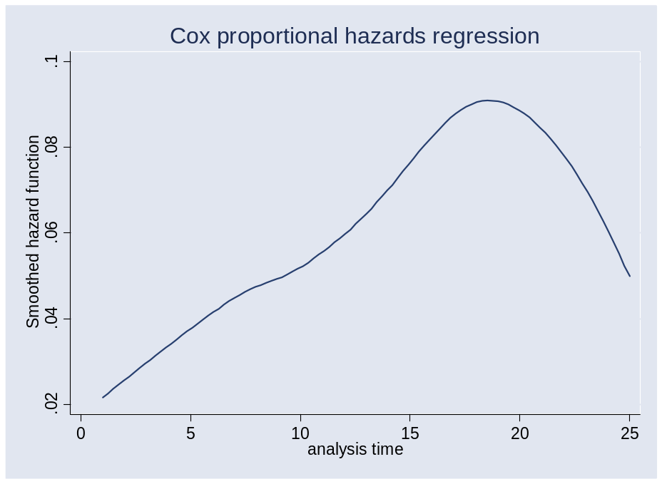
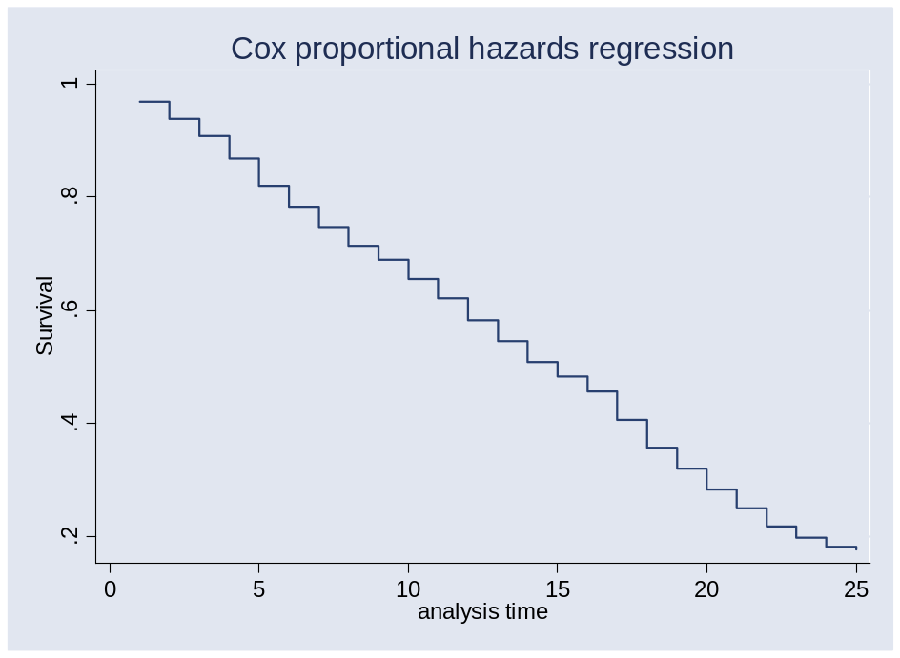
Cox results: baseline hazard function
Mortality a non-linear function of nest age (best approximated by fourth-order)

Slide 16
Overall Survival in Relation to Year Site
Site | S to d22 |  | Year | S to d22
Black John | 0.213 |  | 1997 | 0.207
China Camp | 0.282 |  | 1998 | 0.106
Pet Restor Marsh | 0.134 |  | 1999 | 0.203
Pond 2A | 0.444 |  | 2000 | 0.280
Pet Riv Mouth | 0.312 |  | 2001 | 0.297
Rush Ranch | 0.104 |  | 2002 | 0.230
Benicia | 0.185 |  | 2003 | 0.313
 |  |  | 2004 | 0.204

Slide 17
Model Selection (Year and Site) – Cox model
Used hierarchical approach: first model year and site effects
Model | Deviance | K | ΔAIC_{c} | Weight
Year + Site | 9464.94 | 14 | 0 | 0.824
Site | 9482.36 | 7 | 3.10 | 0.175
Year + Site + Year*Site | 9437.72 | 34 | 14.90 | 0.000
Year | 9496.25 | 8 | 19.02 | 0.000
Intercept Only | 9513.90 | 5 | 30.59 | 0.000

Slide 18
Model Selection (Date, with Site and Year) – Cox Model
Next model date using results from first stage
Model | Deviance | K | ΔAIC_{c} | Weight
Site + Year + ln(Date) | 9426.92 | 15 | 0.00 | 0.521
Site + Year + Date + Date² | 9426.42 | 16 | 1.57 | 0.238
Site + Year + Date | 9429.34 | 15 | 2.42 | 0.155
Site + Year + Date + Date² + Date³ | 9426.38 | 17 | 3.60 | 0.086
Site + Year | 9464.94 | 14 | 35.95 | 0.000

Slide 19
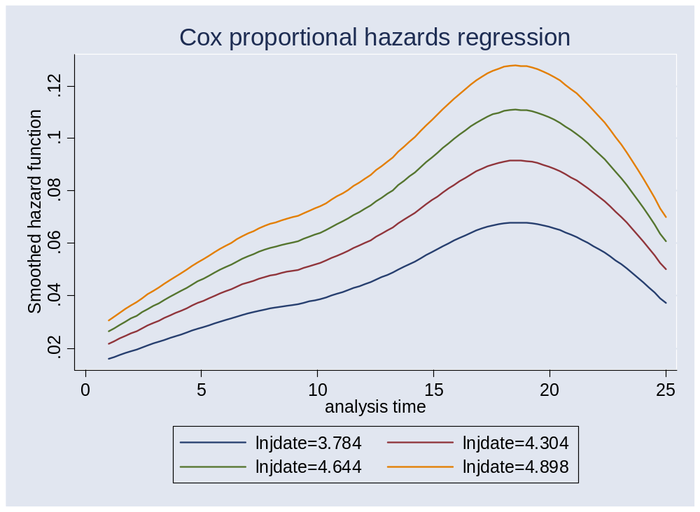
Preferred model so far: includes Site, Year, Date
Effect of laying date,
Estimated effect of laying date = 0.77% (SE = 0.12%) increase in daily mortality rate per day (n.b. range is 123 days, earliest to latest).
Between day 15 and day 21, daily mortality rate is about double for mid-June nests compared to mid-March nests, 6% vs. 12%. That is, a strong effect.
Relative increase of 26% per month.
June
May
April
March
F

Slide 20
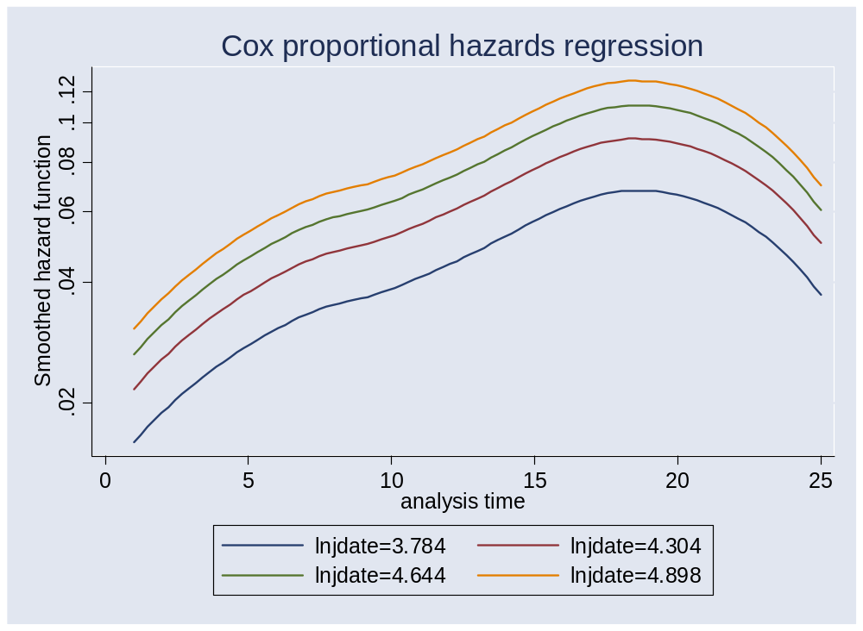
Effect of laying date; non-linear
But it is also a non-linear effect: negative quadratic, decelerating (less and less of a date effect as the season progresses)
June
March
ln h is a linear function of predictor variables
F

Slide 21
Final Model Selection – Cox Model
Effect of nest height
Model | Deviance | K | ΔAIC_{c} | Weight
Site + Year + ln(Date) + NestHeight + NestHeight² | 9170.53 | 17 | 0.00 | 0.374
Site + Year + Date + Date² + NestHeight + NestHeight² | 9170.10 | 18 | 1.64 | 0.164
Site + Year + ln(Date) + NestHeight | 9174.26 | 16 | 1.65 | 0.164
Site + Year + ln(Date) | 9176.45 | 15 | 1.78 | 0.154
Site + Year + Date + Date² + NestHeight | 9173.77 | 17 | 3.23 | 0.074
Site + Year + Date + Date² | 9175.96 | 16 | 3.35 | 0.070

Slide 22

Effect of Nest Height controlling for Year, Site, Date
Interpretation:
Estimated effect of nest height is overall positive,
But is also a positive quadratic, a “true” quadratic.
Mortality rate decreases from 1 cm to 24 cm, reaches at minimum at 24 cm, then increases to maximum at 1 meter
Estimated effect is 46% higher nest mortality rate for 1 m high nest compared to 1 cm high nest

Slide 23
Diagnostics
STATA and other programs can calculate:
Cox-Snell residuals: overall model fit, including proportional hazards assumption
Martingale residuals: assessing the functional form of covariates
Schoenfeld and score residuals: examining proportional hazards assumption, leverage points (i.e., influential data points)
Deviance residuals: assessing model accuracy and identifying outliers
Graphical methods available and Goodness of fit tests

Slide 24
Diagnostics: example of evaluating Schoenfeld residuals
. stphtest, rank detail
Test of proportional hazards assumption
Time: Rank(t)
----------------------------------------------------------------
| rho chi2 df Prob>chi2
------------+---------------------------------------------------
sit1 | -0.04380 1.47 1 0.2251
sit2 | -0.03685 0.95 1 0.3292
sit3 | -0.01440 0.15 1 0.6939
sit4 | 0.01018 0.08 1 0.7806
sit5 | 0.07529 4.12 1 0.0423
sit6 | -0.02099 0.34 1 0.5585
jdate1mar | -0.06904 3.55 1 0.0595
jdate1msq | 0.05008 1.94 1 0.1638
htm | -0.03786 1.17 1 0.2785
htm2 | 0.03064 0.74 1 0.3903
------------+---------------------------------------------------
global test | 15.56 10 0.1130
----------------------------------------------------------------
What to do if PH assumption fails? Use stratified Cox model.
Use Accelerated Failure Time model (with parametric regression)

Slide 25
Advanced Features
Random effects models
Referred to as “frailty” models
Example: a group of nests (e.g., same parent; same sub-plot) share similar mortality rates.
Easy to incorporate
Time-varying covariates
Individual time-varying (varies over time and is nest-specific)
  e.g., in relation to activity at the nest. Concealment of nest (if that varies)
Group time-varying (varies over time, but is common to a whole group),
  e.g., a weather variable
Accelerated Failure Time models
contrast with proportional hazards model; used with parametric regression

Slide 26
Initial Model Selection – Logistic Exposure
All models had quartic age function (4 df)
Model | Deviance | K | ΔAIC_{c} | Weight
Site + Year | 4868.85 | 18 | 0 | 0.952
Site | 4889.38 | 11 | 6.50 | 0.037
Site + Year + Site*Year | 4837.57 | 38 | 8.87 | 0.011
Year | 4901.57 | 12 | 20.69 | 0.000
Intercept Only | 4922.10 | 5 | 27.21 | 0.000
Site / Year
Same order as Cox
Site + Year + Date + Date² | 4813.44 | 20 | 0 | 0.358
Site + Year + ln(Date) | 4815.60 | 19 | 0.16 | 0.330
Site + Year + Date + Date² + Date³ | 4811.80 | 21 | 0.37 | 0.300
Site + Year + Date | 4821.91 | 19 | 6.46 | 0.014
Site + Year | 4868.85 | 18 | 51.41 | 0.000
Date
Different order

Slide 27
Final Model Selection – Logistic Exposure
Model | Deviance | K | ΔAIC_{c} | Weight
Site + Year + Date + Date² + NestHeight + NestHeight² | 4807.64 | 22 | 0 | 0.290
Site + Year + ln(Date) + NestHeight + NestHeight² | 4809.98 | 21 | 0.34 | 0.245
Site + Year Date + Date² + NestHeight | 4811.27 | 21 | 1.63 | 0.128
Site + Year + Date + Date² | 4813.44 | 20 | 1.79 | 0.118
Site + Year + ln(Date) | 4815.60 | 19 | 1.95 | 0.109
Site + Year + ln(Date) + NestHeight | 4813.60 | 20 | 1.91 | 0.109
Effect of nest height modeled similarly for Logistic Exposure and Cox

Slide 28
Resources for Survival Time Analysis
Texts- many: Hosmer & Lemeshow 1999; Collett 2003; Lee and Wang (2003); Kalbfleisch & Prentice 2002
Software packages
R, S-Plus, Stata, SAS, and many others
SAS: phreg, lifereg, lifetest (see Allison 1995)
Courses, Workshops, Online courses
User Groups

Slide 29
Strengths and weaknesses of ST Analysis
ADVANTAGES
Easily available
Free, or as part of regular-used packages
Easy to prepare data for analysis
Easy to modify analyses on the fly
Can easily and quickly fit complex models.
Wide assortment of methods available
Variety of diagnostic tools available
Many texts, much theoretical treatment
Likelihood based method
Allows for unknown outcome (implications for field studies)
Incorporates heterogeneity of failure rates and age-specific mortality
DISADVANTAGES
Need to determine age of nest when found
Need to determine age at failure for failed nests
  What is effect of interval-censoring?
Assumes “day” is the significant time variable but “stage” may be more important (cf. 2 nests each at day 12 one is incubating; the other w/ chicks)
Terminology and examples are often medically-based
AICc weights often need to be calculated; model-averaging more involved

Slide 30
Next Steps and Implications for Field Studies
Further modeling:
  Accelerated failure time
  Random Effects
  Competing Risks
Simulations to evaluate:
Best analytical methodst
  For identifying factors, their effects, and making predictions
Effect of errors in aging nests
Effect of interval censoring
What is an optimal interval? (recognizing logistical constraints)
Do different approachess work better for different interval periods?
  For example, compare studies of songbirds with studies of ducks
Implications:
Important to age nests. Most challenging to do so for nests found during incubation.
May be less important to determine ultimate fate. No need to “guess”

Slide 31
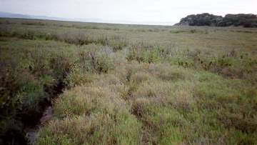
Acknowledgments
Agencies:
  Department of the Navy
  CALFED Bay/Delta Program (USDI, CA DWR),
  EPA (National Office) and NOAA
  US Fish & Wildlife Service, San Pablo Bay NWR
  California State Dept of Parks and Recreation
  Solano County Farmlands and Open Space
  CA Dept of Fish & Game
  OR Dept Fish & Wildlife
Private Foundations:
  Gabilan Foundation,Bernard Osher Foundation
  Richard Grand Foundation, Long Foundation
  Rintels Charitable Trust, Mary A. Crocker Trust
Colleagues and collaborators: Hildie Spautz, Yvonne Chan, Len Liu, Jill Harley, Nils Warnock, Kent Livezey, Russ Morgan
Numerous PRBO Field Biologists and Interns!

