Slide 1
ARL Apex APP
Robert Gehring, Cassie Schwendiman

Slide 2
Conceptual Model

Slide 3
Logical Model

Slide 4
Must Have Features
Report Downloads
Data Loading
Document Uploads
Homepage Search Bar
Region Display Selector
Trees
Shortcut
Shuttle
Group Select List
Modal Branching

Slide 5
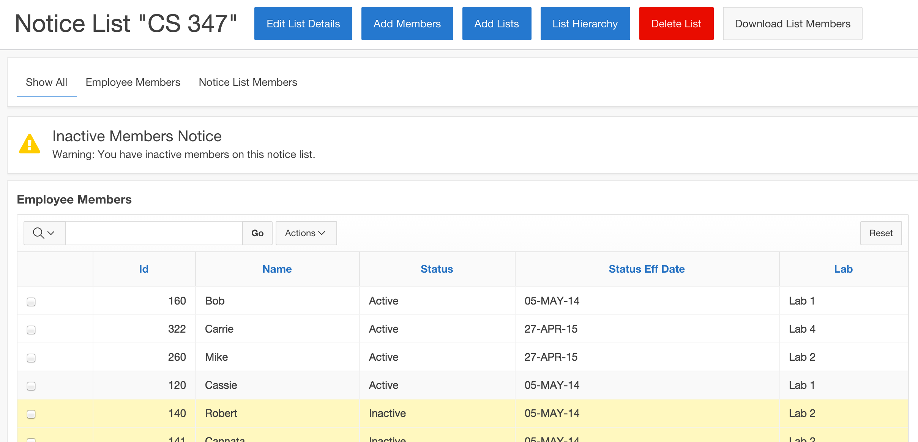
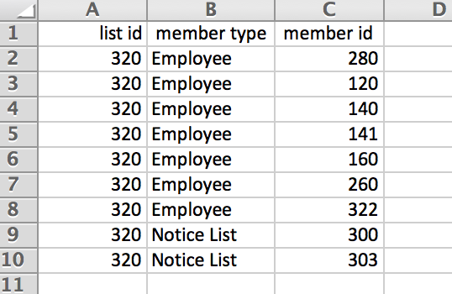
Report Downloads
Notes:
Cassie

Slide 6
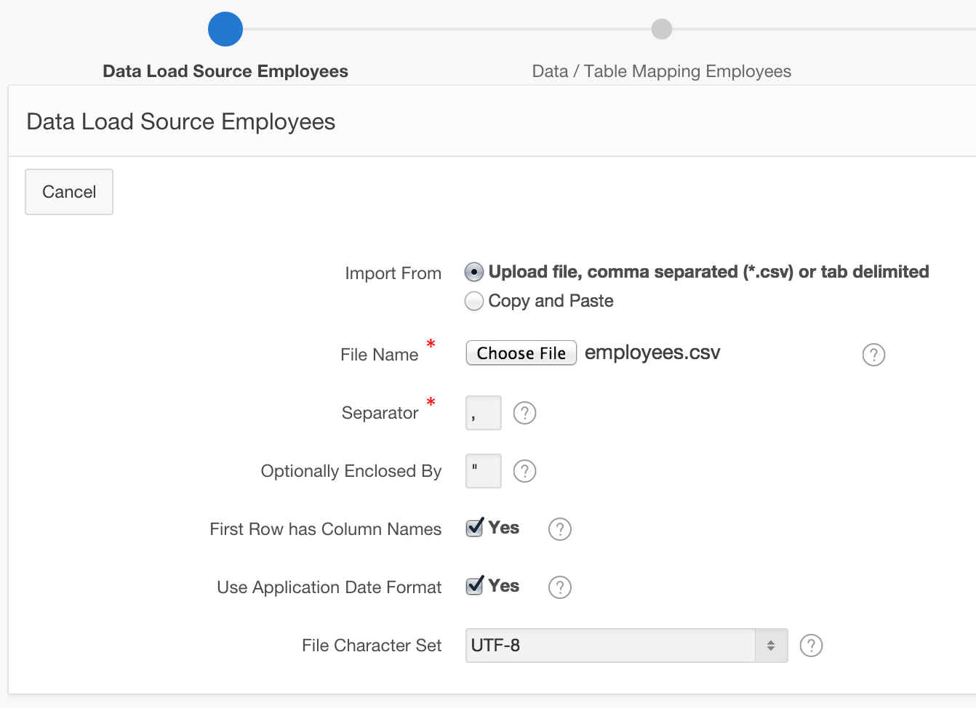
Data Loading
Notes:
Cassie

Slide 7
Document Uploads

Slide 8
Homepage Search Bar
Notes:
Robert

Slide 9
Region Display Selector
Notes:
Cassie

Slide 10
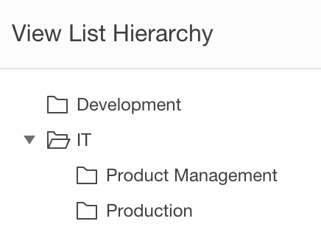
Trees
Notes:
Robert

Slide 11
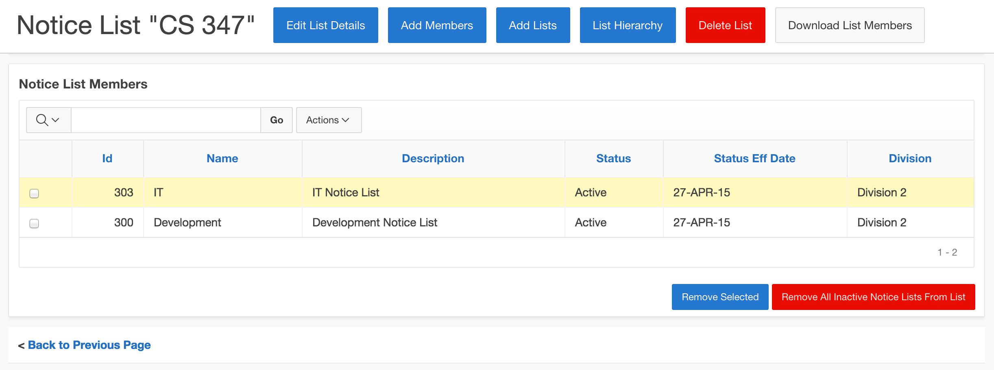
Shortcut
Notes:
Cassie

Slide 12
Shuttle
Notes:
Robert

Slide 13
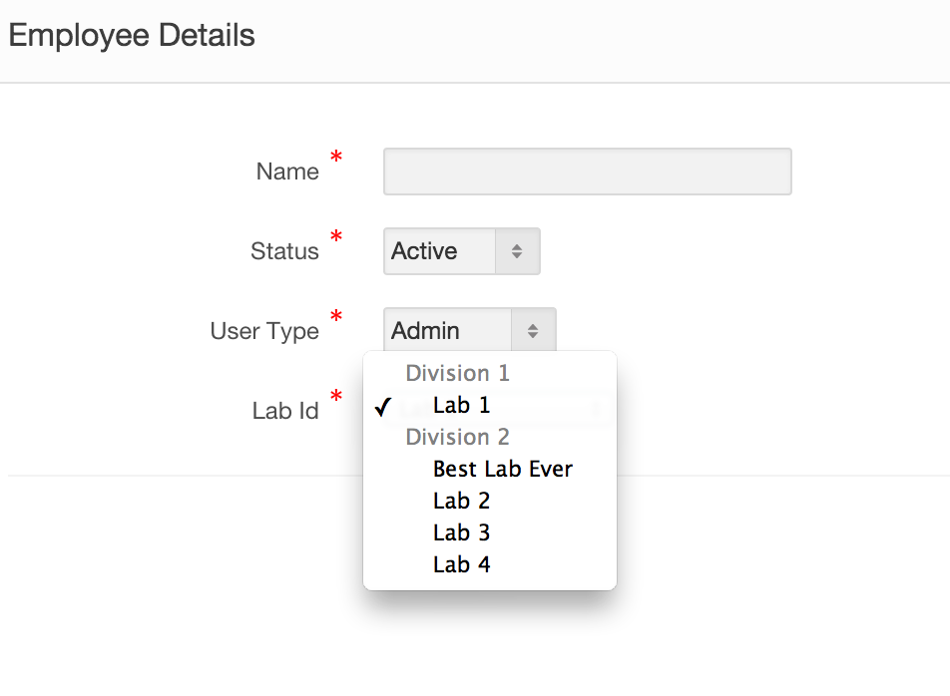
Group Select List
Notes:
Cassie

Slide 14
Modal Branching
Notes:
Cassie

Slide 15
Good to Have Features
Charts
Authorization Schemes

Slide 16
Charts

Slide 17
Authorization Schemes
Notes:
Robert

