Slide 1
ARL Apex APP
Robert Gehring, Cassie Schwendiman
https://apex.oracle.com/pls/apex/f?p=95224:1

Slide 2
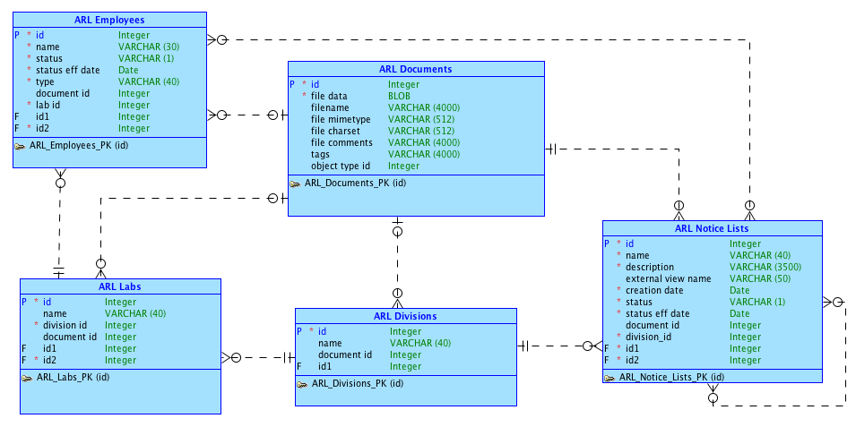
Conceptual Model

Slide 3
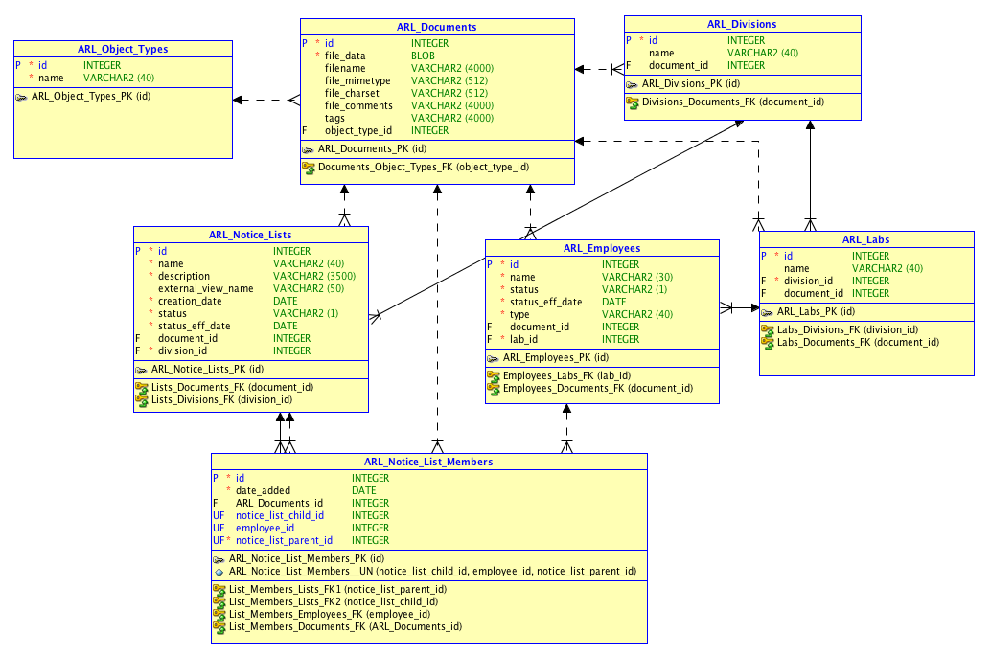
Logical Model

Slide 4
General List Maintenance
Admin Users:
Create lists (only name/description needed)
Edit lists (name, description, division, ext. view name, status)
Standard Users:
- View lists in their division, edit ONLY status

Slide 5
Authentication/Authorization Scheme
User specifies self at login (Authentication)
- Determines Admin/Standard access (Authorization)
Admin:
See all lists, create lists, edit privileges on specified fields
Standard:
See lists in their division, no create privileges, restricted edits

Slide 6
Trigger For Creating Lists
Automatically assigns:
- Id
- Status
- Create_Date
- Status_Effective_Date
- Ownership_Division_Code (maybe)

Slide 7
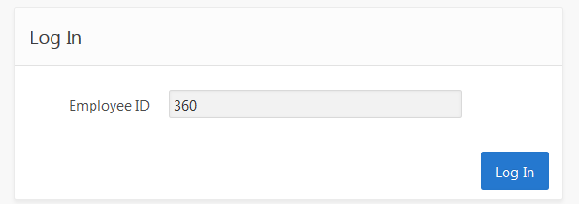
Login
Admin User
Standard User

Slide 8
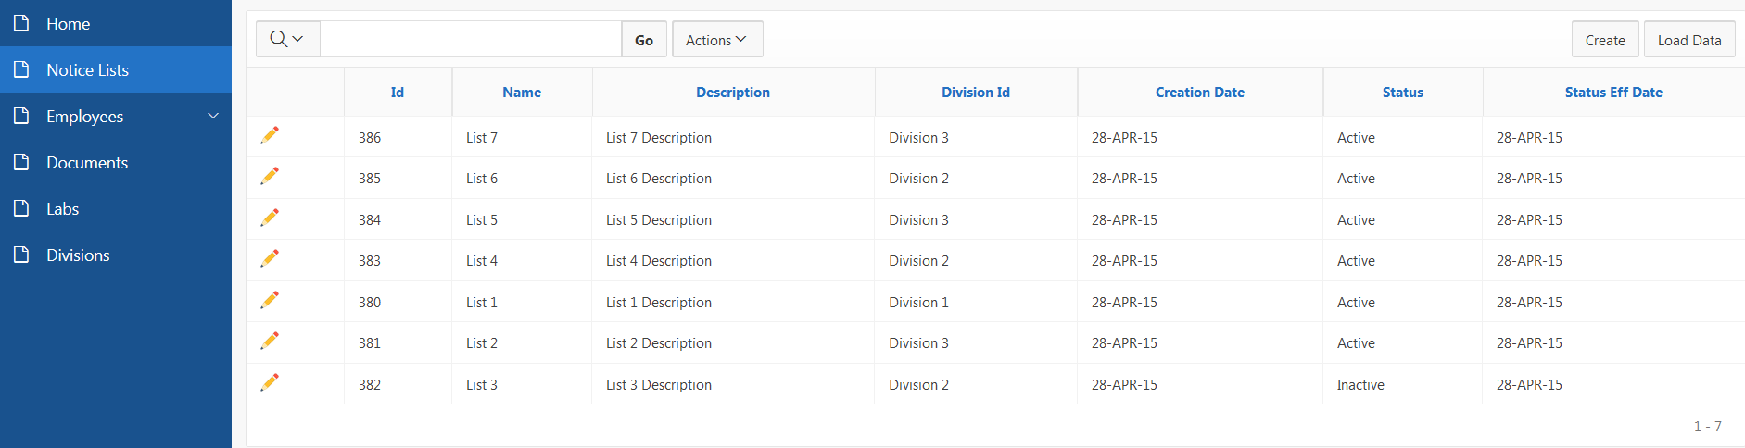
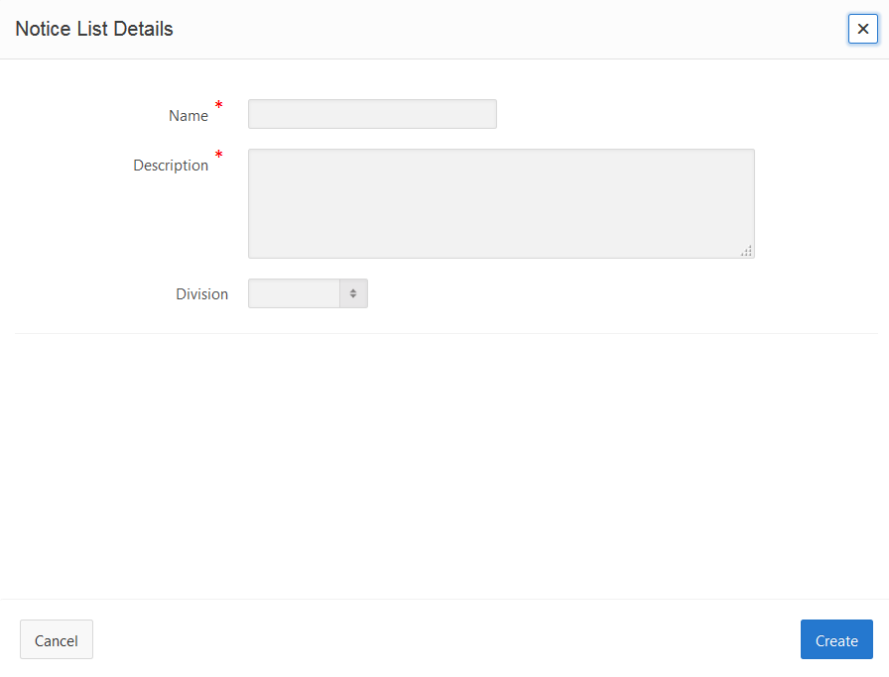
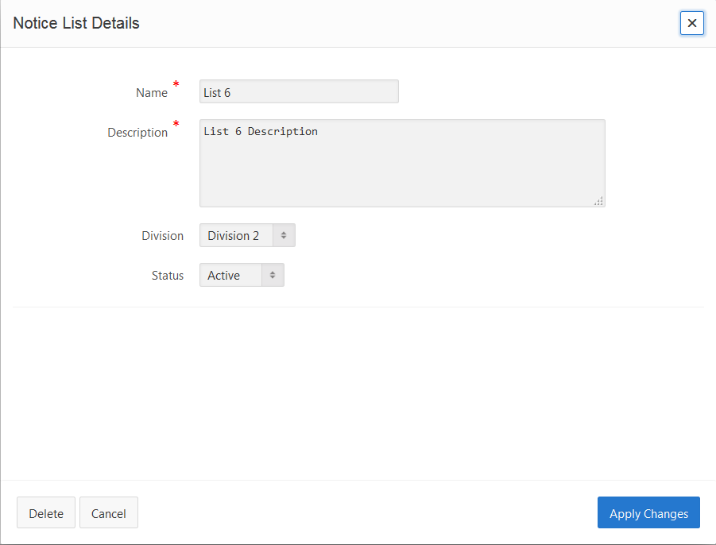
Admin User

Slide 9
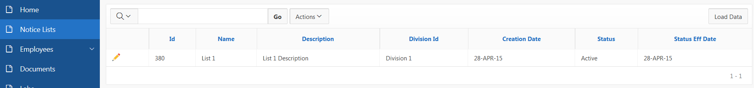
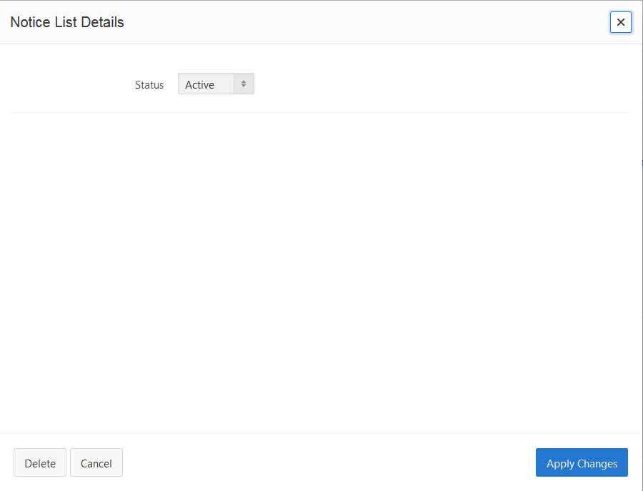
Standard User
Only lists in their division
No create option

Slide 10
List Membership
See current membership, add/remove functionality
See active employees not in list (add >1 at a time)
Warn of inactive members with easy removal
See list of active employees
Searches

Slide 11
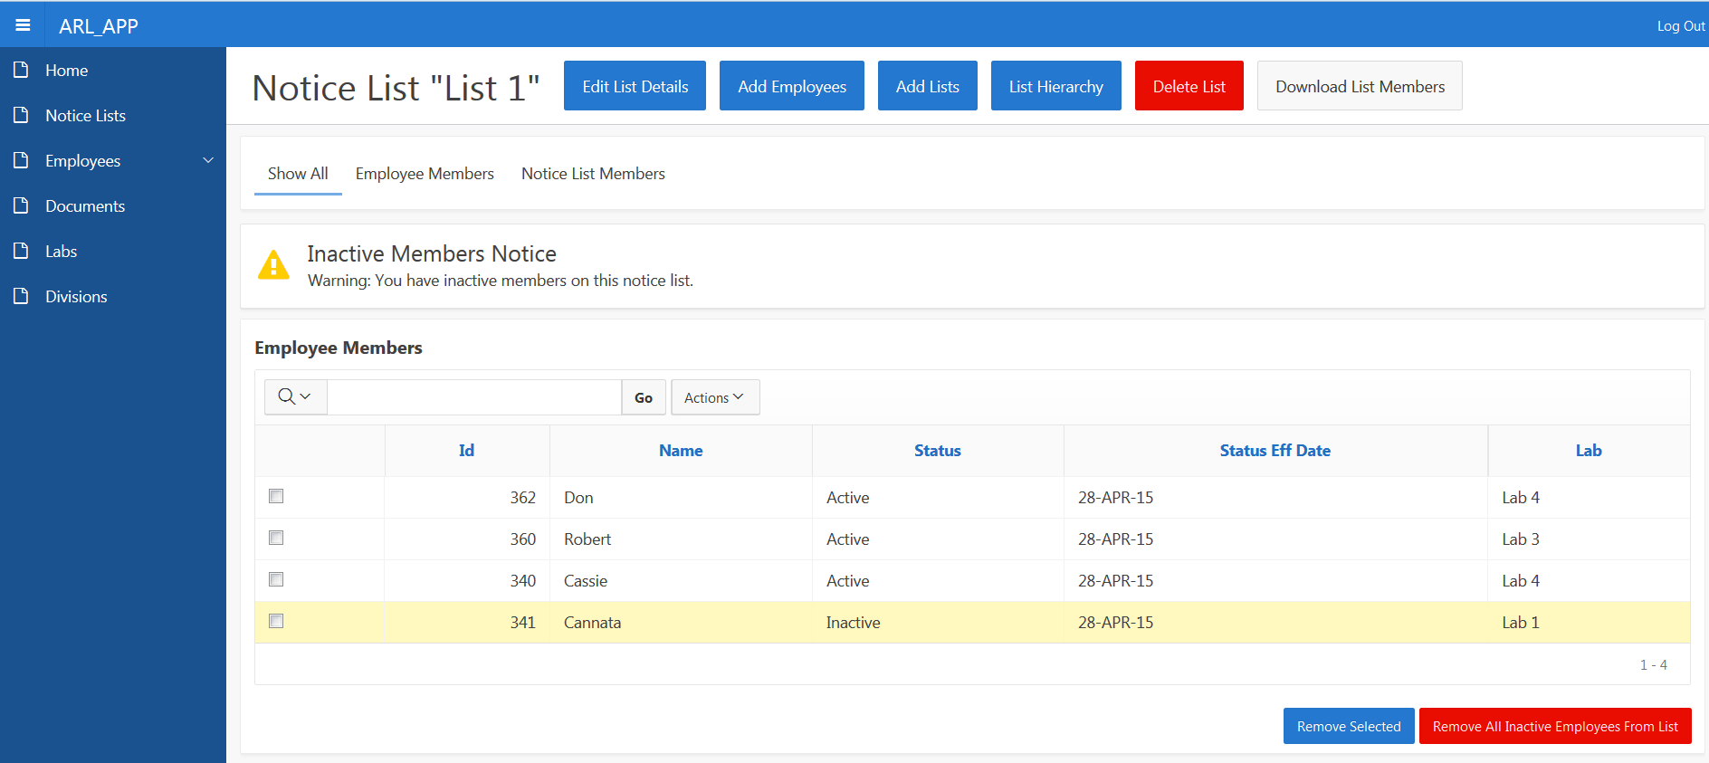
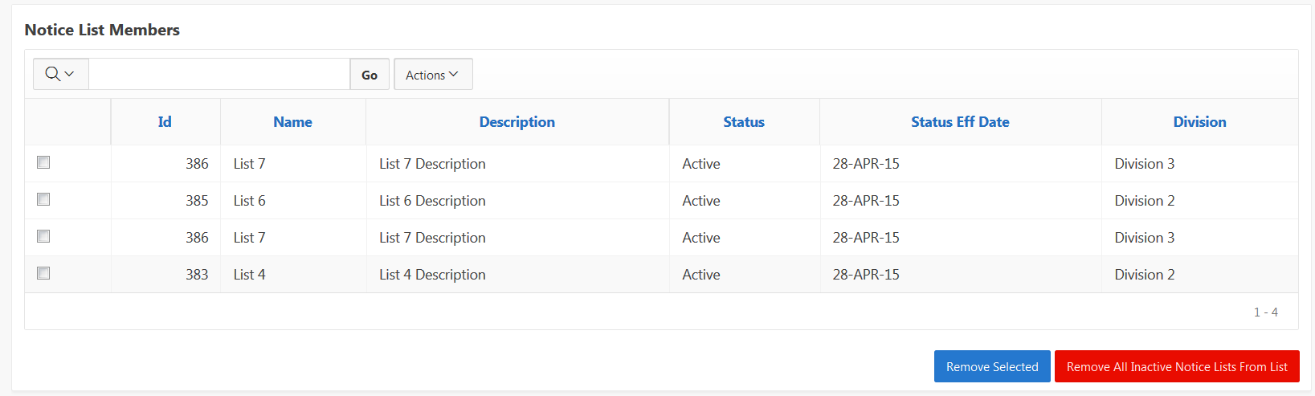
See List Membership
Inactive employees
Delete Employees from list
Add Members

Slide 12
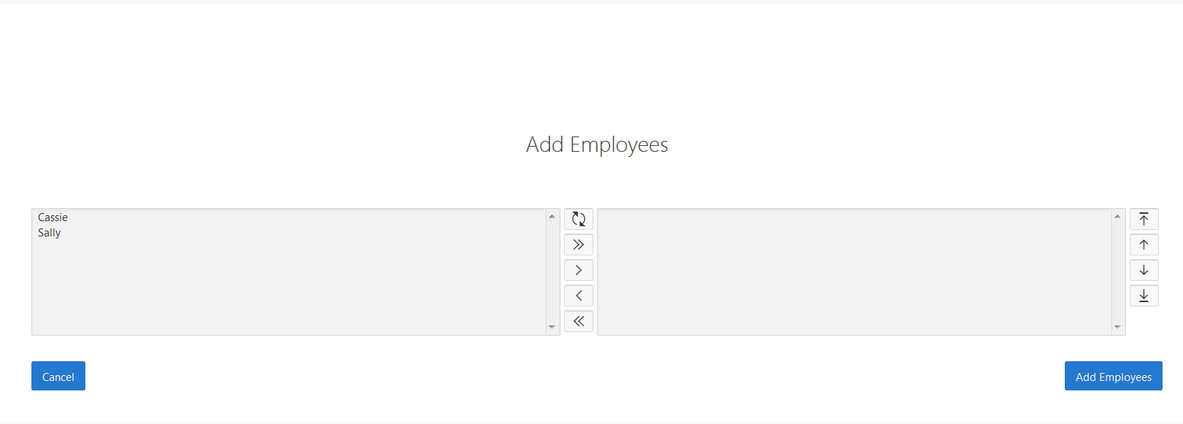
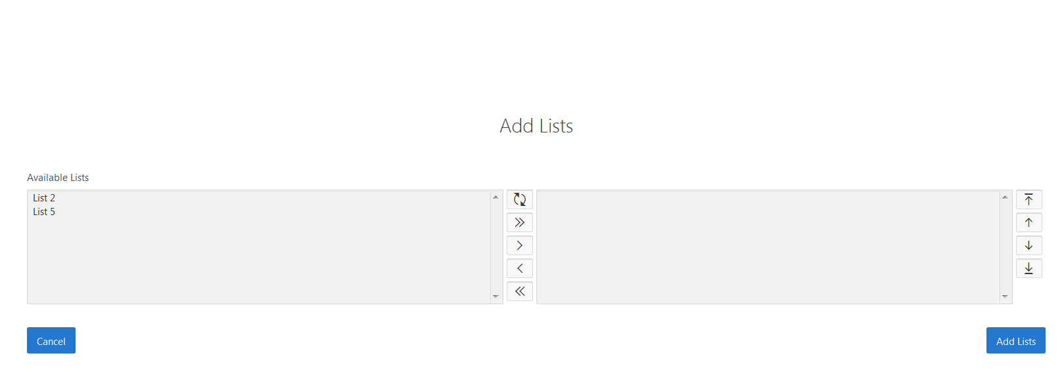
Add Members
See all active employees not on list

Slide 13
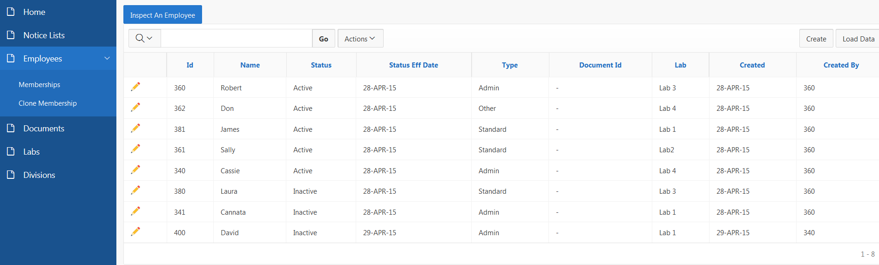
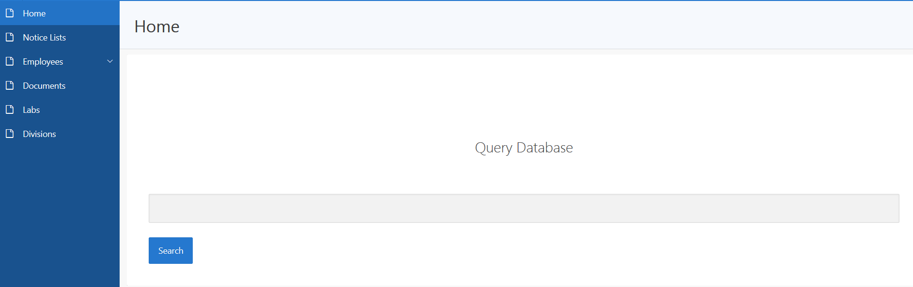
See All Active Employees

Slide 14
General List Maintenance
Clone Membership
Remove employee from all their lists
See all lists employee belongs to

Slide 15
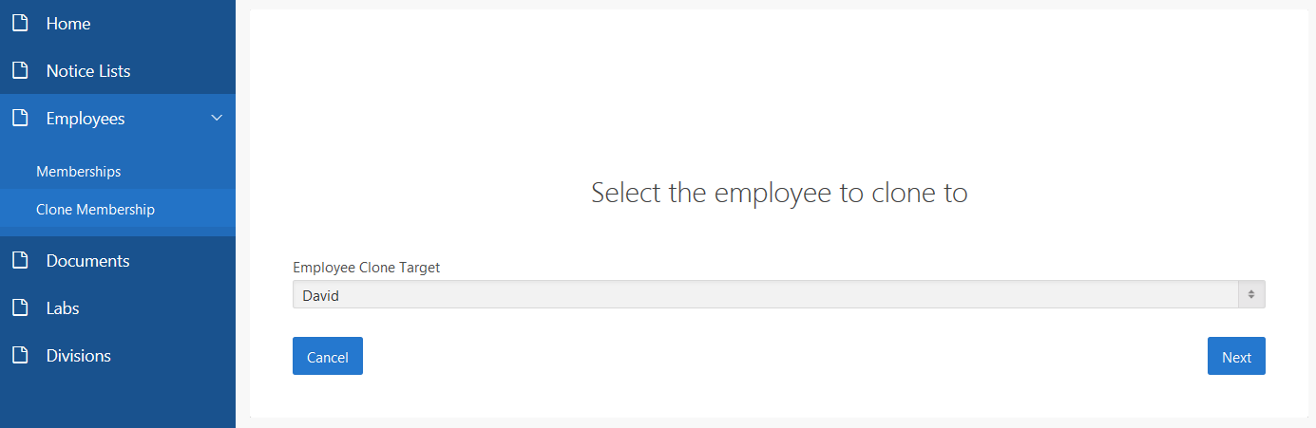
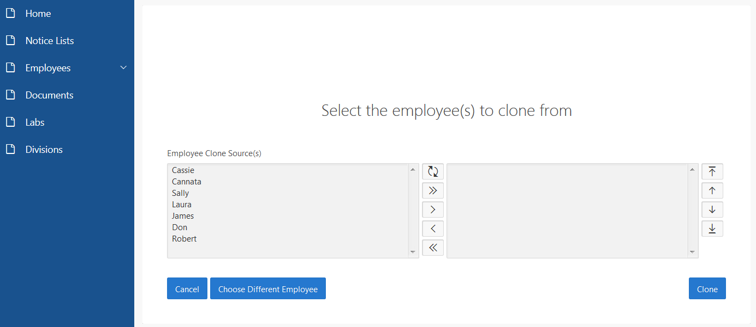
Clone Membership

Slide 16
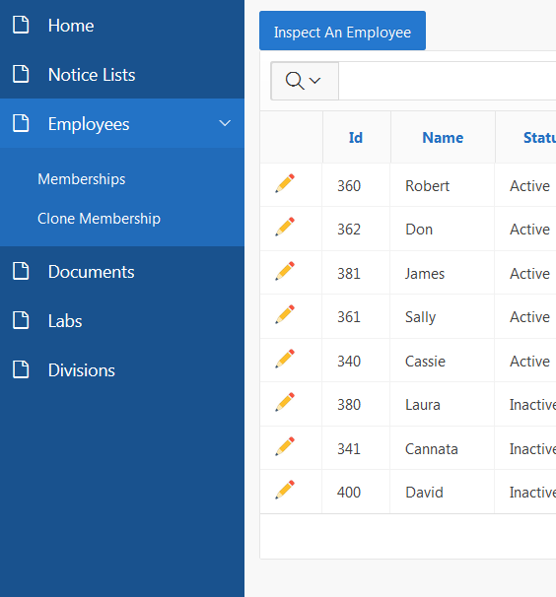
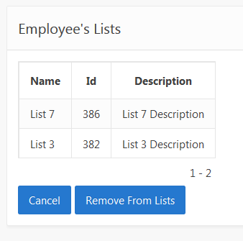
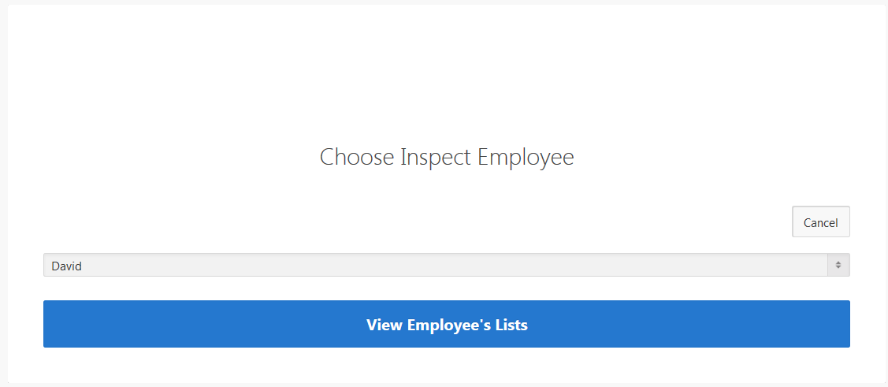
Inspect Employee
See all lists employee is on
Remove employee from all lists

Slide 17
Must Have Features
Report Downloads
Data Loading
Document Uploads
Homepage Search Bar
Region Display Selector
Trees
Shortcut
Shuttle
Group Select List
Modal Branching

Slide 18
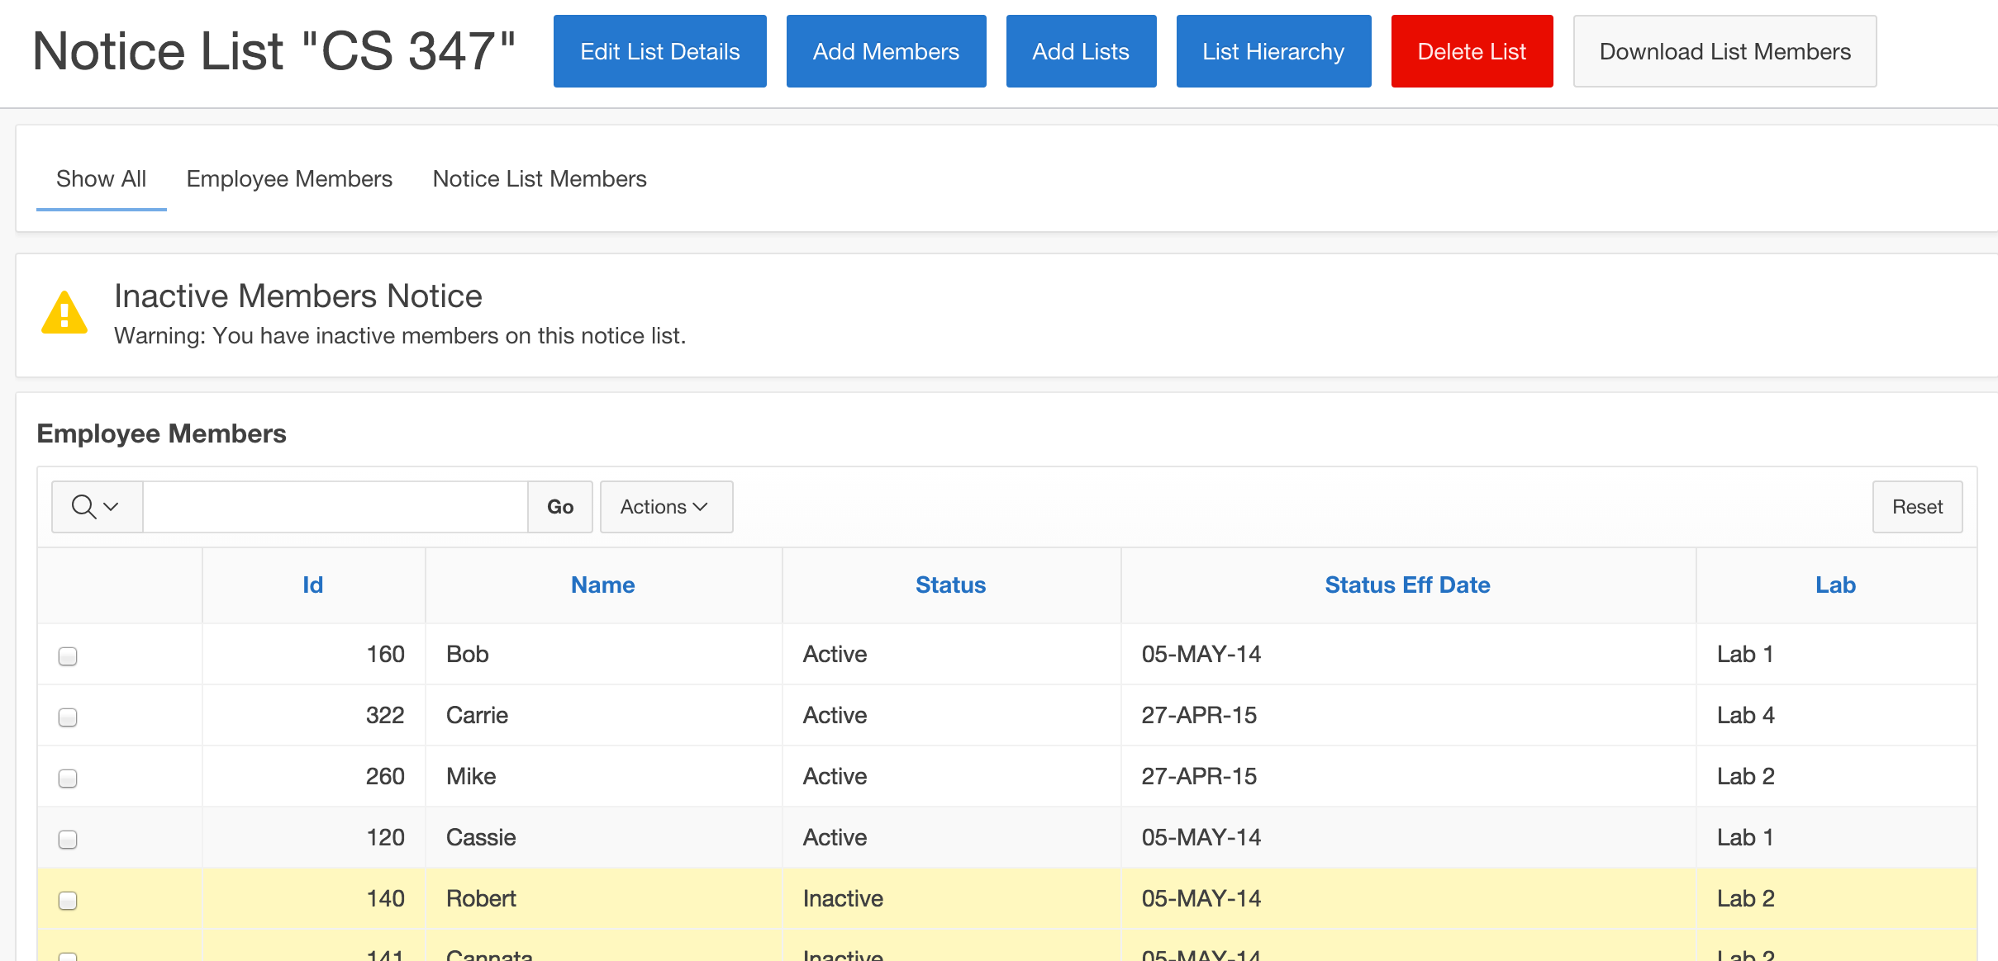
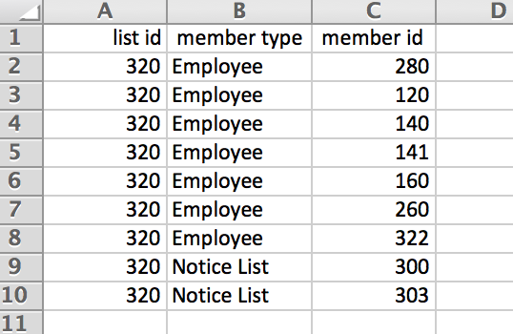
Report Downloads
Notes:
Cassie

Slide 19
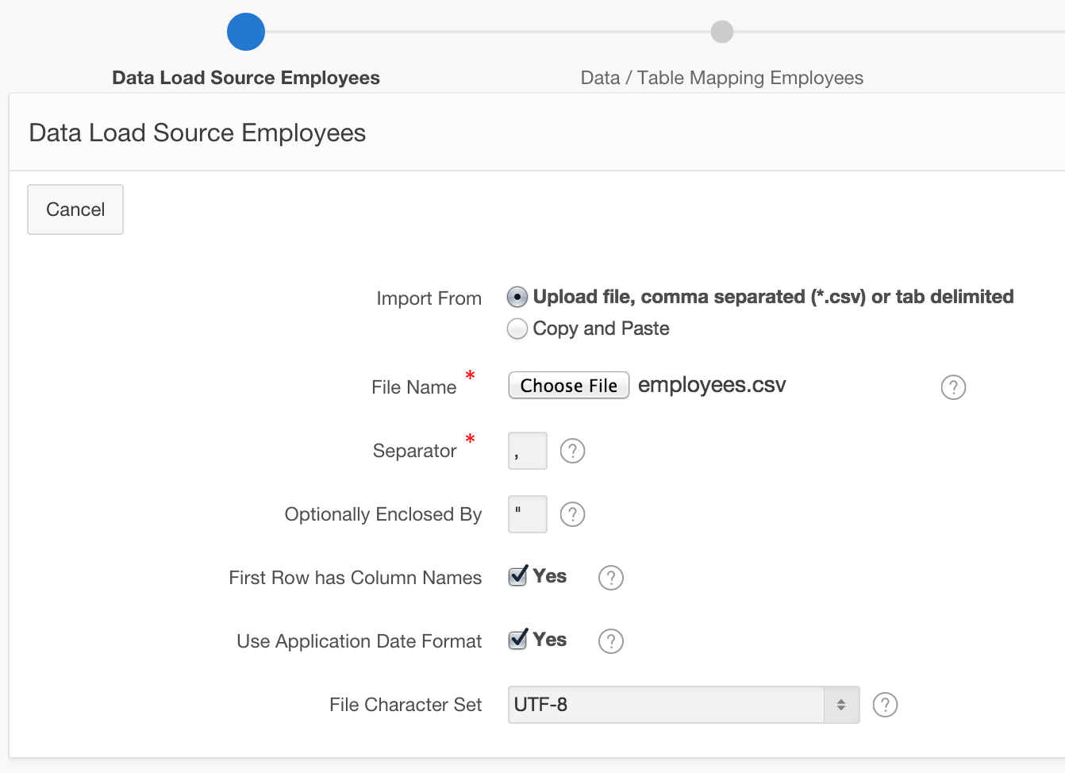
Data Loading
Notes:
Cassie

Slide 20
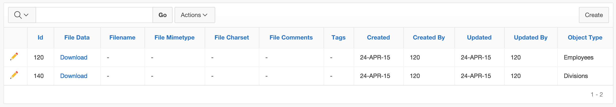
Document Uploads

Slide 21
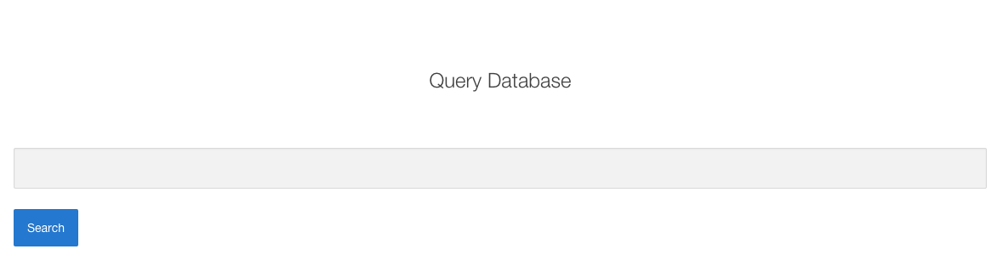
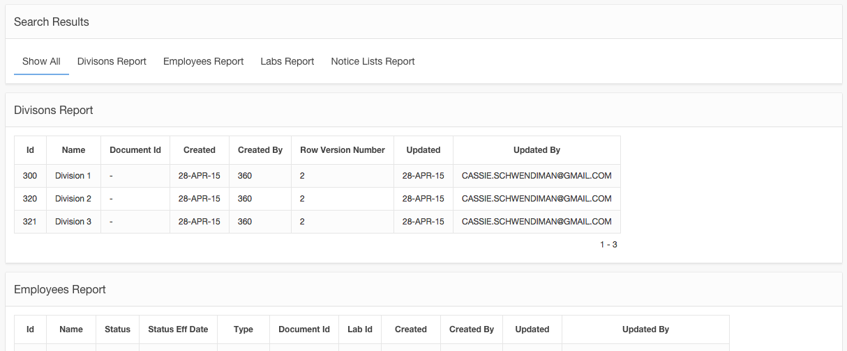
Homepage Search Bar
Notes:
Robert

Slide 22
Region Display Selector
Notes:
Cassie

Slide 23
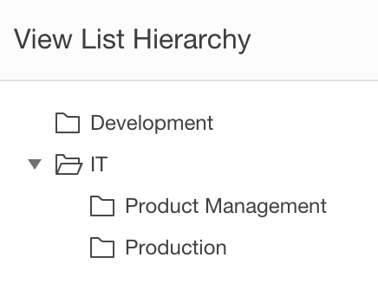
Trees
Notes:
Robert

Slide 24
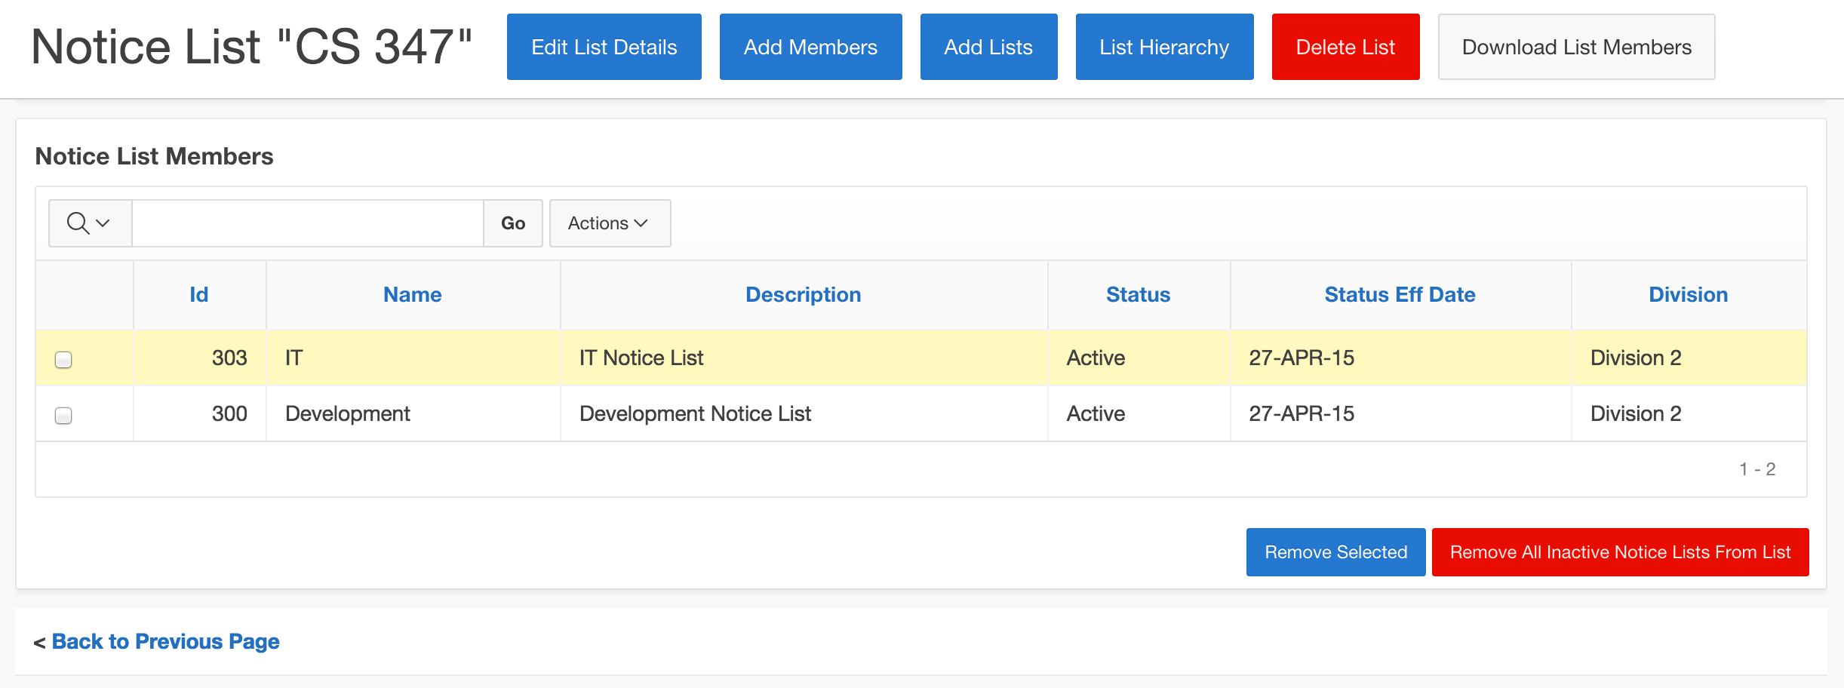
Shortcut
Notes:
Cassie

Slide 25
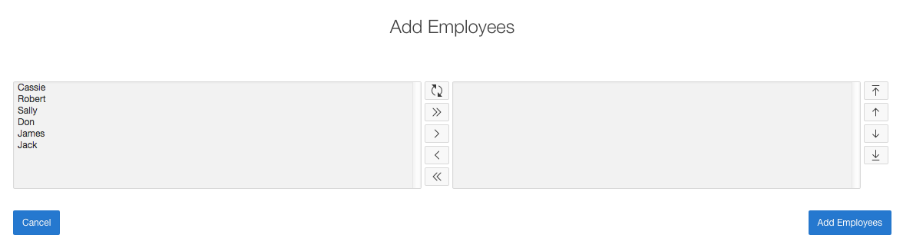
Shuttle
Notes:
Robert

Slide 26
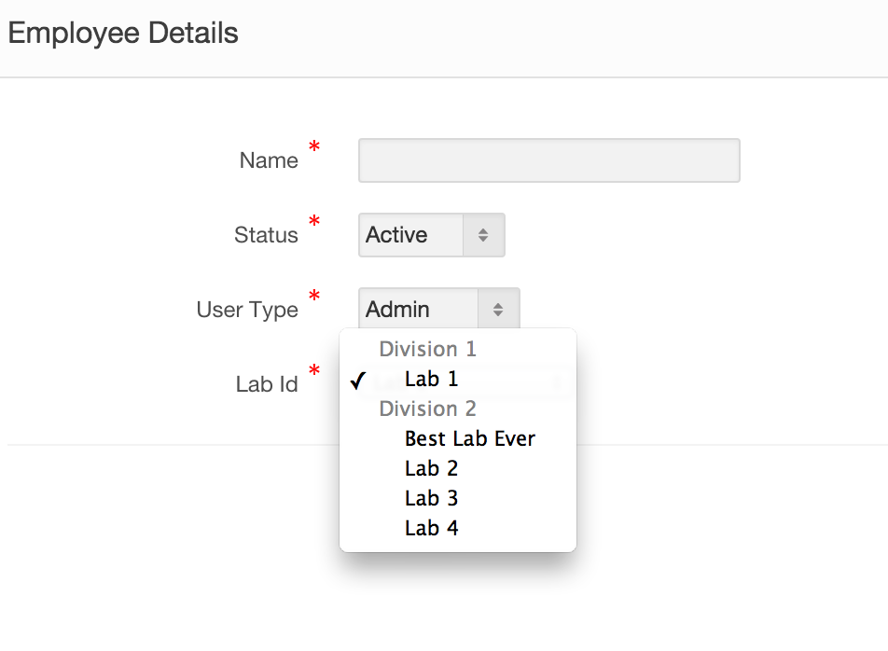
Group Select List
Notes:
Cassie

Slide 27
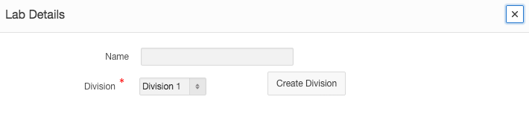
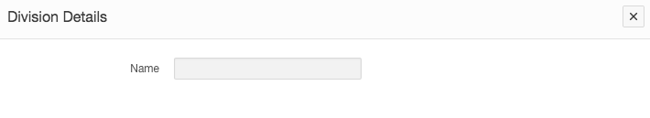
Modal Branching
Notes:
Cassie

Slide 28
Good to Have Features
Charts
Authorization Schemes

Slide 29
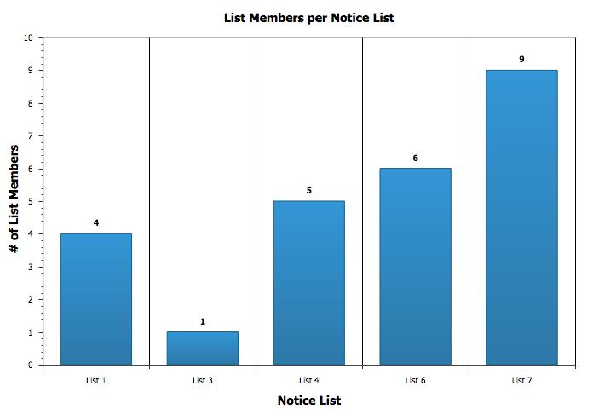
Charts

Slide 30
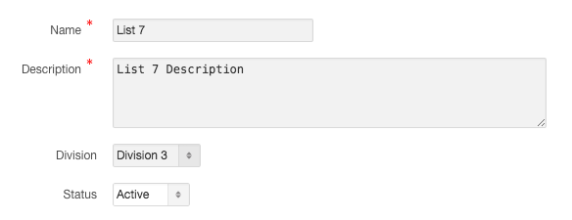

Authorization Schemes
List Maintenance Form:
What an Admin user sees
What a Standard user sees
Notes:
Robert

Slide 31
APEX Link
https://apex.oracle.com/pls/apex/f?p=95224:1

