Slide 1
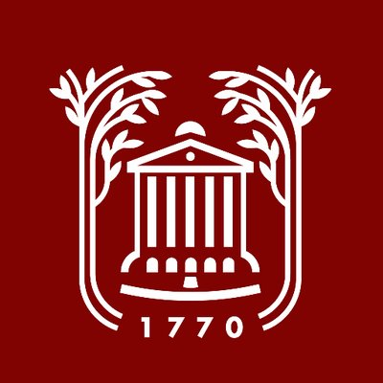
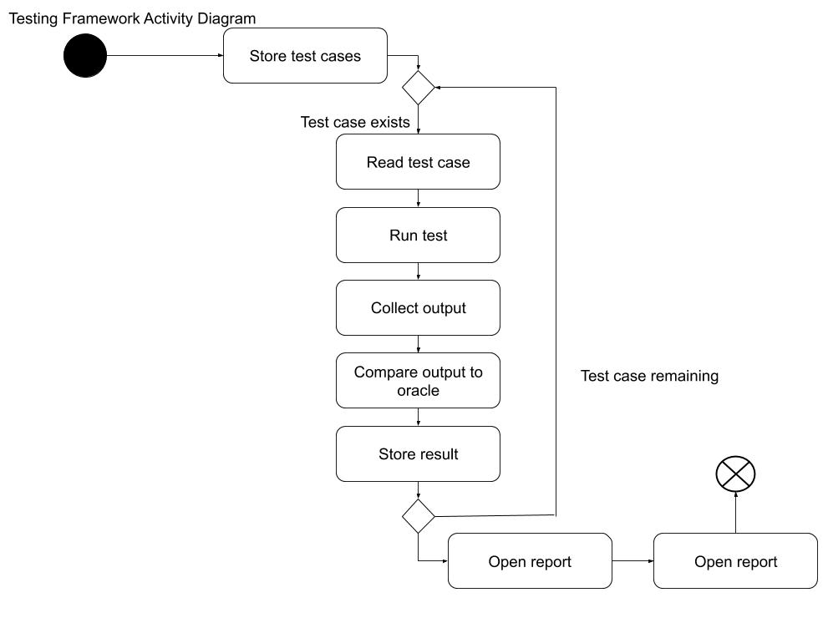
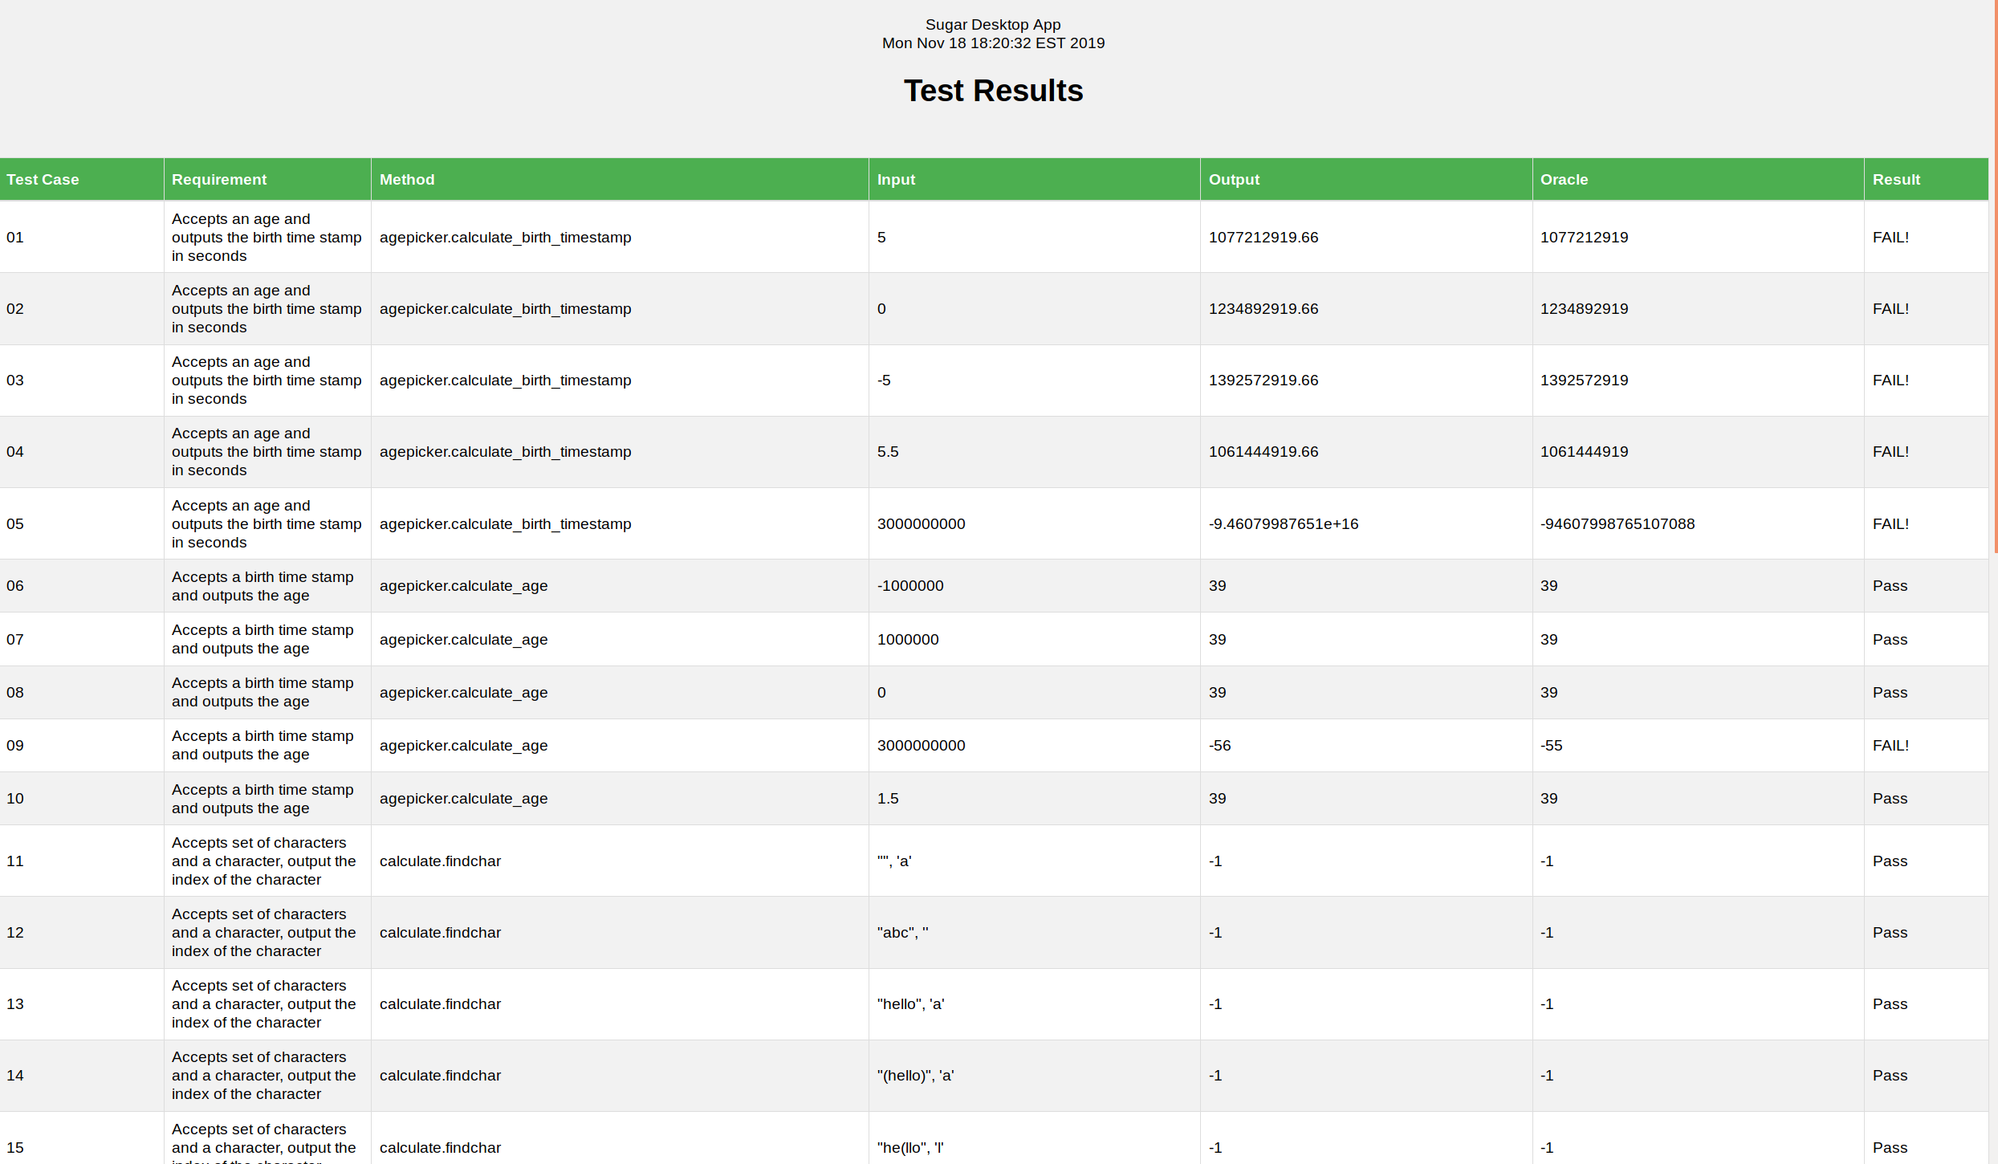
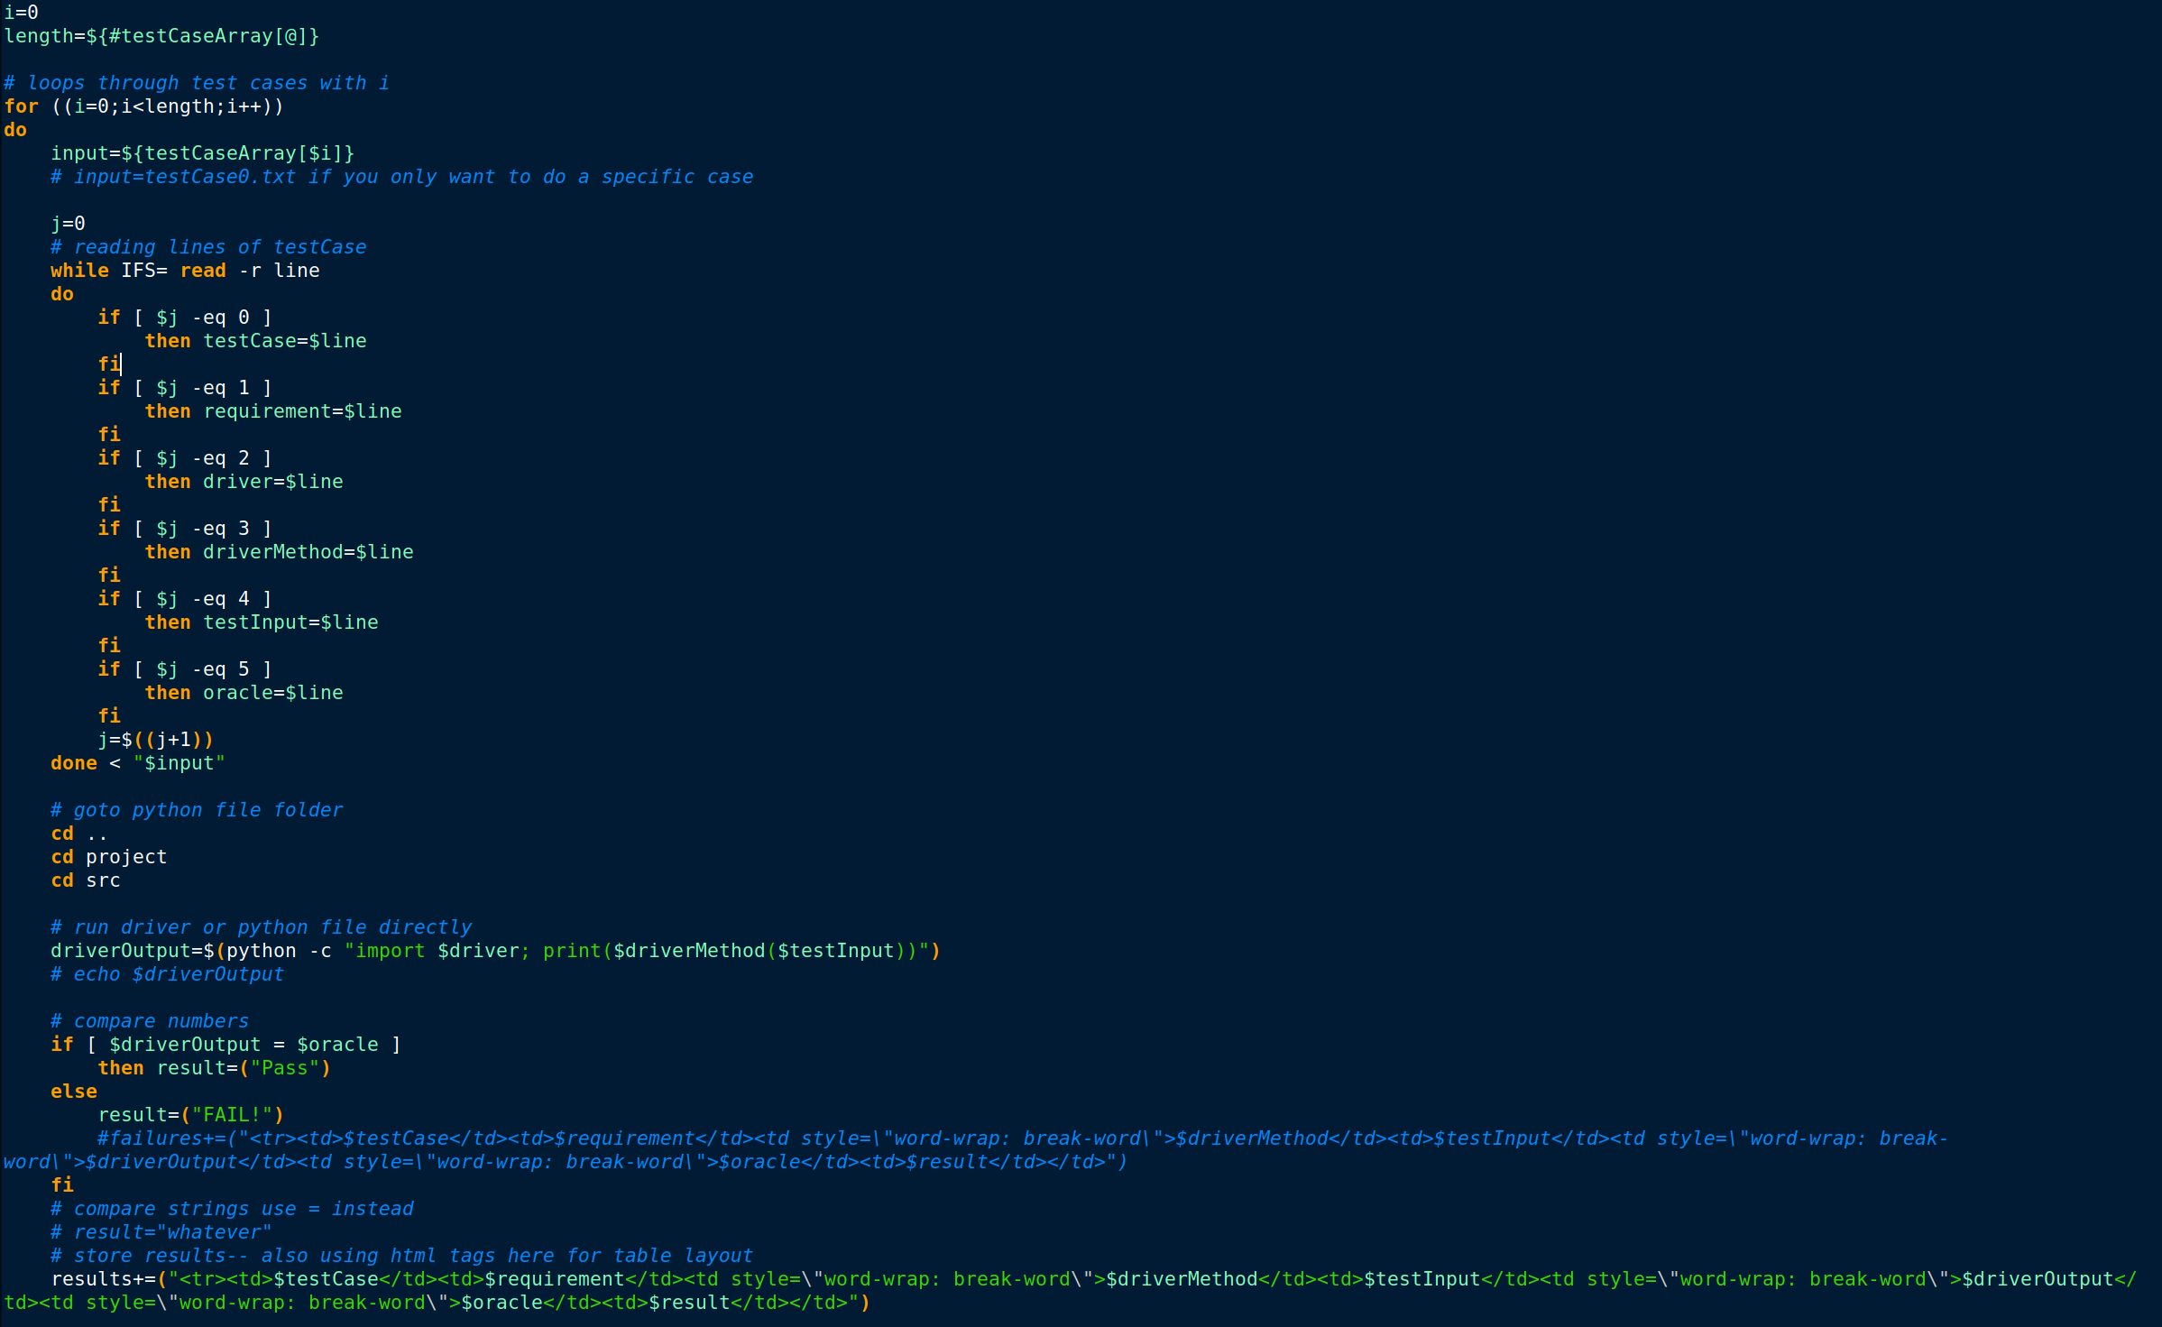
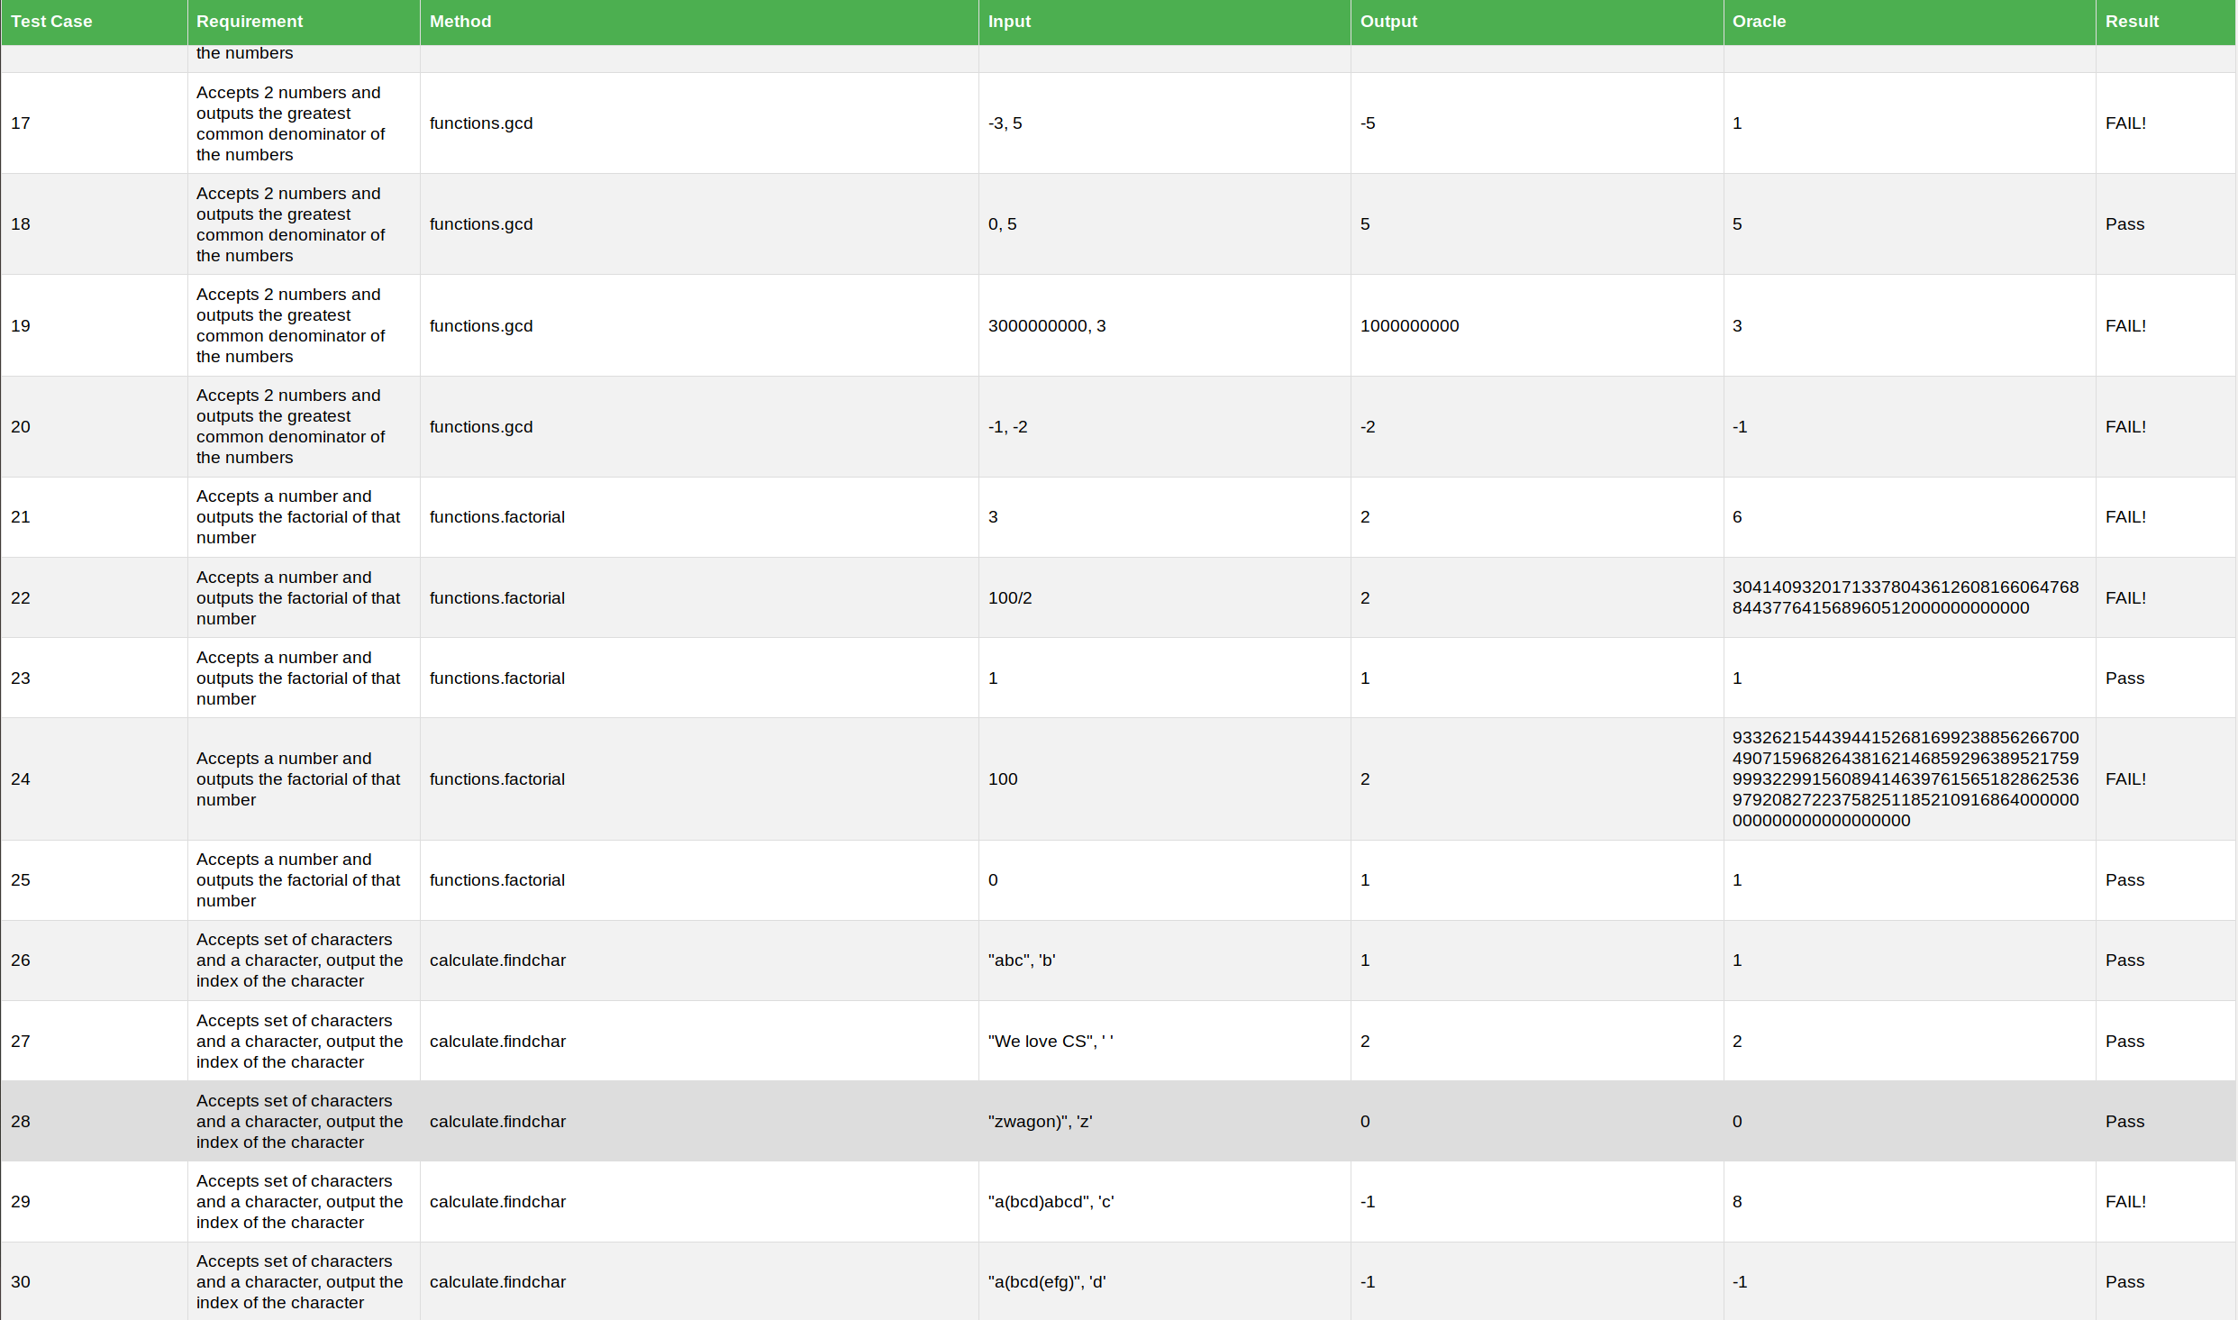
Automated Testing Using the Sugar Framework
Shaina Mainar, David Spry, AJ Williams
Department of Computer Science, College of Charleston, Charleston, SC
Abstract
A last year Computer Science student needs to be equipped with the proper skillset to launch their careers after graduation. CSCI 362 Software Engineering is the class that enables the student to explore the roles and tools that they will possibly take on in industry. This team project is the culmination of all the tools learned and developed by the students in previous major classes. The students were expected to complete this project from start to finish in teams with guidance from Dr. Bowring.
Goals
Create a testing framework to test individual methods
Automate testing using Bash scripting methods
Inject faults in the source code and observe the results
Display the results on a stylized HTML file
Motivation
Computer Science students need to be able to prepare for industry by utilizing tools and enhancing skillsets necessary to succeed.
Hands-on experience with the Software Engineering Life Cycle.
Activity Diagram
Results
Script Snippet
Methodology
Testing:
The source code is written almost exclusively in Python 2, therefore we found that it would best to write our test framework in Python.
Since Python files do not need to be compiled, we were able to access Python methods in the command line using “python -c "import [FILE_NAME]; print([FILE_NAME].[METHOD_NAME]([INPUT]))“
Compile-time faults were injected in the source code to test robustness.
Scripting:
According to the project specifications, the script is run in Ubuntu, therefore it is easier to write the script in Bash.
The script is called within the /TestAutomation directory using “bash ./scripts/runAllTests.sh”
The results are output into a formatted HTML file.
Conclusions
Retrospect
All project specifications were met within the deadline. The team was able to divide task accordingly and with fairness. We were able to pick up roles that were simultaneously new and catered to our individual strengths. The project followed the Software Engineering life cycle from the creation of the test plan to the final presentation. We followed a plan-driven development approached and it was the best approach for the task at hand. Our skillsets were further developed, and we got a taste of what industry will be like.
In the beginning, the team was a bit befuddled. We were not sure how to start and where to start. With the guidance of Dr. Bowring and multiple discussions about the project specifications, we slowly, but surely, began to start our project. It seems that it was easier to tackle one problem at a time. Our first issue was the source code was outdated and was in the middle of being ported to Python 3 therefore, it was a bit of a challenge to get it up and running. Once we were able to get it running, everything else was easier. The scripting was a learning curve and so was the overall system framework. We had to understand how the different parts interacted before we created them. Overall, this was a great starting point and a peek at what industry may look like. It would be interesting to see future teams use agile approaches or create their own source code.

