Slide 1
CSCI 362 Term Project: Sugar Desktop Turtle Blocks
Meagan Gould, Sam Ferguson, and Thomas Davis

Slide 2
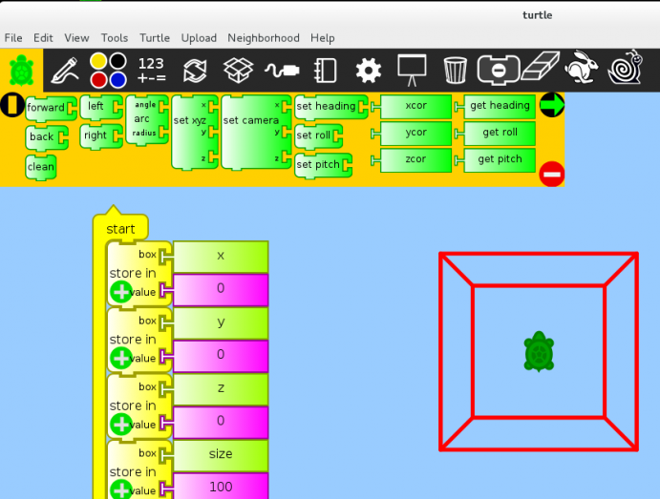
Sugar Desktop and Turtle Blocks
Sugar Desktop is an environment for kids built in Linux
Turtle Blocks teaches kids to program

Slide 3
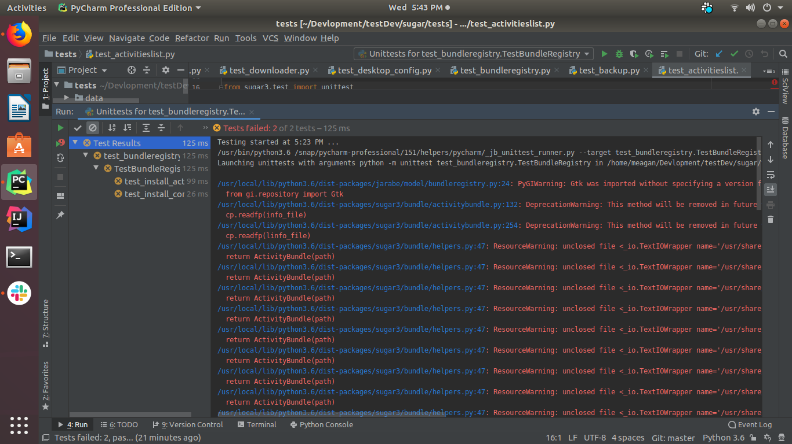
The Beginning - Struggles and Triumphs
Requires many dependencies that are hard to download
Was only able to run 4 test cases
Found a sugar iso we were able to develop in

Slide 4
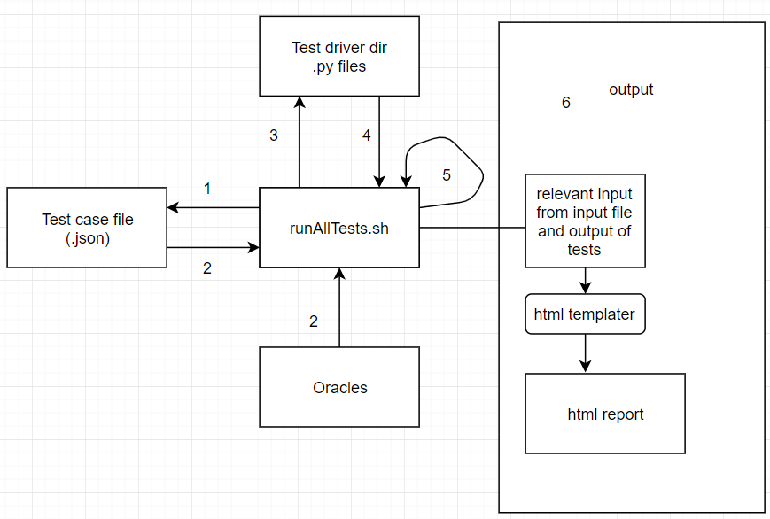
The Design of the Architecture
Notes:
can talk about this for a while

Slide 5
Important Areas
runAllScripts.sh
Driver that runs the program
TestCase > TestCaseExecutables > reports > open in browser
Drivers
Create different objects, runs the methods, and returns outputs to be tested
HTML Template
Python library jinja2
Takes in json

Slide 6
runAllTests.sh libraries
Technology and structures used:
jq
jinja2
xdg-utils

Slide 7
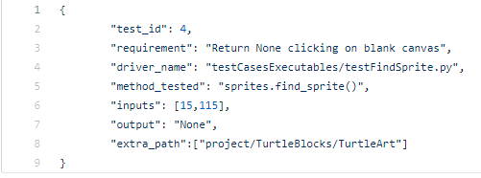
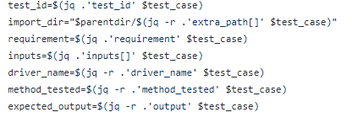
Test case example
Contains attributes that are pulled into the testing script
JSON objects can be made into bash variables with jq command
example --->

Slide 8
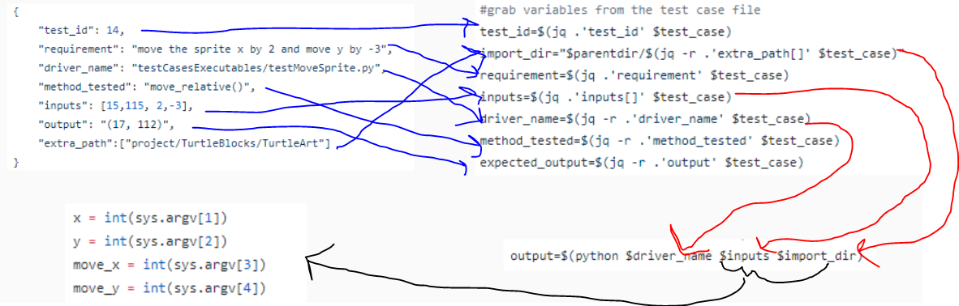
Drivers
Data necessary for testing process sent to driver

Slide 9
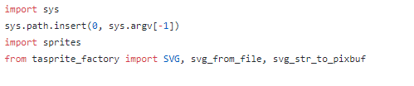
Drivers
Issue with imports to drivers in different locations ---------------------->
output passed through stdout and formatted to JSON -------------->

Slide 10
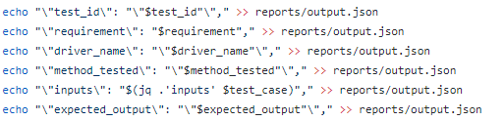
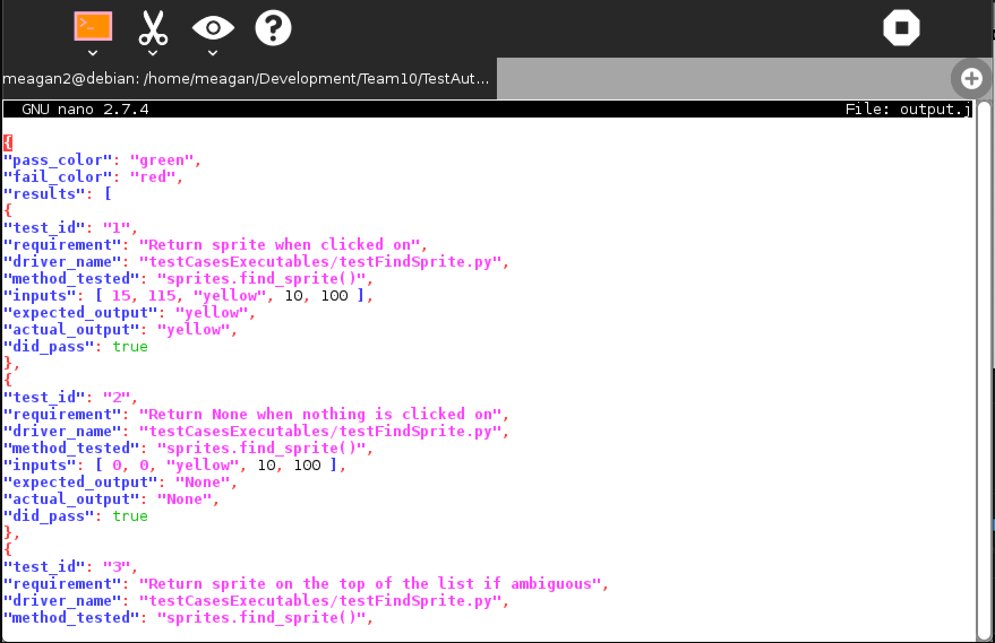
Reporting

Slide 11
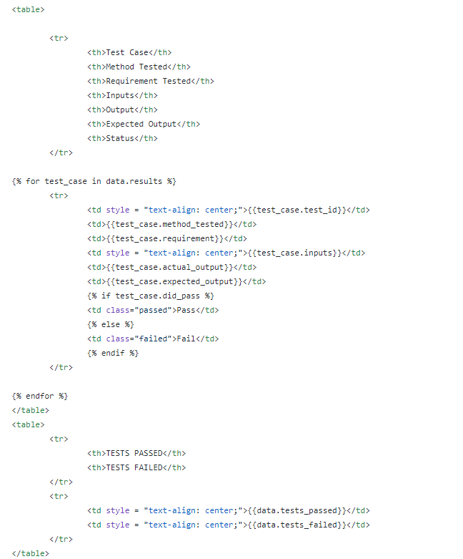
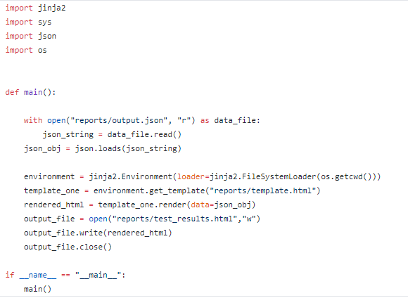
Jinja2

Slide 12
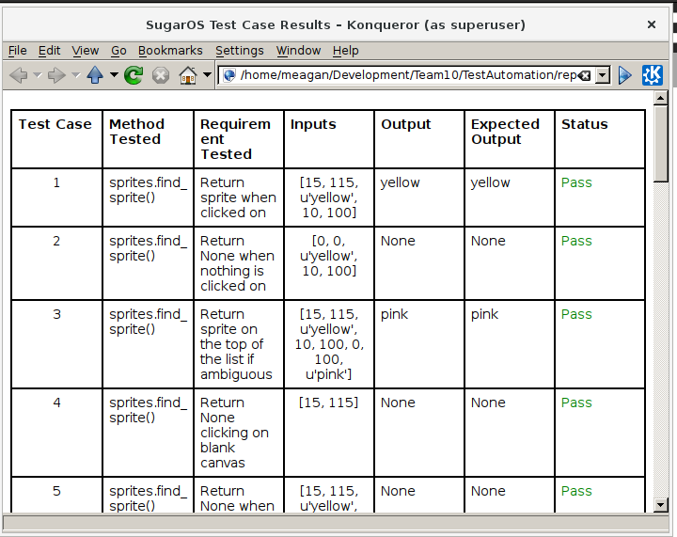

Output
data bound to template html
opened automatically with xdg-open

Slide 13
Methods Tested
find_sprite()
Sprite method
move_relative()
Sprite method
spr_to_turtle()
Turtle method

Slide 14
The Test Results Without Faults
All tests pass when no faults are injected

Slide 15
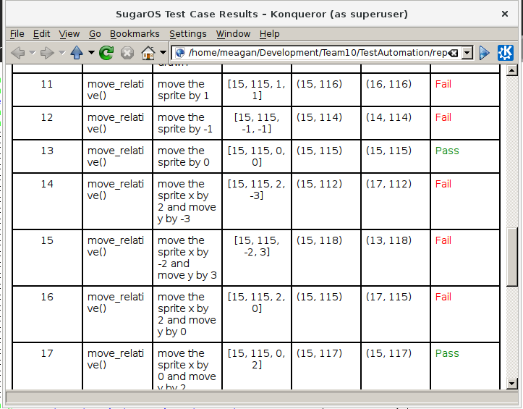
The Test Results With Faults
Quite a few of the test cases fail with the faults injected
Took away certain lines of code
Addition sign
Conversion
If statement checks

Slide 16
Reflections on the Project as a Whole
Time management is definitely needed
Documentation helps
Glad it was python because you do not need to compile things
Just tons of dependencies and figuring out how to run things as root

Slide 17
Questions?

