Slide 1
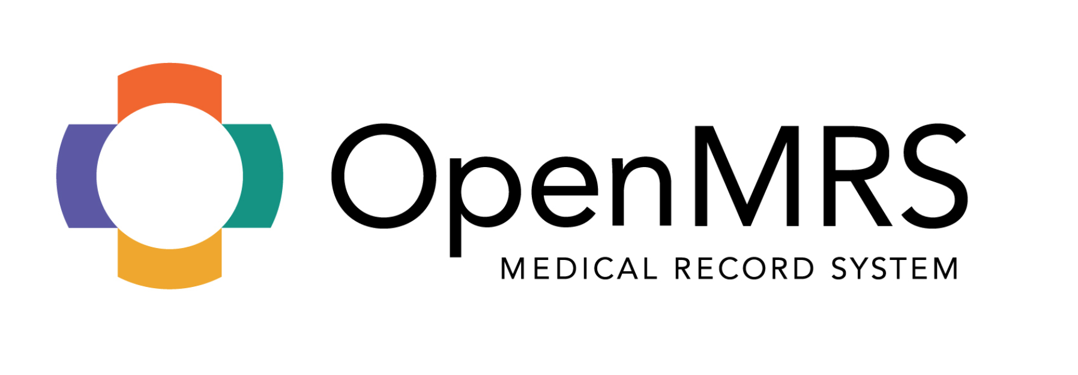
Cameron Dey, Evan Tanner, Brandon Priester

Slide 2
OpenMRS
OpenMRS is, “a patient-based medical record system focusing on giving providers a free customizable electronic medical record system” [1]
The mission of OpenMRS, “is to improve health care delivery in resource-constrained environments by coordinating a global community to create and support this software”[2].
Fundamental Layers:
Data Model: Based on Regenstreif model and concept dictionary.
The API: Provides a programmatic “wrapper” around the data model
-Allows for any developer to program against more simplified method calls rather than having to understand the intricacies of the data model.
Web Application: Includes web front-ends and modules that extend the core functions — these are the user interfaces and applications themselves built upon the lower levels. [3]

Slide 3
Features of OpenMRS https://openmrs.org/about/
Central concept dictionary: Definitions of all data (both questions and answers) are defined in a centralized dictionary, allowing for robust, coded data
Security: User authentication
Patient repository: Creation and maintenance of patient data, including demographics, clinical observations, encounter data, orders, etc
Multiple identifiers per patient: A single patient may have multiple medical record numbers
Patient workflows: An embedded patient workflow service allows patient to be put into programs (studies, treatment programs, etc.) and tracked through various states.
Localization / internationalization: Multiple language support and the possibility to extend to other languages with full UTF-8 support
Support for complex data: Radiology images, sound files, etc. can be stored as “complex” observations
Cohort management: The cohort builder allows you to create groups of patients for data exports, reporting, etc.
Modular architecture: An OpenMRS Module can extend and add any type of functionality to the existing API and webapp.

Slide 4
Initial Phase: The dark days
What’s a BASH?!
JUnit?
Linux Flavors
Installation issues
OpenMRS installation issues

Slide 5
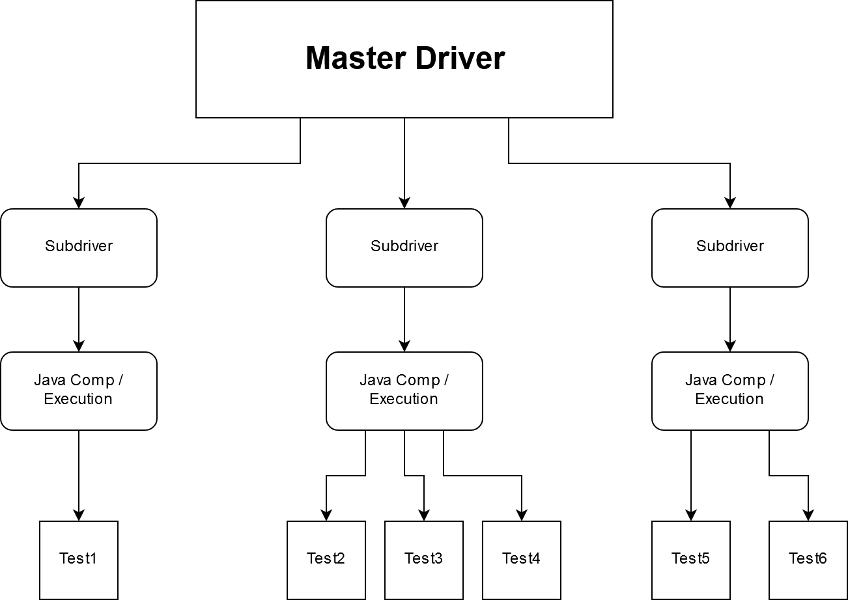
Testing Framework Prototype
SLOW
Modular
Increased Dependencies

Slide 6
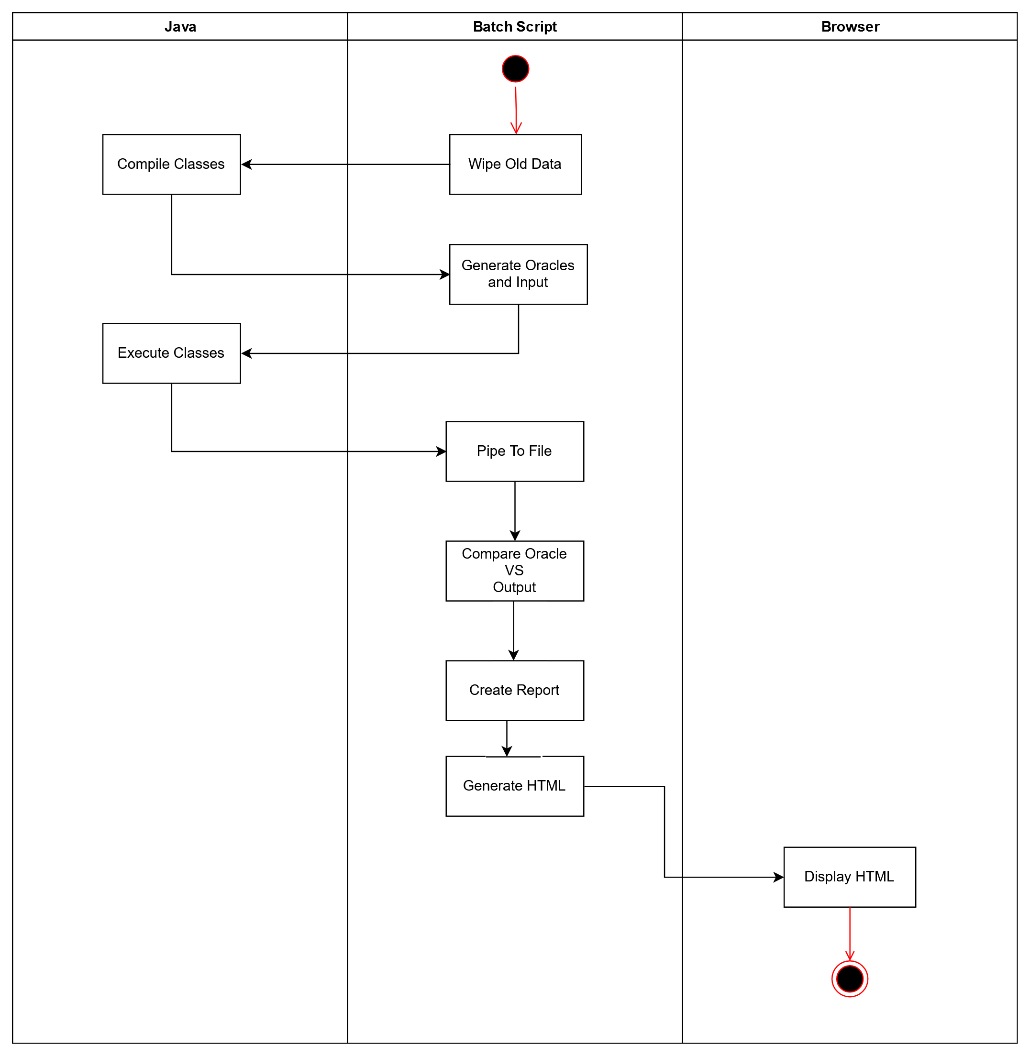
Final Framework
More Efficient! (3N => N)
Less dependencies
Less Modular
More Coupled

Slide 7
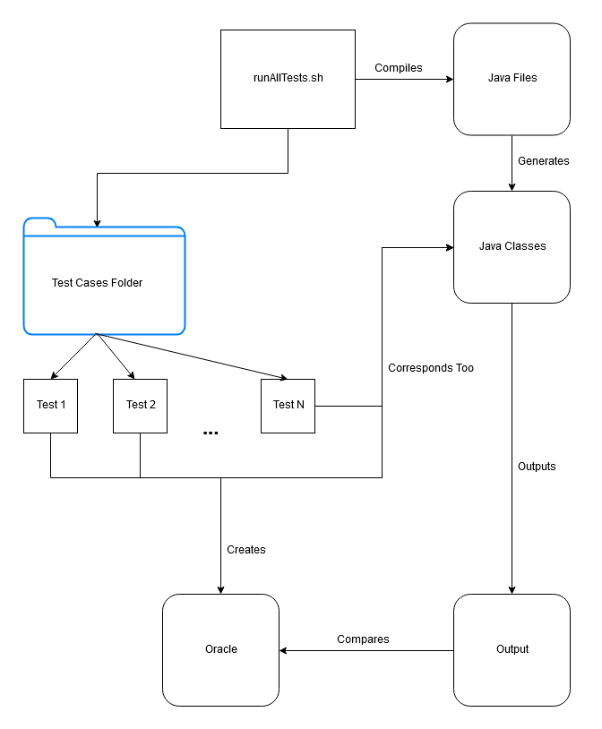

Slide 8
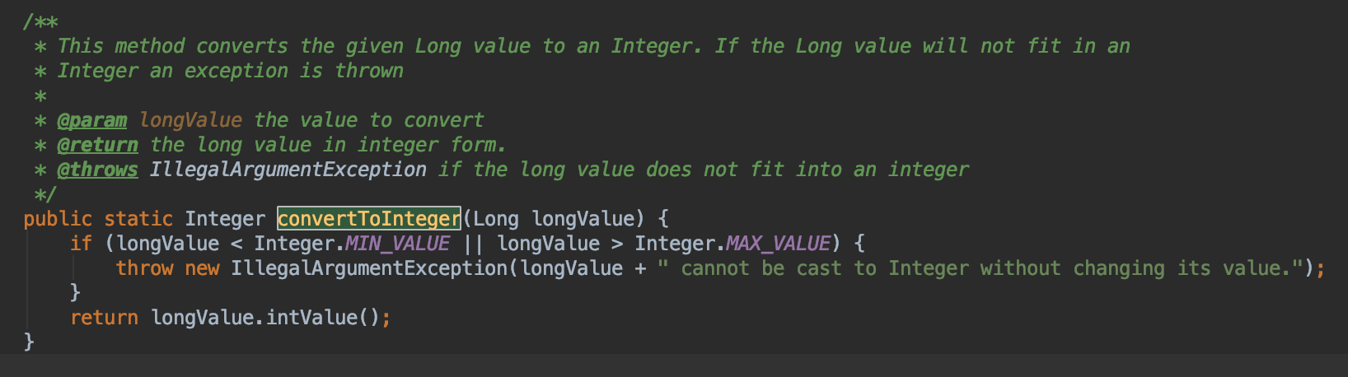
Java Methods Used
converToInteger
The faulty jar removes all of the if statement statement and its operations.

Slide 9
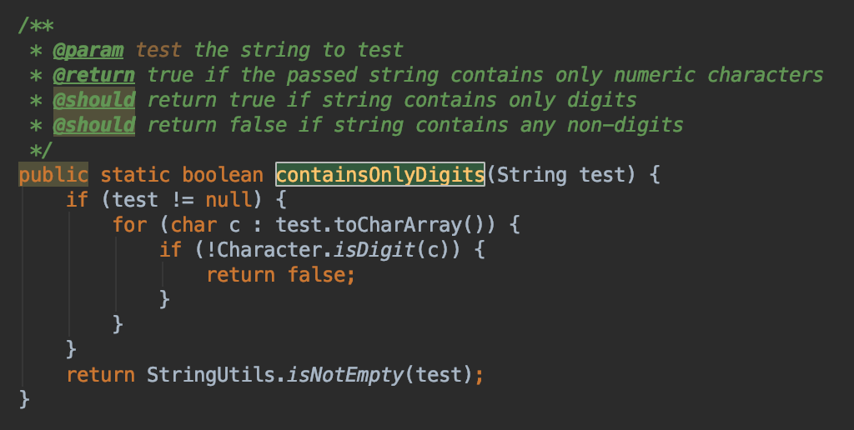
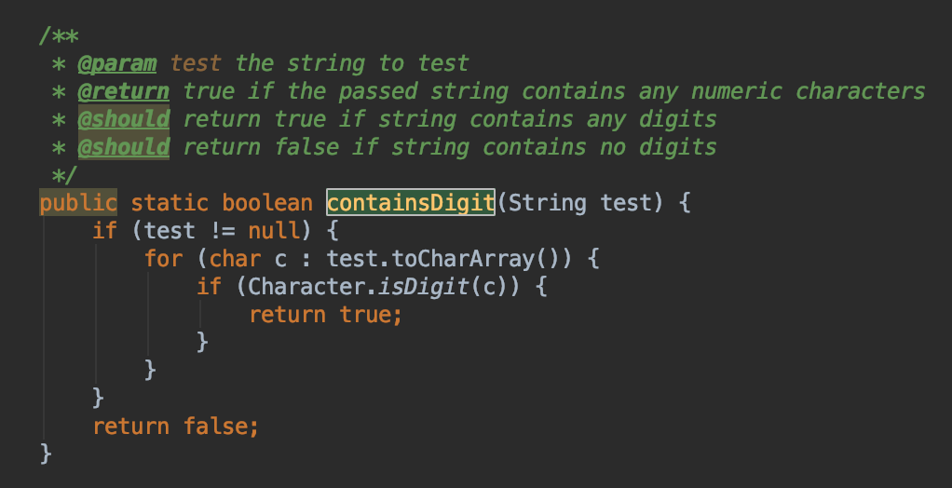
containsOnlyDigits
containsDigits
The faulty jar removes the null delimiter here as well
The faulty jar removes the null delimiter

Slide 10
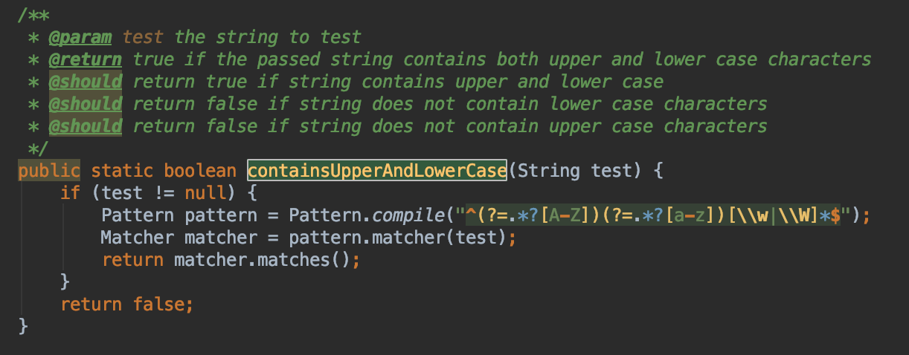
containsUpperAndLowerCase
The faulty jar removes part of the pattern such that the upper case letters ‘A’, ‘B’, ‘C’ are removed from the alphabet along with the letters ‘a’, ‘b’, ‘c’.

Slide 11
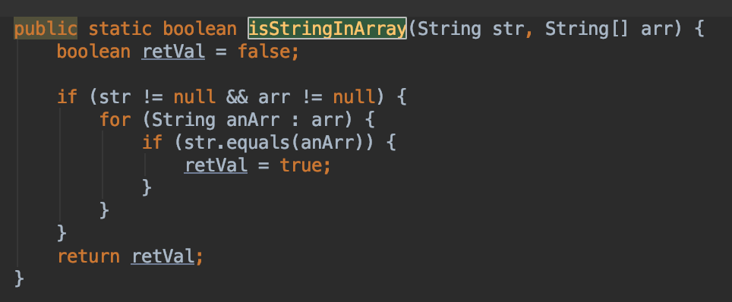
isStringInArray
The faulty jar removes the null delimiter

Slide 12


Slide 13
Questions?

Slide 14
Citations:
[1] https://openmrs.org/
[2] https://github.com/openmrs/openmrs-core
[3] https://openmrs.org/about/
[4] https://www.draw.io/

