Slide 1
Mars Map Maker
Testing Framework
Cormac Conahan, Robert Niggebrugge, Seth Hinson

Slide 2
Introduction to Best Team
Seth Hinson
Class: Senior
Major(s): Computer Science
Minor(s): Data Science and Russian Studies
Extra curriculars: Cyber Security Club, Student Network Engineer with CofC IT
Main Role: Team Lead
Cormac Conahan
Class: Junior
Major(s): Computer Science
Minor(s): Math
Extra curriculars: Rock Climbing
Main Role: Scribe
Robert Niggebrugge
Class: Senior
Major(s): Computer Science
Minor(s): Data Science
Extra curriculars: CIRDLES, ACM
Main Role: Technical Lead

Slide 3
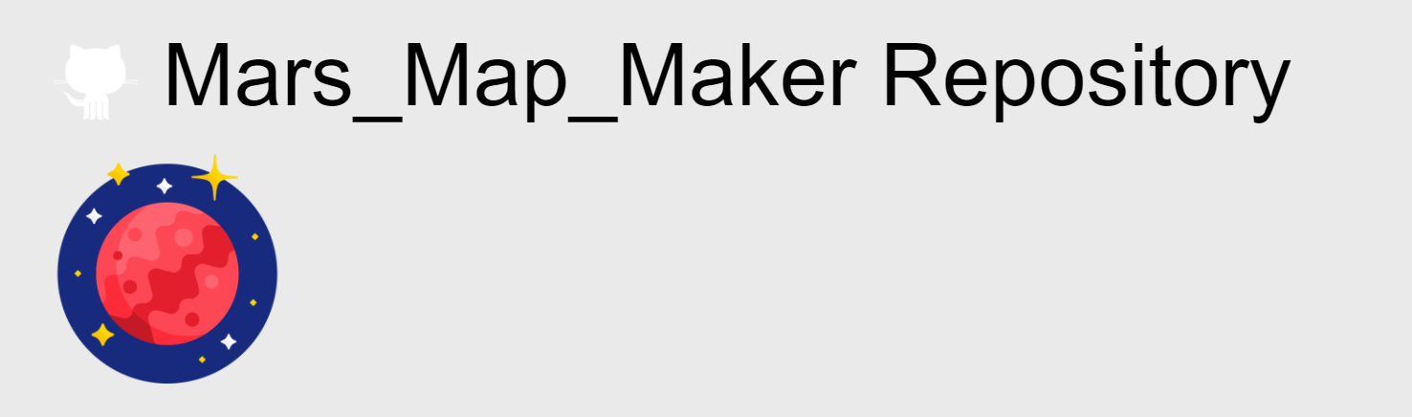
Finding our Source Code
Apertium (initial choice)
Mars Map Maker (final choice)

Slide 4
Testing Architecture
scripts
oracles
testCases
testCasesExecutables
reports

Slide 5
How to Get Started
Step 1: Run on Ubuntu Focal Fossa 20.04
Step 2: Install git “sudo apt install git -y”
Step 3: Clone repository "git clone https://github.com/csci-362-01-2020/Best-Team"
Step 4: Move into the TestAutomation directory
Step 5: run quickSetUp.sh (this installs all our dependencies)
Step 6: run runAllTests.sh
(Follow next steps to access/run tests on faulted code)
Step 7: Checkout our mutation branch “git checkout mutationBranch”
Step 8: run runAllTests.sh (mutated code can be found in the project directory while on this branch)

Slide 6
Searching for Code to Test
Specific criteria
Low level methods
No high level renders
One input, one output

Slide 7
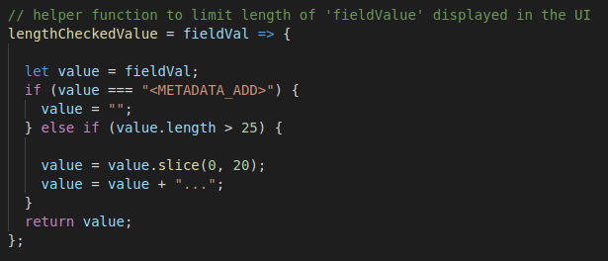

Slide 8
Example Test Case
"module": "DropDown", // chooses the module from which the tested function is retrieved
"ID": 1, // sets the test case ID
"functionName": "entWithContent", // chooses which function from the module to test
"metaData": "Must take in an array of objects and return the last index that contains non empty strings that are present with the key "value" or return -1", // short description of expected inputs and expected outputs
"metaDataShort": "DropDown.entWithContent(input) must return -1", // precise expectations of this test case
"input": [], // input for the function to test functionality described above
"expectedOutput": -1 // expected output of the function with given input

Slide 9
Testing Framework in Action

Slide 10
Fault Injections
Testing the tests
Necessary to demonstrate integrity
Catches more bugs

Slide 11
What did we change?
Fault 1: Dropdown entWithContent: "!==" in the second if statement was changed to "==="
Fault 2: CardList typeField: "else if (numbers.test(f) === true)" was replaced with "else if (numbers.test(f) !== true)"
Fault 3: FieldCard lengthCheckedValue: "else if (value.length > 25)" was changed to "else if (value.length < 25)"
Fault 4: App findDuplicates: "(names[i] === names[j])" was changed to if "(names[i] !== names[j])"
Fault 5: FieldCard isMetaDataAddCard: "let totalAddedCards = 4" was changed to "let totalAddedCards = 2"

Slide 12
Fault Injections in Action

Slide 13
Reflections and Conclusions
Teamwork
Learning Experience
Thank You

