Slide 1
Best Team
Mars Map Maker
Testing Framework
Cormac Conahan, Robert Niggebrugge, Seth Hinson

Slide 2
Introduction to Best Team
Seth Hinson
Class: Senior
Major(s): Computer Science
Minor(s): Data Science and Russian Studies
Extra curriculars: Cyber Security Club, Student Network Engineer with CofC IT
Main Role: Team Lead
Cormac Conahan
Class: Junior
Major(s): Computer Science
Minor(s): Math
Extra curriculars: Cyber Security CTF, Rock Climbing
Main Role: Scribe
Robert Niggebrugge
Class: Senior
Major(s): Computer Science
Minor(s): Data Science
Extra curriculars: CIRDLES, ACM
Main Role: Technical Lead

Slide 3
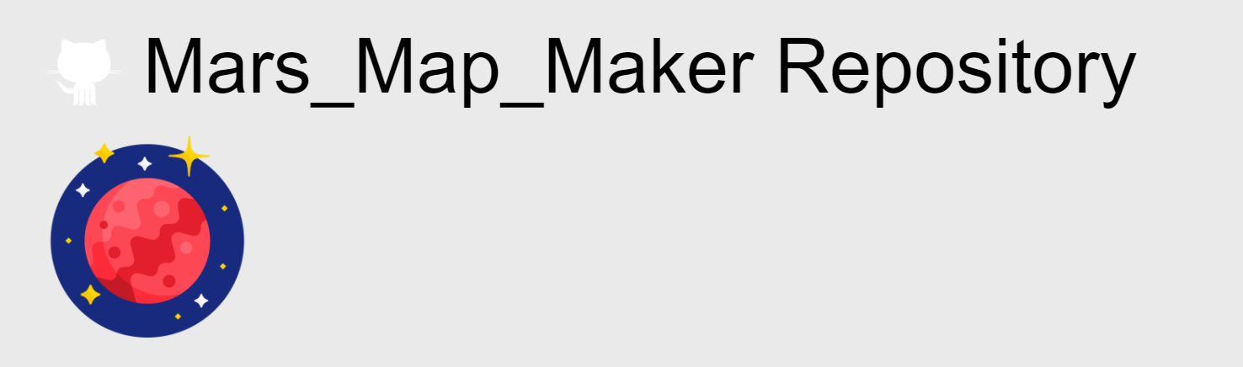
Finding our Source Code
Apertium (initial choice)
Too complex
Mars Map Maker (final choice)
Robert’s project

Slide 4
Architecture of /BestTeam/TestAutomation/
runAllTests.sh
Run this to execute the testing framework
scripts
Contains necessary driver scripts to call the framework
oracles
Contains the correct results to compare actual results to
testCases
Contains each test case in its own .json
testCasesExecutables
Contains driver scripts for testing each module
reports
Contains documentation for test reports

Slide 5
Searching for Code to Test
Specific criteria
Low level methods
No high level renders
One input, one output

Slide 6
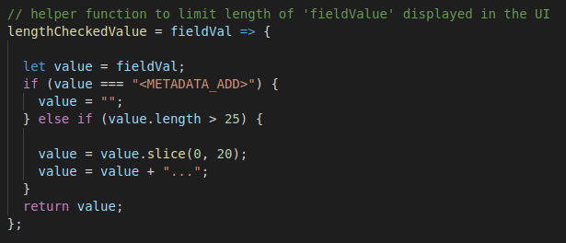
Example of a Good Method to Test:

Slide 7
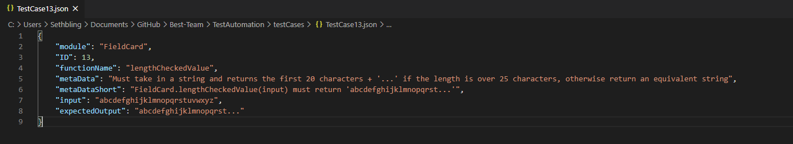
Example Test Case

Slide 8
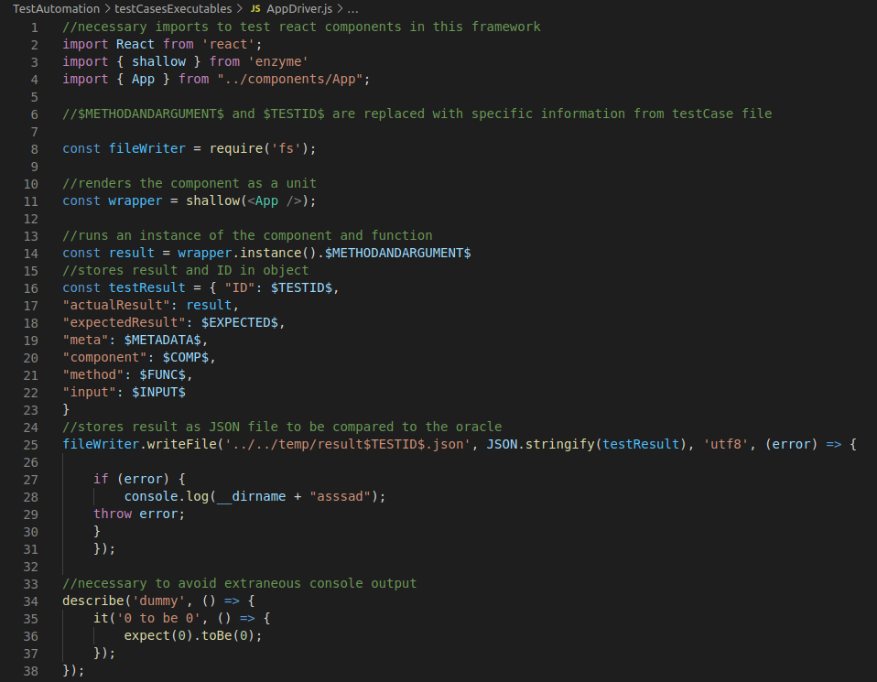
Example Module Driver

Slide 9
How to Get Started
Step 1: Run on Latest Ubuntu
Step 2: Install git “sudo apt install git -y”
Step 3: Clone repository "git clone https://github.com/csci-362-01-2020/Best-Team"
Step 4: Move into the /Best-Team/TestAutomation directory
Step 5: run quickSetUp.sh (this installs all our dependencies)
Step 6: run runAllTests.sh
(Follow next steps to access/run tests on faulted code)
Step 7: Checkout our mutation branch “git checkout mutationBranch”
Step 8: run runAllTests.sh (mutated code can be found in the project directory while on this branch)

Slide 10
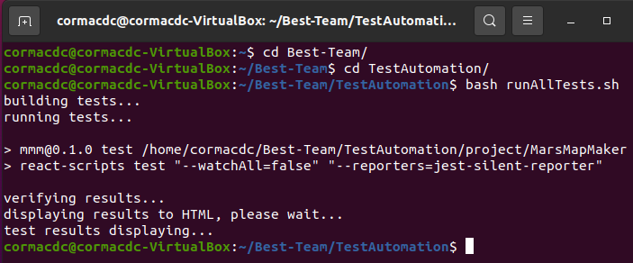
Running the Framework

Slide 11
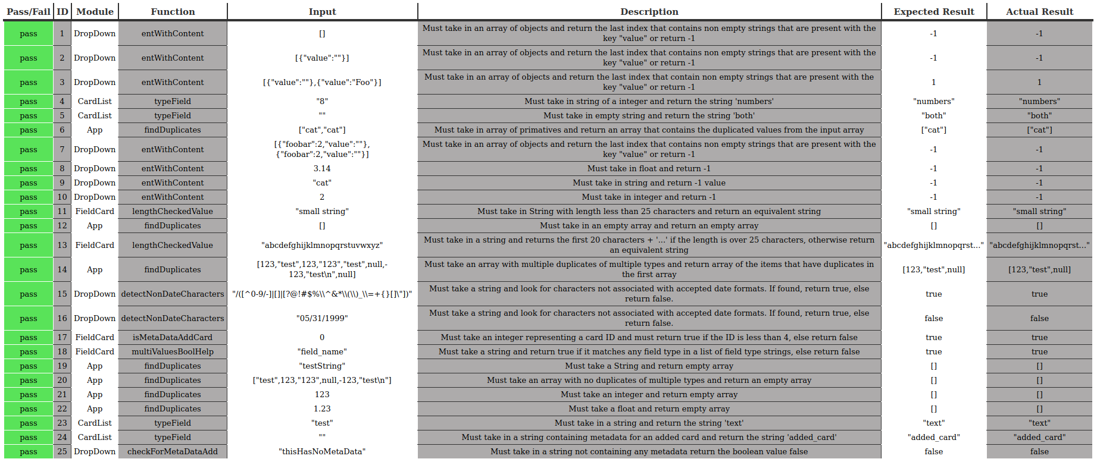
Framework Results

Slide 12
Fault Injections
Necessary to demonstrate integrity
Catches more bugs
Looking for false negatives/positives

Slide 13
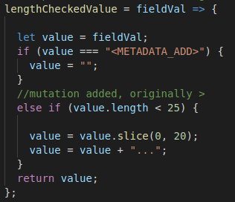
What did we change?
Simple logic/arithmetic changes
Example: FieldCard lengthCheckedValue
Becomes

Slide 14
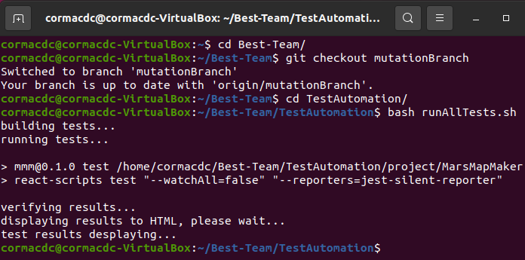
Running the Fault Framework

Slide 15
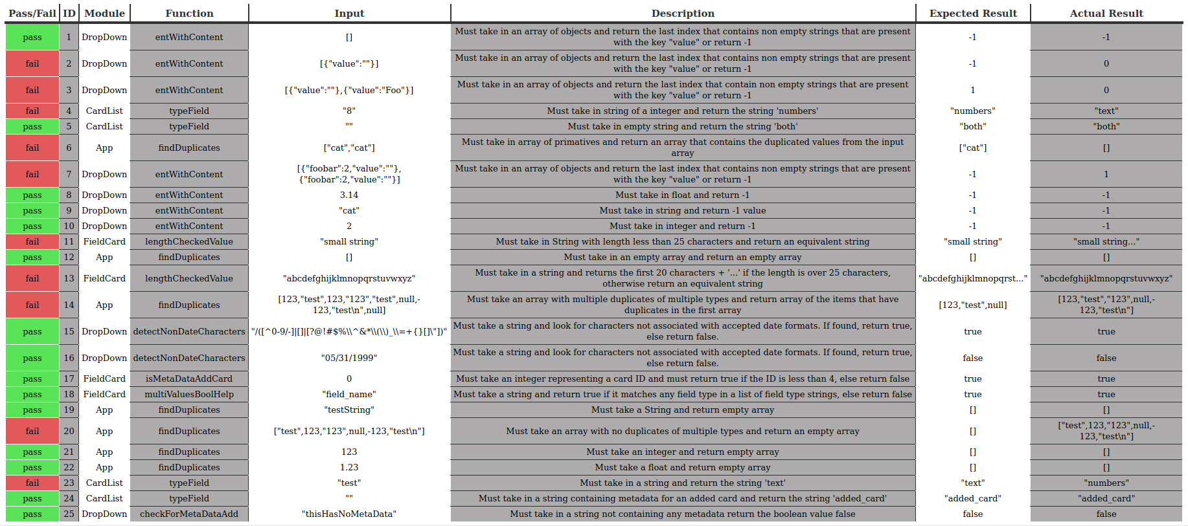
Fault Framework Results

Slide 16

Reflections and Conclusions
Teamwork
Learning Experience
Bug Catching
Thank You

