Slide 1
Mars Map Maker
Testing Framework
Cormac Conahan, Robert Niggebrugge, Seth Hinson

Slide 2
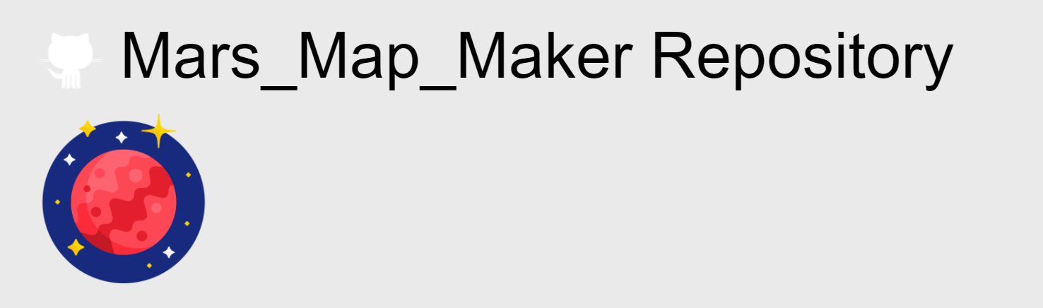
Introduction to Best Team
Apertium
Mars Map Maker

Slide 3
Testing Architecture
scripts
oracles
testCases
testCasesExecutables
reports

Slide 4
How to Get Started
Step 1: Clone the repository "git clone https://github.com/csci-362-01-2020/Best-Team"
Step 2: Move into the TestAutomation/MarsMapMaker/ and run the command "git submodule update --init"
Step 3: In the same directory, run command "git pull https://github.com/hafey1/MarsMapMaker"
Step 4: Install npm "npm install"
Step 5: Once install is complete, change to the scripts directory and run the quickSetUp.sh script (bash quickSetUp.sh)
Step 6: Once the quick setup is complete, run the runAllTests.sh script (bash runAllTests.sh)

Slide 5
Searching for Code to Test
Specific criteria
Low level methods
No high level renders
One input, one output

Slide 6
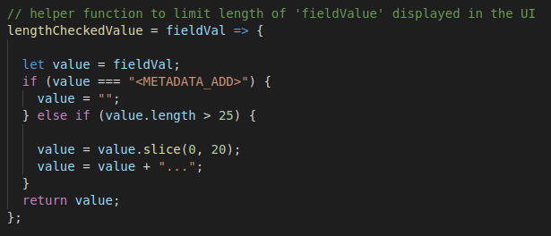

Slide 7
Example Test Case
"module": "DropDown", // chooses the module from which the tested function is retrieved
"ID": 1, // sets the test case ID
"functionName": "entWithContent", // chooses which function from the module to test
"metaData": "Must take in an array of objects and return the last index that contains non empty strings that are present with the key \"value\" or return -1", // short description of expected inputs and expected outputs
"metaDataShort": "DropDown.entWithContent(input) must return -1", // precise expectations of this test case
"input": [], // input for the function to test functionality described above
"expectedOutput": -1 // expected output of the function with given input

Slide 8
Testing Framework in Action

Slide 9
Fault Injections
Testing the tests
Necessary to demonstrate integrity
Catches more bugs

Slide 10
Fault Injections in Action

Slide 11
Reflections and Conclusions
Teamwork
Learning Experience
Thank You

