Slide 1
Team Fantastic-Four

Slide 2
Who are we?

Slide 3
Team Members behind the Code
Patrick McCabe
Year: Senior
Major: Computer Science
Minor(s): History & Data Science
Extra Curricular(s): Cyber Security Club
Github: pmccabe5
David Thompson
Year: Senior
Major: Computer Science
Minor(s): -
Extra Curricular(s): Chucktown Sound, cLoL
Github: DavidThompson8

Slide 4
H/FOSS Project Selection

Slide 5
Criteria for Our Project
Is it Open Source?
Programming Language
Python
Java
Everything else

Slide 6
Our Project: SugarLabs

Slide 7
sugarlabs/sugar
What is it?
This is the full desktop environment for sugar
Open Source: Yes (part of H/FOSS projects)
Programming Language: Python3
Issues that we ran into:
Unable to run on the following Ubuntu distributions from source: 20.04 Focal Fossa, 19.04 Disco Dingo, 18.04 Bionic Beaver, and 17.04 Artful Aardvark
The following scripts were built to try and combat the issue to no avail

Slide 8
Our Project: SugarLabs
Our Project: calculate-activity

Slide 9
sugarlabs/calculate-activity
What is it?
This is the calculator application for the sugarlabs/sugar desktop environment (DE)
Open Source: Yes (part of H/FOSS projects)
Programming Language: Python3
Issues that we ran into:
Set sights too far ahead
Unable to run full DE without installing the apt package for sugarlabs/sugar
Activity/class search (minor issue, but resolved quickly after meeting with the client)

Slide 10
What did we test?

Slide 11
Methods Tested
add(x, y)
sub(x, y)
mul(x, y)
div(x, y)
pow(x, y)

Slide 12
Our Testing Framework

Slide 13
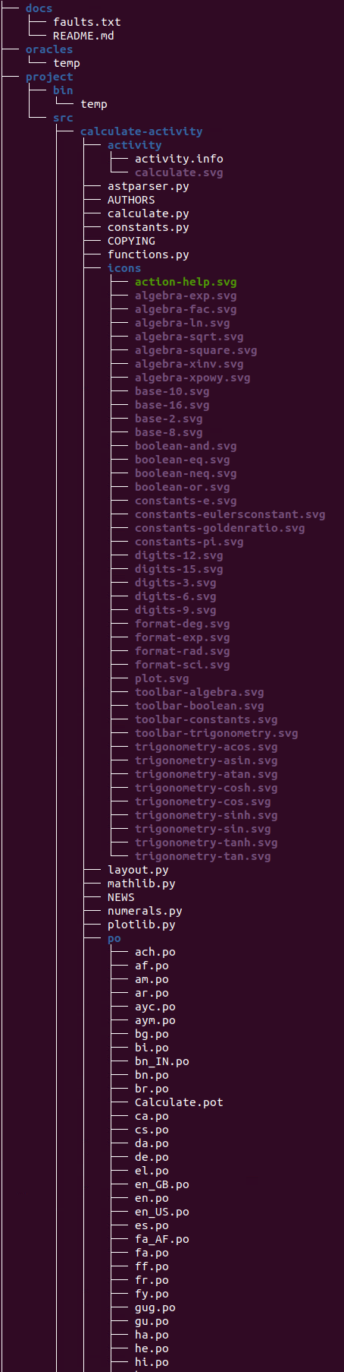
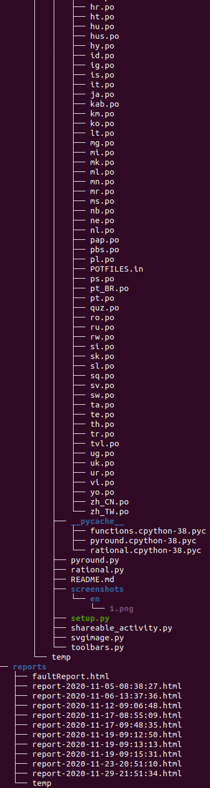
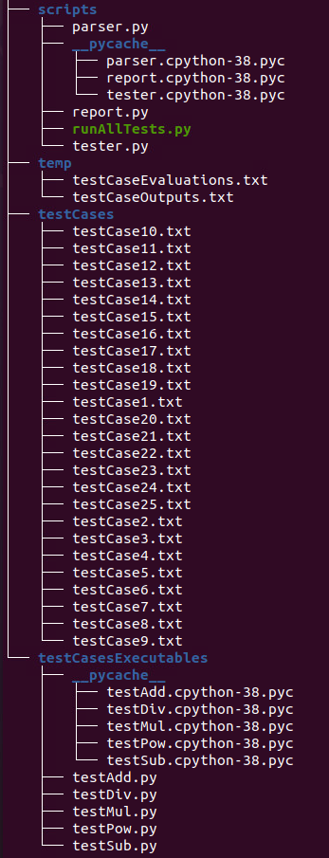
Main
Directories
docs
oracles
project
bin
src
calculate-activity
reports
scripts
temp
testCases
testCasesExecutables
**Output taken from the terminal output of tree .

Slide 14
Testcase File Sample Layout
Test Suite: TS0001
Test ID: TC0001
Requirement: Addition of two whole numbers
Component: functions.py
Driver: testAdd.py
Method: add(x, y)
Inputs: 2, 1
Oracle: 3

Slide 15
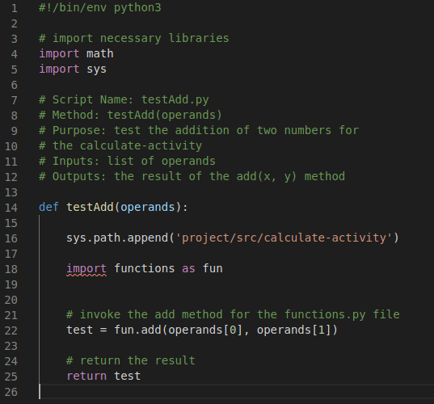
Sample Testcase Driver

Slide 16
Framework Demo

Slide 17
Fault Injections

Slide 18
Our Fault Injections
For the add(x, y) method: + replaced with -
For the sub(x, y) method: - replaced with +
For the mul(x, y) method: * added
For the div(x, y) method: / added
For the pow(x, y) method: * removed

Slide 19
Final Remarks

Slide 20
What we learned from this Project and future improvements
Learned a lot about:
Git
Bash
Python
Testing
What can be improved:
Generalization
Time and space efficiency
Issues with the project initially:
Selection of the project (research)
Getting the environment set up
Bash

Slide 21
Link to Our Project
https://github.com/csci-362-01-2020/Fantastic-Four

Slide 22
Questions?

