Slide 1
Presentation
By Tristan Lawler, Ryan Ratliffe, Noah Drake, Chloe Harris

Slide 2
STEM - Spatiotemporal Epidemiological Modeler
•Tool designed to help scientist and public health officials create and use spatial and temporal models of emerging diseases. These models can aid in understanding the spread of such a disease over time.

Slide 3
Script
•Originally the script was split into two separate files
•Build.sh – this builds all the java file within the project
•runAllTests.sh – this runs all the test cases and prints out the results
•We later moved build.sh into runAllTest.sh to make running the project simpler and accurate to the guidlines

Slide 4
Drivers
Drivers are .java files that contain the code to run the methods we intend to test
For example GetSqrdEdgeRangeDriver.java will take in parameters that it will format for the GetSqrdEdgeRange method and run that method with said parameters

Slide 5
Demonstration

Slide 6
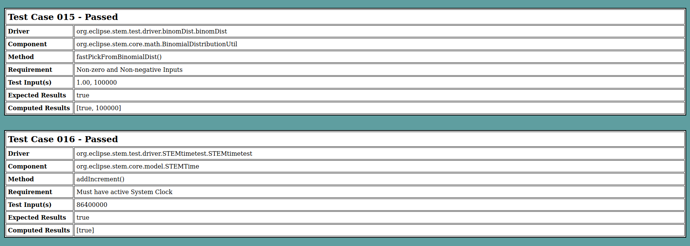
Test Results

Slide 7
What we learned
Don’t procrastinate
ect.

