Slide 1
Team-4 Presentation
By Tristan Lawler, Ryan Ratliffe, Noah Drake, Chloe Harris
Notes:
Noah does intro, and then everyone introduces themselves

Slide 2
Martus
Didn’t work
Had Not been updated in years, no servers, too much work
Notes:
Chloe

Slide 3
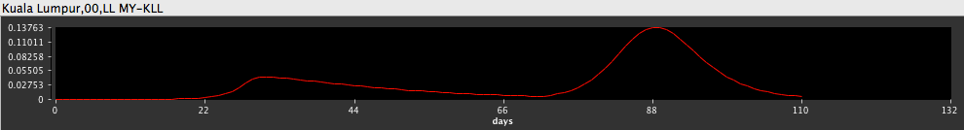
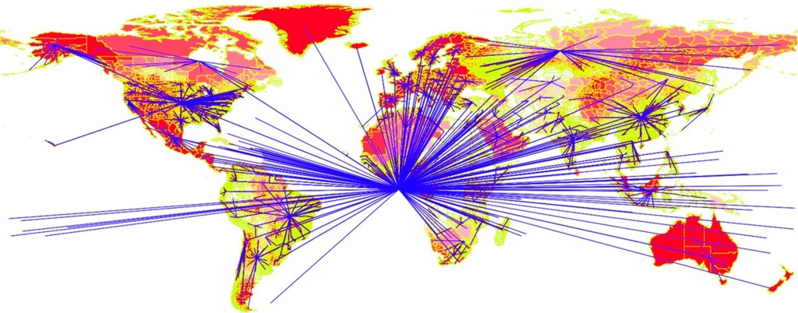
“The Spatiotemporal Epidemiological Modeler (STEM) tool is designed to help scientists and public health officials create and use spatial and temporal models of emerging infectious diseases. These models can aid in understanding and potentially preventing the spread of such diseases.” -Eclipse Foundation
Effects of Social Distancing Policy in Kuala Lumpur
Example Air Travel Network Model
https://wiki.eclipse.org/File:KualaLumparInfectious.png
https://wiki.eclipse.org/images/3/3c/Airtravelnetwork.jpg
Notes:
Chloe

Slide 4
More about STEM...
First made by IBM (2006)
Originally built with Java 6; current version requires Java 8
Utilizes component-based software engineering
Graphs implemented using the Eclipse Modeling Framework (EMF)
Extensive documentation available for developers looking to implement their own plugins for the software.
Notes:
Chloe

Slide 5
Our Testing Framework for STEM
Defined file structure for automated test case execution
Runs on Ubuntu 20.04; requires open-jdk-8
Formatted test case files
Bash scripts to automate compilation of source code and test case execution
Drivers to execute test case methods
HTML report document of test case results
Notes:
Tristan

Slide 6
File structure
/TestAutomation
/project
/src
/org/eclipse/stem
/test
/driver (source code for drivers)
/analysis (source code for classes tested)
/core (source code for classes tested)
/graphgenerators (source code for classes tested)
/dependencies
automaticexperiment.jar
Analysis.jar
...
/scripts
build.sh
runAllTests.sh
/testCasesExecutables
/org/eclipse/stem
/test
/driver (.class files for drivers)
TestReporter.class
/analysis (.class files for classes tested)
/core (.class files for classes tested)
/graphgenerators (.class files for classes tested)
/docs
README.txt
/reports
report.html
Notes:
Tristan

Slide 7


Dependencies
Ubuntu 20.04
Java 8 (open-jdk-8)
itprotoday.com
design.ubuntu.com
Notes:
Ryan Ratliffe can talk about this.

Slide 8
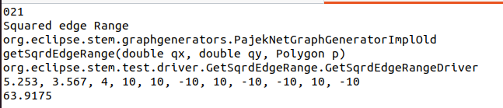
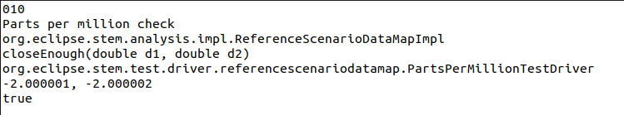
Test cases
Notes:
Noah

Slide 9
Scripts
•Originally the script was split into two separate files
•Build.sh – this builds all the java files within the project
•runAllTests.sh – this runs all the test cases and prints out the results
•We later moved build.sh into runAllTest.sh to make running the project simpler and accurate to the guidelines...
Notes:
Noah - Will show on Ubuntu during presentation

Slide 10
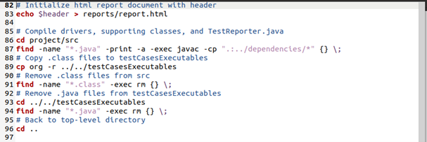
Scripts
Compiling STEM code, drivers, and supporting classes
Notes:
Noah

Slide 11
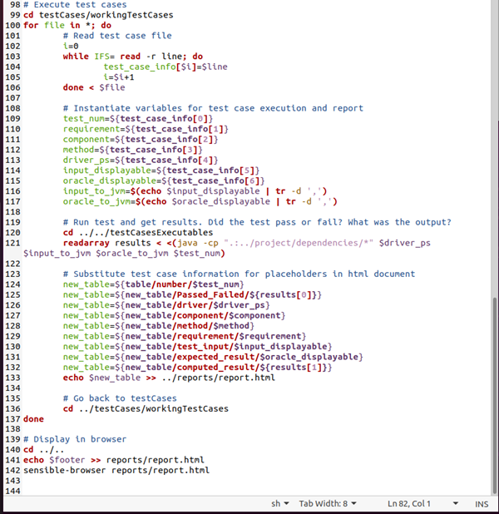
Scripts
Parsing test case files and executing test cases by passing in parameters to drivers
Notes:
Noah

Slide 12
Drivers
.java files that run the following methods for testing
All drivers report tests through a TestReporter class
All files under project/src/org/eclipse/stem/test/driver
GetSqrdEdgeRangeDriver
Tests getSqrdEdgeRange() of org.eclipse.stem.graphgenerators.impl.PajekNetGraphGeneratorImplOld
STEMTimeTestDriver
Tests addIncrement() of org.eclipse.stem.core.model.STEMTime
BinomDistDriver
Tests fastPickFromBinomialDist() of org.eclipse.stem.core.math.BinomialDistributionUtil
NelderMeadTestDriver
Tests execute() of org.eclipse.stem.analysis.automaticexperiment.NelderMeadAlgorithm
PPMTestDriver
Tests closeEnough() of org.eclipse.stem.analysis.impl.ReferenceScenarioDataMapImpl
Notes:
Tristan

Slide 13
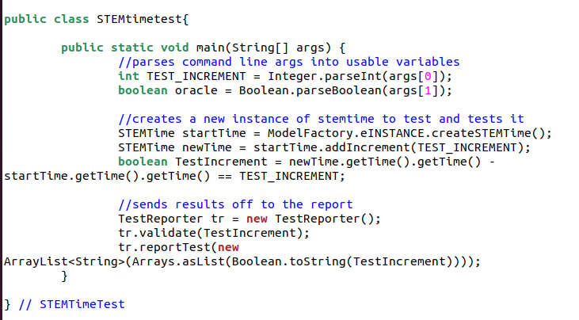
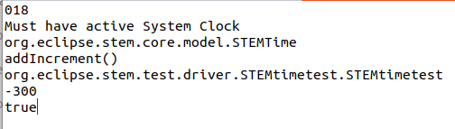
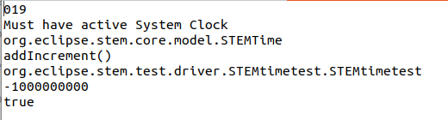
Driver example
Notes:
Tristan

Slide 14
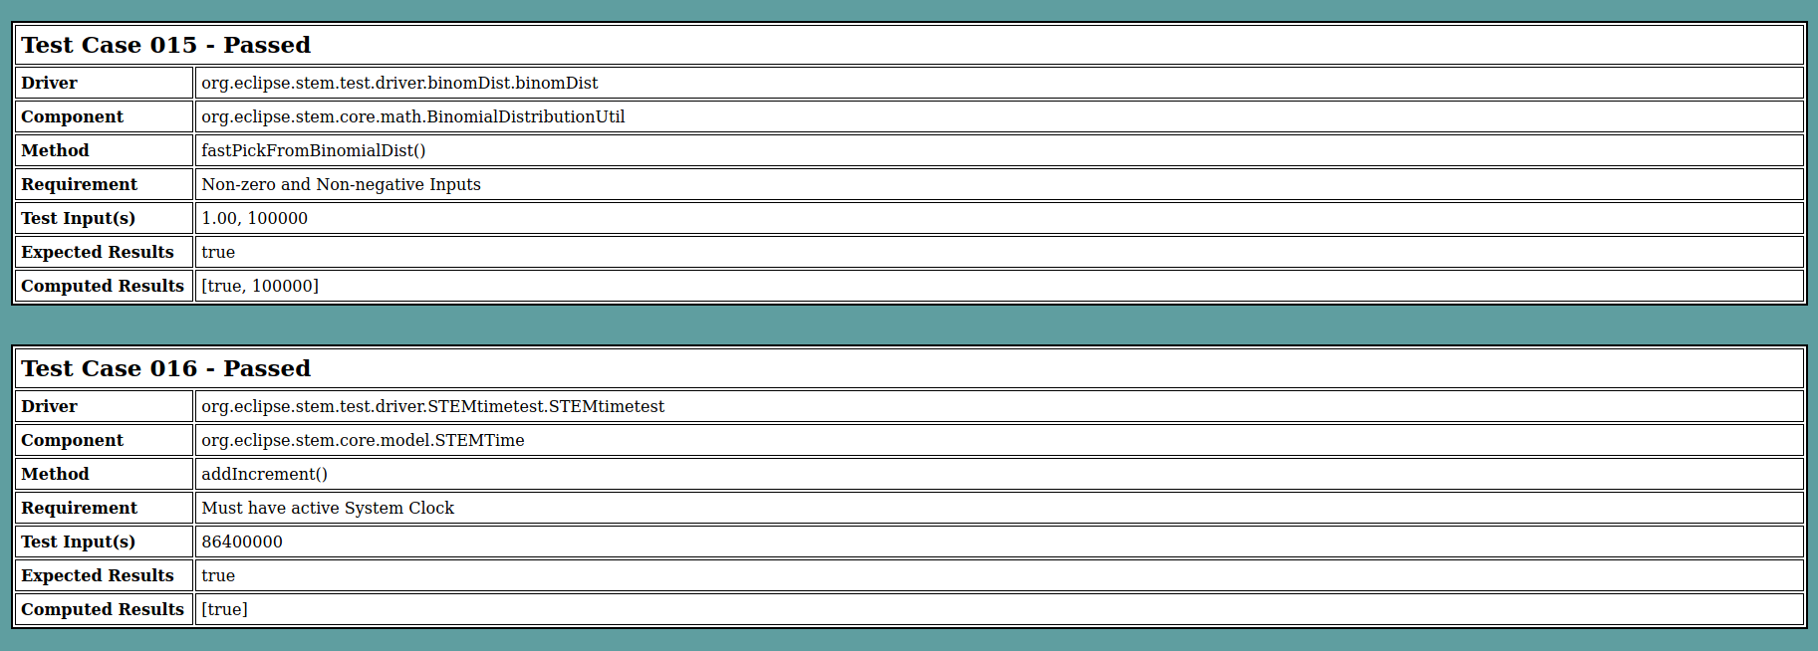
Test Results
Notes:
Chloe

Slide 15
Demonstration
Notes:
Ryan Ratliffe can talk about this.

Slide 16
Fault Injection
org.eclipse.stem.graphgenerators.impl.PajekNetGraphGeneratorImplOld
line 1022: Remove "- x" (will cause all test cases to fail)
org.eclipse.stem.analysis.automaticexperiment.NelderMeadAlgorithm
Line 44: Change 0.5 to 0.1 (will cause test case 004 to fail)
org.eclipse.stem.analysis.impl.ReferenceScenarioDataMapImpl
Line 911: Change Math.abs(2.0*(d1-d2)/(d1+d2)) to Math.abs(2.0*(d1+d2)/(d1-d2)) (will cause test cases 007 and 008 to fail)
org.eclipse.stem.core.math.BinomialDistributionUtil
Line 71: Change p = p/100 to p = p*100 (will cause test cases 012 and 014 to fail)
org.eclipse.stem.core.model.impl.STEMTimeImpl
Line 104: Change final long newTime = newTime().getTime() + timeIncrement; to final long newTime = newTime().getTime() - timeIncrement;(will cause test cases 016, 018, 019, and 020 to fail)
Notes:
Ryan

Slide 17
What we learned
How to use the basic syntax of Bash.
How to use Git in Ubuntu.
How to collaborate on a project using features of version control.
How to compile Java programs with dependencies from the command line.
How to automate the compilation and execution of Java programs with Bash.
How to work with a large, open-source software project.
Notes:
Chloe

Slide 18
Sources
https://en.wikipedia.org/wiki/Spatiotemporal_Epidemiological_Modeler
https://wiki.eclipse.org/STEM
https://wiki.eclipse.org/Welcome_STEM_Developers#Creating_a_new_standalone_STEM_application
https://www.eclipse.org/stem/intro.php

