Slide 1
Creating an Automated Testing Framework for the Miradi Open-Source Project
Team-5:
Ian Dudderar, Jacob Lipsey, Jacob Nash, & Jacob Roddam

Slide 2
Selecting and Building a Project
Initially decided on ODK Collect, Android app & part of open-source ODK Project
Reasoning:
Developed in Java, a language we are all familiar and comfortable with.
It’s role in aiding in data collection peaked our interests--as nerds, we all love data.
Requires Android Studio and IntelliJ for development, both of which we were all able to set up on our respective Ubuntu Linux virtual Machines.

Slide 3
First Roadblocks: Issues with ODK Collect and Decision to switch projects
After repeated issues with setting up the proper Gradle dependencies, only Jacob Nash was able to build the full project on his virtual machine.
App’s classes and methods were overwhelmingly dedicated to graphics and user interface tools.
The team came to a realization that this app offered few options that were conducive to automated testing.

Slide 4
New project: Miradi
Miradi: A Java desktop app that allows users to plan and manage biodiversity projects.
Our interest was piqued by the classes in Miradi’s “Utils” package.
Classes had few to no outside dependencies.
Methods from classes had predictable and testable output.
These reasons would make building and testing these classes simpler.
OptionalDouble class
Class with methods to handle the manipulation and formatting of double values.
These methods also assist with handling special cases (i.e. null values)
IgnoreCaseStringComparator class
Class with a single method that compares the toString() output of two objects, ignoring case.

Slide 5
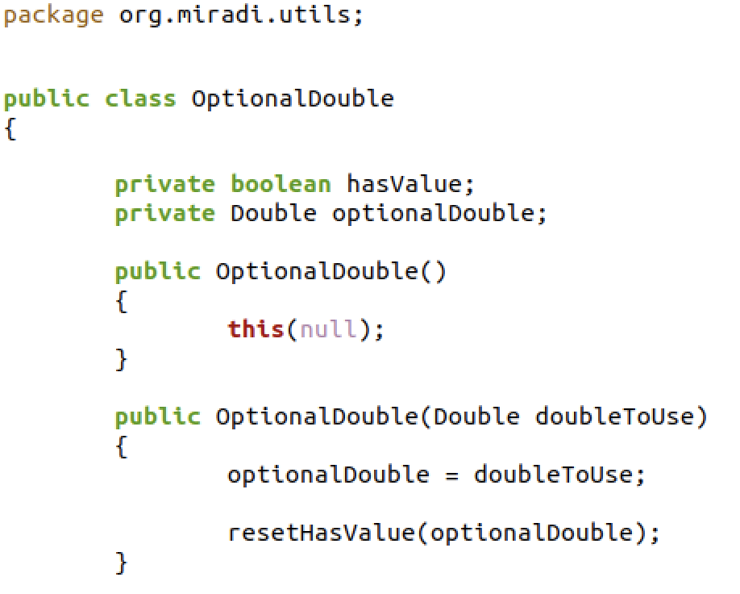
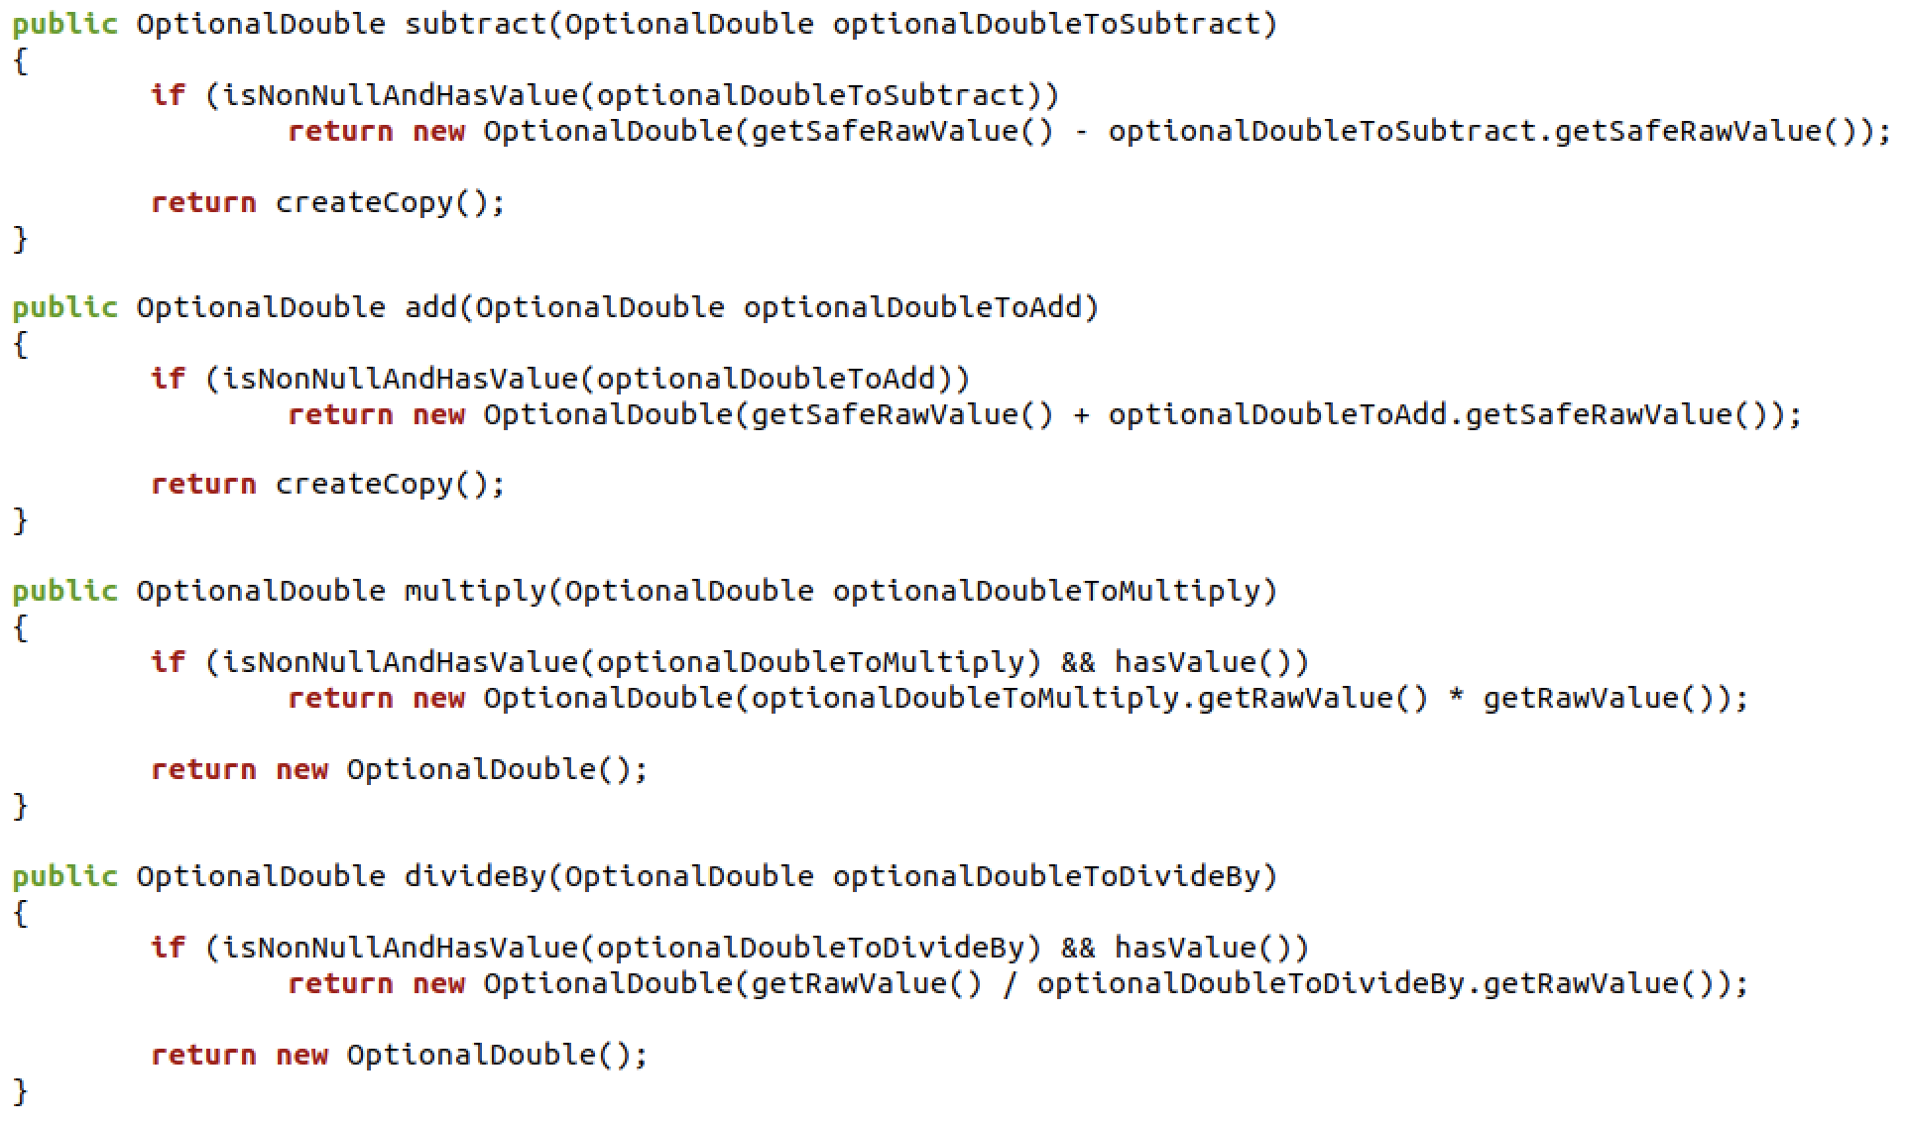
OptionalDouble.java

Slide 6
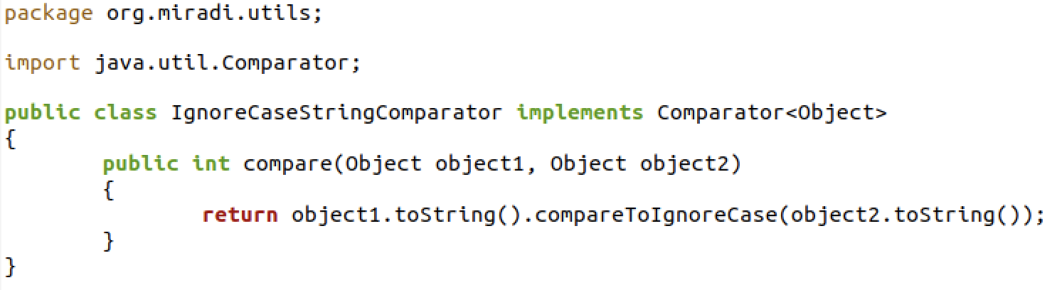
IgnoreCaseStringComparator.java

Slide 7
First Test Cases
Test # | Class | Method | Requirement | Inputs | Oracle
1 | OptionalDouble | OptionalDouble add(OptionalDouble optionalDoubleToAdd) | add() Method returns correct sum of two positive doubles with no value after decimal | 2.0, 3.0 | 5.0
2 | OptionalDouble | OptionalDouble add(OptionalDouble optionalDoubleToAdd) | add() Method returns correct sum for two positive doubles with values after decimal | 5.7, 3.6 | 9.3
3 | OptionalDouble | OptionalDouble add(OptionalDouble optionalDoubleToAdd) | add() Method returns correct sum for two very large positive doubles | 99999.9999,123456.789 | 223456.78899
4 | OptionalDouble | OptionalDouble add(OptionalDouble optionalDoubleToAdd) | add() Method returns correct sum for two very large negative doubles | -99999.99999, -123456.789 | -223456.78899
5 | OptionalDouble | OptionalDouble add(OptionalDouble optionalDoubleToAdd) | add() Method returns correct sum for a positive double and a small double | 7.0, -5.6 | 1.4

Slide 8
Initial Framework
testCases
2) Script compiles and runs the Java test executable specified by the test case with the inputs and oracle specified by the test case
testExcutables
1) Script reads through each test case text file to get the data necessary to run each test case
runAllTests.sh
script
3) Output of test written to temporary text file
5) Script formats output in html wrapper and opens html report in browser
4) Script reads output from temporary file
Temp output
report.html

Slide 9
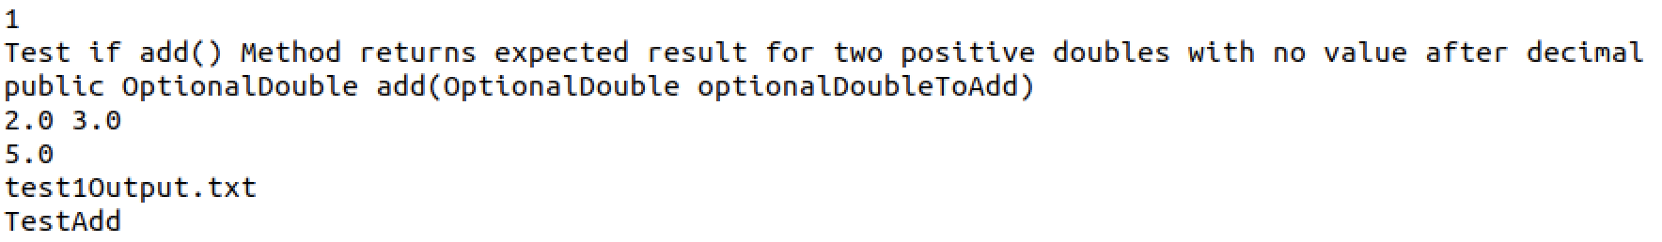
Initial Framework Components
Test Case File
Test #
Requirement
Inputs
Oracle
Temporary Output File
Test Executable

Slide 10
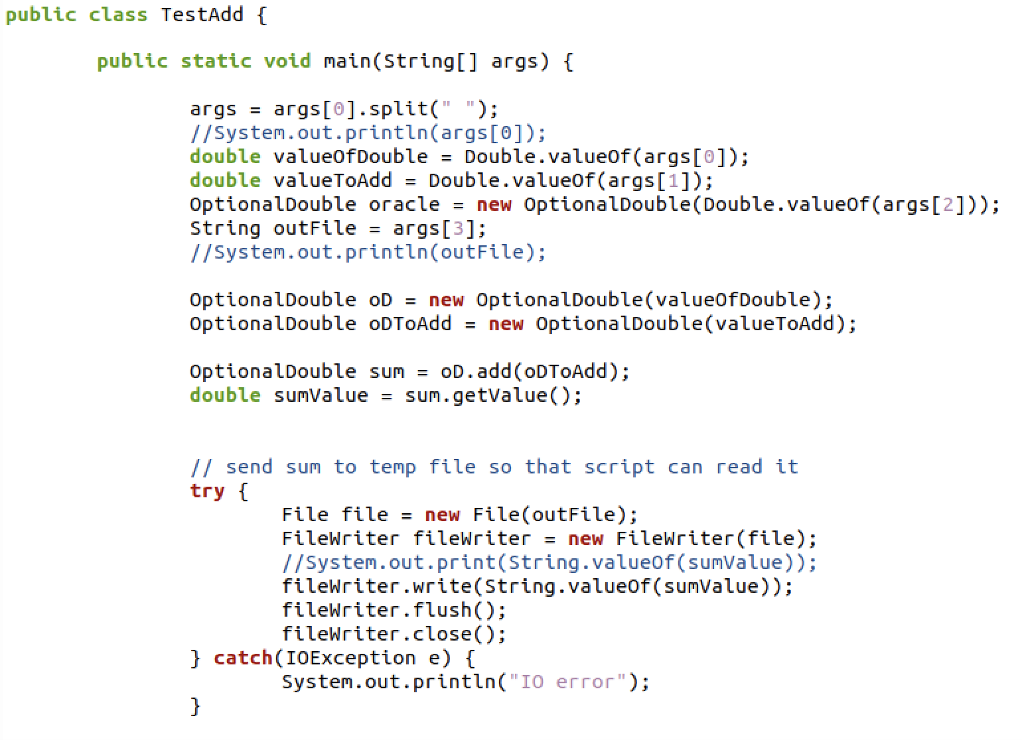
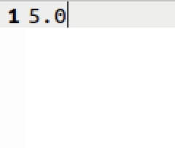
Initial Framework Components
Test Executable
Temporary Output File

Slide 11
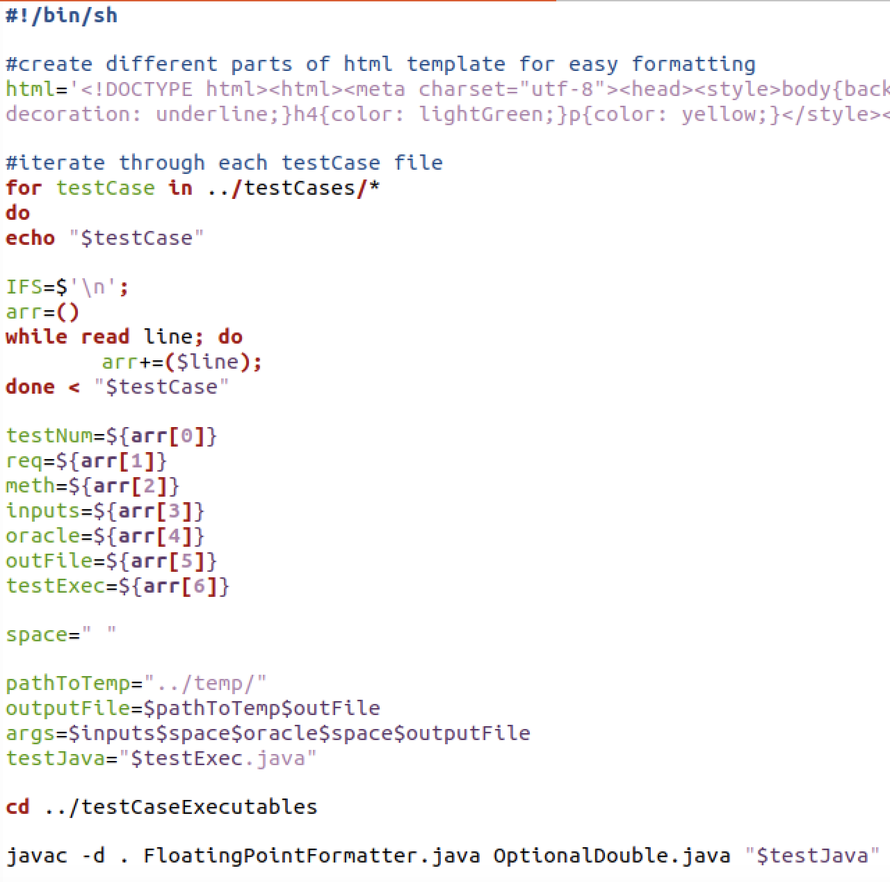
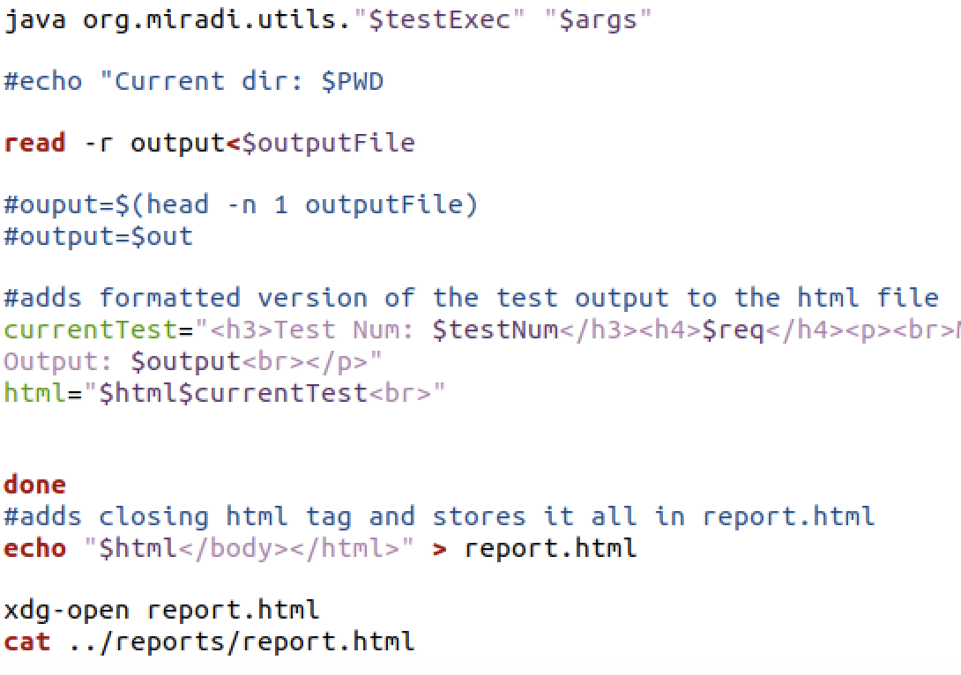
Initial Framework Components
runAllTests.sh script

Slide 12
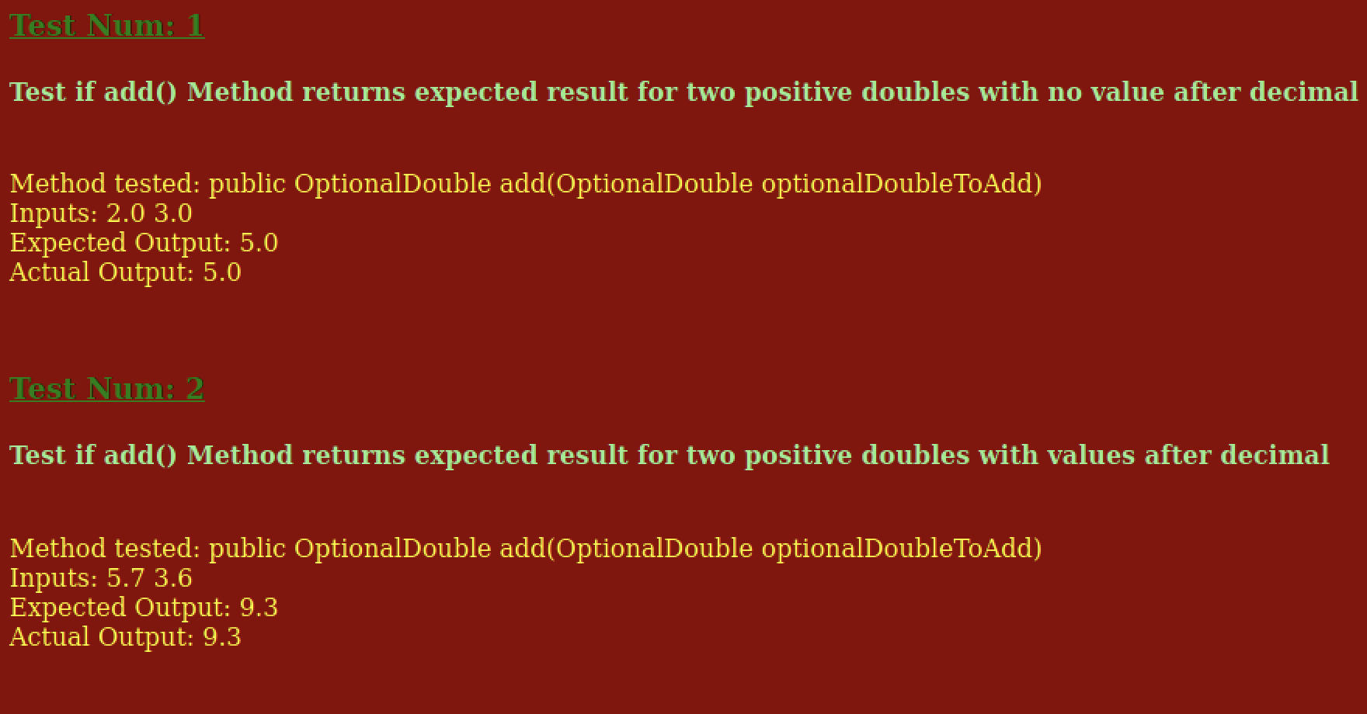
First HTML Test Report

Slide 13
Necessary Revisions
Adjust script so that it runs correctly when called from TestAutomation directory
Change wording of requirements in the test cases to reflect the requirement being tested, not the action of the test itself.
Get rid of system of writing/reading from temporary file; instead have script read directly from the output of the test.
Include in the report whether each test passed or failed.
Format report in html table in order to increase readability.

Slide 14
Revised Test Framework
testCases
2) Script compiles and runs the Java test executable specified by the test case with the inputs and oracle specified by the test case
testExcutables
1) Script reads through each test case text file to get the data necessary to run each test case
runAllTests.sh
script
3) Test executable prints output and test result directly to system output, which is then read by script
4) Script formats output in html table wrapper and opens html report in browser
report.html

Slide 15
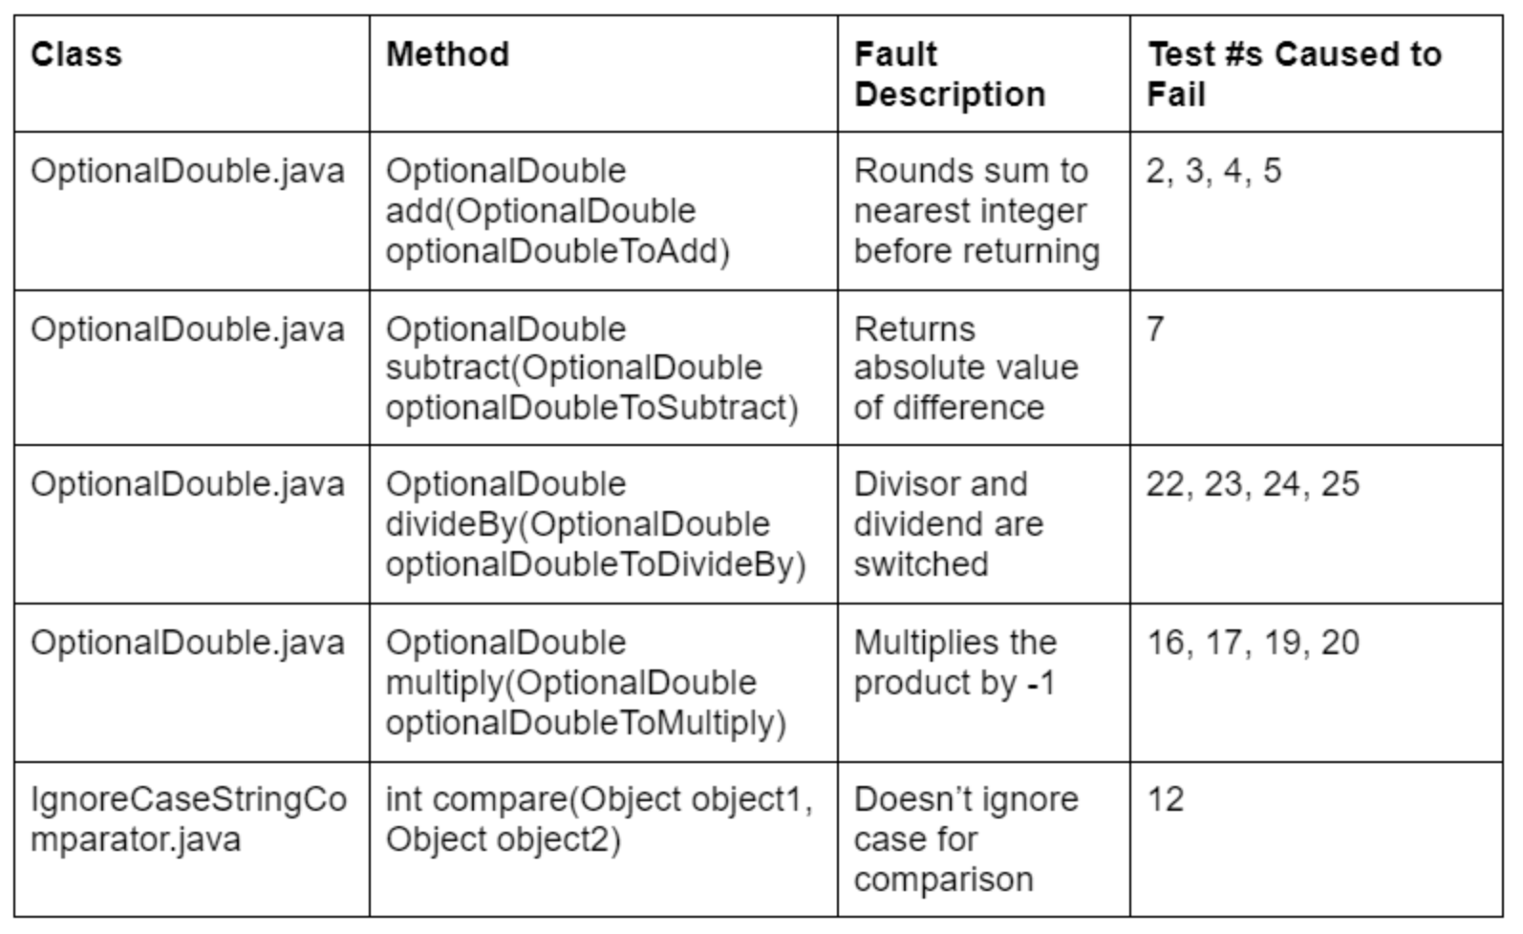
Inserting Faults
To remove these faults, you will need to edit the OptionalDouble.java and IgnoreCaseStringComparator.java files
Go to the method of the fault you want to remove.
The original and faulty code still exist and are specified by comments; however, the original code is surrounded by a multi-line comment.
To remove a fault, remove the multi-line comment from around the original code and surround the faulty code with a multi-line comment.
To re-insert the fault, remove the multi-line comment from around the faulty code and surround the original code with a multi-line comment.
After saving the edited file, the next time you run `bash scripts/runAllTests.sh` from the TestAutomation directory, your changes will be reflected in the results.

Slide 16
Demonstration of Framework!

Slide 17
What We’ve Learned
Be decisive when deciding to make a change.
Strive for simplicity; avoid unnecessary complexity.
Communicate with team members early and often.
Plan for deadlines--the earlier the better.
A LOT about scripting and bash. They can be powerful tools for connecting components and driving automation.
How to develop and handle projects with a greater number of components.

