Slide 1
CSCI 362 HFOSS Open Source Project
Team-6: Megan Simpson, George Lutas, and Christian Ellwood
Notes:
George

Slide 2
The Project Being Tested
Notes:
George

Slide 3

OpenMRS
An open source project aiming to provide a basis for electronic medical record-keeping, particularly in the developing world.
This project was written entirely in Java, and, given the group’s proclivity for Java, we decided this project would be the best fit for us to test.
In addition, the current climate regarding COVID-19, as well as other diseases known to decimate more developing countries (i.e. AIDS, tuberculosis, and malaria), made the decision to test this program much easier.
Notes:
George

Slide 4

Building OpenMRS
Overall, building OpenMRS was a test in perseverance, as incomplete documentation and hidden requirements made it much harder than the documentation led it to believe.
As a result, in building this, some additional considerations had to be made.
i.e. changing our methods to be tested
Notes:
George

Slide 5
Testing Plan
Looking through the OpenMRS codebase, we identified multiple points of weakness, however, we decided on testing the Thread Safe Circular First In First Out Queue program.
This was due to low dependencies, their inherently public nature, ease of reading/understanding, in addition to ease of transport to the directory where the drivers were located and minimal code variance given the single source we’re pulling from.
Our first choice, User.java, was found to be inconsistent with our needs, possessing a high number of dependencies, including external dependencies, which made testing extremely difficult.
Notes:
Megan

Slide 6

Testing Framework
In order to broaden our scope of knowledge with various scripting languages, we elected to use the bash scripting language for the testing framework despite no prior experience in the bash language.
In this, we learned a variety of methodologies for working with bash, including “returning” values and command substitution.
Notes:
Megan

Slide 7
Demo 1
Framework and Passing Tests
Notes:
Megan

Slide 8

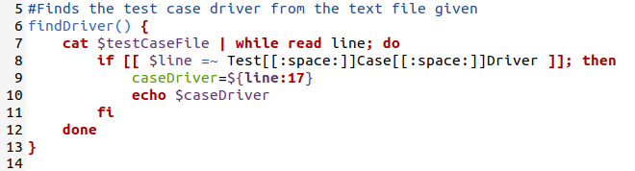
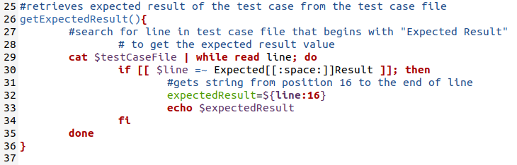
Bash Script Highlights

Slide 9
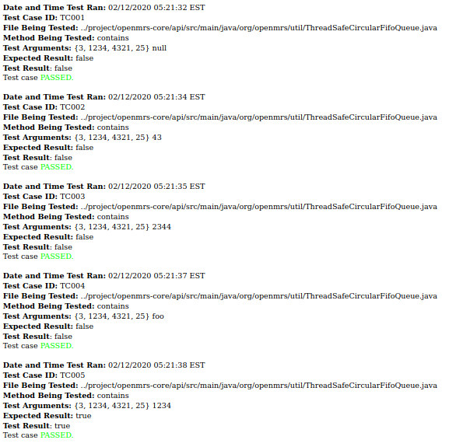
Method: contains
Determines if the queue/array contains a given object

Slide 10
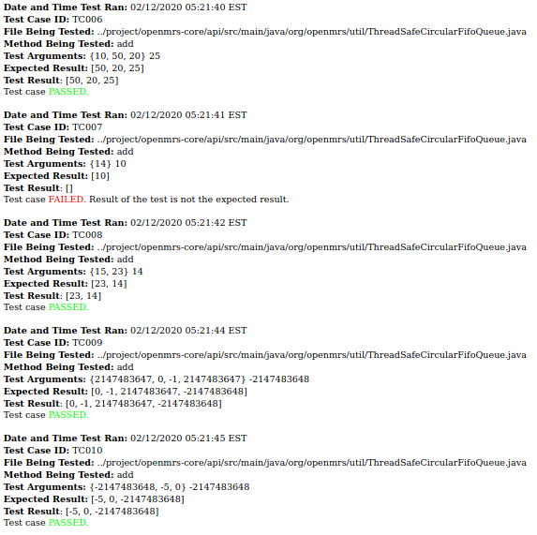
Method: add
Adds an element to the queue

Slide 11
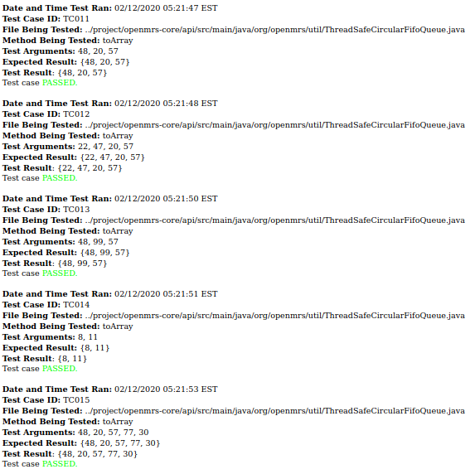
Method: toArray
Casts given data to an array

Slide 12
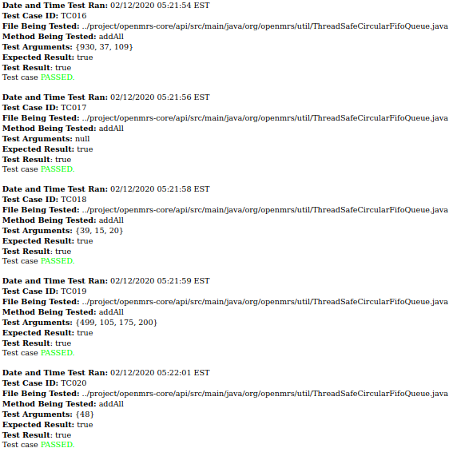
Method: addAll
Adds all given generic type items to an array

Slide 13
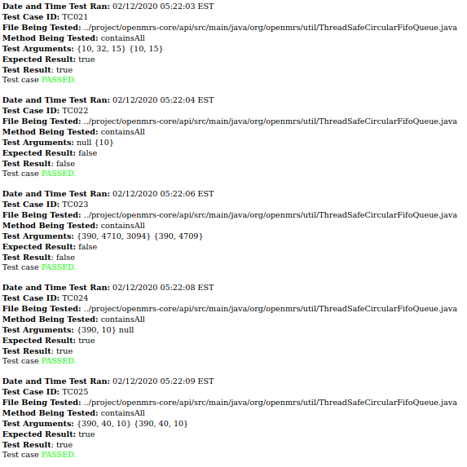
Method: containsAll
Loops through all given elements to check if each
is in the queue/array

Slide 14

Fault Injection
Looking through the codebase multiple times and identifying potential faults was a very slow business, especially given that potential faults occasionally returned no failing test cases.
From this, we were able to find 5 places in the code that triggered faults that caused some test cases to fail, but not all.
Notes:
Christian

Slide 15
Demo 2
Fault-Injection Results
Notes:
Christian

Slide 16
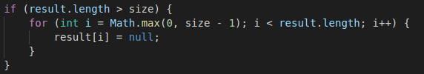
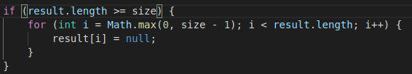
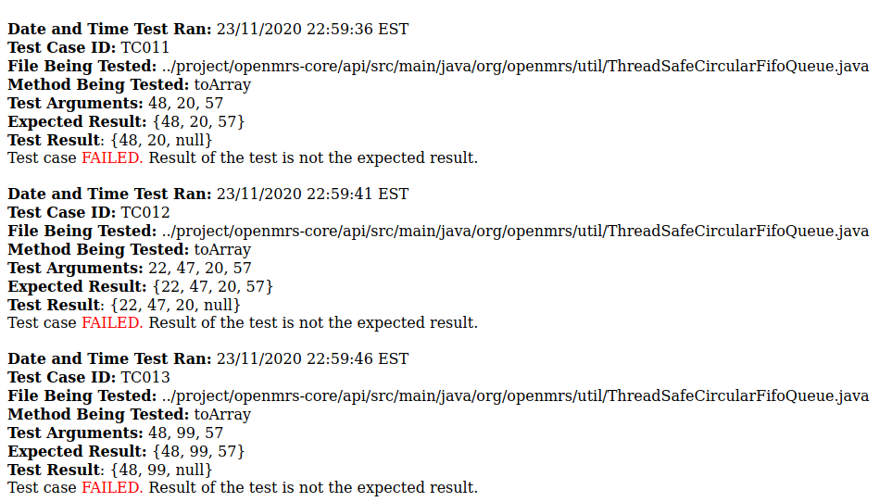
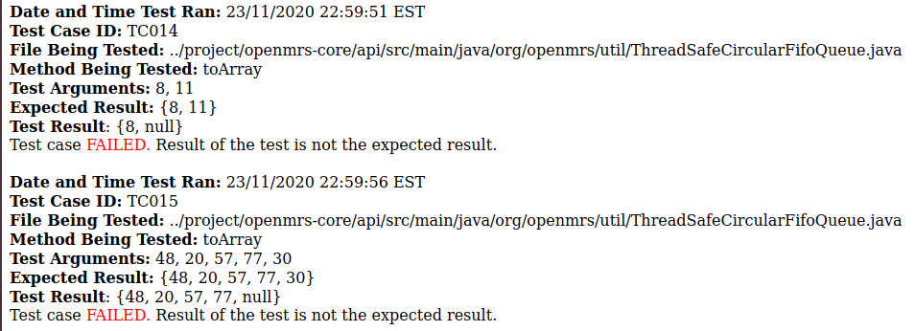
Change 1

Slide 17
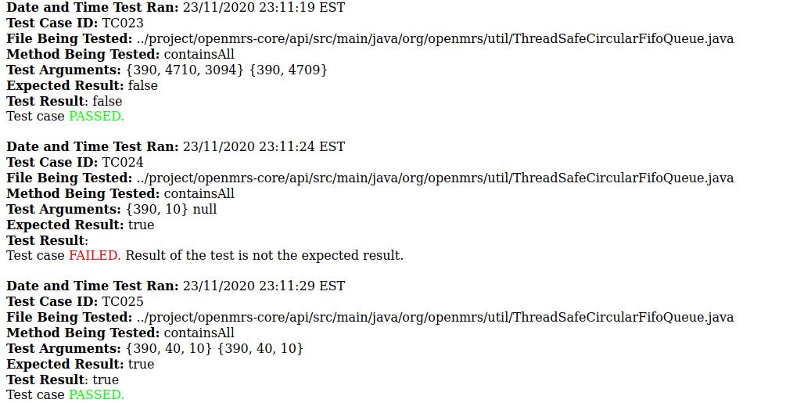
Change 2

Slide 18
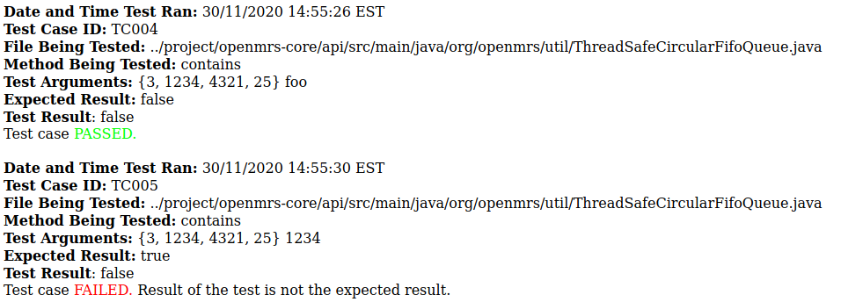
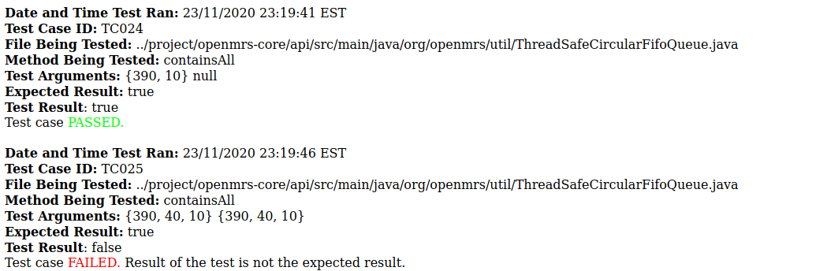
Change 3

Slide 19
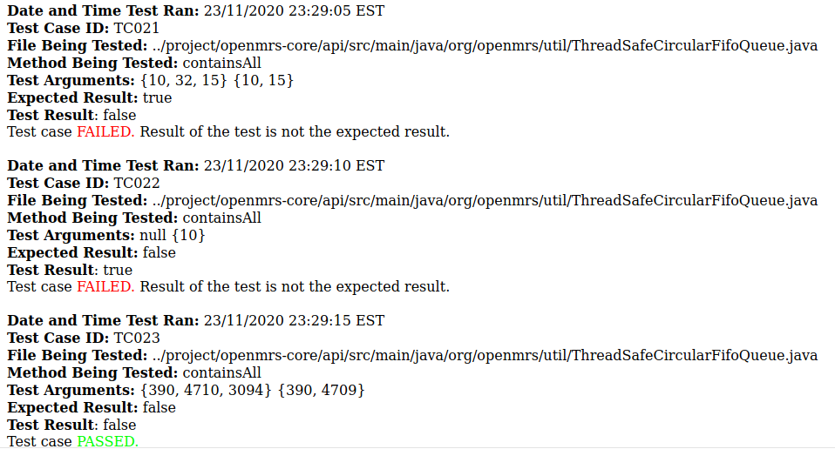
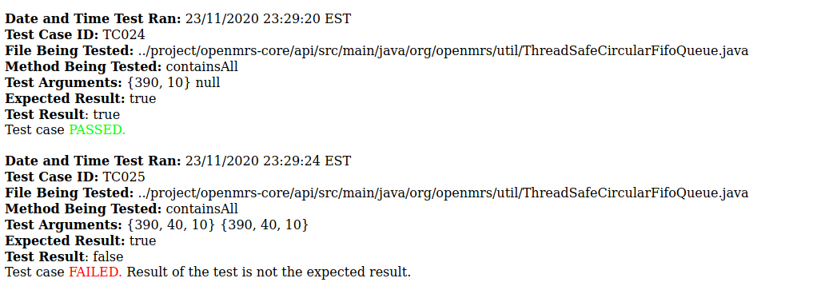
Change 4

Slide 20
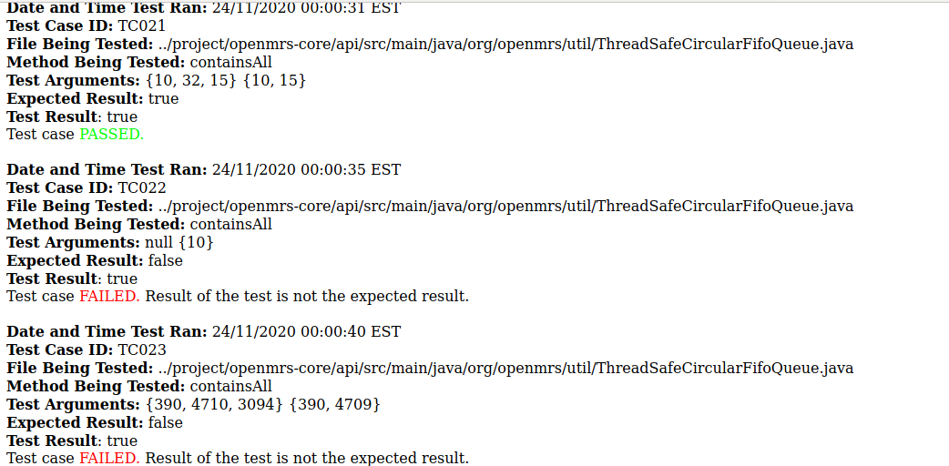
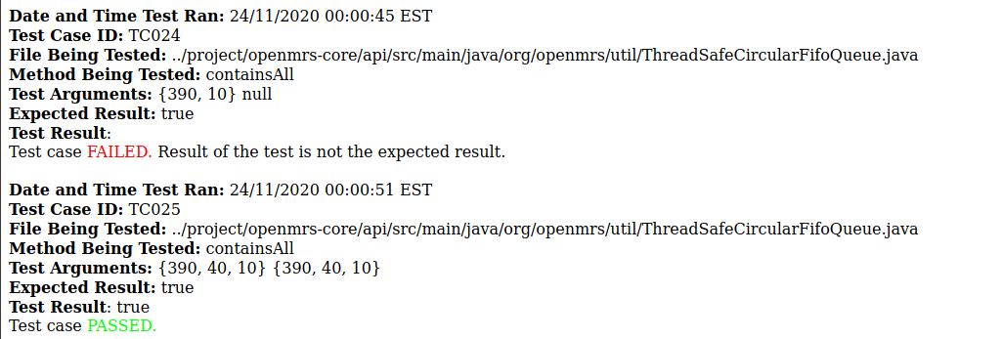
Change 5

Slide 21
Lessons Learned
(Usually the hard way)
Notes:
Megan

Slide 22


Hidden & Incorrect End-of-Line Characters
Methods in our script would function properly for some test cases and not for others.
All test cases implemented identical structures
i.e. returning blank/empty string vs. the expected result
Caused by differences in various text editors
Simply two lines of code per variable corrected this issue after hours of struggling with the bug
Lessons Learned: 1. Concept of hidden end-of-line
characters, 2. Code doesn’t always work as expected.
Notes:
Megan

Slide 23
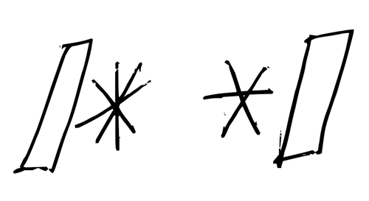
Commenting Code
Working in groups can save lots of time, as all the work does not fall onto just one person.
However, the need to understand someone else’s code in order to expand on it takes more time.
We realized what we had been taught in our introductory programming courses to be true: commenting really is important.
Even if you know the programming language, it’s not always easy to follow someone else’s logic who may think differently than you.
Lesson Learned: Commenting is crucial.
Notes:
Christian:
Following another person’s logic becomes increasingly more difficult when the code blocks are larger and, therefore, usually more complicated.

Slide 24

A Single Space Can Make All the Difference
Script reads all characters after specific given inputs for each test case text file
Resulting string is then parsed by the drivers, where we discovered that a single space at the end of the string (or anywhere in the string for that matter) can make or break the driver’s functionality
All string input was made uniform and proper functioning of the drivers ensued
Lesson Learned: be precise with EVERYTHING, including end-of-line spaces
Notes:
Megan

Slide 25

Team Communication is Key
As our guest speaker, Joye Nettles, stated: “OVER communicate.”
This is much better than wondering if you’ve communicated well enough.
Especially essential for working virtually in teams versus in-person
More difficult to work together virtually where you cannot always see what other group members are doing
We observed that better/more frequent communication leads to:
Increased efficiency &, therefore, increased productivity
Less group member frustration and confusion
More accountability
Notes:
George:
Less frustration/confusion → positive team atmosphere and team-building, which is necessary for overall enjoyment while working on any team project

Slide 26

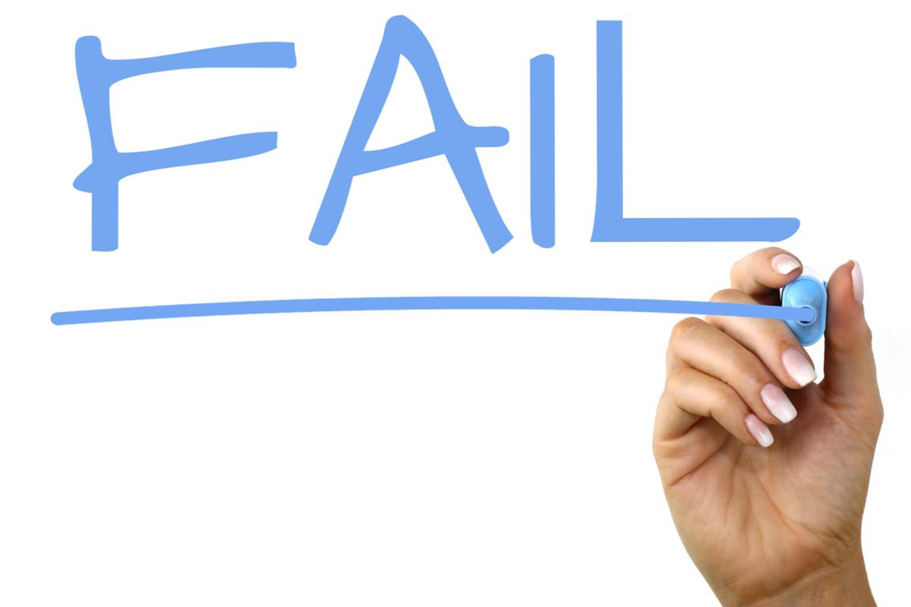
Bug Found in OpenMRS Source Code
“Add” method: when adding a single item to a filled list of length 1, the method returns an empty list (as opposed to a list with the one item)
Circular Queue
Causes exactly one failing test case
Our next steps: reporting this bug to the OpenMRS GitHub repo
Lesson Learned: It should never be assumed that code is correct.
Notes:
Christian:
Talk about how circular queue works.

Slide 27

Miscellaneous Lessons Learned
Make sure that code actually does its job (some of ours was bypassed originally).
Be prepared with your development environment from the beginning. Make sure master copies exist.
Bash scripting as a tool
Virtual machines running out of space for no reason
Notes:
George

Slide 28

Time for Questions!
Notes:
George

