Slide 1
OPENMRS
TEAM 7: Jayton Fee, Violet Smith and Thomas Marshall

Slide 2
What is OpenMRS?
OpenMRS is a patient based medical record system focusing on giving providers a free customizable electronic medical record system.
The mission of OpenMRS is to improve health care delivery in resource-constrained environments by coordinating a global community that creates a robust, scalable, user-driven, open source medical record system platform.

Slide 3
Why OpenMRS?
OpenMRS is making a difference in the world today. They are currently working with health care providers to help track and treat Covid-19 patients today.
OpenMRS is a java application.
The project is capable to run on a local computer without needing servers and is not resource demanding.
Excellent documentation that allowed our team to easily download and run the project.

Slide 4
Testing Framework
The current testing framework is designed to be completely relative, so provided the user follows our instructions properly, no adjustments to the script should be necessary to account for different users.
The scripts starts by wiping the finalResults.html and result.txt files to prepare for the new outputs
Next, the script navigates to the test case text files and iterates through each file in the testCases directory. To help the user know how far the script has gotten it also prints what test case it is currently viewing as well.
The script will create an array of seven parts, each one being a line found in each text file.
Using the name of the specified driver, within the current test case, the script will navigate to the executable files within the openMRS project and run the predetermined driver with the given inputs from the test case.
The output from each executable is then recorded to the results.txt file and the full content of the test case is formatted into html code and recorded in the finalResults.html file. The actual and expected outputs are compared, and the scripts records whether the test passed or failed.
After every test file in the testCases directory has been executed and recorded, the scripts final task is to automatically open the finalResults.html in the user’s preferred browser.

Slide 5
Tests
NaturalStrings.java
Method: compareNaturalAscii
NaturalStrings.java
Method: compareNaturalAscii
NaturalStrings.java
Method: compareNaturalIgnoreCaseAscii
NaturalStrings.java
Method: compareNaturalAscii
User.java
Method: getGender

Slide 6
Tests
DoubleRange.java
Method: compareTo
DoubleRange.java
Method: compareTo
DoubleRange.java
Method: compareTo
LocaleUtility.java
Method: fromSpecifications
User.java
Method: hasRole

Slide 7
Tests
User.java
Method: isSuperUser
User.java
Method: isSuperUser
DoubleRange.java
Method: contains
Allergy.java
Method: hasSameAllergen
Allergy.java
Method: hasSameAllergen

Slide 8
Tests
DoubleRange.java
Method: contains
LocaleUtility.java
Method: supportsPropertyName
NaturalStrings.java
Method: compareNaturalAscii
DoubleRange.java
Method: contains
ProviderByPersonNameComparator.java
Method: compare

Slide 9
Tests
Format.java
Method: formatPercentage
Format.java
Method: format
Format.java
Method: format
Format.java
Method: formatPercentage
UserByNameComparator.java
Method: compare

Slide 10
Code Fault Injections
Fault Injection 1:
File: UserByNameComparator.java
In line 37 change ‘==’ to ‘!=’ inside the if statement.
Expected Test Failure: Test 25
Result: Test Failed
Fault Injection 2:
File: DoubleRange.java
In line 130 change ‘<’ to ‘>’ inside the if statement.
Expected Test Failure: Test 13
Result: Test Failed

Slide 11
Code Fault Injections
Fault Injection 3:
File: Format.java
In line 37 change the ‘!=’ to ‘==’ in the if statement.
Expected Test Failure: Test 22
Result: NullPointerException (The scripts still returns true even though the method errors because the expected outcome is a blank string.)
Fault Injection 4:
File: Format.java
In line 45 change ‘return “” + (d)’ to ‘return “ + (d)”’.
Expected Test Failure: Test 23
Result: Test Failed
Fault Injection 5:
File: DoubleRange.java
In line 133 change ‘true’ to ‘false in the final return statement.
Expected Test Failure: Test 16
Result: Test Failed

Slide 12
Lessons Learned
BASH application
Terminal applications
Java Testing Automation
HTML code application in combination with BASH scripting

Slide 13
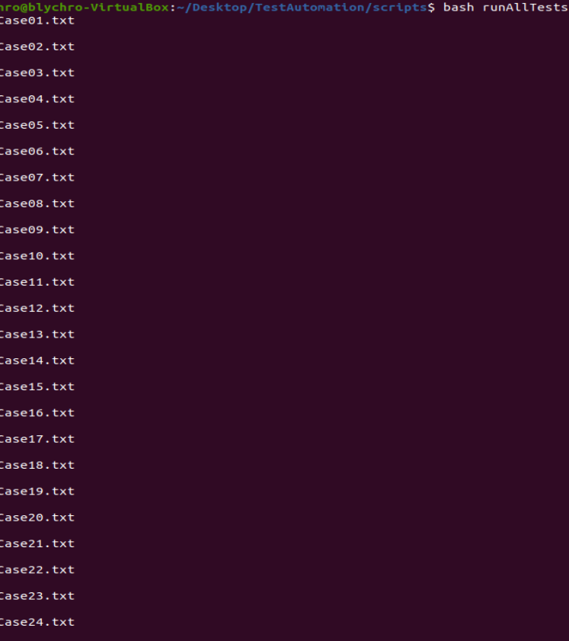
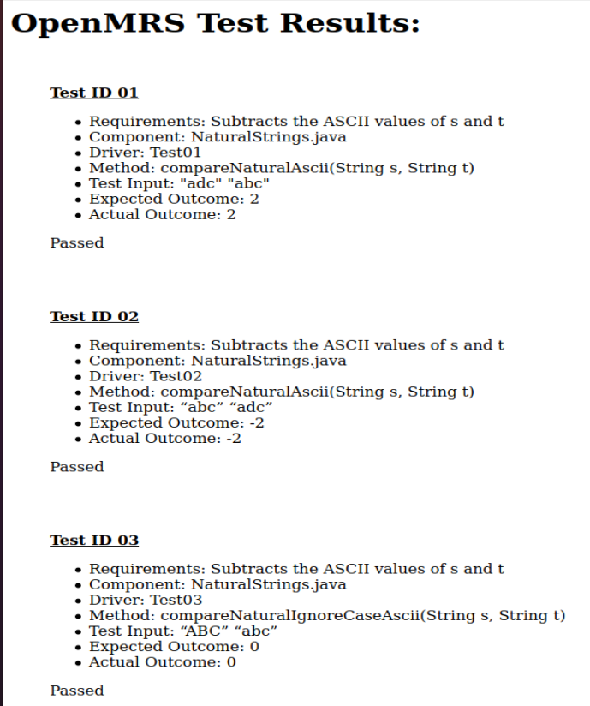
Demo

Slide 14
Questions?

