Slide 1
Testing of Tanaguru Contrast-Finder
Team CargoPants
Collin Bauer Dylan Evans Isabel Lally

Slide 2
Choosing the project

Slide 3
Tanaguru Contrast Finder
Picked 3 candidates from the HFOSS projects
Decided on Tanaguru contrast finder
Takes a color and computes a different color
This helps color blind people see colors on a computer better

Slide 4
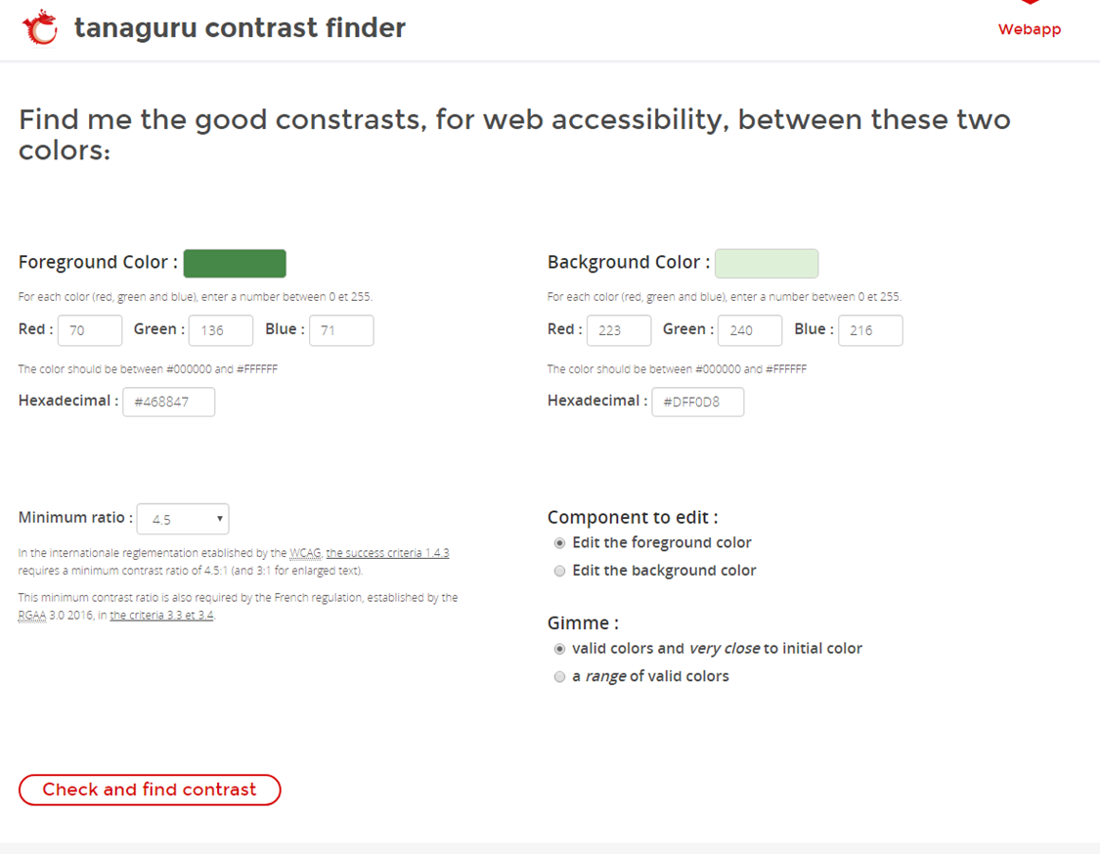

Slide 5
Testing Framework

Slide 6
Framework Requirements
Linux
The project is required to run on a Ubuntu distribution
We chose Lubuntu as our working distribution
Contrast Finder
Requires JDK 1.7 to compile and run
Contrast Finder is compiled using Maven

Slide 7
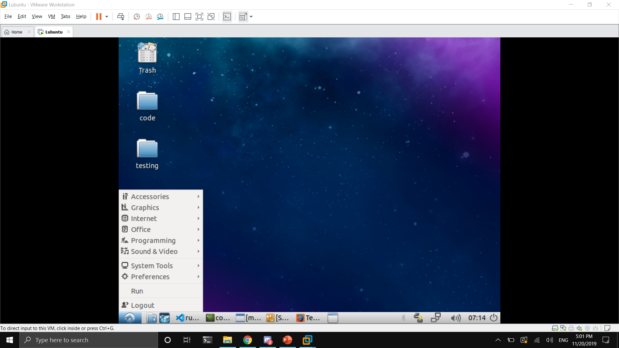
“Baby Computer”

Slide 8
Drivers and test cases

Slide 9
Selecting methods to test
Requirements for a testable method
Must accept input(s) and provide a single output
Output must be predictable
Cannot be a predefined Java method
equals() method initially chosen for testing
Driver successfully compiled, but method was not very testable
Driver was scrapped as a result

Slide 10
Drivers
Five drivers that test five test cases each
Java written code that tests a method
Each driver tests one contrast finder method
Test Cases
Templates for testing methods
7 lines that explain what is being tested

Slide 11
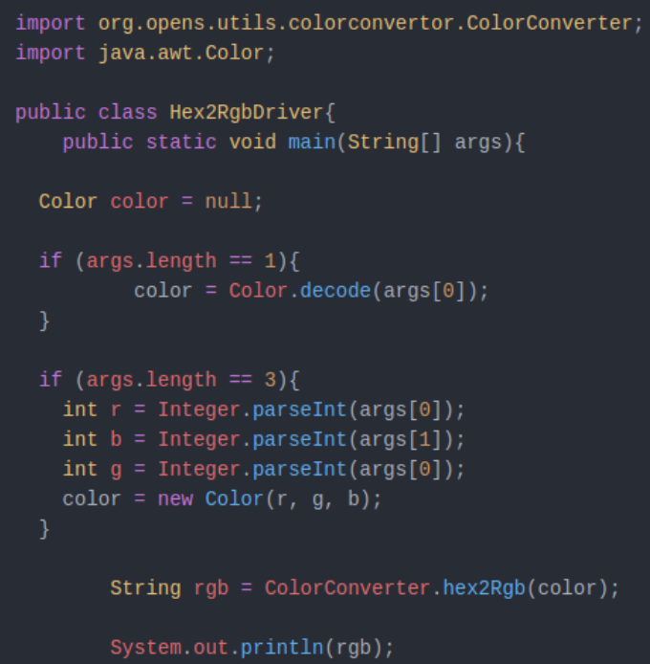
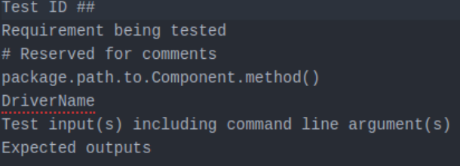
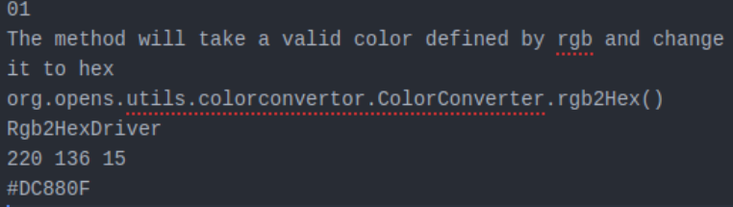

Slide 12
Automation

Slide 13
Scripting
Scripts created
runAllTests.sh
Individually reads cases to pass to runSingleTest
Takes output from runSingleTest and injects to HTML output
compileDrivers.sh
Reads through drivers folder and individually (re)compiles each
runSingleTest.sh
Parses test case file and runs contents in specified driver

Slide 14
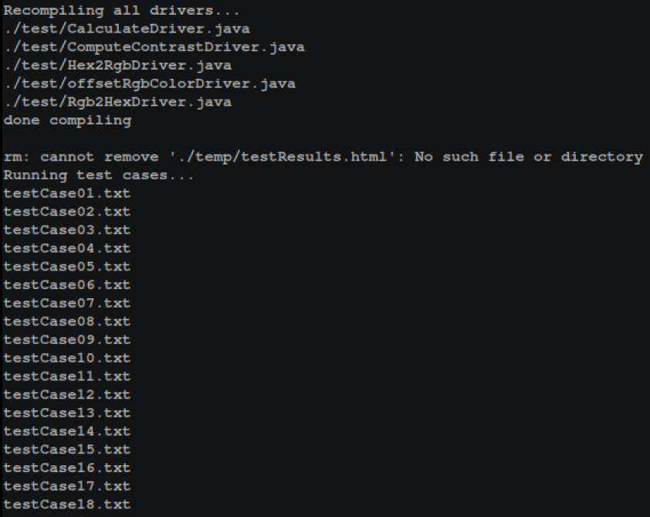

Slide 15
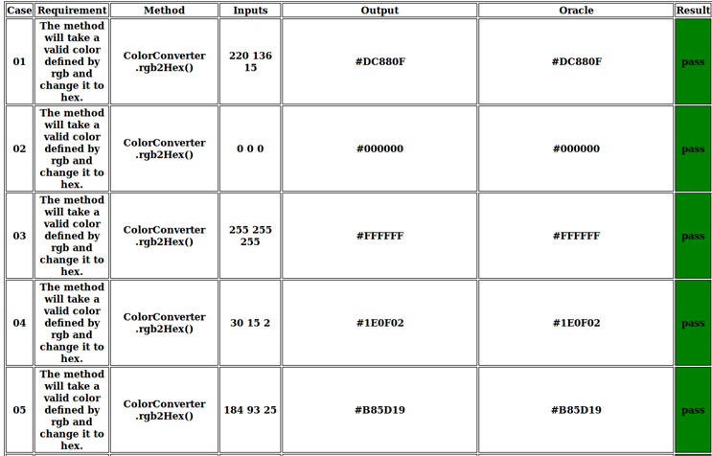

Slide 16
Fault injection

Slide 17
We injected five errors into Tanaguru’s code
For the rgb2hex, we changed the order of the color so instead of rgb it print in gbr
For the hex2rgb, we did the same re ordering but this time we did brg
For the ComputeContrast, we changed a division to multiplication and changed one of the set variables they had already computed
For the offSetRgbColor, we are subtracting the values to give the wrong offset values

Slide 18
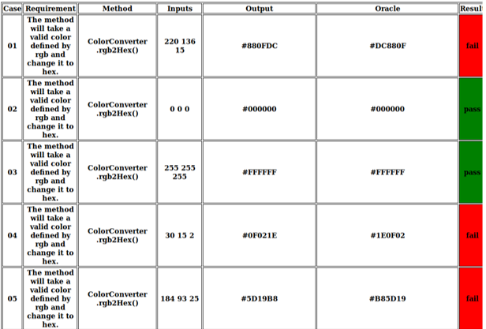

Slide 19
Conclusion

Slide 20
Twenty Five test cases are not as much as it seems and does not cover everything needed.
Linux and bash is intimidating at first but the best way to learn is just to dive in and get hands on experience.
Everyone makes mistakes and we can not fault anyone because we are human ( we found an error in the DistanceCalculator method and it caused our test cases to fail)
Teamwork is important and you start to form a bond with the people you work with as you all struggle together.

