Slide 1
STEM Automated Testing Framework
By: Ryan Barrett, Jimmy Chu, Tyler Malone
(Team CtrlAltElite)

Slide 2
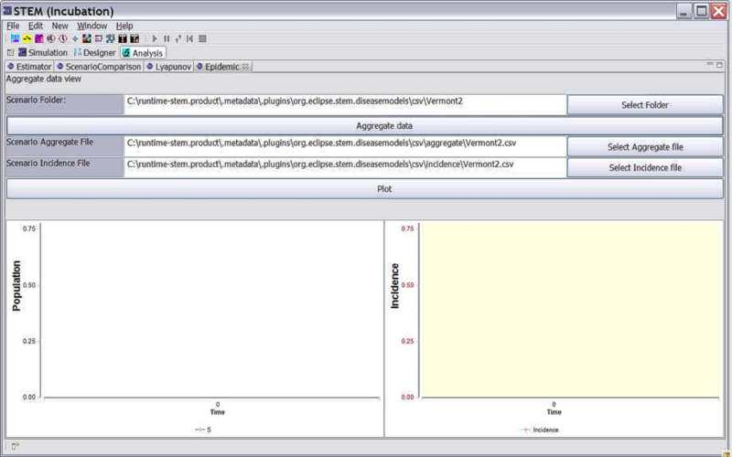
What is STEM?
Spatiotemporal Epidemiological Modeler
Models the spread of diseases

Slide 3
Early Strifes
Link failure
Dated instructions

Slide 4
Methods Tested
GCD (Greatest Common Divisor)
LCM (Least Common Multiple)
ArgMin
ArgMax
ApproxEqual

Slide 5
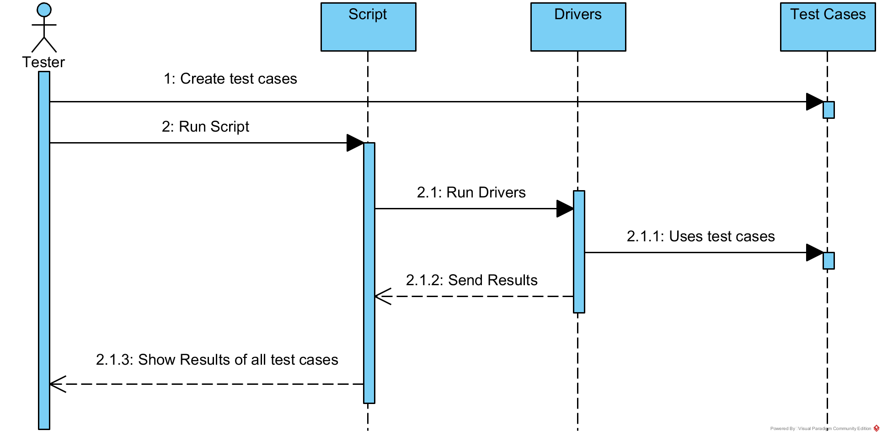
Architecture

Slide 6
Fault Injections
Modified the lcm method from
return Math.abs(arg0 * arg1) / MathOps.gcd(arg0, arg1); to
return Math.abs(arg0 * arg1) / MathOps.gcd(arg0, arg0);
We expected this to cause all test cases with arguments that aren’t equal to fail.
Changed the gcd loop while condition from rest > 0 to rest >= 0.
We expected this to cause an infinite loop and cause all test cases to fail. This is precisely what happened. Since lcm uses this method, we expected it to also cause all test cases for lcm to fail, which is what happened.
In argMax, changed entries[element] > entries[argmax] to entries[element] < ….
We expected this to cause all test cases to fail except for (0, 50)
In argMin, changed entries[element] < entries[argmax] to entries[element] > …
We expected this to cause all test cases to fail except for (0, 50)
Changed dbl1 - dbl2 to dbl1 + dbl2 in approxEqual
We expected this to cause only (1, 1) to fail

Slide 7
Lessons Learned
Became more familiar with shell scripting
Creating drivers
Benefits of Git
Capabilities of the Linux terminal

