Slide 1
SugarLabs Automated Testing Framework
Team TBD
Austin Purtell
Johnnie Cooper
Thomas Setzler

Slide 2
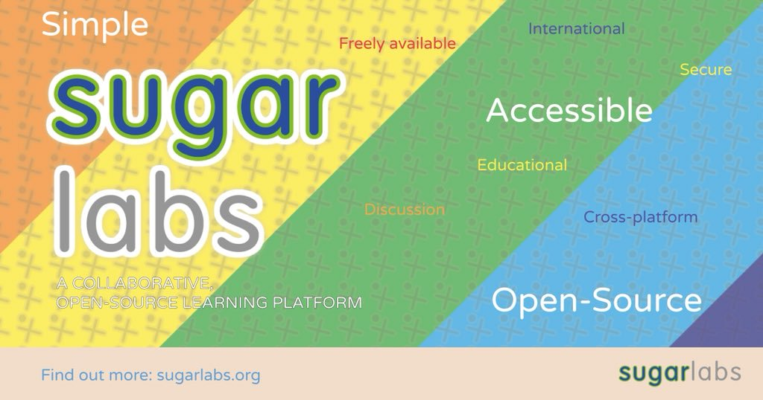
SugarLabs Overview
HFOSS (Humanitarian Free and Open Source Software) designed to operate as its own environment
Part of the One Laptop Per Child project to promote educational opportunities around the world
The overarching organization of Sugar, and everything that goes with it

Slide 3
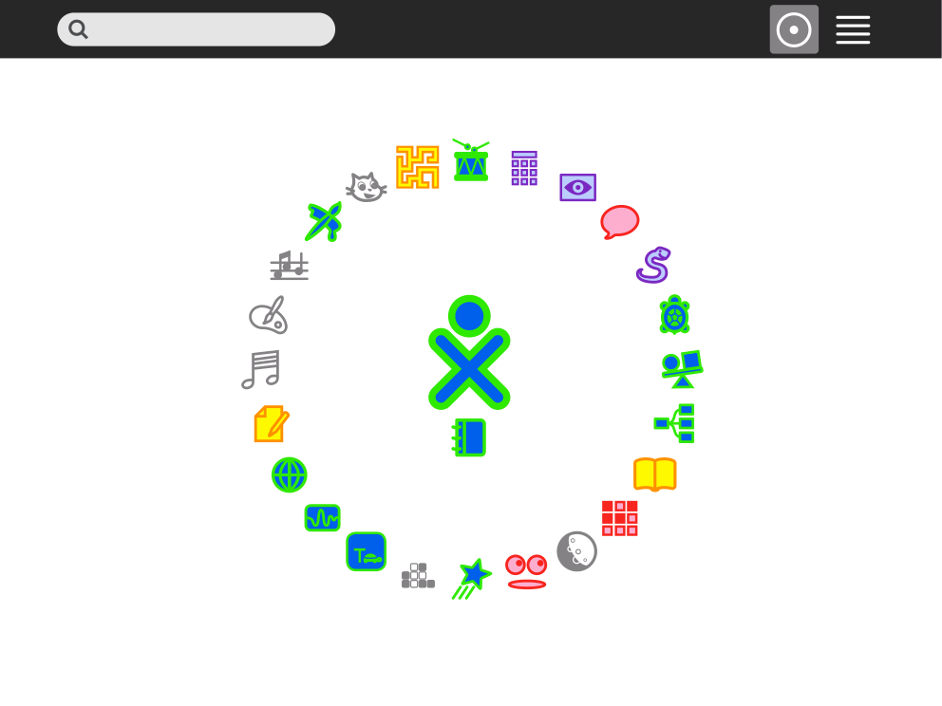
Sugar: The SugarLabs Learning Environment
Independent environment which allows for users to create and share learning activities
Primary component of the SugarLabs project
Designed to be intuitive and easy to pick up for teachers and children
Activities
Programs which can be run in the Sugar environment and shared with others
The Sugar UI

Slide 4
Development Goals for Testing Procedure
Master driver
Runs modularized testing drivers for each method to be tested
Test cases from JSON files
Contain input, oracles, descriptions
Test Report
Output to a web page with details of tests
Python Pipeline
Same as Sugar

Slide 5
Testing Goals
Test functions.py, a script used in Sugar’s calculator activity.
Contains a variety of mathematical operations
Select 5 methods within functions.py to be tested
Create 5 test cases per method, which check logic branches, floats, integers, strings, overflow, and other requirements
Compare oracle results to returned output and check for pass or fail
Exercise framework with fault injection

Slide 6

Test Methods
div(x, y):
Division function. Must handle division by zero, integers, and floats
pow(x, y):
Exponent function. Must support integers, floats, and values between 0 and 1
ln(x):
Natural logarithm function. Must operate on values greater than 0, and refuse values less than or equal to 0
factorial(x):
Function to perform factorials. Must support integers greater than 0 and refused non-integer numbers less than or equal to 0
mod( x, y):
Modular division function. Must accept integers, handle non integers, and return the remainder of x divided by y

Slide 7
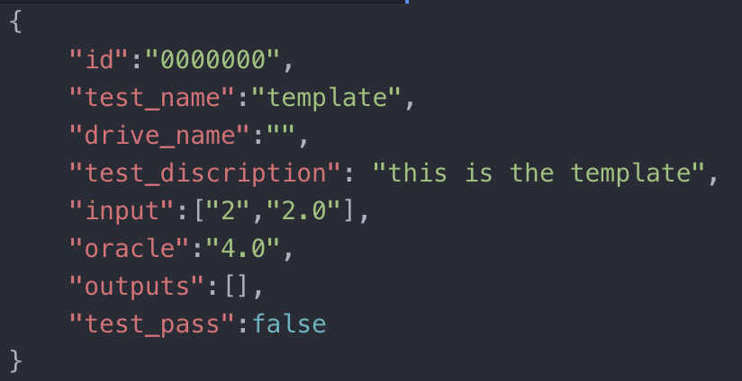
Test Case Template

Slide 8
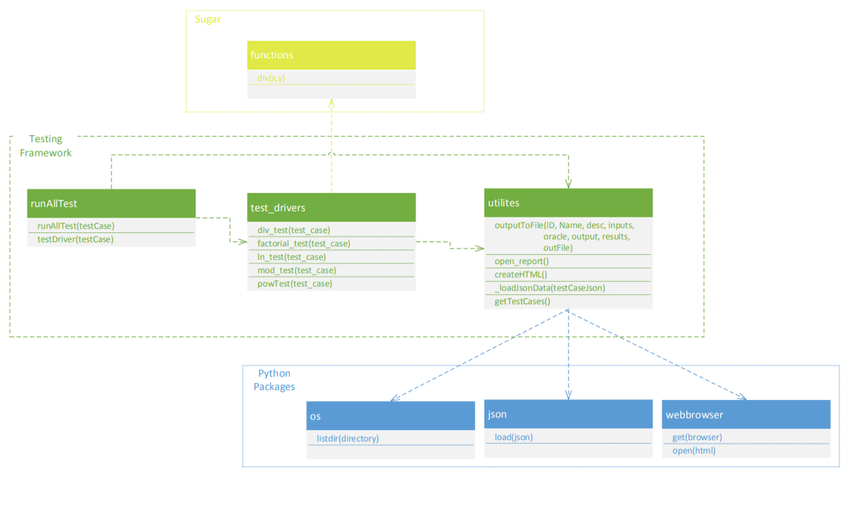
Framework Overview

Slide 9
Demonstration
Brought to you by Thomas Setzler

Slide 10
Testing Results
24/25 Tests Passed
1 failure: throws misleading error in mod()

Slide 11
Fault Injection Results
Faults injected:
Commented out or inverted if statements in div, pow, factorial, and mod
12/25 Tests Failed
1 in div
2 in pow
4 in factorial
4 in mod (1 in mod already fails)

Slide 12
Lessons Learned
How to create dynamic testing procedures
How to manage effective collaboration between partners
How to design and organize a framework
The value of coding methods which handle a wide variety of input

Slide 13
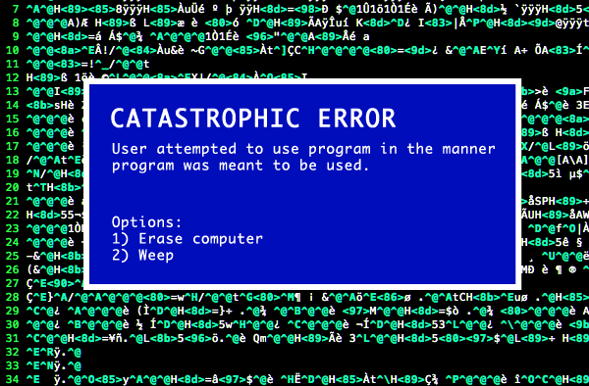
Issues Along the Way
Importing in python
Working on 3 different operating systems
Casting input and output properly
Creating an organized architecture

Slide 14
Questions

