Slide 1


Slide 2




Picking a Project
Notes:
One of the first things we had to do as a group was to pick an Open Source project to work on for the semester. As a group we had a few decisions to make regarding the types of projects we wanted to explore. As a group we decided, it would be best if we picked a project that primarily used Java or Python. While it would have been a fun challenge to learn a new language we decided to expand our knowledge on what we already were familiar with. So after looking at the different projects we decided to try to build and compile (CLICK) Cadasta,
(CLICK) Sugarlabs,
(CLICK) and glucosio.
However we ran into a few of issues with these projects. Both Cadasta and Sugarlabs would have required a VM within a VM which, while possible would not be very practical and glucosio required Android studio to work, and it took up just way too much space on the VM sometimes not having enough. So after a lot of trial and error with other projects we decided
(CLICK) work on OpenMrs for our project

Slide 3
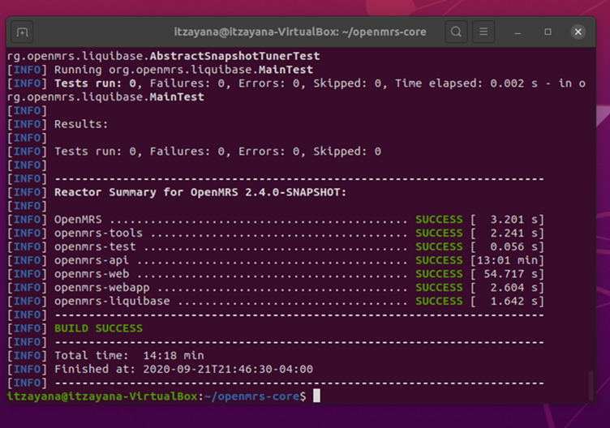
Running OpenMRS
OpenMRS s a program that provides an electronic medical record system and their mission is to:
“Improve health care delivery in resource-constrained environments by coordinating a global community to create and support this software.”
In addition to being a great cause, OpenMrs has been kept up to date and had great documentation which is why we decided to choose it.
Notes:
OpenMRS s a program that provides an electronic medical record system and their mission is to:
“Improve health care delivery in resource-constrained environments by coordinating a global community to create and support this software.”
In addition to being a great cause OpenMrs has been kept up to date and had great documentation which is why we decided to chose it.

Slide 4
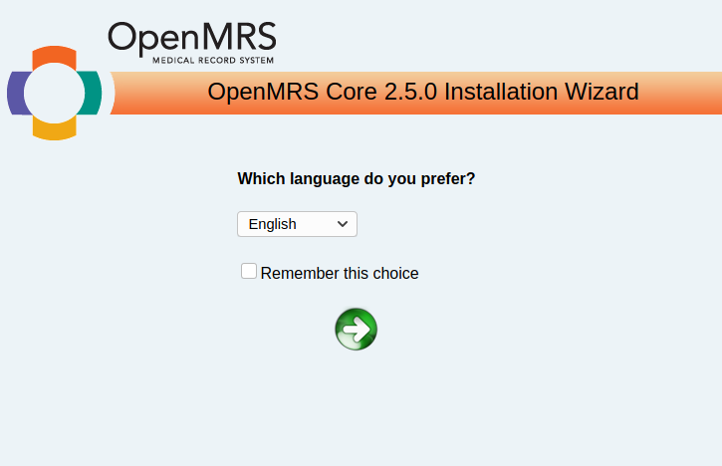
Learning Experience: Building and Compiling Projects
VS
Notes:
Learning how to compile and build a program was the first learning experience we had as a team. No one in our group had ever worked on an open source project before so we were not sure what to look for. This confusion caused us a lot of grief, since we tried to build and compile project after project and having, what seemed to be, no success. OpenMrs was the first project we managed to compile and build as well as open the system in a browser. This was very exciting for our team, however when we tried to do testing within the browser we ran into so many issues with mySQL. It wasn’t until we looked back at the assignment and what other groups were working on that we were able to understand that compiling the code does not equate to running the system in a browser.

Slide 5
Picking Methods
Class | Method | Requirements
OpemmrsUtil | lastMometOfDay | This method will take a date and time, then shift the time to be the last second of the day on that date.
DateUtil | DateUtil | This method will return a Date and time with the milliseconds truncated
OpenmrsUtil | containsOnlyDigits | This method returns true if a string only contains digits
OpenmrsUtil | convertToInteger | This method turns a long into an integer, as long as it does not exceed the int memory limit
OpenmrsUtil | containsUpperAndLower | This method returns true if a string has upper and lower case letters
Notes:
Picking methods to test was tricky. OpenMrs is more or less a medical information database, which means that more of the methods will be setters and getters. However for this project we wanted to test methods that were a little more complex than that. It took some time but eventually we found a few methods in OpenmrsUtil and DateUtil that were static methods, so they had very few dependencies and were not setters and getters.
(READ AND TALK ABOUT CHART)

Slide 6
Learning Experience: DrugsByNameComparaitor
DrugsByNameComparator was originally one of the methods we wanted to test because it was comparing two drug names. At first, we thought it was using the standard compare method, but upon closer inspection, it wasn’t. Instead, it was using a convoluted system of checks. Returning the same number for different outputs. Besides, it didn’t elaborate on how they came up with said number, which made determining the expected output difficult. As a result of its weird quirks, we decided to scrap it and replace it with the lastMomentofDay method. However, through this experience, we learned how important it is for your code to be testable and that it makes sense.
Notes:
DrugsByNameCompartior was originally one of the methods we wanted to test, because it was comparing two drug names. At first we thought it was using the standard compare method, but upon closer inspection it wasn’t. Instead it was using a convolidued system of checks. Returning the same number for different output. In addition, it didn’t elaborate on how they came up with said number, which made determining the expected output difficult. As a result of it’s weird quirks we decided to scrap it and replace it with the lastMomentofDay method. However, through this experience we learned how important it is for your code to be testable and that it makes sense.

Slide 7
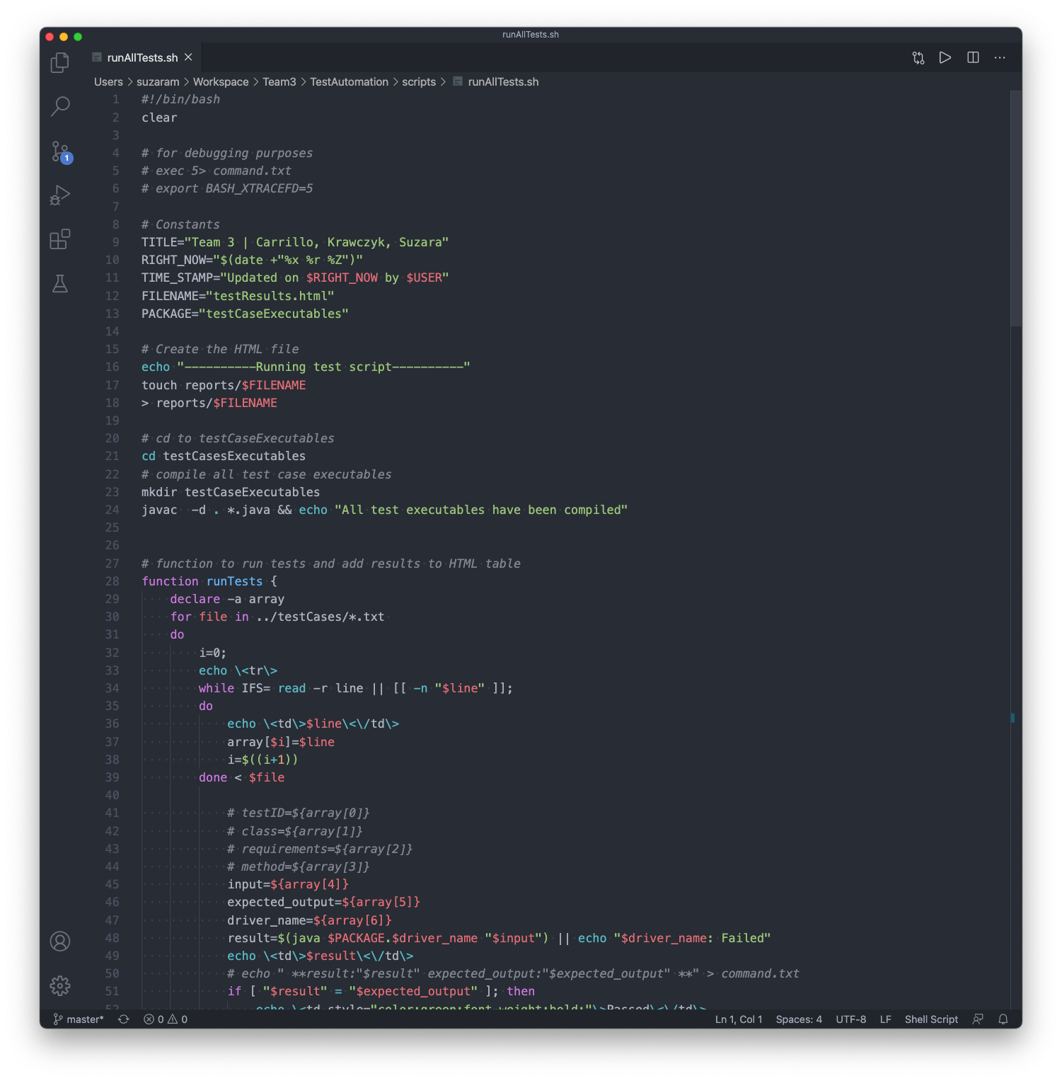
Creating The Automated Testing Script
Creating the testing script was an enjoyable learning experience. It involved a great amount of researching and applying bits and pieces at a time like building a complex puzzle. Learning all the capabilities of the bash shell opened our minds to how much power can be harnessed with a simple script.

Slide 8
Learning Experience: Scripting
The scripting learning experience was quite a challenge. Our team had little to no experience with the bash shell so learning often felt like jumping into the deep end of the pool with no flotation device nearby. After the steep learning curve and some constructive feedback from Dr. Bowring, we were able to put together a script that accomplished the task at hand. Some of the obstacles we faced were having the script knowing about certain methods which is not the best practice when creating an automated testing framework. Overall, we learned much from our mistakes which resulted in a testing framework we are all proud of.

Slide 9
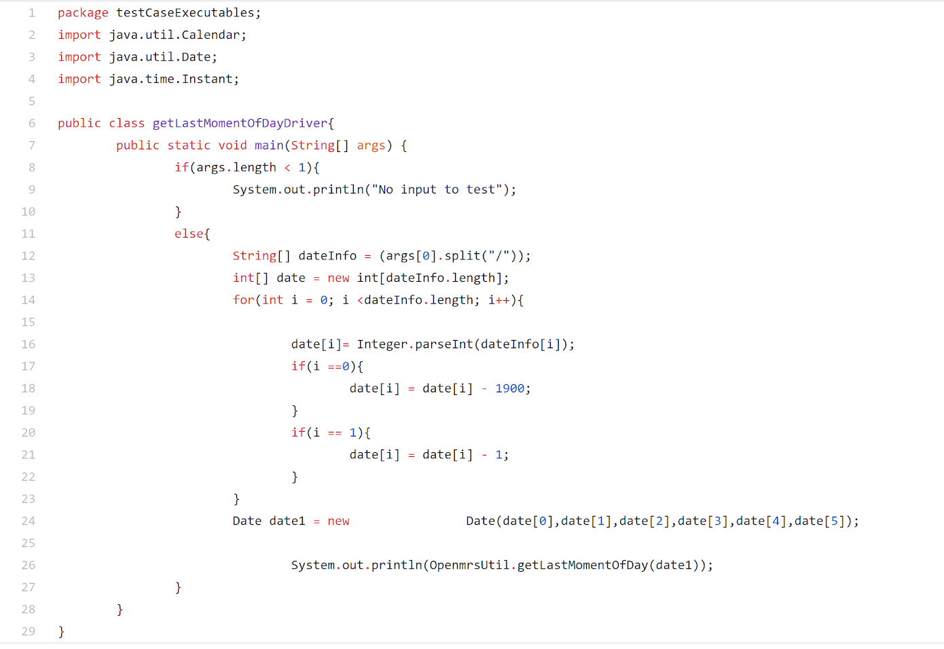
Creating Test Cases and Drivers
05 OpenmrsUtil This method will take a date and time, then shift the time to be the last second of the day on that date. getLastMomentOfDay 1998/12/20/20/45/30 Sun Dec 20 23:59:59 EST 1998 getLastMomentOfDayDriver
Notes:
Creating Test cases and Drivers was a pretty simple process once we had the methods picked out.
For the Test Cases we decided to use a text file. It was simple and effective and familiar to us. These test cases her formatted as followed
Testcase ID
Class in which the method is found
Requirments
Method Name
Input
Expected output
Driver name
Creating the drivers was also a simple process. The most challenging aspect of it was learning how to compile a java file through the command line. But once that was figured out it, all that was left was to make sure there were no errors and that it could compile.
We also learned how to compile in a package which was hepful

Slide 10


Learning Experience: DO NOT USE WINDOWS/UNIX
Notes:
One thing we learned the hard way was not to cross Operating Systems in anyway because it causes problems.
Our first experience with this happened while creating the script. Part of the script was made on a mac which didn’t seem to be too much of a problem at first, especially since UNIX and LINUX are very similar, however there are a few key differences that caused our script to break when transfered over to our LINUX VM. Fortunately we could go back and find an older version of the script that we had working and apply the necessary changes.
The second issue we had with this was with our test cases. Our first five test cases were made on a windows machine. We figured that a standard txt file should change too much from OS to OS, but we were wrong. For whatever reason when it came to comparing expected output to actual output our text file kept adding an invisible “/r” to the end of every sentence making even correct output appear false. After a lot of trial and error we managed to figure out that because the test case was made in windows it was messing everything up. So we deleted those files and made new ones.

Slide 11

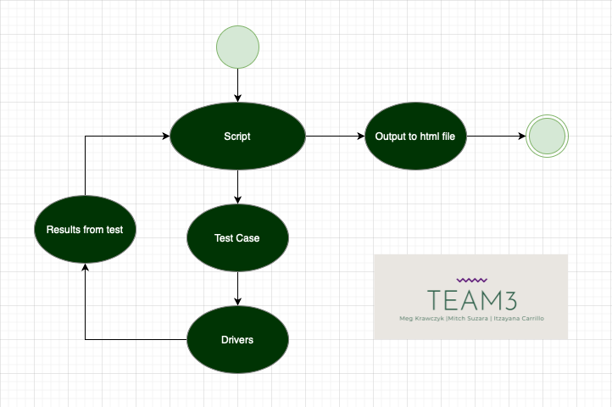
Testing Framework

Slide 12
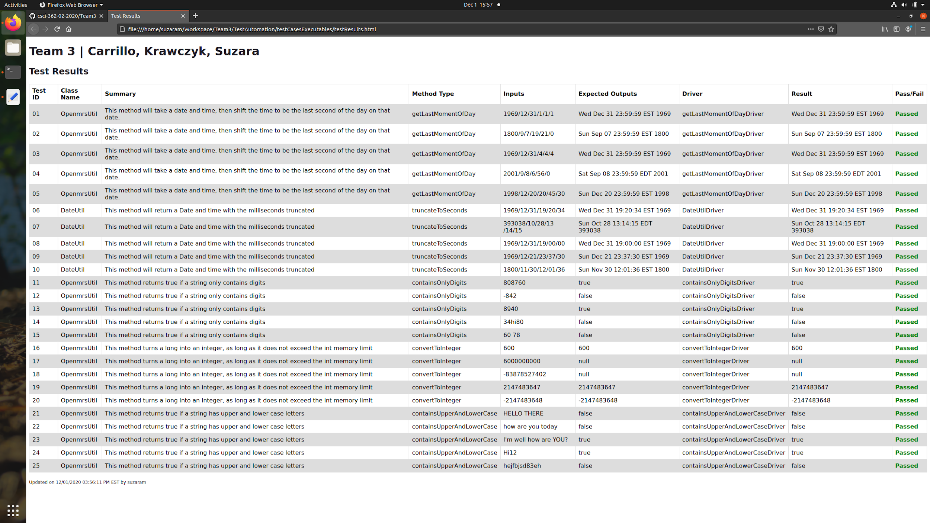
Testing Results
Notes:
When you run our automatic testing framework a firefox browser should open up and display these results. As you can see in this example all the tests passed. However one weird quirk we found was that with certain dates Mitch’s actual output would be one second before the expected output but on the other team members computers the test passed without any issue. It’s not really a problem just something interesting

Slide 13
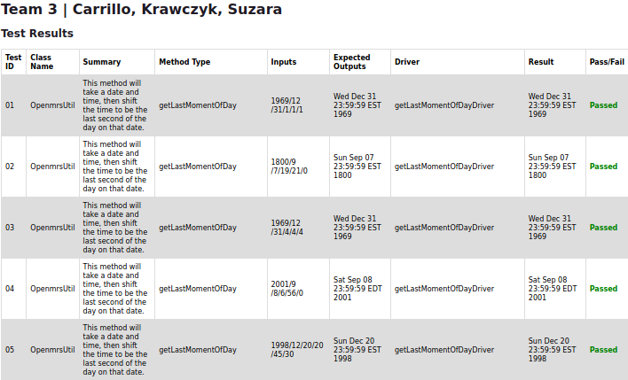
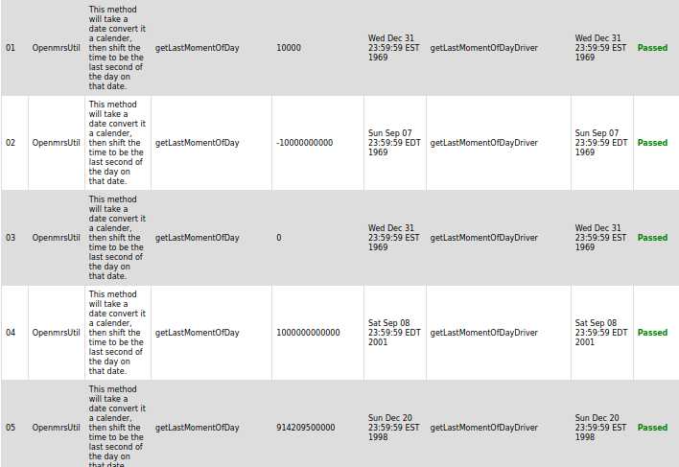
Learning Experience: Readability of Results
Notes:
One thing we learned was that readability of our test results and test cases was very important. After our presentations throughout the semester we made a few changes to make our HTML output file to make it more user friendly
The first tweak we made was to color the word PASS green and the word FAIL red. This way the user can just glance at the webpage and know if a test passed or not.
The second major way we made our test results more readable was by using clarifying descriptions and meaningful input. Particularly in the DateUtil and lastMomentOfDay methods our input was a super long number, meant to represent the number of milliseconds from the date Dec 31st 1960 at midnight. However that was very convoluted and made it hard to understand what exactly the output should be. So instead of passing in a long number. We changed the input to be the data and time, formatted as Year, Month, Day, Hour, Minutes, Seconds. Each separated by a forward slash. This is far easier to read as input, but it is also just much easier to know what the expected output should be. (CLICK TO SHOW NEW CHART)

Slide 14
Implementing Errors: Overview
We implemented a few errors in our program and see whether our automated testing framework would catch these errors. The way we decided to implement these errors was through comments as described above. In each method, there is a comment that contains a snippet of code with an error in it. To run the code with the error in it simply uncomment that code segment and comment out the segment above it.
Notes:
We implemented a few errors in our program and see whether our automated testing framework would catch these errors. The way we decided to implement these errors was through comments as described above. In each method there is a comment that contains a snpit of code with an error in it. To run the code with the error in it simply uncomment that code segment and comment out the segment above it.

Slide 15
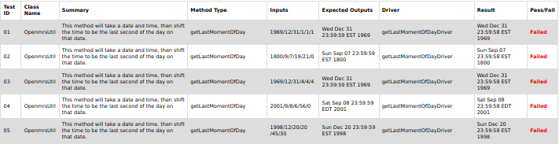
Implementing Errors: lastMomentOfDay
calender.set(Calendar.SECOND, 59);
calender.set(Calendar.SECOND, 58); //THIS IS AN ERROR
Notes:
For the getLastMomentOfDay method, we decided that the error we would implement would be to set the seconds to be 58 instead of 59. This seemed like an error that could easily occur if someone was typing fast or didn't read the requirements. When we ran our script with the error in place, it caught the error in all but one. This result makes sense, because the 58 was a hardcoded mistake and as a result it affected all the test cases.

Slide 16
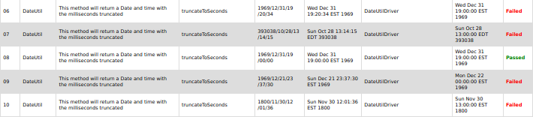
Implementing Errors: DateUtil
Instant instant = date.toInstant().truncatedTo(ChronoUnit.SECONDS);
Instant instant = date.toInstant().truncatedTo(ChronoUnit.HOURS); //THIS IS THE ERROR
Notes:
For the DataUtil method, we decided that the error we would implement would be to truncate hours instead of seconds. By truncating by the hour, the seconds section of time will always be 00 rather than the actual number of seconds. When we ran our script with the error in place, it caught the error in all cases. In that case the seconds and hours time segments had been set to zero anyway so truncating the seconds didn't make a difference.

Slide 17
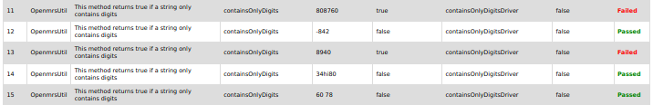
Implementing Errors: containsOnlyDigits
return !test.isEmpty();
return test.isEmpty(); //THIS IS THE ERROR
Notes:
For the containsOnlyDigits method, we decided that the error we would implement would be to return if a string is empty instead of if it's not. If a string makes it to the end of the program it will return the opposite of what we want. When we ran our script with the error in place, the error was not caught in the test cases that were expected to be false. This was confusing at first, but after going back and looking at the code we realized that this method had a separate return statement that is triggered when a string contains something other than digits. Which left those cases untouched by our error.

Slide 18
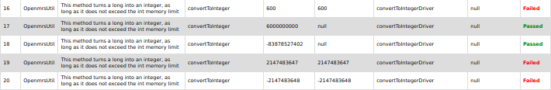
Implementing Errors: convertToInteger
if (longValue < Integer.MIN_VALUE || longValue > Integer.MAX_VALUE) {
if (longValue > Integer.MIN_VALUE || longValue < Integer.MAX_VALUE) { //THIS IS THE ERROR
Notes:
For the convertToInteger method, we decided that the error we would implement would be to flip the greater than and less than symbols in an if-statement. This error will make the program think that convertible numbers are invalid. When we ran our script with the error in place, the error was not caught in the test cases that were expected to return a null. This makes sense because now the range of numbers that will trigger that if-statement is all possible numbers. So any number I put in as input will return a null.

Slide 19
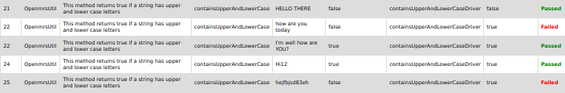
Implementing Errors: containsUpperAndLower
Pattern pattern = Pattern.compile("^(?=.*?[A-Z])(?=.*?[a-z])[\\w|\\W]*$");
Pattern pattern = Pattern.compile("(?=.*?[a-z])[\\w|\\W]*$"); //THIS IS THE ERROR
Notes:
For the containsUpperAndLower method, we decided that the error we would implement would take out the part of the pattern that recognized Uppercase letters. This error will make the program return true as long as the input contains lower case letters. When we ran our script with the error in place, the error was not caught in the test cases that contained only lowercase letters. This makes sense because now the inputs with both upper and lowercase letters would still pass the test because this error only checks for lowercase and returns true if an input contains lowercase letters.

Slide 20
Overall Experience
Overall this group project was a positive learning experience. The team collectively learned a great deal about the importance of testing. Taking the time to test code while it is being developed saves time, resources, and headaches in the long run. We learned about one of the most powerful tools in the computing world; the command line. Having a graphical user interface is convenient, but the power that comes with the command line is far superior. In the end, we enjoyed the semester-long project and look forward to learning more in the continuation of CSCI 462.
Notes:
Overall this group project was a positive learning experience. The team collectively learned a great deal about the importance of testing. Taking the time to test code while it is being developed saves time, resources, and headaches in the long run. We learned about one of the most powerful tools in the computing world; the command line. Having a graphical interface is convenient for visualization purposes, but the power that comes with the command line is far superior. In the end, we enjoyed the semester-long project and look forward to learning more in the continuation of CSCI 462.

