Slide 1
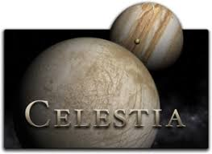
Team Go Gitters
Jacob Mattox, Alexander Swanson, Lara Brooksbank, Kyle Cooper

Slide 2
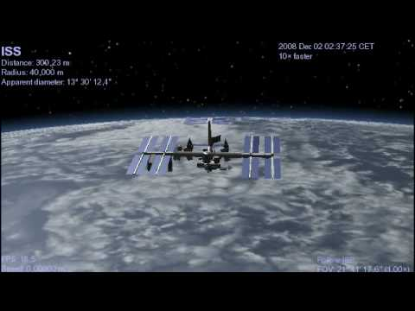
Celestia is “The free space simulation that lets you explore our universe in three dimensions”

Slide 3
Building Celestia
Was the first problem we encountered.
The README in the Celestia Source Code was of little use to get Celestia to compile in Linux.
Inspired us to make our first tests oriented around the building of Celestia and its required libraries.
Wrote a script that downloads all required libraries and compiles Celestia.
Test case check that all files are downloaded and the Celestia executable was built.

Slide 4
Math Library
Because of the physics-based nature of Celestia, it is important that the math functions produce consistent and accurate outputs
We tested nine different math functions in the Celestia source code:
Degrees to radians
Area of a circle
Radians to degrees
Square
Clamp
Cube
Sign (neg / zero / pos)
Sphere surface area
Mod

Slide 5



Live Demo

Slide 6
Lessons Learned
Skills Acquired
Time Management
Consistent Meetings
Decide on each member’s role from the beginning
C++
Bash Scripting
GitHub/Version Control
HTML
Testing Process

Slide 7
Future Progress
We only had enough time to test the internal functions of Celestia, future progress would include testing more functions as well as the graphical interface.
More time to use PyAutoGui for graphical test cases
Finally, testing the In-game command interface with LUA scripting.

Slide 8
Questions?

