Slide 1

ML FOR GHOSTBUSTERS
ARAVIND JYOTHI
ILANCHEZHIAN INIYA NEHRU
ROSHINI CHAKRAPANI
SANKARESWARI GOVINDARAJAN
VIPUL SINGH

Slide 2
Ghostbusters - An Introduction
A pursuit evasion game with 5 Ghostbusters chasing one Ghost staying undercover
Structure :
A map with numbered locations inside haunted city and 4 placement figures representing the ghostbusters is present to start the game
Movement through numbered locations enabled through use of different stamina tokens
Ghost and Ghostbusters will be given stamina tokens to play 25 rounds
Termination :
Ghost wins if - Ghostbusters are no longer able to move or Ghost reaches the last space in the travel log i.e. it reaches round 25
Ghostbusters win if, one of the ghostbusters catches the ghost

Slide 3
Why did we choose this?
To analyze the efficiency of machine learning algorithm(s) to play games involving pursuit-evasion problems like Ghostbusters
To understand how the non-player characters (NPCs), or objects behave in real-time, based on the player’s actions and decisions
To try to implement neural agents which perform as good as humans.
As it involves a large state space which in turn produces multiple state space exploration possibilities.

Slide 4
Deep Q-Learning
Adversarial Neural Networks for Hide and Search Algorithm (Base Research Paper) https://link.springer.com/article/10.1007%2Fs00521-018-3701-0
Deep Q Learning in GhostBusters
Calculate Approximate Q values with Neural Networks
2 Neural Networks - One for Ghost and the other for Ghostbusters
Neural Network weights are updated from Q values
Input: Current State of game
Output: Q values for all possible actions from that state

Slide 5
Environment Details
Neural Network :
PyTorch
Python 3.6
Libraries : Matplotlib, NumPy
Hyperparameters:
Activation = RELU, Optimizer = ADAM, Learning rate = 0.001, Loss = RMSE
Backend:
Python 3.6
Firebase
Frontend:
ReactJS
Redux

Slide 6
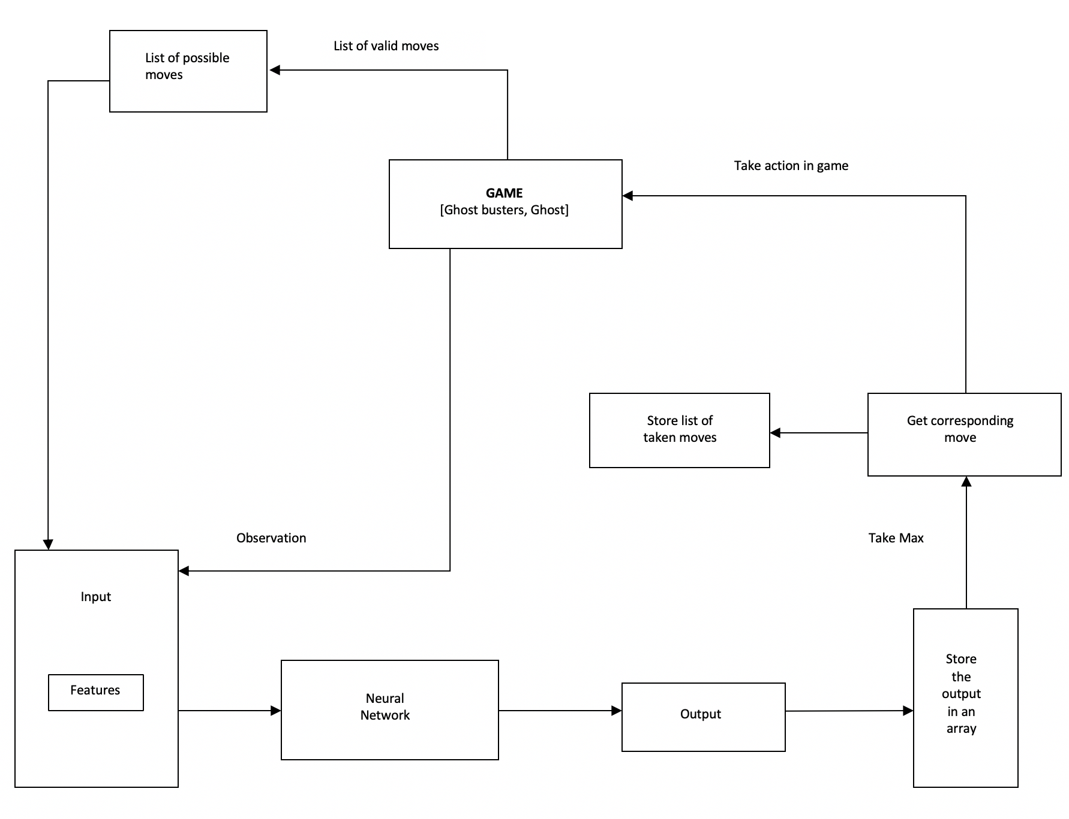
Architecture Flow Diagram

Slide 7
Progress Till Midterm
Implemented a Map Based UI
Markers for Ghost and Ghostbusters
Round and Move Counter
Position of Ghostbusters
Last known position of Ghost (shown every 5 rounds)
Neural Network for Ghost Bot
A random generator based rule agent to make moves for ghostbusters
Neural agent to make moves for ghost
Trained and Tested ghost bot against rule based ghostbusters

Slide 8
Progress After Midterm
Implemented Neural Network for Ghostbusters Bots
A random generator based rule agent to make moves for ghost
Neural agent to make moves for the ghostbusters
Trained and tested ghostbusters bot with rule based ghost agent
Expanded feature space to enable Neural agents to play against each other
Previously, we had different features for neural networks
Trained both neural networks on new feature space
Tested the game with both neural agents playing against each other

Slide 9
Final Results
Ghost Agent | Ghostbusters Agent | Winrate
Neural Agent | Rule Based Agent | 71% for Ghost
Rule Based Agent | Neural Agent | 31% for Ghostbusters
Neural Agent | Neural Agent | 75% for Ghost
For detailed results and plots - checkout the technical paper at https://teamghostbusters.github.io/

Slide 10
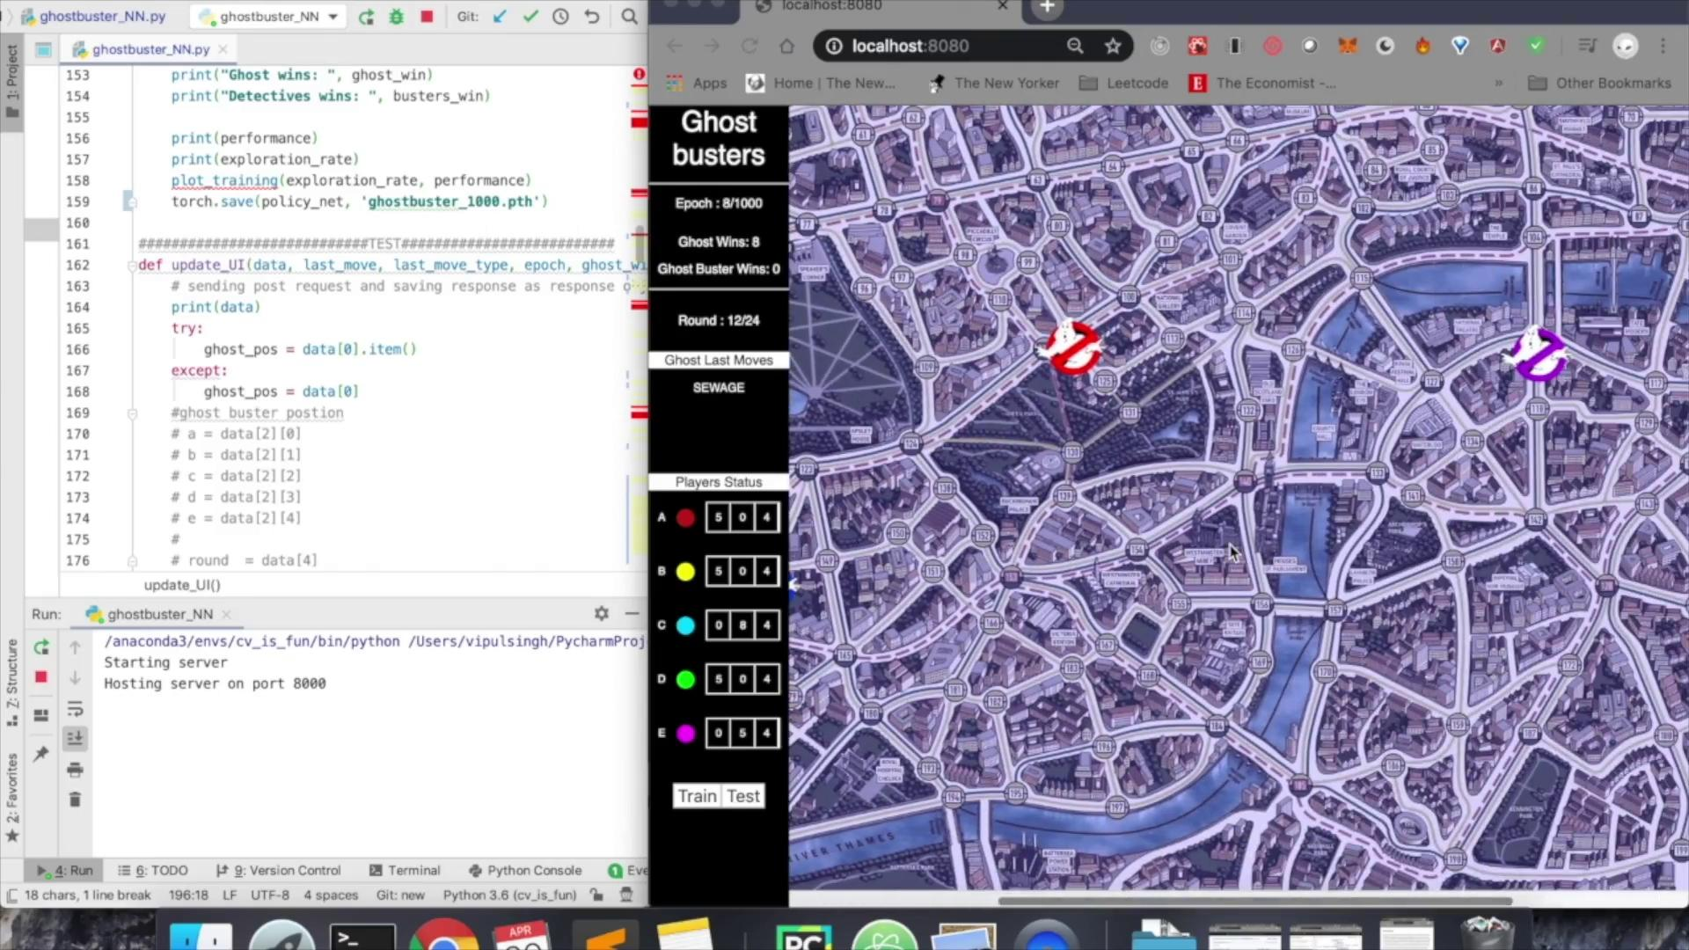
Demo

Slide 11
Future Scope
Achieving better performance for ghostbusters bot via
Intuition based decision making
Adding Teaming and Team Play to ghostbusters bots
Better Heuristics for Ghostbusters

Slide 12

THANK YOU

