Slide 1
ML FOR CS:GO
PRESENTED BY -
CHAITRALI KSHIRSAGAR
RAGHAK RADHAKRISHNAN
SRIRAM GIRIDHARAN

Slide 2
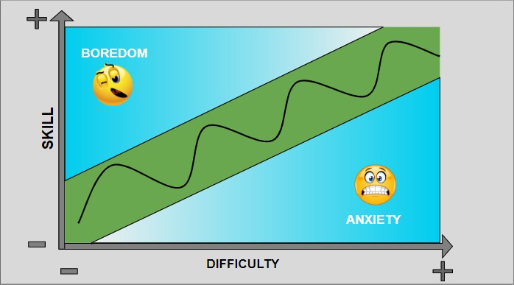
GOAL AND MOTIVATION
GOAL - To capture flow in a game from audience perspective.
MOTIVATION - Game flow design is generally developed for players, but it is also important for live games to engage audience for long time.
Capture flow between game and audience involvement using commentary audio, game video frames and Twitch data.

Slide 3
DATA COLLECTION
Starladder Major Berlin 2019 Championship from CS:GO News & Coverage | HLTV.org
VIDEO - Total 7 games between different teams (Best of 3 rounds) . Each round is around an hour long.
AUDIO - Extracted only audio (commentary) from each gameplay video.
TWITCH DATA - Downloaded Twitch chat data by online audience for each gameplay.

Slide 4
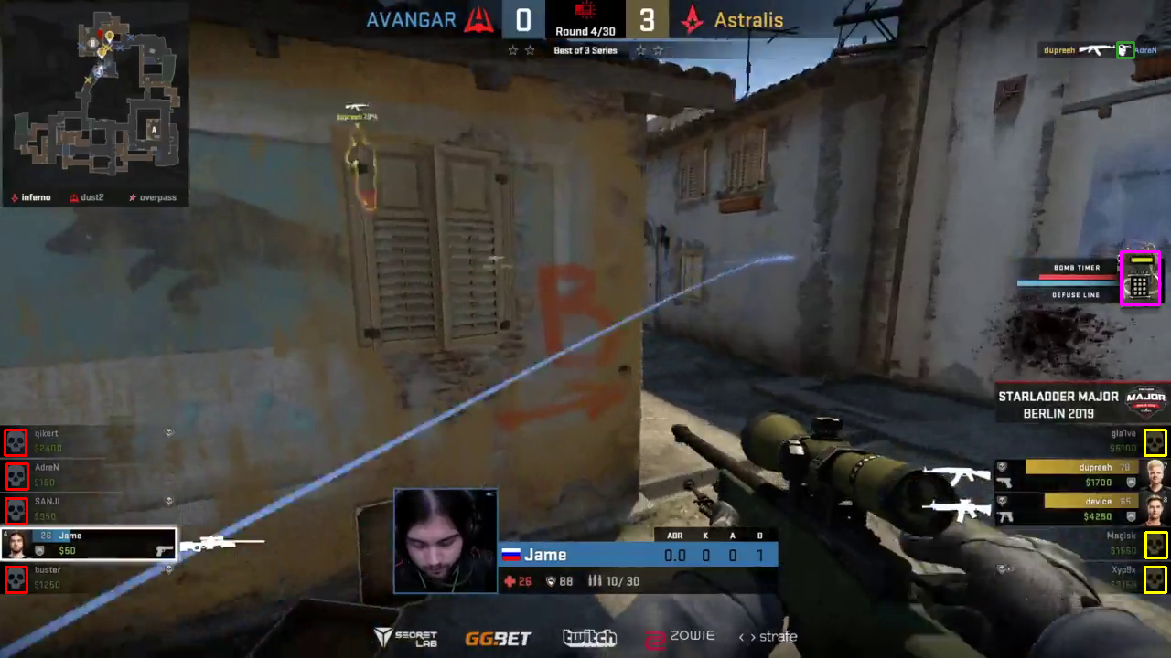
THE VISION PIPELINE
IDEA - Capture interesting events and happenings in the game trusted to create emotions for audience using both classical image processing and Convolution Neural Networks.
Extract required template to be matched for every frame - headshot, bomb planting, kills.
Once matches are obtained, locations are selected based on a threshold (hyperparameter).
Deep Learning based methods recognized regions of interest in a scattered manner.

Slide 5
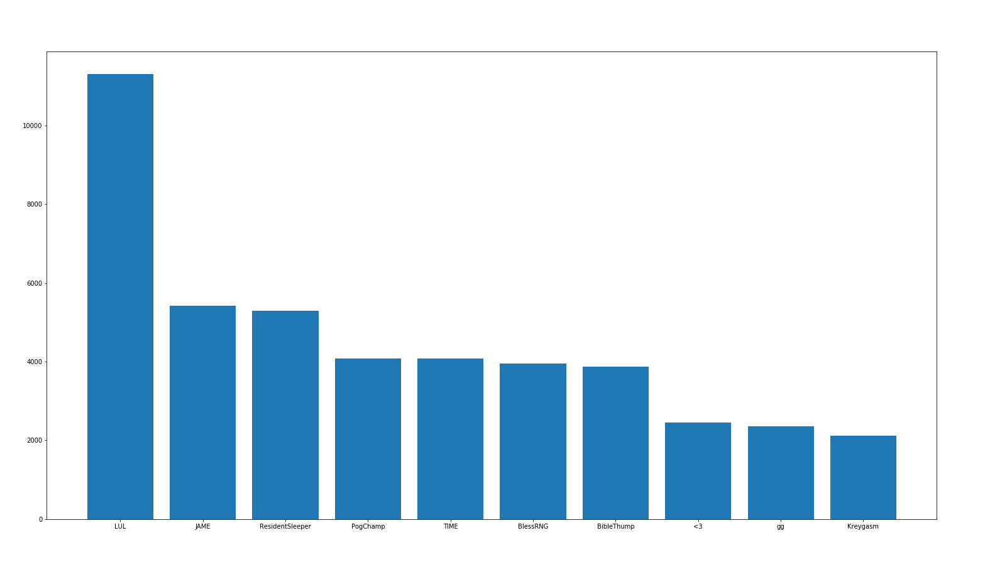
THE TWITCH CHAT PIPELINE
The twitch chat is extracted using a Twitch Chat Downloader API.
Data chat log: 2 uses - Sentiment Analysis and frequency map
Input to model - frequency of chats at each timestamp.

Slide 6
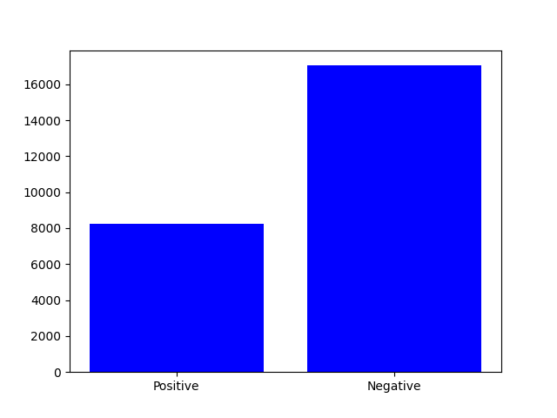
SENTIMENT ANALYSIS USING TWITCH
Twitch chat - only source of audience based data.
Analyze sentiments from the chat messages for every timestamp.
Used pre-trained LSTM and GloVE embeddings.
Average value taken for multiple chats at one timestamp.
Word | Sentiment
Pogchamp | Positive
Pog | Negative
Dudududududu | Negative
TriHard | Negative

Slide 7
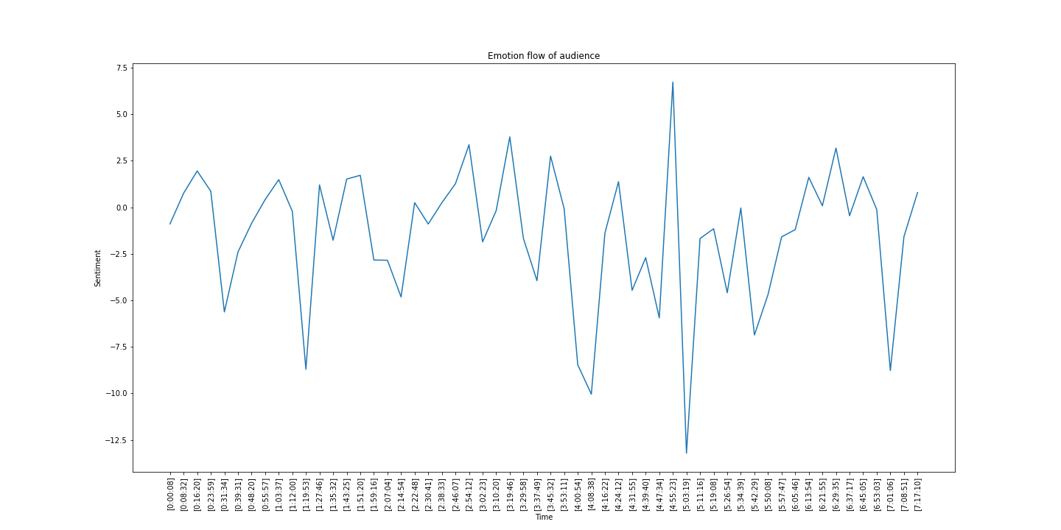

Slide 8
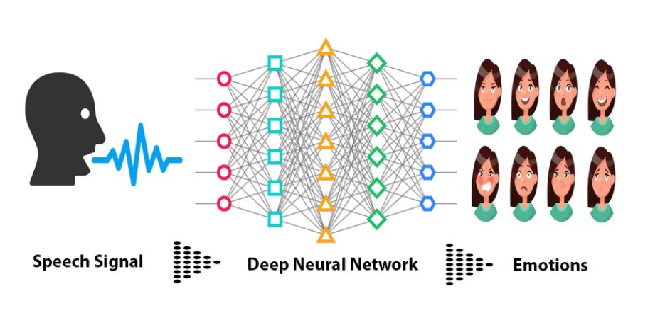
THE AUDIO PIPELINE
Split the audio from the Twitch gameplay videos.
To extract the speech, split into a mono channel and feed it to a Voice Activity Detector.
The Voice Activity Detector will separate out the speech part from the commentary.

Slide 9
PREPARING LABELS
Audio data used to capture emotions.
CNN pretrained on RAVDESS Dataset used for emotion detection.
8 emotions divided into groups of 2. Hashmap created with key as emotion and value to be our label for training:
{‘positive’: '0', ‘negative’: '1'}
4:45:53 | Excitement
4:45:54 | angry
4:45:55 | angry
4:45:56 | calm
4:45:57 | calm
4:45:58 | calm
4:45:59 | angry

Slide 10
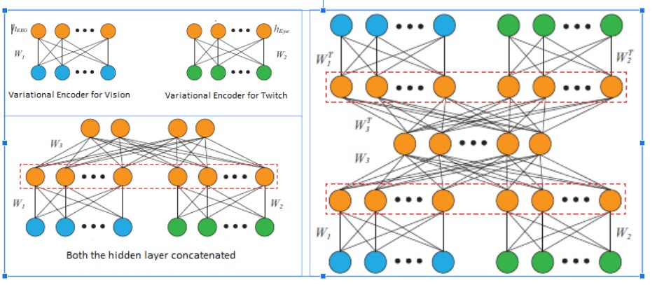
Joint Representation

Slide 11
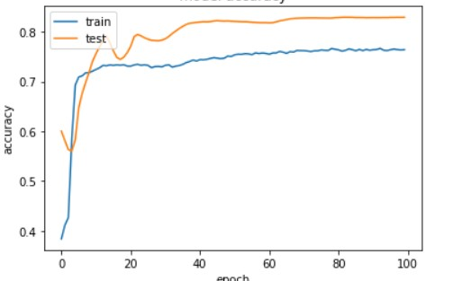
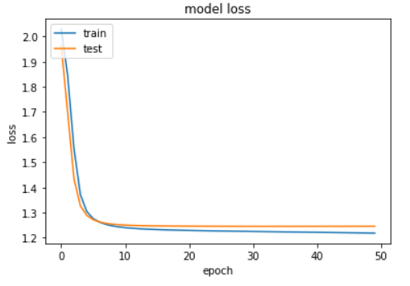
FINAL MODEL & PERFORMANCE
LSTM :
PROS - Time component taken into consideration.
CONS - take longer time, more memory to train, easy to overfit
_________________________________________________________________
Layer (type) Output Shape Param #
============================================
lstm_1 (LSTM) (None, 20) 2080
_________________________________________________________________
dense_1 (Dense) (None, 8) 48
============================================
Total params: 2,248
Trainable params: 2,248
Non-trainable params: 0
_________________________________________________________________

Slide 12
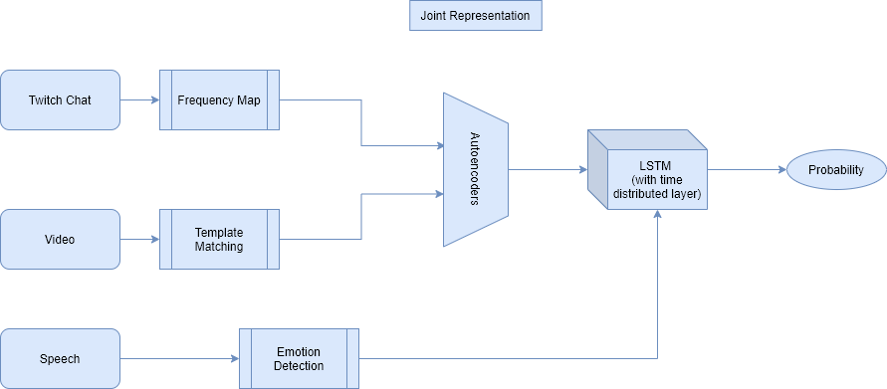
FINAL SYSTEM

Slide 13

DEMO ...

Slide 14
CONCLUSION
It is an involved problem with limited audience based data.
Deep learning for vision surprisingly did not work very well.
Speech was the best bet for both labels and analyzing emotions.
Twitch chat data helpful and also plentiful but lack of good pretrained word embeddings.
Inspite of certain trivial methodologies used, model could generalize quite well.

Slide 15
THANK YOU!

