Slide 1
CSCI 104 Recursion
Mark Redekopp
Sandra Batista
Aaron Cote’

Slide 2
Recursion in CS 104
Recursion is a key concept in this course
But it rarely comes easily to students. You must work at it!
Many problems that would be VERY difficult to solve without recursion (i.e. only loops) have extremely elegant solutions to problems
Learn to look for those elegant solutions
In this class, assume the recursive approach has an elegant/simple solution
If you find yourself writing a large, complex recursive solution, assume you are doing something you should not!
Stop and reconsider how it should be done

Slide 3
Recursive Definition of C++
Rule | Expansion
expr | constant | variable_id | function_call | assign_statement | ‘(‘ expr ‘)’ | expr binary_op expr | unary_op expr
assign_statement | variable_id ‘=‘ expr
expr_statement | ‘;’ | expr ‘;’
Example:
5 * (9 + max);
expr * ( expr + expr );
expr * ( expr );
expr * expr;
expr;
expr_statement
Example:
x + 9 = 5;
expr + expr = expr;
expr = expr;
NO SUBSTITUTION
Compile Error!

Slide 4
C++ Grammar
Rule | Substitution
statement | expr_statement | compound_statement | if ( expr ) statement | while ( expr ) statement …
compound_statement | ‘{‘ statement_list ‘}’
statement_list | statement | statement_list statement
while(x > 0) { doit(); x = x-2; }
while(expr) { expr; assign_statement; }
while(expr) { expr; expr; }
while(expr) { expr_statement expr_statement }
while(expr) { statement statement }
while(expr) { statement_list statement }
while(expr) { statement_list }
while(expr) compound_statement
while(expr) statement
statement
while(x > 0)
x--;
x = x + 5;
Example:
Example:
while(expr)
statement
statement
statement
statement

Slide 5
Steps to Formulating Recursive Solutions
Write out some solutions for a few input cases to discover the recursive structure
Identify how the problem can be decomposed into smaller problems of the same form
Does solving the problem on an input of smaller value or size help formulate the solution to the larger
Identify the base case
An input for which the answer is trivial
Assume the recursive call for the smaller problem "magically" computes the correct solution(s) to those problem(s) and identify how to combine those solution(s) from the smaller problem(s) into the solution for the larger problem

Slide 6
Guiding Principle
1
f(n)
f(n-1)
A useful principle when trying to develop recursive solutions is that the recursive code should handle only 1 element, which might be:
An element in an array
A node a linked list
A node in a tree
One choice in a sequence of choices
Then use recursion to handle the remaining elements
And finally combine the solution(s) to the recursive call(s) with the one element being handled
0
1
2
3
4
50
51
52
53
54
2
f(head)
f(head->next)
0x148
0x148
0x1c0
0x380
3
0x1c0
9
0x380
7
0x0 NULL
val
next
val
next
val
next
3
f(n)
f(right)
f(left)

Slide 7

Recursive Formulation Ex
Suppose we only have 1 and 3 dollar bills
You need to pay off an n dollar debt but must only pay 1 bill per day.
How many ways, f(n), are there to use 1 and 3 dollar bills to pay n dollars?
Follow the suggested steps:
Write out solutions to some problems
Try to find how solutions to smaller problems can be combined to solve the solution to the harder problem
What is the "1 thing" we can handle and then use recursion for the remaining problem?
Now formulate the recursive answer
Base case: _________________________
Recursive case: ____________________
f(1)=__:
f(2)=__:
f(3)=__:
f(4)=__:
f(5)=__:
f(6)=__:
f(7)=__:
This Photo by Unknown Author is licensed under CC BY-SA

Slide 8
Recursive Formulation Ex
Suppose we only have 1 and 3 dollar bills
You need to pay off an n dollar debt but must only pay 1 bill per day.
How many ways, f(n), are there to use 1 and 3 dollar bills to pay n dollars?
Follow the suggested steps:
Write out solutions to some problems
Try to find how solutions to smaller problems can be combined to solve the solution to the harder problem
What is the "1 thing" we can handle and then use recursion for the remaining problem? What bill do we pay for 1 day?
Now formulate the recursive answer
Base case: f(1) = 1, f(2) = 1, f(3) = 2;
Recursive case: f(n) = f(n-1) + f(n-3)
f(1)=1: 1
f(2)=1: 1+1
f(3)=2: 1+1+1, 3
f(4)=3: 1+1+1+1, 1+3, 3+1
f(5)=4: 1+1+1+1+1, 1+1+3, 1+3+1, 3+1+1
f(6)=6:
1+1+1+1+1+1, 1+1+1+3, 1+1+3+1, 1+3+1+1, 3+1+1+1, 3+3
f(7)=9:
This Photo by Unknown Author is licensed under CC BY-SA

Slide 9
Recursive Formulation Ex
Suppose we only have 1 and 3 dollar bills
You need to pay off an n dollar debt but must only pay 1 bill per day.
How many ways, f(n), are there to use 1 and 3 dollar bills to pay n dollars?
Now formulate the recursive answer
Base case: ________________________
Recursive case: _____________________
int waysToPay(int n)
{
if(n <= 2) return __;
else if(n == 3) return __;
else {
return ________________
}
}
This Photo by Unknown Author is licensed under CC BY-SA

Slide 10
Recursive Formulation Ex
Suppose we only have 1 and 3 dollar bills
You need to pay off an n dollar debt but must only pay 1 bill per day.
How many ways, f(n), are there to use 1 and 3 dollar bills to pay n dollars?
Now formulate the recursive answer
Base case: f(1) = 1, f(2) = 1, f(3) = 2;
Recursive case: f(n) = f(n-1) + f(n-3)
int waysToPay(int n)
{
if(n <= 2) return 1;
else if(n == 3) return 2;
else {
return f(n-1)+f(n-3);
}
}
This Photo by Unknown Author is licensed under CC BY-SA

Slide 11
Recursive Analysis Tip: Box Diagrams
To analyze recursive functions draw a box diagram which is…
A simplified view of each function instance on the stack
One box per function
Show arguments, pertinent local variables, and return values
int fact(int n) { if(n == 1){ return 1; } else { return n * fact(n-1);
} }
Main()
fact(4)
fact(3)
fact(2)
fact(1)
4
n
3
n
2
n
1
n
4*6=24
2*3=6
1*2=2
1

Slide 12
Recursive Call Timeline
int main(){ int data[4] = {8, 6, 7, 9}; int size=4; cout << rsum_it(data, size); ... }
int rsum_it(int data[], int len) { if(len == 1) return data[0]; else int sum = rsum_it(data, len-1); return sum + data[len-1]; }
800
8
6
7
9
data[4]:
0
1
2
3
Time
rsum_it(data,4) int sum= rsum_it(data,4-1)
len = 2
len = 1
rsum_it(data,3) int sum= rsum_it(data,3-1)
rsum_it(data,2) int sum= rsum_it(data,2-1)
len = 4
len = 3
rsum_it(data,1) return data[0];
int sum = 8 return 8+data[1];
8
int sum = 14 return 14+data[2];
14
4
int sum = 21 return 21+data[3];
3
21
2
1
30
Each instance of rsum_it has its own len argument and sum variable
Every instance of a function has its own copy of local variables

Slide 13
Recursion and Linked Lists
Notice that one Item's next pointer looks like a head pointer to the remainder of the linked list
If we have a function that processes a linked list by receiving the head pointer as a parameter we can recursively call that function by passing our 'next' pointer as the 'head'
head
0x148
The 'next' pointer of an Item struct can act as a "head" pointer to the remaining list
0x148
0x1c0
0x168
3
0x1c0
9
0x168
2
0x0 (Null)
val
next
val
next
val
next

Slide 14
Recursive Operations on Linked List
Many linked list operations can be recursively defined
Can we make a recursive iteration function to print items?
Recursive case: Print one item then the problem becomes to print the n-1 other items.
Notice that any 'next' pointer can be though of as a 'head' pointer to the remaining sublist
Base case: Empty list (i.e. Null pointer)
How could you print values in reverse order?
void print(Item* ptr)
{
if(ptr == NULL) return;
else {
cout << ptr->val << endl;
print(ptr->next);
}
}
int main()
{ Item* head;
...
print(head);
}
print
0xbe8
0x0
ptr
0xbec
004001844
Return link
print
0xbe8
0x1c0
ptr
Is this head or tail recursion?
0xbec
004001844
Return link
print
0xbf0
0x148
ptr
0xbf4
004001844
Return link
0xbf8
0x148
head
head
0x148
0x148
0x1c0
main
3
0x1c0
9
0x0 NULL
0xbfc
00400120
Return link
val
next
val
next

Slide 15
Recursive Operations on Linked List
How could you print values in reverse order?
void print(Item* ptr)
{
if(ptr == NULL) return;
else {
print(ptr->next);
cout << ptr->val << endl;
}
}
int main()
{ Item* head;
...
print(head);
}
head
0x148
0x148
0x1c0
3
0x1c0
9
0x0 NULL
val
next
val
next

Slide 16
Summing the Values
Write a recursive routine to sum the values of a linked list
Head Recursion (recurse first, do work on the way back up)
Tail Recursion (do work on the way down, then recurse)
0x148
0x148
0x1c0
0x168
3
0x1c0
9
0x168
2
0x0 (Null)
val
next
val
next
val
next

Slide 17
Head Recursion
Recurse to the end of the chain (head == NULL) and then start summing on the way back up
What should the base case return
What should recursive cases (normal nodes) return?
Main()
head
0x148
sum(0x148)
sum(0x1c0)
sum(0x168)
sum(0x0)
0x148
0x1c0
0x168
3
0x1c0
9
0x168
2
0x0 (Null)
val
next
val
next
val
next
3+11=14
2+9=11
0+2=2
0
What would the prototype of this recursive function be?

Slide 18
Tail Recursion
Produce sum as you walk down the list then just return the final answer back up the list
Main()
head
0x148
sum(0x148)
sum(0x1c0)
sum(0x168)
sum(0x0)
0
0x148
3
0x1c0
12
0x168
14
3
0x1c0
9
0x168
2
0x0 (Null)
val
next
val
next
val
next
14
14
14
14
What would the prototype of this recursive function be?

Slide 19
Recursive Copy
How could you make a copy of a linked list using recursion
struct Item {
int val;
Item* next;
Item(int v, Item* n){
val = v; next = n;
}
};
Item* copyLL(Item* head)
{
if(head == NULL) return NULL;
else {
}
}
int main()
{ Item* oldhead, *newhead;
...
newhead = copyLL(oldhead);
}
oldhead
0x148
0x148
0x1c0
3
0x1c0
9
0x0 NULL
val
next
val
next
newhead
???
What work can you do as you recurse down the list and what needs to be done on the way back up?

Slide 20
Recursive Copy
Is head or tail recursion more appropriate?
We need the address of the next Item to finish our item so…
struct Item {
int val;
Item* next;
Item(int v, Item* n){
val = v; next = n;
}
};
Item* copyLL(Item* head)
{
if(head == NULL) return NULL;
else {
return new Item(head->val,
copyLL(head->next));
}
}
int main()
{ Item* oldhead, *newhead;
...
newhead = copyLL(oldhead);
}
oldhead
0x148
0x148
0x1c0
3
0x1c0
9
0x0 NULL
val
next
val
next
newhead
???

Slide 21
Recursive DL Append
Add a new item to end of doubly linked list given head and new value (and no tail pointer)
:
struct DLItem {
int val; DLItem* prev; DLItem* next;
DLItem(int v, DLItem* p, DLItem* n);
};
void append(DLItem *& head, int v)
{
if (head == NULL){
head = new DLItem(v, NULL, NULL);
} else if (head->next == NULL){
head->next = new DLItem(v, head, NULL);
} else {
append(head->next, v);
}
}

Slide 22
Practice Exercises
Exercises on course web page: llsum_head, llsum_tail, llmax_head
Recursively reverse a singly linked list: Given a pointer to the head, return pointer to the new head without allocating any more memory,
Item* reverse(Item * head);
Recursively remove an item with a specified value from a singly linked list : Given a pointer to the head and the value to remove,
void remove(Item *& head, int valToRemove);

Slide 23
Recursive Do's and Don'ts
When using recursion for linked lists (and later trees) some generally useful guidelines are:
Use the check for head==NULL (when possible) rather than head->next == NULL (in case you get an empty list)
A more general guideline is make sure you can prove the pointer you are about to dereference (with * or ->) is not NULL otherwise it might segfault
Another implication of this is we will actually recurse off the end of the list (call our function with a NULL pointer) but the immediate base case check will catch this and return
Each function should only access/modify the data of one node/item (usually the one pointed to by the argument)
If you need multiple "return" values you can use reference parameters

Slide 24
What about Recursion
Assume N items in the linked list
Setup and solve a recurrence relationship for the runtime
T(n) = 1 + _______; T(0) = __
Now unroll the recurrence relationship to find a series/summation that you can solve
void print(Item* head)
{
if(head==NULL) return;
else {
cout << head->val << endl;
print(head->next);
} }

Slide 25
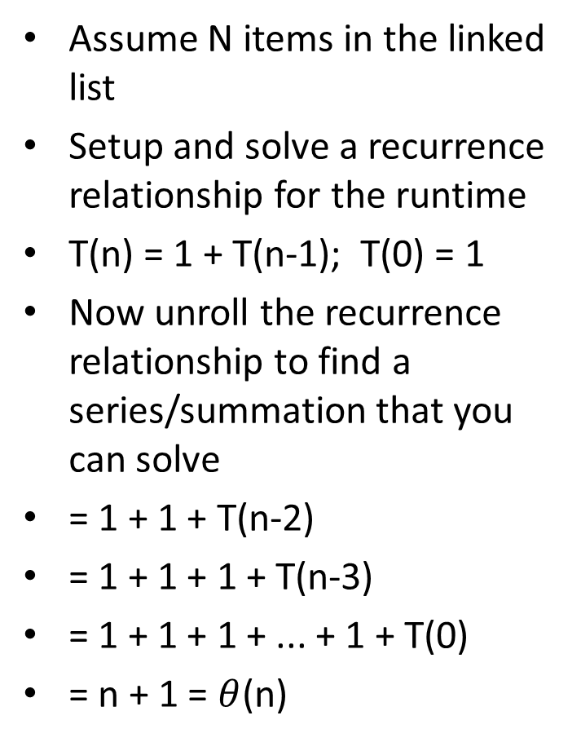
What about Recursion
Assume N items in the linked list
Setup and solve a recurrence relationship for the runtime
T(n) = 1 + T(n-1); T(0) = 1
Now unroll the recurrence relationship to find a series/summation that you can solve
= 1 + 1 + T(n-2)
= 1 + 1 + 1 + T(n-3)
= 1 + 1 + 1 + ... + 1 + T(0)
= n + 1 = $θ$(n)
void print(Item* head)
{
if(head==NULL) return;
else {
cout << head->val << endl;
print(head->next);
} }

Slide 26
Solving Recurrence Relationships
1) Find the recurrence relationship
T(n) = T(n-1) + n and T(0) = 1 or
T(n) = T(n/2) + 1 and T(1) = 1
2) Unroll/unravel the relationship a few times to see the pattern emerging
3) Write an expression for T(n) for the k-th iteration/unrolling
4) Determine what value of k will cause you to hit the base case
5) Substitute the value you found for k from part 4) into the expression for T(n) you found in part 3)

Slide 27
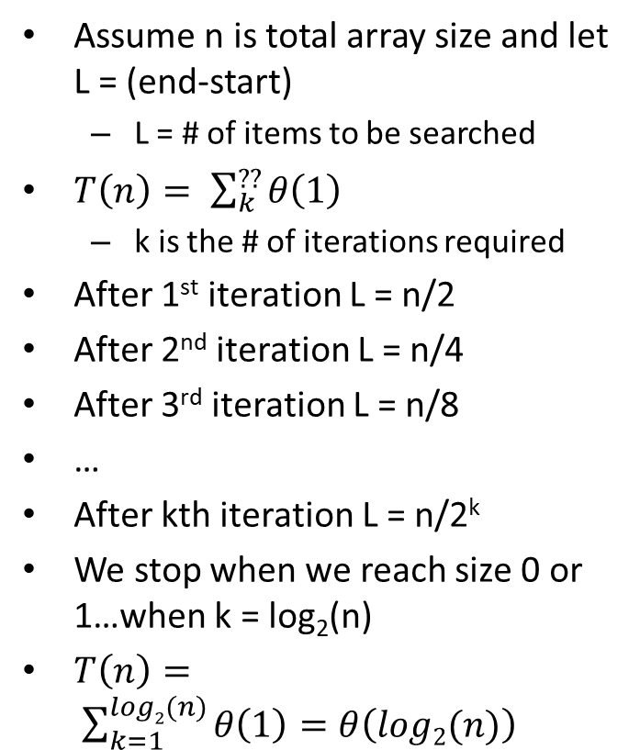
Iterative Binary Search
Assume n is total array size and let L = (end-start)
L = # of items to be searched
$T\left(n\right)= \sum_{k}^{??}{θ\left(1\right)}$
k is the # of iterations required
After 1st iteration L = n/2
After 2nd iteration L = n/4
After 3rd iteration L = n/8
…
After kth iteration L = n/2^{k}
We stop when we reach size 0 or 1…when k = log₂(n)
$T\left(n\right)= \sum_{k=1}^{log2(n)}{θ\left(1\right)=θ\left(log2(n)\right)}$
int main()
{ int data[4] = {1, 6, 7, 9};
it_bsearch(3,data, 4);
}
int it_bsearch(int target,
int data[],int len)
{
int start = 0, end = len-1, mid;
while (start < end) {
mid = (start+end)/2;
if (data[mid] == target){
return mid;
} else if ( target < data[mid]){
end = mid-1;
} else {
start = mid+1;
}
}
return -1;
}

Slide 28

Binary Search
Assume n is (end-start)
# of items to be searched
T(n) = _________________ and T(1) = $θ$(1)
int bsearch(int data[], int start, int end, int target) { if(start >= end) return -1; int mid = (start+end)/2; if(target == data[mid]) return mid; else if(target < data[mid]) return bsearch(data, start, mid-1, target); else return bsearch(data, mid+1, end, target); }

Slide 29
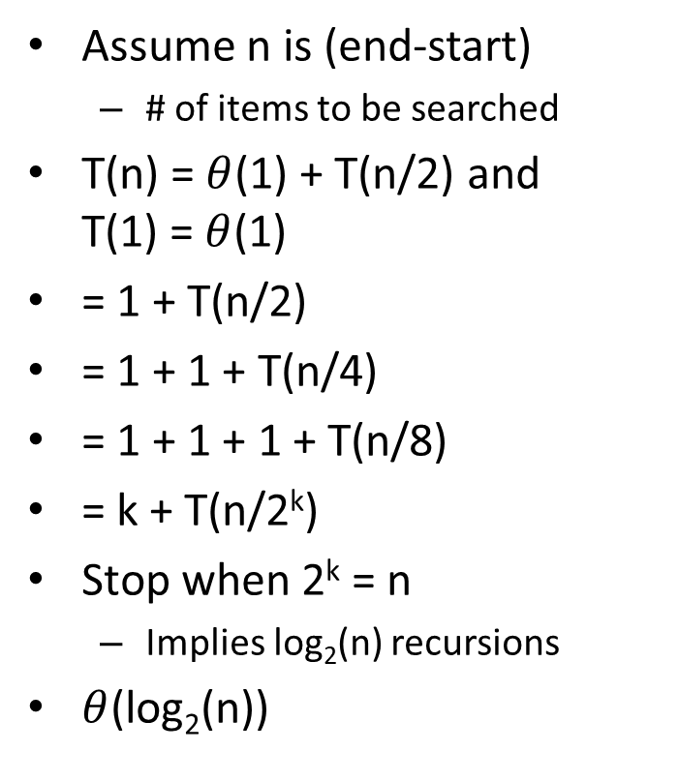
Binary Search
Assume n is (end-start)
# of items to be searched
T(n) = $θ$(1) + T(n/2) and T(1) = $θ$(1)
= 1 + T(n/2)
= 1 + 1 + T(n/4)
= 1 + 1 + 1 + T(n/8)
= k + T(n/2^{k})
Stop when 2^{k} = n
Implies log₂(n) recursions
$θ$(log₂(n))
int bsearch(int data[], int start, int end, int target) { if(end >= start) return -1; int mid = (start+end)/2; if(target == data[mid]) return mid; else if(target < data[mid]) return bsearch(data, start, mid-1, target); else return bsearch(data, mid+1, end, target); }

Slide 30
Towers of Hanoi Problem
Problem Statements: Move n discs from source pole to destination pole (with help of a 3rd alternate pole)
Cannot place a larger disc on top of a smaller disc
Can only move one disc at a time
A (src)
B (dst)
C (alt)
A (src)
B (dst)
C (alt)
1
1
2
2
3
3
Start (n=3)
Goal (n=3)
A
B
C
2
3
1
Not allowed

Slide 31
Observation 1
Observation 1: Disc 1 (smallest) can always be moved
Solve the n=2 case:
A (src)
B (dst)
C (alt)
1
2
Start
A
B
C
A
B
C
2
1
2
1
Move 1 from src to alt
Move 2 from src to dst
A
B
C
1
2
Move 1 from alt to dst

Slide 32
Observation 2
Observation 2: If there is only one disc on the src pole and the dest pole can receive it the problem is trivial
A (src)
B (dst)
C (alt)
1
3
2
A
B
C
A
B
C
1
1
3
2
3
2
Move n-1 discs from src to alt
Move disc n from src to dst
A
B
C
1
2
3
Move n-1 discs from alt to dst

Slide 33
Recursive solution
But to move n-1 discs from src to alt is really a smaller version of the same problem with
n => n-1
src=>src
alt =>dst
dst=>alt
Towers(n,src,dst,alt)
Base Case: n==1 // Observation 1: Disc 1 always movable
Move disc 1 from src to dst
Recursive Case: // Observation 2: Move of n-1 discs to alt & back
Towers(n-1,src,alt,dst)
Move disc n from src to dst
Towers(n-1,alt,dst,src)
A (src)
B (dst)
C (alt)
1
2
3

Slide 34
Recursive Box Diagram
Towers Function Prototype
Towers(disc,src,dst,alt)
Towers(3,a,b,c)
Towers(2,a,c,b)
Move D=3 a to b
Towers(2,c,b,a)
Towers(1,a,b,c)
Towers(1,c,a,b)
Move D=2 a to c
Towers(1,b,c,a)
Move D=2 c to b
Towers(1,a,b,c)
Move D=1 a to b
Move D=1 b to c
Move D=1 c to a
Move D=1 a to b

Slide 35
Recursion's Power
The power of recursion often comes when each function instance makes multiple recursive calls
As you will see this often leads to an exponential number of "combinations" being generated/explored in an easy fashion

Slide 36
Binary Combinations
If you are given the value, n, and a string with n characters could you generate all the combinations of n-bit binary?
Do so recursively!
0
1
00
01
10
11
000
001
010
011
100
101
110
111
0000
0001
0010
0011
0100
0101
0110
0111
1000
1001
1010
1011
1100
1101
1110
1111
1-bit Bin.
2-bit Bin.
3-bit Bin.
Exercise: bin_combo_str
4-bit Bin.

Slide 37
Recursion and DFS
Recursion forms a kind of Depth-First Search
// user interface
void binCombos(int len)
{
binCombos("", len);
}
// helper-function
void binCombos(string prefix,
int len)
{
if(prefix.length() == len )
cout << prefix << endl;
else {
// recurse
binCombos(prefix+"0", len);
// recurse
binCombos(prefix+"1", len);
}
}
Options
0
1
Generally: Recursion must perform the same code sequence for each item. Where we need variation, use 'if' statements.
N = length
__
__
__
__
binCombos(…,3)
Set to 0; recurse;
Set to 1; recurse;
0
1
binCombos(…,3)
Set to 0; recurse;
Set to 1; recurse;
00
01
10
11
binCombos(…,3)
Set to 0; recurse;
Set to 1; recurse;
000
001
010
011
100
101
110
111
binCombos(…,3)
Base case

Slide 38
Generating All Combinations
Recursion offers a simple way to generate all combinations of N items from a set of options, S
Example: Generate all 2-digit decimal numbers (N=2, S={0,1,…,9})
00
0
void NDigDecCombos(string data, int n)
{
if(data.size() == n )
cout << data;
else {
for(int i=0; i < 10; i++){
// recurse
NDigDecCombos(data+(char)('0'+i),n);
}
}
}
1
01
TDC(data)
2
…
…
02
9
09
0
TDC(data)
0
1
1
TDC(data)
2
2
TDC(data)
…
90
9
0
9
1
0
91
Options
2
TDC(data)
1
…
N = length
2
92
9
…
__
__
__
9
99

Slide 39
Another Exercise
#include <iostream>
#include <string>
#include <vector>
using namespace std;
void all_combos(vector<char>& letters, int n) {
// ???
}
int main() {
vector<char> letters = {'U', 'S', 'C'};
all_combos(letters, 4);
return 0;
}
Generate all string combinations of length n from a given list (vector) of characters
Options
U
S
C
N = length
__
__
__
__
Use recursion to walk down the 'places'
At each 'place' iterate through & try all options

Slide 40
Recursion and Combinations
Recursion provides an elegant way of generating all n-length combinations of a set of values, S.
Ex. Generate all length-n combinations of the letters in the set S={'U','S','C'} (i.e. for n=2: UU, US, UC, SU, SS, SC, CU, CS, CC)
General approach:
Need some kind of array/vector/string to store partial answer as it is being built
Each recursive call is only responsible for one of the n "places" (say location, i)
The function will iteratively (loop) try each option in S by setting location i to the current option, then recurse to handle all remaining locations (i+1 to n)
Remember you are responsible for only one location
Upon return, try another option value and recurse again
Base case can stop when all n locations are set (i.e. recurse off the end)
Recursive case returns after trying all options

Slide 41
Exercises
bin_combos_str
Zero_sum
Prime_products_print
Prime_products
basen_combos
all_letter_combos

Slide 42
Recursive Backtracking Search
Recursion allows us to "easily" enumerate all solutions/combinations to some problem
Backtracking algorithms are often used to solve constraint satisfaction problems or optimization problems
Find (the best) solutions/combinations that meet some constraints
Key property of backtracking search:
Stop searching down a path at the first indication that constraints won't lead to a solution
Many common and important problems can be solved with backtracking approaches
Knapsack problem
You have a set of products with a given weight and value. Suppose you have a knapsack (suitcase) that can hold N pounds, which subset of objects can you pack that maximizes the value.
Example:
Knapsack can hold 35 pounds
Product A: 7 pounds, $12 ea. Product B: 10 pounds, $18 ea.
Product C: 4 pounds, $7 ea. Product D: 2.4 pounds, $4 ea.
Other examples:
Map Coloring, Satisfiability, Sudoku, N-Queens

Slide 43

N-Queens Problem
Problem: How to place N queens on an NxN chess board such that no queens may attack each other
Fact: Queens can attack at any distance vertically, horizontally, or diagonally
Observation: Different queen in each row and each column
Backtrack search approach:
Place 1st queen in a viable option then, then try to place 2nd queen, etc.
If we reach a point where no queen can be placed in row i or we've exhausted all options in row i, then we return and change row i-1

Slide 44
8x8 Example of N-Queens
Now place 2nd queen

Slide 45
8x8 Example of N-Queens
Now place others as viable
After this configuration here, there are no locations in row 6 that are not under attack from the previous 5
BACKTRACK!!!

Slide 46
8x8 Example of N-Queens
Now place others as viable
After this configuration here, there are no locations in row 6 that is not under attack from the previous 5
So go back to row 5 and switch assignment to next viable option and progress back to row 6

Slide 47
8x8 Example of N-Queens
Now place others as viable
After this configuration here, there are no locations in row 6 that is not under attack from the previous 5
Now go back to row 5 and switch assignment to next viable option and progress back to row 6
But still no location available so return back to row 5

Slide 48
8x8 Example of N-Queens
Now place others as viable
After this configuration here, there are no locations in row 6 that is not under attack from the previous 5
Now go back to row 5 and switch assignment to next viable option and progress back to row 6
But still no location available so return back to row 5
But now no more options for row 5 so return back to row 4
BACKTRACK!!!!

Slide 49
8x8 Example of N-Queens
Now place others as viable
After this configuration here, there are no locations in row 6 that is not under attack from the previous 5
Now go back to row 5 and switch assignment to next viable option and progress back to row 6
But still no location available so return back to row 5
But now no more options for row 5 so return back to row 4
Move to another place in row 4 and restart row 5 exploration

Slide 50
8x8 Example of N-Queens
Now place others as viable
After this configuration here, there are no locations in row 6 that is not under attack from the previous 5
Now go back to row 5 and switch assignment to next viable option and progress back to row 6
But still no location available so return back to row 5
But now no more options for row 5 so return back to row 4
Move to another place in row 4 and restart row 5 exploration

Slide 51
8x8 Example of N-Queens
Now a viable option exists for row 6
Keep going until you successfully place row 8 in which case you can return your solution
What if no solution exists?

Slide 52
8x8 Example of N-Queens
Now a viable option exists for row 6
Keep going until you successfully place row 8 in which case you can return your solution
What if no solution exists?
Row 1 queen would have exhausted all her options and still not find a solution

Slide 53

Backtracking Search
Recursion can be used to generate all options
'brute force' / test all options approach
Test for constraint satisfaction only at the bottom of the 'tree'
But backtrack search attempts to 'prune' the search space
Rule out options at the partial assignment level
Brute force enumeration might test only when a complete assignment is made (i.e. all 4 queens on the board)

Slide 54
N-Queens Solution Development
i
Let's develop the code
1 queen per row
Use an array where index represents the queen (and the row) and value is the column
Start at row 0 and initiate the search [i.e. search(0) ]
Base case:
Rows range from 0 to n-1 so STOP when row == n
Means we found a solution
Recursive case
Recursively try all column options for that queen
But haven't implemented check of viable configuration…
0
1
2
3
Index = Queen i in row i
0
1
2
3
q[i] = column of queen i
2
0
3
1
int *q; // pointer to array storing // each queens location
int n; // number of board / size
void search(int row) { if(row == n)
printSolution(); // solved!
else { for(q[row]=0; q[row]<n; q[row]++){
search(row+1); } }

Slide 55
N-Queens Solution Development
i
To check whether it is safe to place a queen in a particular column, let's keep a "threat" 2-D array indicating the threat level at each square on the board
Threat level of 0 means SAFE
When we place a queen we'll update squares that are now under threat
Let's name the array 't'
Dynamically allocating 2D arrays in C/C++ doesn't really work
Instead conceive of 2D array as an "array of arrays" which boils down to a pointer to a pointer
0
0
1
1
1
1
1
1
0
0
2
1
0
1
0
3
1
0
0
1
Index = Queen i in row i
0
1
2
3
q[i] = column of queen i
0
00
01
02
03
04
05
06
07
08
09
10
11
12
13
14
15
16
17
18
int *q; // pointer to array storing // each queens location
int n; // number of board / size
int **t; // thread 2D array
int main()
{
q = new int[n];
t = new int*[n];
for(int i=0; i < n; i++){
t[i] = new int[n];
for(int j = 0; j < n; j++){
t[i][j] = 0;
}
}
search(0); // start search
// deallocate arrays
return 0;
}
Allocated on line 08
0
1
2
3
Each allocated on an iteration of line 10
Each entry is int *
0
0
0
0
0
1a0
0
0
0
0
t
410
1
2c0
Thus t is int **
2
1b4
0
0
0
0
t[2] = 0x1b4
3
3e0
t[2][1] = 0
0
0
0
0

Slide 56
N-Queens Solution Development
i
After we place a queen in a location, let's check that it has no threats
If it's safe then we update the threats (+1) due to this new queen placement
Now recurse to next row
If we return, it means the problem was either solved or more often, that no solution existed given our placement so we remove the threats (-1)
Then we iterate to try the next location for this queen
0
1
2
3
Index = Queen i in row i
0
1
2
3
q[i] = column of queen i
0
int *q; // pointer to array storing // each queens location
int n; // number of board / size
int **t; // n x n threat array
void search(int row) { if(row == n)
printSolution(); // solved!
else { for(q[row]=0; q[row]<n; q[row]++){
// check that col: q[row] is safe
if(t[row][q[row]] == 0){
// if safe place and continue
addToThreats(row, q[row], 1);
search(row+1);
// if return, remove placement
addToThreats(row, q[row], -1);
} } }
t
0
1
2
3
t
0
1
2
3
t
0
1
2
3
0
0
0
0
0
0
0
1
1
1
0
0
0
0
0
1
0
0
0
0
1
1
1
0
0
1
0
0
0
0
2
0
0
0
0
2
1
0
1
0
2
0
0
0
0
3
0
0
0
0
3
1
0
0
1
3
0
0
0
0
Safe to place queen in upper left
Now add threats
Upon return, remove threat and iterate to next option

Slide 57
addToThreats Code
i
Observations
Already a queen in every higher row so addToThreats only needs to deal with positions lower on the board
Iterate row+1 to n-1
Enumerate all locations further down in the same column, left diagonal and right diagonal
Can use same code to add or remove a threat by passing in change
Can't just use 2D array of booleans as a square might be under threat from two places and if we remove 1 piece we want to make sure we still maintain the threat
0
1
2
3
Index = Queen i in row i
0
1
2
3
q[i] = column of queen i
0
void addToThreats(int row, int col, int change)
{
for(int j = row+1; j < n; j++){
// go down column
t[j][col] += change;
// go down right diagonal
if( col+(j-row) < n )
t[j][col+(j-row)] += change;
// go down left diagonal
if( col-(j-row) >= 0)
t[j][col-(j-row)] += change;
}
}
t
0
1
2
3
t
0
1
2
3
0
0
1
1
1
0
0
1
1
1
1
1
1
0
0
1
1
1
0
0
2
1
0
1
0
2
1
1
2
1
3
1
0
0
1
3
2
0
1
1

Slide 58
N-Queens Solution
00
01
02
03
04
05
06
07
08
09
10
11
12
13
14
15
16
17
18
19
int *q; // queen location array
int n; // number of board / size
int **t; // n x n threat array
int main()
{
q = new int[n];
t = new int*[n];
for(int i=0; i < n; i++){
t[i] = new int[n];
for(int j = 0; j < n; j++){
t[i][j] = 0;
}
}
// do search
if( ! search(0) )
cout << "No sol!" << endl;
// deallocate arrays
return 0;
}
20
21
22
23
24
25
26
27
28
29
30
31
32
33
34
35
36
37
38
39
40
41
42
43
44
45
46
47
48
49
50
51
52
53
void addToThreats(int row, int col, int change)
{
for(int j = row+1; j < n; j++){
// go down column
t[j][col] += change;
// go down right diagonal
if( col+(j-row) < n )
t[j][col+(j-row)] += change;
// go down left diagonal
if( col-(j-row) >= 0)
t[j][col-(j-row)] += change;
}
}
bool search(int row) { if(row == n){
printSolution(); // solved!
return true;
}
else { for(q[row]=0; q[row]<n; q[row]++){
// check that col: q[row] is safe
if(t[row][q[row]] == 0){
// if safe place and continue
addToThreats(row, q[row], 1);
bool status = search(row+1);
if(status) return true;
// if return, remove placement
addToThreats(row, q[row], -1);
}
}
return false;
} }

Slide 59
General Backtrack Search Approach
Select an item and set it to one of its options such that it meets current constraints
Recursively try to set next item
If you reach a point where all items are assigned and meet constraints, done…return through recursion stack with solution
If no viable value for an item exists, backtrack to previous item and repeat from the top
If viable options for the 1st item are exhausted, no solution exists
Phrase:
Assign, recurse, unassign
General Outline of Backtracking Sudoku Solver
00
01
02
03
04
05
06
07
08
09
10
11
12
13
14
15
16
17
18
19
bool sudoku(int **grid, int r, int c)
{
if( allSquaresComplete(grid) )
return true;
}
// iterate through all options
for(int i=1; i <= 9; i++){
grid[r][c] = i;
if( isValid(grid) ){
bool status = sudoku(...);
if(status) return true;
}
}
return false;
}
Assume r,c is current square to set and grid is the 2D array of values

