Slide 1

Counting

Slide 2


The Product Rule
A company has 3 new employees: Aaron, Neal, and Phillip. There are 12 offices. How many different ways are there to assign offices?
12 ∙ 11 ∙ 10 = 1320
The Product Rule states that if a procedure can be broken up into a sequence of k tasks, and there are n_{i} ways to do the i-th task, then there are a total of $\prod_{i=1}^{k}{ni}$ ways to do the procedure, or |A x B| = |A|∙|B|.
How many ways are there to arrange 10 people in a line?
10! = 3628800
If a license plate has 3 letters followed by 3 digits, how many license plates are there?
26³ ∙ 10³ = 17576000

Slide 3
The Subtraction Rule
How many bit strings of length 8 either start with a 1 or end with two 0s?
2⁷ + 2⁶ – 2⁵ = 160
The Subtraction Rule states that if a task can be done in either one of n₁ ways or one of n₂ ways, and there is an overlap between these two methods of n₃ common ways, then the number of ways to do the task is n₁ + n₂ – n₃, or |A ∪ B| = |A| + |B| - |A ∩ B|
Corollary: The Sum Rule states that if there is no overlap, then the number of ways is n₁ + n₂, or |A ∪ B| = |A| + |B|
The company Grinding Gear Games has 350 job applicants. 220 are CSCI majors, 147 are BUAD majors, and 51 are double majors in both. How many applicants are neither?
350 – (220 + 147 – 51) = 34

Slide 4
Practice
How many ways are there to roll a total of 6 with two standard dice?
1-5, 2-4, 3-3, 4-2, 5-1 = 5
How many 7 digit phone numbers are there, if they cannot start with a 0, a 1, or the sequence 911?
8 ∙ 10⁶ – 10⁴ = 7990000
How many odd 4-digit numbers are there with no leading zeroes, and no repeated digits?
5 ∙ 8 ∙ 8 ∙ 7 = 2240

Slide 5


The Division Rule
How many different ways are there to seat 4 people around a circular table, where two seatings are considered identical if each person has the same left neighbor in both settings, and the same right neighbor in both settings?
$\frac{4!}{4}$ = 6
The Division Rule states that there are n/d ways to do a task which can be done in one of n different ways, but for each specific way, it is identical to d-1 other ways.
How many ways are there to arrange 10 people in a line, when it is unspecified which end is the front?
$$\frac{10!}{2}$$

Slide 6
Practice Problems
In a version of BASIC, variables can be one or two alphanumeric characters (lower-case and upper-case is not distinguished). The first character must be a letter, and there are five 2-character strings that are reserved. How many different variable names are there?
26 + 26*36 – 5 = 957
A computer system requires a password between 6 and 8 alphanumeric characters (lower-case and upper-case is not distinguished). At least one character must be a digit. How many different passwords are there?
36⁶ – 26⁶ + 36⁷ – 26⁷ + 36⁸ – 26⁸
Why is it not 10*36⁵ + 10*36⁶ + 10*36⁷?
Why is it not 6*10*36⁵ + 7*10*36⁶ + 8*10*36⁷?

Slide 7
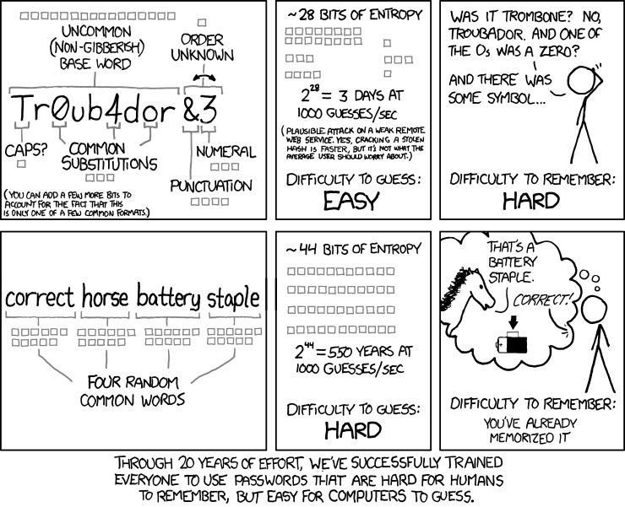
XKCD #936
Password Strength

Slide 8
Brute-Force Counting
How many bit strings of length 4 do not have two consecutive 1s?
0
1
0
1
0
8
0
1
0
0
1
0
1
0
0
1
0
1
0

Slide 9


Permutations
How many ways can we select 3 students from a group of 5 to stand in line for groceries?
$\frac{5!}{2!}$ = 5 ∙ 4 ∙ 3 = 60
An r-permutation is an ordered arrangement of r elements from a set of n, denoted
_{n}P_{r} = $\frac{n!}{\left(n−r\right)!}$
A permutation of a set of size n means n-permutation.
How many permutations of the letters DIJKSTRA contain the substring IJK?
6!

Slide 10


Combinations
How many ways are there to select 3 students to receive an A out of a set of 7 students?
$$\frac{7!}{3!∙4!}$$
An r-combination is an unordered arrangement of r elements from a set of size n, is commonly spoken as “n choose r” and is denoted _{n}C_{r} or
$\left({n \atop r}\right)$ = $\frac{nPr}{rPr} \text{= }\frac{n!}{r! ∙ \left(n−r\right)!}$

Slide 11
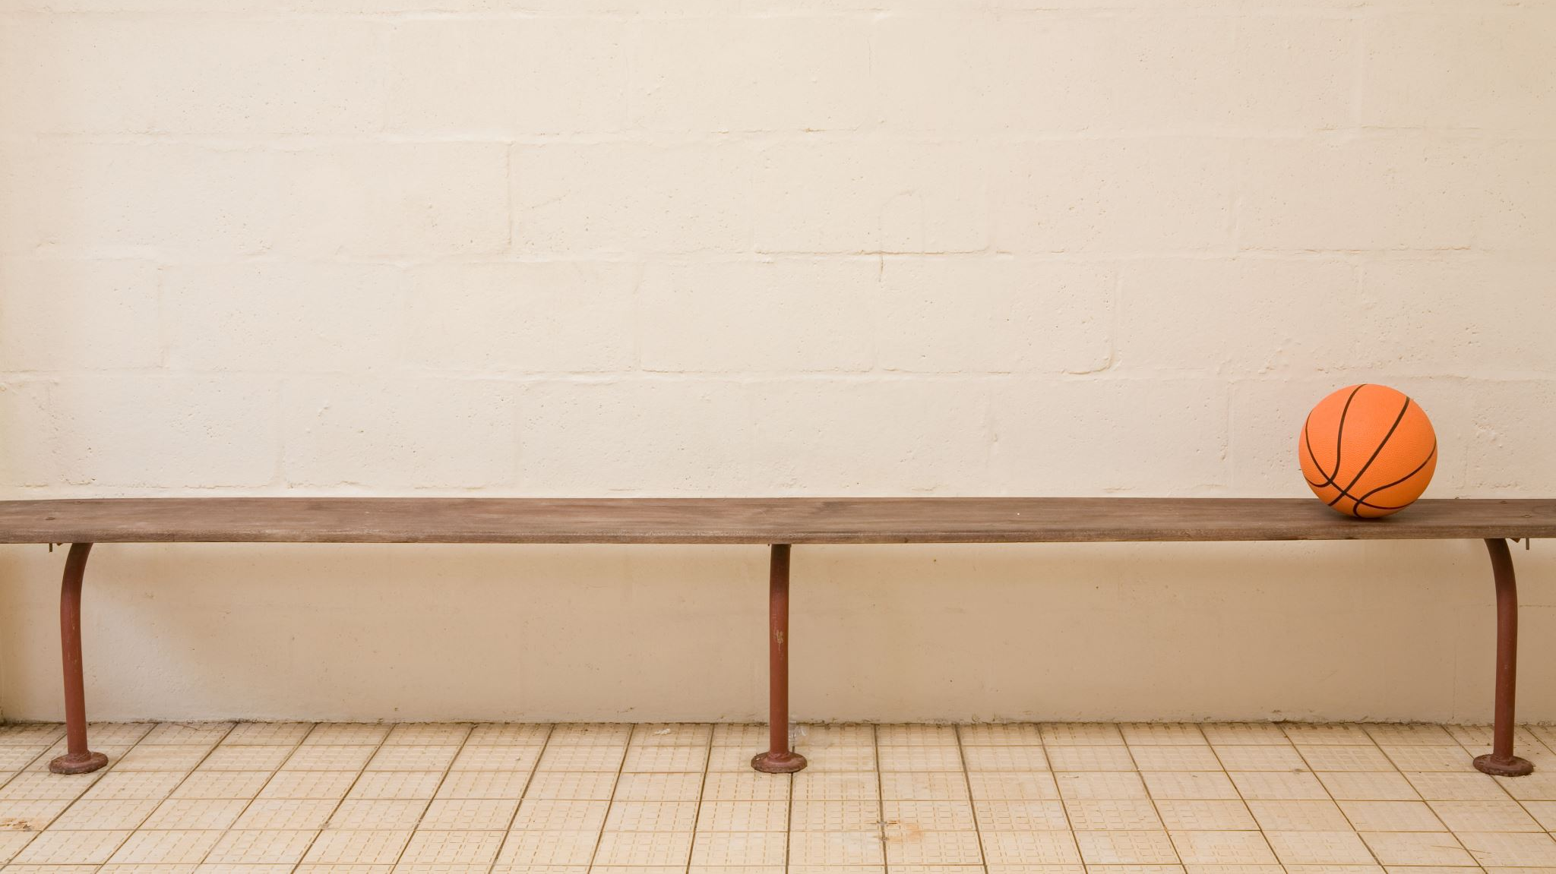

Practice
How many different 5-card Poker hands can be dealt from a standard deck of 52 cards?
$\left({52 \atop 5}\right)$ = 2,598,960
How many different 47-card hands can be dealt?
2,598,960
How many bit strings of length n contain exactly r 1’s?
$$\left({n \atop r}\right)$$

Slide 12
A card trick
Phillip shuffles a standard deck of 52 cards, and deals himself 5.
Phillip looks at his 5 cards, then reveals 4 of them to Aaron, one at a time.
Aaron then correctly determines the 5th card in Phillip’s hand.
There’s no information being relayed to Aaron other than the cards Phillip reveals, and the order in which they are revealed.
There’s no magic: you can replicate this feat with a friend who also knows how it works. It comes down to a pigeonhole principle counting argument!

Slide 13
The first card
There are 4 suits (♣, ♦, ♥, ♠) and 5 cards.
By the pigeonhole principle, Phillip must have 2 cards of the same suit.
Phillip will choose one of them to be the first card flipped over, and the other to be the card he keeps in his hand.
There are 13 values (2-10, J=11, Q=12, K=13, A=14).
If the value of the smaller card is within 6 of the larger card, Phillip will display the smaller card first. Otherwise, the larger card.
After the first card flip, Aaron has narrowed the possible cards down to 6.
If J♦ is displayed, it is either Q♦, K♦, A♦, 2♦, 3♦, or 4♦.
If it were 5♦, Phillip would display that instead, which leaves 6♦, 7♦, 8♦, 9♦, 10♦, J♦ as the possibilities.

Slide 14

The remaining cards
By convention, if two cards have the same value, the tie-breaker is the suit: ♣ < ♦ < ♥ < ♠
Phillip will choose the order of the remaining 3 cards based on which of the 6 options he wants Aaron to choose.
Smallest, then middle, then largest = 1st of the 6 options.
Smallest, then largest, then middle = 2nd option.
Middle, then smallest, then largest = 3rd option.
Middle, then largest, then smallest = 4th option.
Largest, then smallest, then middle = 5th option.
Largest, then middle, then smallest = 6th option.

Slide 15

Binomial Theorem
Expand (x+y)³
x³+3x²y+3xy²+y³
$$\left({3 \atop 0}\right)\text{x}\text{3}\text{+}\left({3 \atop 1}\right)\text{x}\text{2}\text{y}\text{+}\left({3 \atop 2}\right)\text{xy}\text{2}\text{+}\left({3 \atop 3}\right)\text{y}\text{3}$$
The Binomial Theorem is as follows:
$$\left(x+y\right)n= \sum_{j=0}^{n}{\left({n \atop j}\right)xn−jyj}$$
What is the coefficient of x¹²y¹³ in the expansion of (x+y)²⁵?
$$\left({25 \atop 13}\right)=\left({25 \atop 12}\right)$$

Slide 16
















Pascal’s Triangle
1
$$\left({0 \atop 0}\right)$$
1
1
$$\left({1 \atop 0}\right)$$
$$\left({1 \atop 1}\right)$$
1
2
1
$$\left({2 \atop 0}\right)$$
$$\left({2 \atop 1}\right)$$
$$\left({2 \atop 2}\right)$$
1
3
3
1
$$\left({3 \atop 0}\right)$$
$$\left({3 \atop 1}\right)$$
$$\left({3 \atop 2}\right)$$
$$\left({3 \atop 3}\right)$$
1
4
6
4
1
$$\left({4 \atop 0}\right)$$
$$\left({4 \atop 1}\right)$$
$$\left({4 \atop 2}\right)$$
$$\left({4 \atop 3}\right)$$
$$\left({4 \atop 4}\right)$$
Pascal’s Identity:
$$\left({n+1 \atop k}\right)=\left({n \atop k−1}\right)+\left({n \atop k}\right)$$

Slide 17


Proof: $\left({n+1 \atop k}\right)=\left({n \atop k−1}\right)+\left({n \atop k}\right)$
Let T be a set with n+1 elements. Let a be an element in T, and let S = T – {a}
There are $\left({n+1 \atop k}\right)$ subsets of T with k elements: some include a, the rest don’t.
There are $\left({n \atop k}\right)$ ways to choose k elements from S (subsets of T without a)
There are $\left({n \atop k−1}\right)$ ways to choose k-1 elements from S
Add a to each of these, corresponding to subsets of T with a.
Therefore, $\left({n+1 \atop k}\right)=\left({n \atop k−1}\right)+\left({n \atop k}\right)$

Slide 18


Prove: $\left({2n \atop n}\right)=\sum_{k=0}^{n}{ \left({n \atop k}\right)2}$
$$\sum_{k=0}^{n}{ \left({n \atop k}\right)2}=\sum_{k=0}^{n}{ \left({n \atop k}\right)∙\left({n \atop n−k}\right)}$$
Suppose we have a class of 2n people, and we need to choose n people to get an A.
We can divide the room up into the men (there are n of them) and the women (also n).
The kth term in the summation is the number of ways to assign A’s, so that exactly k men get an A and n-k women get an A.
If we add up over all k, this will give us the total number of ways to assign A’s.

Slide 19
Permutations with Repetition
A message on a Twitter-like service must consist of exactly r characters.
Because it is the internet, people only communicate using capital letters, spaces, and the exclamation mark.
How many different messages can one post on this service?
28^{r}
The number of r-permutations of a set of n objects, where repetition is allowed, is n^{r}.

Slide 20

Permutations of Types
How many different strings can be made by reordering the letters of SUCCESS?
$$\left({7 \atop 3}\right)∙\left({4 \atop 2}\right)∙\left({2 \atop 1}\right)∙\left({1 \atop 1}\right)$$
$$= \frac{7!}{3!∙4!}∙\frac{4!}{2!∙2!}∙\frac{2!}{1!∙1!}∙\frac{1!}{0!∙1!}$$
$$= \frac{7!}{3!∙2!∙1!∙1!}$$
The number of permutations of n objects, where n_{i} are indistinguishable objects of type i, is
$$\frac{n!}{\prod_{i=1}^{k}{ni}!}$$

Slide 21

Distinguishable Objects over Distinguishable Boxes
4 people are playing Poker, wherein each player receives 5 cards from a standard deck of 52 distinct cards. How many ways are there to deal out hands?
$$\left({52 \atop 5}\right)∙\left({47 \atop 5}\right)∙\left({42 \atop 5}\right)∙\left({37 \atop 5}\right)$$
$$= \frac{52!}{5!∙47!}∙\frac{47!}{5!∙42!}∙\frac{42!}{5!∙37!}∙\frac{37!}{5!∙32!}$$
$$= \frac{52!}{5!∙5!∙5!∙5!∙32!}$$
The number of ways to distribute n distinguishable objects into k distinguishable boxes so that n_{i} objects are placed in box i is:
$$\frac{n!}{\prod_{i=1}^{k}{ni}!}$$

Slide 22
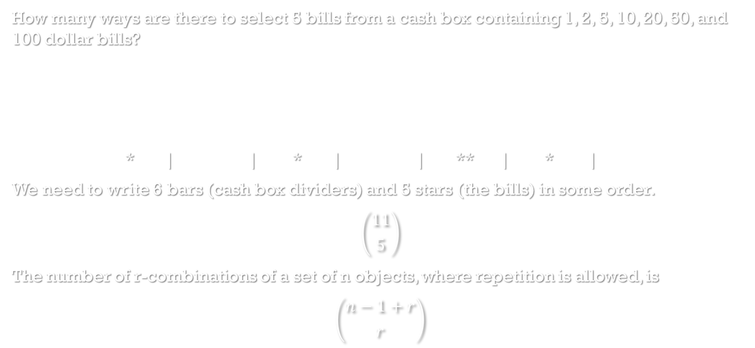
Combinations with Repetition
How many ways are there to select 5 bills from a cash box containing 1, 2, 5, 10, 20, 50, and 100 dollar bills?
* | | * | | ** | * |
We need to write 6 bars (cash box dividers) and 5 stars (the bills) in some order.
$$\left({11 \atop 5}\right)$$
The number of r-combinations of a set of n objects, where repetition is allowed, is
$$\left({n−1+r \atop r}\right)$$
1$ | 2$ | 5$ | 10$ | 20$ | 50$ | 100$
* |  | * |  | ** | *

Slide 23
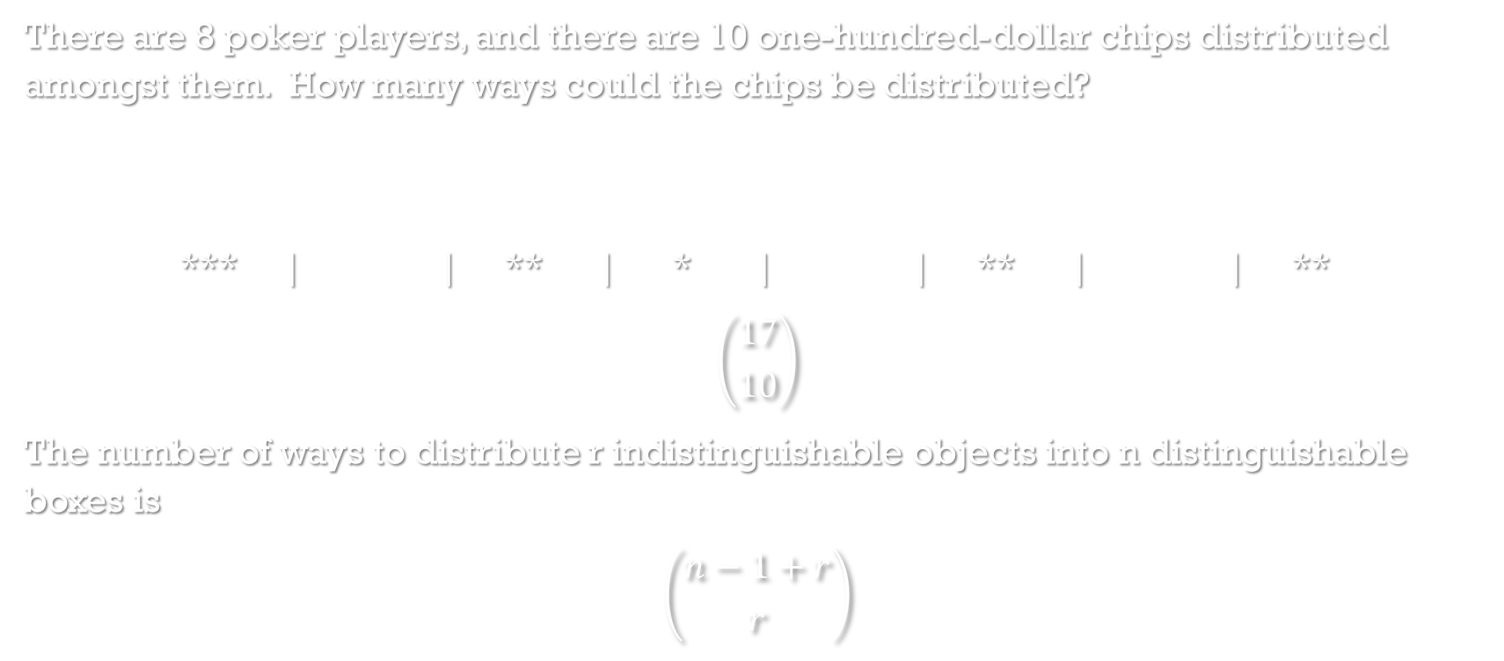
Indistinguishable Objects over Distinguishable Boxes
There are 8 poker players, and there are 10 one-hundred-dollar chips distributed amongst them. How many ways could the chips be distributed?
*** | | ** | * | | ** | | **
$$\left({17 \atop 10}\right)$$
The number of ways to distribute r indistinguishable objects into n distinguishable boxes is
$$\left({n−1+r \atop r}\right)$$
Player 1 | Player 2 | Player 3 | Player 4 | Player 5 | Player 6 | Player 7 | Player 8

Slide 24

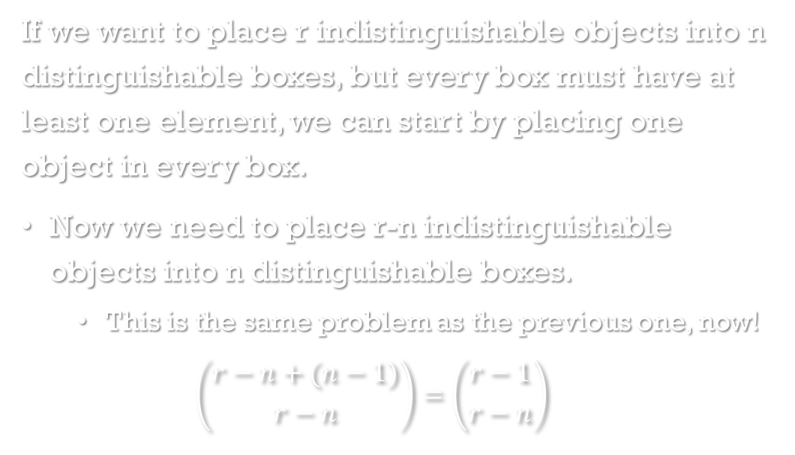
Indistinguishable Objects over Nonempty Distinguishable Boxes
If we want to place r indistinguishable objects into n distinguishable boxes, but every box must have at least one element, we can start by placing one object in every box.
Now we need to place r-n indistinguishable objects into n distinguishable boxes.
This is the same problem as the previous one, now!
$$\left({r−n+(n−1) \atop r−n}\right)=\left({r−1 \atop r−n}\right)$$

Slide 25

Practice
How many ways can ANAGRAM be rearranged?
$$\frac{7!}{3!}$$
How many ways are there to select 4 pieces of fruit from a bowl containing apples, oranges, and pears?
Combinations, with repetition
$$\left({6 \atop 4}\right)$$
How many solutions does the equation x₁+x₂+x₃=11 have, where x₁, x₂, and x₃ are nonnegative integers?
Indistinguishable objects into distinguishable boxes
$$\left({13 \atop 11}\right)$$

Slide 26
Distinguishable Objects over Indistinguishable Boxes
4 different roommates are playing a multi-player game, and they’re distributed over 3 indistinguishable servers. How many ways are there to distribute them?
(4,0,0) = 1
(3,1,0) = 4
(2,1,1) = 6
(2,2,0) = 3
Total = 14
There is no closed-form formula for this problem.

Slide 27
Indistinguishable Objects over Indistinguishable Boxes
The company just worries about server-load, not who plays where.
How many ways can you distribute 6 faceless players over 4 indistinguishable servers?
(6,0,0,0)
(5,1,0,0) (4,2,0,0) (3,3,0,0)
(4,1,1,0) (3,2,1,0) (2,2,2,0)
(3,1,1,1) (2,2,1,1)
Total = 9
There is no closed-form formula for this problem.

