Slide 1
CSCI 104 Inheritance
Mark Redekopp
David Kempe
Sandra Batista
Aaron Cote’

Slide 2
Inheritance
A way of defining interfaces, re-using classes and extending original functionality
Allows a new class to inherit all the data members and member functions from a previously defined class
Works from more general objects to more specific objects
Defines an "is-a" relationship
Square is-a rectangle is-a shape
Square inherits from Rectangle which inherits from Shape
Similar to classification of organisms:
Animal -> Vertebrate -> Mammals -> Primates
Parent/ Base
Child / Derived
Grandchild

Slide 3
Base and Derived Classes
Derived classes inherit all data members and functions of base class
Student class inherits:
get_name() and get_id()
name_ and id_ member variables
class Person { public: Person(string n, int ident); string get_name(); int get_id(); private: string name_; int id_; }; class Student : public Person { public: Student(string n, int ident, int mjr); int get_major(); double get_gpa(); void set_gpa(double new_gpa); private: int major_; double gpa_; }; int main() { Student s1("Tommy", 1, 9); // Student has Person functionality // as if it was written as part of // Student cout << s1.get_name() << endl; }
class Person
class Student
string name_
string name_
int id_
int id_
int major_
double gpa_

Slide 4
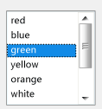
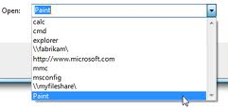
Inheritance Example
Inheritance Diagrams (arrows show derived to base class relationships)
Component
Component
Draw()
onClick()
Window
Minimize()
Maximize()
ListBox
Get_Selection()
ScrollBox
onScroll()
DropDownBox
onDropDown()
Window
ListBox
ScrollBox
DropDown Box

Slide 5
Constructors and Inheritance
Constructors are only called when a variable is created and cannot be called directly from another constructor
How to deal with base constructors?
Also want/need base class or other members to be initialized before we perform this object's constructor code
Use initializer format instead
See example below
class Person { public: Person(string n, int ident); ... private: string name_; int id_; }; class Student : public Person { public: Student(string n, int ident, int mjr); ... private: int major_; double gpa_; };
Student::Student(string n, int ident, int mjr) { // How to initialize Base class members? Person(n, ident); // No! can’t call Construc. // as a function
}
Student::Student(string n, int ident, int mjr) :
Person(n, ident) { cout << "Constructing student: " << name_ << endl; major_ = mjr; gpa_ = 0.0; }

Slide 6
Constructors & Destructors
Constructors
A Derived class will automatically call its Base class constructor BEFORE it's own constructor executes, either:
Explicitly calling a specified base class constructor in the initialization list
Implicitly calling the default base class constructor if no base class constructor is called in the initialization list
Destructors
The derived class will call the Base class destructor automatically AFTER it's own destructor executes
General idea
Constructors get called from base->derived (smaller to larger)
Destructors get called from derived->base (larger to smaller)
base
(1)
child (2)
grandchild (3)
Constructor call ordering
base
(3)
child (2)
grandchild (1)
Destructor call ordering

Slide 7
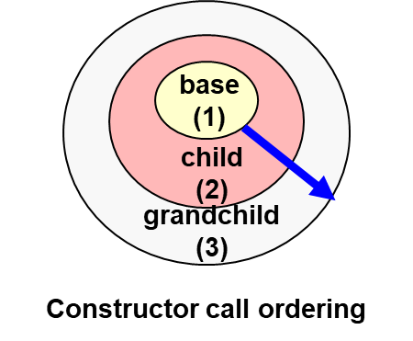
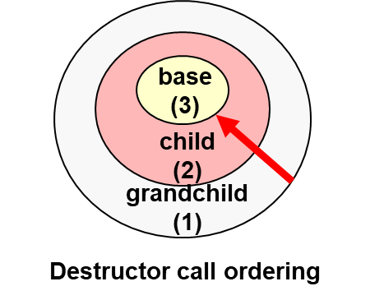
Constructor & Destructor Ordering
class A {
int a;
public:
A() { a=0; cout << "A:" << a << endl; }
~A() { cout << "~A" << endl; }
A(int mya) { a = mya; cout << "A:" << a << endl; }
};
class B : public A {
int b;
public:
B() { b = 0; cout << "B:" << b << endl; }
~B() { cout << "~B "; }
B(int myb) { b = myb; cout << "B:" << b << endl; }
};
class C : public B {
int c;
public:
C() { c = 0; cout << "C:" << c << endl; }
~C() { cout << "~C "; }
C(int myb, int myc) : B(myb) { c = myc; cout << "C:" << c << endl; }
};
int main()
{
cout << "Allocating a B object" << endl;
B b1;
cout << "Allocating 1st C object" << endl;
C* c1 = new C;
cout << "Allocating 2nd C object" << endl;
C c2(4,5);
cout << "Deleting c1 object" << endl;
delete c1;
cout << "Quitting" << endl;
return 0;
}
Test Program
Allocating a B object
A:0
B:0
Allocating 1st C object
A:0
B:0
C:0
Allocating 2nd C object
A:0
B:4
C:5
Deleting c1 object
~C ~B ~A
Quitting
~C ~B ~A
~B ~A
Sample Classes
Output

Slide 8
Protected Members
Private members of a base class can not be accessed directly by a derived class member function
Code for print_grade_report() would not compile since ‘name_’ is private to class Person
Base class can declare variables with protected storage class which means:
Private to any object or code not inheriting from the base (i.e. private to any 3rd party)
Public to any derived (child) class can access directly
class Person { public: ... private: string name_; int id_; };
class Student : public Person { public: void print_grade_report(); private: int major_; double gpa_; };
void Student::print_grade_report() { cout << “Student “ << name_ << ... }
X
class Person { public: ... protected: string name_; int id_; };

Slide 9
Public/Private/Protected Inheritance
Base Class
class Person { public: Person(string n, int ident); string get_name(); int get_id(); private: // INACCESSIBLE TO DERIVED string name_; int id_; };
public/protected/private inheritance before base class indicates HOW the public base class members are viewed by clients (those outside) of the derived class
public
public and protected base class members are accessible to the child class and grandchild classes
Only public base class members are accessible to 3rd party clients
protected
public and protected base class members are accessible to the child class and grandchild classes
no base class members are accessible to 3rd parties
private
public and protected base class members are accessible to the child class
No base class members are accessible to grandchild classes or 3rd party clients
class Student : public Person { public: Student(string n, int ident, int mjr); int get_major(); double get_gpa(); void set_gpa(double new_gpa); private: int major_; double gpa_; }; class Faculty : private Person { public: Faculty(string n, int ident, bool tnr); bool get_tenure(); private: bool tenure_; };
int main(){
Student s1("Tommy", 73412, 1);
Faculty f1("Mark", 53201, 2); cout << s1.get_name() << endl; // works cout << f1.get_name() << endl; // fails }

Slide 10
Inheritance Access
class Person { public: Person(string n, int ident); string get_name(); int get_id(); private: // INACCESSIBLE TO DERIVED string name_; int id_; };
Derive as public if…
You want users of your derived class to be able to call base class functions/methods
Derive as private if…
You only want your internal workings to call base class functions/methods
Derive as protected more rearely
Same reasons as private inheritance but also allow grandchild classes to use Base class methods
Base Class
class Student : public Person { public: Student(string n, int ident, int mjr); int get_major(); double get_gpa(); void set_gpa(double new_gpa); private: int major_; double gpa_; }; class Faculty : private Person { public: Faculty(string n, int ident, bool tnr); bool get_tenure(); private: bool tenure_; };
Inherited Base | Public | Protected | Private
Public | Public | Protected | Private
Protected | Protected | Protected | Private
Private | Private | Private | Private
int main(){
Student s1("Tommy", 73412, 1);
Faculty f1("Mark", 53201, 2); cout << s1.get_name() << endl; // works cout << f1.get_name() << endl; // fails }
External client access to Base class members is always the more restrictive of either the base declaration or how the base is inherited.

Slide 11
Overloading Base Functions
class Car{ public: double compute_mpg(); private: string make; string model; }; double Car::compute_mpg() { if(speed > 55) return 30.0; else return 20.0; }
class Hybrid : public Car { public: void drive_w_battery(); double compute_mpg(); private: string batteryType; };
double Hybrid::compute_mpg() { if(speed <= 15) return 45; // hybrid mode else if(speed > 55) return 30.0; else return 20.0; }
A derived class may want to redefine the behavior of a member function of the base class
A base member function can be overloaded in the derived class
When derived objects call that function the derived version will be executed
When a base object calls that function the base version will be executed
Class Car
string make
string model
Class Hybrid
string make
string model
string battery

Slide 12
Scoping Base Functions
class Car{ public: double compute_mpg(); private: string make; string model; }; double Car::compute_mpg() { if(speed > 55) return 30.0; else return 20.0; }
class Hybrid : public Car { public: void drive_w_battery(); double compute_mpg(); private: string batteryType; };
double Hybrid::compute_mpg() { if(speed <= 15) return 45; // hybrid mode else return Car::compute_mpg(); }
We can still call the base function version by using the scope operator (::)
base_class_name::function_name()

Slide 13
Composition
class List{ public: List(); void insert(int loc, const int& val);
int size(); int& get(int loc);
void pop(int loc;) private: IntItem* _head;
};
Code reuse is a common need in (object-oriented) programming
We could use a pre-written List class to make a Queue class
An easy and often preferable way is to simply use the existing class as a data member
Composition defines a "has-a" relationship
A Queue "has-a" List in its implementation
But could we inherit?
Public inheritance would mean a Queue "is-a" List and a Queue should be able to do anything a List can do, but that's not the case
Private inheritance could be used but is not a universal approach supported by other languages
Often programmers say "prefer composition rather than inheritance" when the goal is code reuse
Base Class
class Queue
{ private:
List mylist;
public: Queue();
push_back(const int& val)
{ mylist.insert(size(), val); }
int& front();
{ return mylist.get(0); }
void pop_front();
{ mylist.pop(0); }
int size() // need to create wrapper
{ return mylist.size(); }
};
Queue via Composition

Slide 14
Warning: Multiple Inheritance
Animal
public:
int getWeight();
Private:
int weight;
C++ allows multiple inheritance but it is not usually recommended
What happens for the following code?
Suppose in main()
Liger x;
int wt = x.getWeight();
Inheritance Diagrams (arrows shown base to derived class relationships)
Tiger: public Animal
Lion: public Animal
Class Liger
int Tiger::weight
int Lion::weight
Liger: public Tiger, public Lion
Example source: https://www.programmerinterview.com/index.php/c-cplusplus/diamond-problem

