Slide 1
CSCI 104 Tries
Mark Redekopp
David Kempe
Sandra Batista
Aaron Cote’

Slide 2
Review of Set/Map Again
Recall the operations a set or map performs…
Insert(key)
Remove(key)
find(key) : bool/iterator/pointer
Get(key) : value [Map only]
We can implement a set or map using a binary search tree
Search = O( log(n) )
But what work do we have to do at each node?
Compare (i.e. string compare)
How much does that cost?
Int = O(1)
String = O( k ) where k is length of the string
Thus, search costs O( k * log(n) )
"help"
"hear"
"ill"
"heap"
"held"
"in"

Slide 3
Review of Set/Map Again
We can implement a set or map using a hash table
Search = O( 1 )
But what work do we have to do once we hash?
Compare (i.e. string compare)
How much does that cost?
Int = O(1)
String = O( k ) where k is length of the string
Thus, search costs O( k )
"help"
Conversion function
2
0
1
2
3
4
5
heal
help
ill
hear
3.45

Slide 4
Tries
Assuming unique keys, can we still achieve O(k) search but not have collisions?
O(k) means the time to compare is independent of how many keys (i.e. n) are being stored and only depends on the length of the key
Trie(s) (often pronounced "try" or "tries") allow O(k) retrieval
Sometimes referred to as a radix tree or prefix tree
Consider a trie for the keys
"HE", "HEAP", "HEAR", "HELP", "ILL", "IN"
-
H
I
H
I
E
L
N
E
L
N
A
L
L
A
L
L
P
R
P
P
R
P

Slide 5
Tries
Rather than each node storing a full key value, each node represents a prefix of the key
Highlighted nodes indicate terminal locations
For a map we could store the associated value of the key at that terminal location
Notice we "share" paths for keys that have a common prefix
To search for a key, start at the root consuming one unit (bit, char, etc.) of the key at a time
If you end at a terminal node, SUCCESS
If you end at a non-terminal node, FAILURE
-
H
I
H
I
E
L
N
E
L
N
A
L
L
A
L
L
P
R
P
P
R
P

Slide 6
Tries
To search for a key, start at the root consuming one unit (bit, char, etc.) of the key at a time
If you end at a terminal node, SUCCESS
If you end at a non-terminal node, FAILURE
Examples:
Search for "He"
Search for "Help"
Search for "Head"
Search takes O(k) where k = length of key
Notice this is the same as a hash table
-
H
I
H
I
E
L
N
E
L
N
A
L
L
A
L
L
P
R
P
P
R
P
For a map, a "value" type could be stored for each terminal node

Slide 7
Practice
Construct a trie to store the set of words
Ten
Tent
Then
Tense
Tens
Tenth

Slide 8


Application: IP Lookups
Network routers form the backbone of the Internet
Incoming packets contain a destination IP address (128.125.73.60)
Routers contain a "routing table" mapping some prefix of destination IP address to output port
128.125.x.x => Output port C
128.209.32.x => Output port B
128.x.x.x => Output port D
132.x.x.x => Output port A
Keys = Match the longest prefix
Keys are unique
Value = Output port
Octet 1 | Octet 2 | Octet 3 | Port
10000000 | 01111101 |  | C
10000000 | 11010001 | 00100000 | B
10000000 |  |  | D
10000100 |  |  | A

Slide 9
IP Lookup Trie
A binary trie implies that the
Left child is for bit '0'
Right child is for bit '1'
Routing Table:
128.125.x.x => Output port C
128.209.32.x => Output port B
128.209.44.x => Output port D
132.x.x.x => Output port A
1
0
0
0
…
0
1
0
0
-
Octet 1 | Octet 2 | Octet 3 | Port
10000000 | 01111101 |  | C
10000000 | 11010001 | 00100000 | B
10000000 |  |  | D
10000100 |  |  | A
0
0
D
A
0
1
-
-
…
C
B

Slide 10
Structure of Trie Nodes
What do we need to store in each node?
Depends on how "dense" or "sparse" the tree is?
Dense (most characters used) or small size of alphabet of possible key characters
Array of child pointers
One for each possible character in the alphabet
Sparse
(Linked) List of children
Node needs to store ______
template < class V > struct TrieNode{ V* value; // NULL if non-terminal TrieNode<V>* children[26]; };
V*
a
b
…
z
template < class V > struct TrieNode{ char key; V* value; TrieNode<V>* next; // sibling TrieNode<V>* children; // head ptr };
c
s
f
c
f
s
h
r
h
r

Slide 11
Search
V*
Search consumes one character at a time until
The end of the search key
If value pointer exists, then the key is present in the map
Or no child pointer exists in the TrieNode
Insert
Search until key is consumed but trie path already exists
Set v pointer to value
Search until trie path is NULL, extend path adding new TrieNodes and then add value at terminal
V* search(char* k, TrieNode<V>* node)
{
while(*k != '\0' && node != NULL){
node = node->children[*k – 'a']; k++;
}
if(node) return node->v;
else return NULL;
}
k
0x120
h
e
a
r
\0
0x120
void insert(char* k, Value& v)
{
TrieNode<V>* node = root;
while(*k != '\0' && node != NULL){
node = node->children[*k – 'a']; k++; }
if(node){
node->v = new Value(v);
}
else {
// create new nodes in trie
// to extend path
// updating root if trie is empty
}
}

Slide 12
Thinking Exercise: Removal
How would removal of a key work in a trie and what are the cases you'd have to worry about?
Does removal of a key always mean removal of a node?
If we do remove a node, would it only be one node in the trie?
-
H
I
H
I
E
L
N
E
L
N
A
L
L
A
L
L
P
R
P
P
R
P
A "value" type could be stored for each non-terminal node

Slide 13
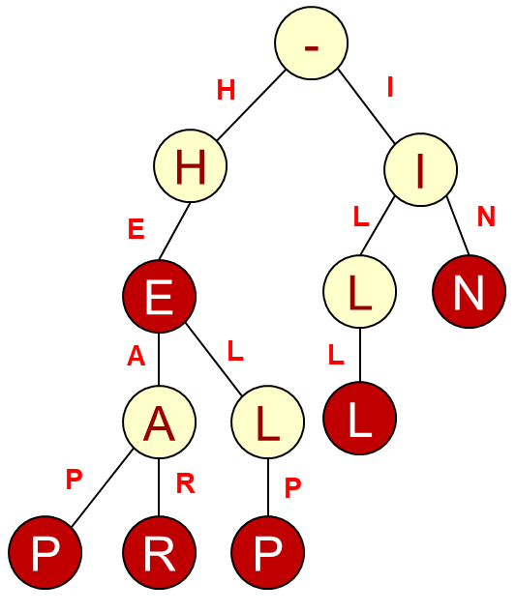
Compressed Trie
We can reduce the number of nodes and thus storage, by storing substrings in each node
If a non-word, non-root node has only one child, combine
https://www.cs.usfca.edu/~galles/visualization/RadixTree.html
-
H
I
HE
I
A
L
L
N
A
LP
LL
N
P
R
P
R

Slide 14
Compressed Trie
Walk key string based on the length of the substring in the current node and then use the next key string character to choose the child node
Key is not present if key string characters are exhausted before substring in node or no corresponding child entry
Examples: 'H', 'HERD'
-
H
I
HE
I
A
L
L
N
A
LP
LL
N
P
R
P
R

Slide 15
Practice
Construct a compressed trie to store the set of words
Ten
Tent
Then
Tense
Tens
Tenth

Slide 16
Prefix Trees (Tries) Review
What problem does a prefix tree solve
Lookups of keys (and possible associated values)
A prefix tree helps us match 1-of-n keys
"He"
"Help"
"Hear"
"Heap"
"In"
"Ill"
Here is a slightly different problem:
Given a large text string, T, can we find certain substrings or answer other queries about patterns in T
A suffix tree (trie) can help here

Slide 17
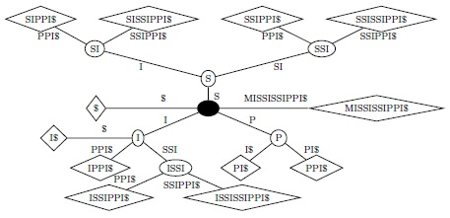
Suffix Trees
A suffix tree of a string W is a compressed trie consisting of all possible suffixes of W.
Are `issip` or `sipi` substrings?

Slide 18
Suffix Trees
When W has n characters, the suffix tree has:
n leaves, each one representing a single suffix W[i : (n-1)]
Every non-leaf node has at least two children
Each edge is labelled with a substring of W
If e and e’ are edges out of the same node, then their labels start with different letters.
For any root-leaf path, the concatenation of their edge labels is equal to W[i : (n-1)]
< n internal nodes
O(n) total nodes
There is an algorithm (Ukkonen’s Algorithm) which can build a suffix tree in linear time.

Slide 19
What Have We Learned
[Key Point]: Think about all the data structures we've been learning
There is almost always a trade-off of memory vs. speed
i.e. Space vs. time
Most data structures just exploit different points on that time-space tradeoff continuum
Often we build a data structure that replicates data and takes a lot of memory space…
…so that we can find data faster

